Slide 1
Alternator Lead-Time Heuristics (V11)
Recall 6/10 vs V10.6.2 5/10 | 0/15 false alarms

Slide 2
The problem V10.6.2 left open
• Frozen classifier says WHICH truck (AUROC 0.927) but gives no timing.
• Per-truck RUL cannot beat a fleet-clock dummy (structural, n=10).
• Only genuine precursor was the GED=2 storm — fired for just 2/10 failures.
• Open question: can we get earlier, higher-recall precursors from the same 6 channels?

Slide 3
Approach: 12 heuristics on 6 raw CAN channels
• Load-normalised & regime-conditioned voltage (dVSI/dRPM, load residual, reg duty).
• Crank/recovery dynamics (post-crank recovery, crank effort).
• Excitation & instability (full GED states, idle hunting), sag typing, UV dose.
• Compound voting alarm (#11) + per-truck change-point (#12).

Slide 4
Honest validation gate (unchanged from V10.6.2)
• A deviation counts ONLY if within-truck z>=2 AND outside healthy-fleet p05-p95.
• MIN_EO_SAMPLES=200 trust filter; horizons 90/60/45/30/14/7 days.
• NF self-test: every healthy truck scored as-if-failing (false-alarm honesty).
• n=10 events — results are leads, not calibrated rates.

Slide 5
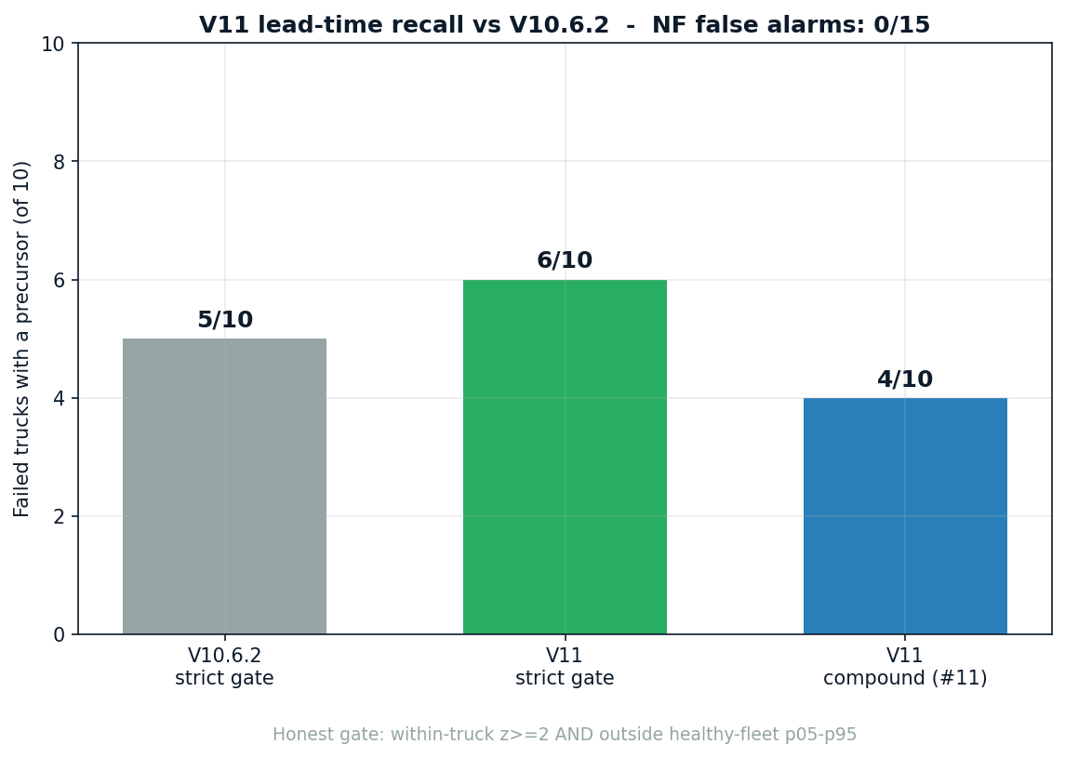
Result: lead-time recall

Slide 6
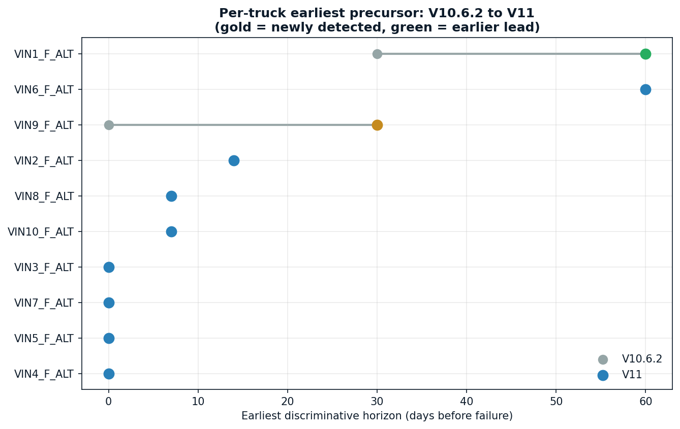
Per-truck head-to-head

Slide 7
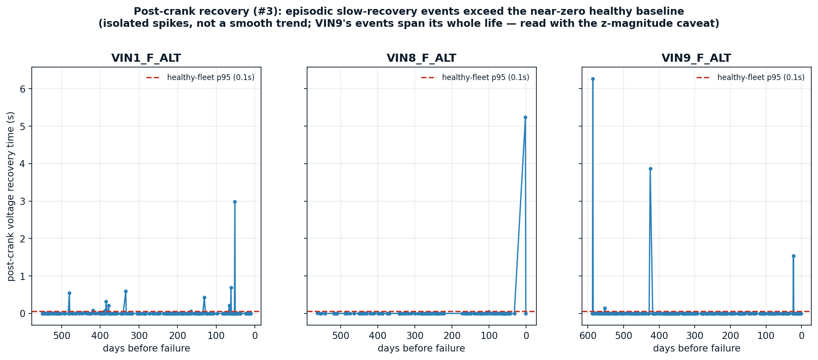
Strongest new signal: post-crank recovery (#3) — episodic

Slide 8
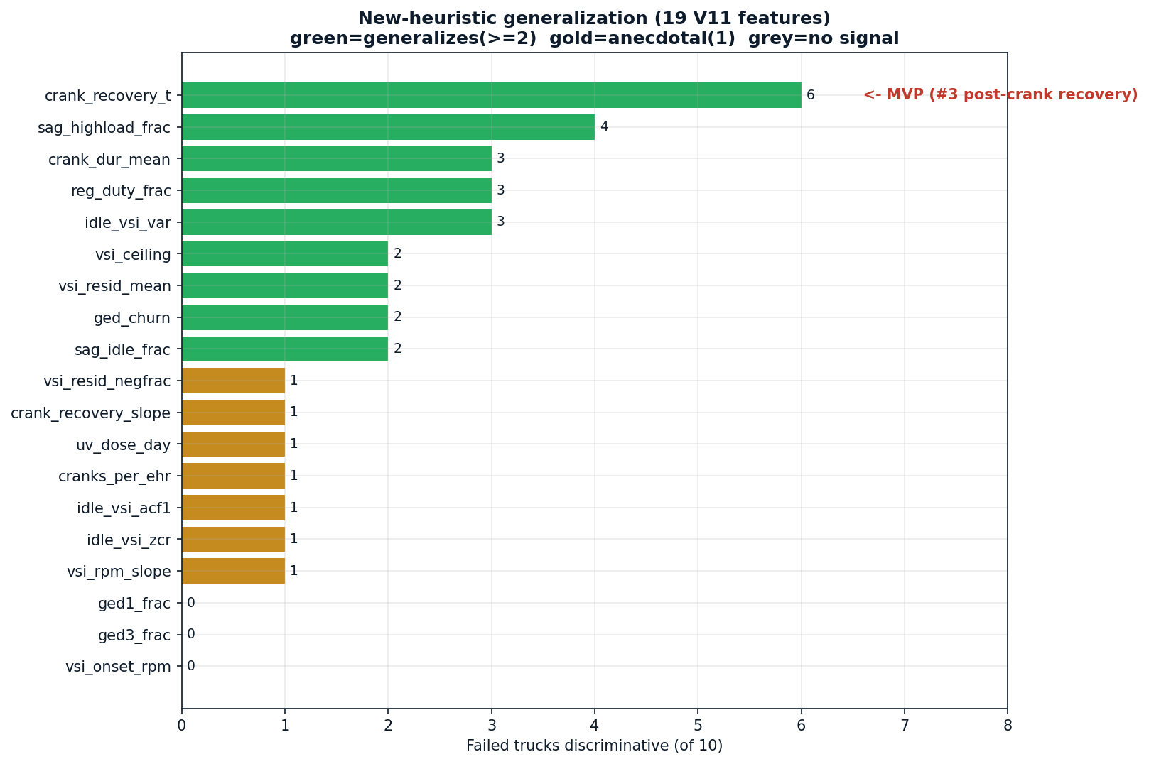
Which heuristics generalised

Slide 9
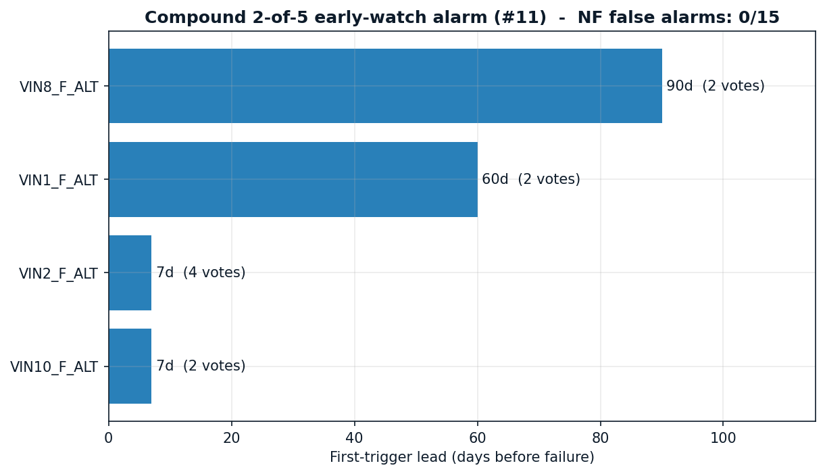
Compound early-watch alarm (#11)

Slide 10
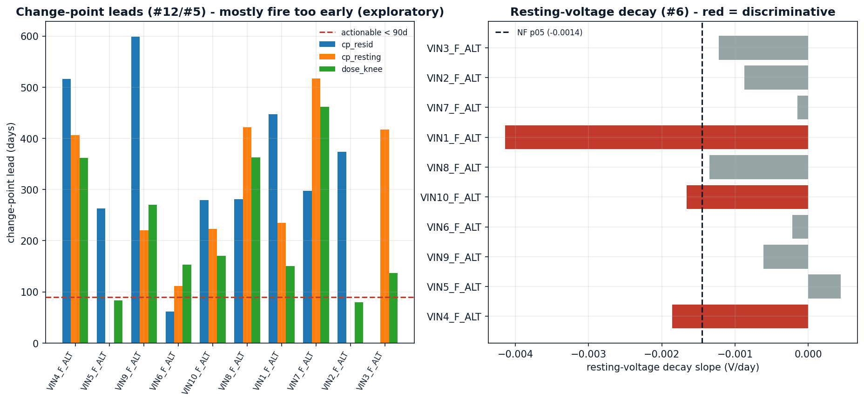
Change-point / resting voltage (exploratory)

Slide 11
Limitations
• Net gain is modest: +1 detection (VIN9), +1 earlier lead (VIN1).
• crank_recovery_t z-magnitudes inflated (healthy baseline ~0.05s); trust the 0/15 NF guard.
• The recovery signal is episodic (isolated spikes); VIN9's events span its whole life.
• VIN8 strict-gate hit rests on 3 trusted days (compound catches it at 90d).
• 4/10 failures remain undetectable (abrupt/silent); no per-truck daily RUL implied.

Slide 12
Deployment recommendation
• Add crank_recovery_t to the emergency channel alongside the GED=2 storm.
• Surface the compound 2-of-5 vote as an 'early-watch' tier (0 false alarms).
• Use sag-typing (high-load vs idle) + reg-duty for repair-direction guidance.
• WHICH (classifier) + WHEN-fleet (Weibull) unchanged from V10.6.2.

Slide 13
Appendix — data sources
• All numbers from V11 cache/forensics + results/comparison.csv.
• No RUL/Weibull/backtest data (V11 is the precursor fork; see V10.6.2 for RUL).
• Graphs: visualizations/V11_graphs/.
• Pipeline reproducible via V11_ALT_heuristics_orchestrator.py.

