Slide 1

Internship Project

Slide 2

Student Name : Himanshu Gaikwad
Student ID : STU6669447dca04a1718174845
College Name : DY Patil College of Engineering Akurdi, Pune

Slide 3
CAPSTONE PROJECT SHOWCASE
Project Title : Energy Consumption Dashboard using PowerBI and Excel
Abstract | Problem Statement | Project Overview | Proposed Solution | Technology Used | Modelling & Results | Conclusion | Q&A

Slide 4
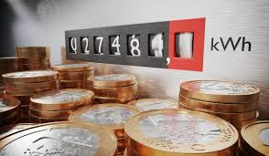
Abstract
The Energy Consumption Dashboard is a powerful, user-friendly tool developed to track and visualize energy usage across categories such as water, electricity, and gas. Built using Power BI, the dashboard brings together data from various sources to uncover key consumption trends, cost patterns, and regional insights. It offers features like interactive filters, comparison tools, and detailed breakdowns by building, city, and year. This helps users identify areas of inefficiency and make data-driven decisions to improve resource management and promote sustainability. The project emphasizes the importance of visual analytics in driving energy-conscious practices.

Slide 5
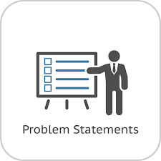
Problem Statement
Efficient energy management is essential for reducing costs and promoting sustainability, but fragmented data often hinders actionable insights. Organizations need a centralized, intuitive dashboard to analyze energy consumption trends across water, electricity, and gas, track costs, and identify opportunities for optimization.

Slide 6
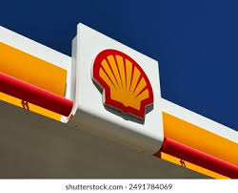
Project Overview
The Energy Consumption Dashboard is a comprehensive solution designed to analyze and visualize energy usage data across water, electricity, and gas. Built using Power BI, it consolidates data from multiple sources to provide insights into consumption trends, cost analysis, and regional patterns. The dashboard enables users to monitor energy usage effectively, identify inefficiencies, and make data-driven decisions to optimize resource management and promote sustainability.

Slide 7

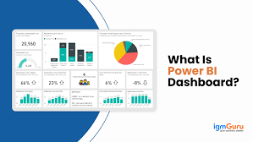
Proposed Solution
To address the challenge of inefficient energy management and fragmented data, the proposed solution is the development of an interactive Energy Consumption Dashboard. By integrating data from various sources into a single platform using Power BI, the dashboard provides a clear and comprehensive view of energy usage across water, electricity, and gas. It enables users to track consumption trends, monitor costs, and identify areas of inefficiency. Interactive features allow users to filter data by building, city, or year, while visualizations highlight key insights for informed decision-making. This solution empowers organizations to optimize energy use, reduce costs, and make sustainable, data-driven choices.

Slide 8

Technology Used
1. PowerBI : The primary technology used for data integration , visualizations , and Dashboard creation .
2. Excel : Microsoft is Powerful tool used for data modelling and analysis . It is used for cleaning and modelling data as per our requirement .

Slide 9
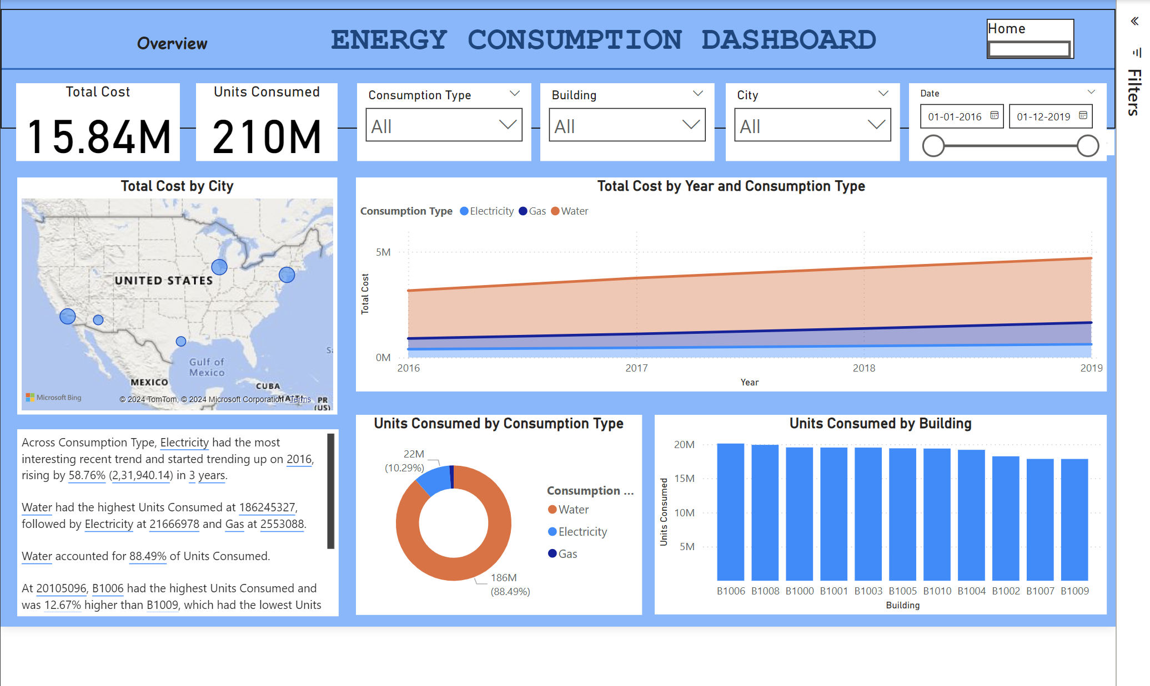
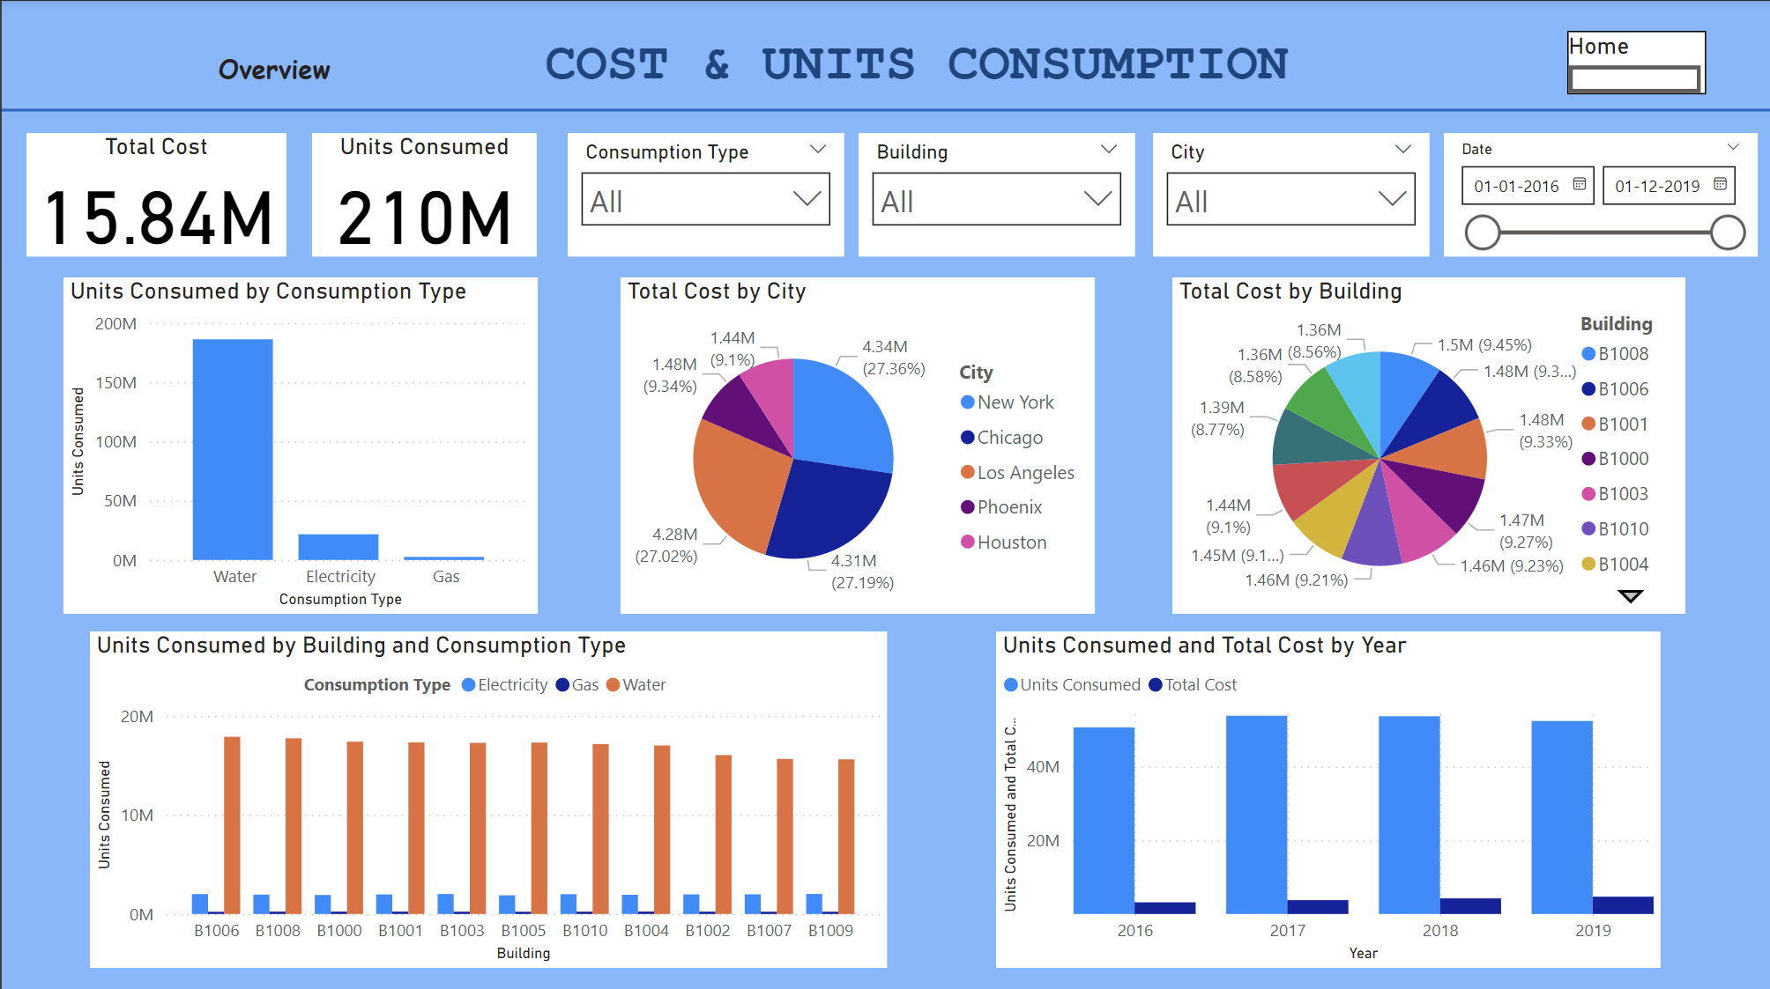
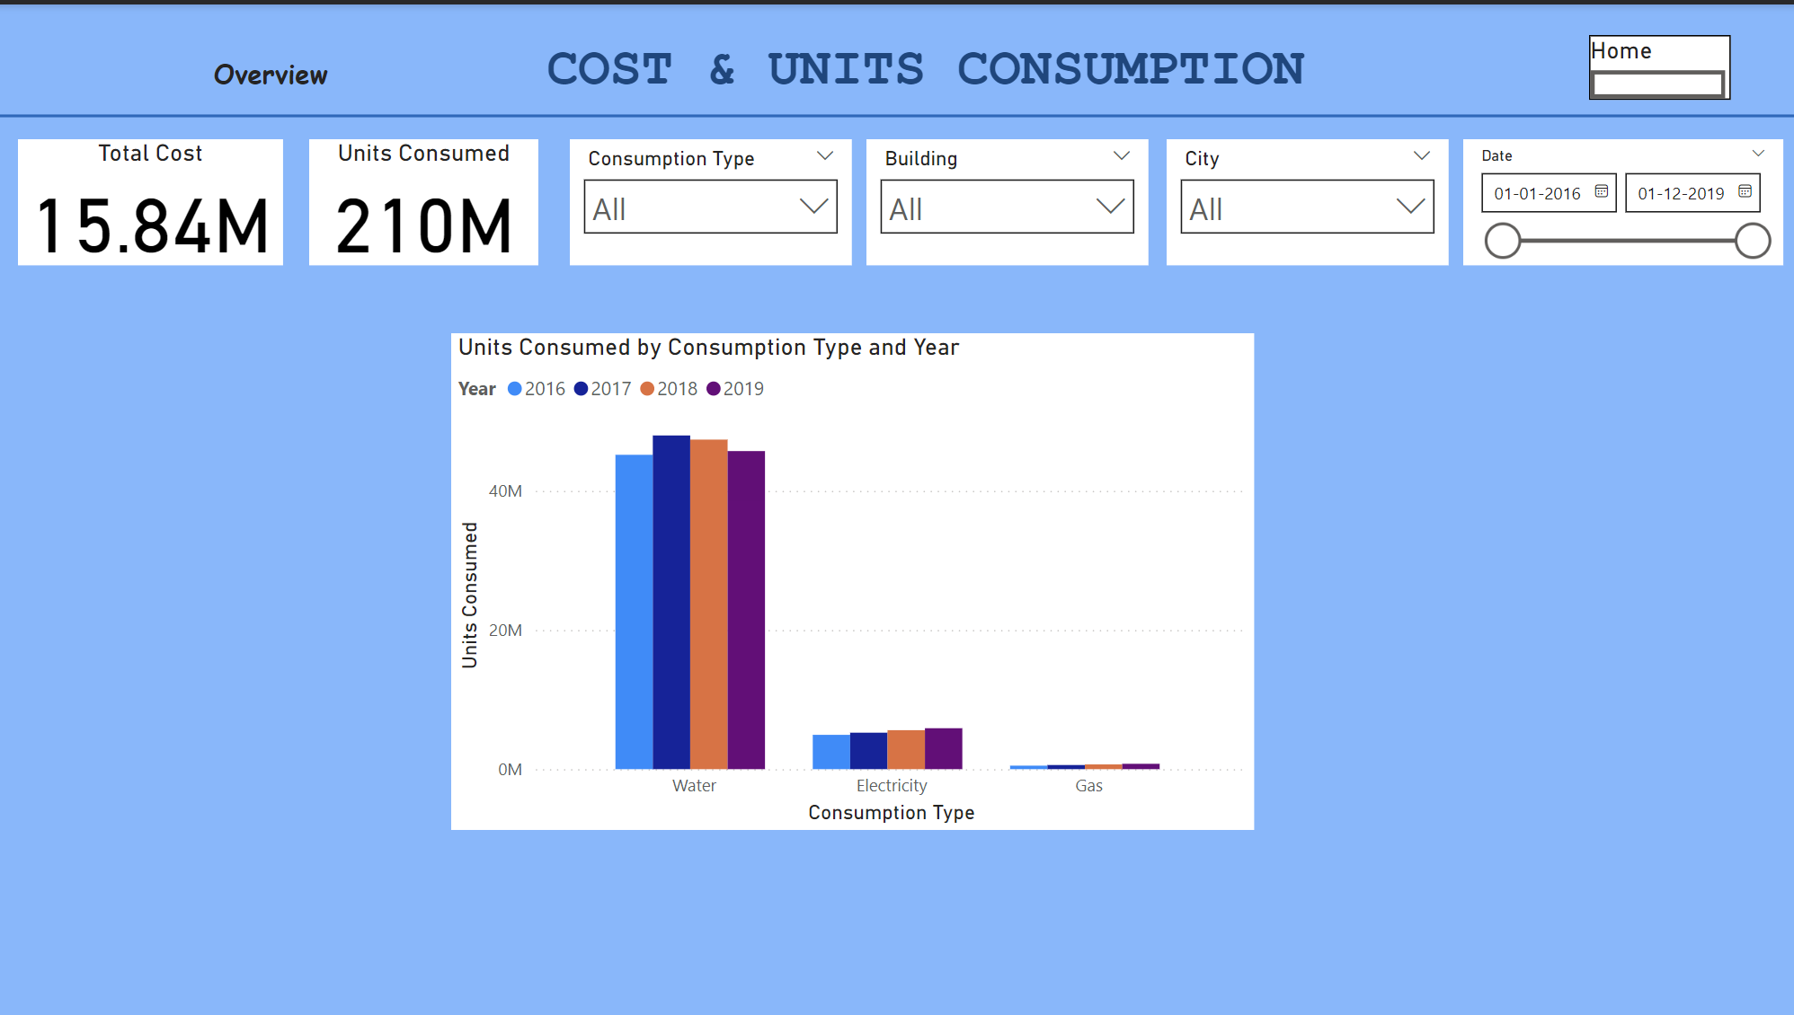
Modelling & Results
The Energy Consumption Dashboard uses Power BI to model and visualize energy usage data. The data is collected from various sources, including historical consumption records for water, electricity, and gas. Key steps in the modeling process include data cleaning, filtering, and aggregation to create meaningful metrics such as total consumption, cost trends, and consumption by building, city, and year.
Results from the dashboard reveal patterns in energy usage across different regions and buildings, helping users identify high-consumption areas and periods. The cost analysis provides insights into the financial impact of energy usage, while the geographical insights highlight areas with potential for optimization. The dashboard allows users to interact with the data, filter by various parameters, and track consumption and cost trends over time, supporting informed decision-making for energy efficiency improvements.

Slide 10
Conclusion
The Energy Consumption Dashboard successfully provides a powerful, interactive tool for tracking and analyzing energy usage across water, electricity, and gas. By consolidating data from multiple sources and offering detailed insights into consumption patterns, costs, and regional trends, the dashboard empowers organizations to make data-driven decisions. It helps identify inefficiencies, optimize resource usage, and promote sustainability. Overall, the project demonstrates the importance of data visualization in energy management and its potential to drive informed actions towards energy conservation and cost reduction.

Slide 11
Thank You!
Notes:
Thank You !!

