Slide 1

Reinforcement Learning Based Resolution Improvement of Geophysical Data
Himanshu Jain
20MC0039
Under The Guidance Of
Prof. Swarandeep Sahoo
Assistant Professor
Department of Applied Geophysics
Indian Institute of Technology
(Indian School of Mines), Dhanbad

Slide 2
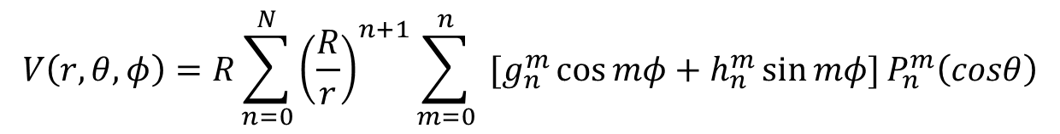
Data:
Objective:
Objective is to predict unknown IGRF coefficients for the epoch 1900 to 1995 for degree n = 11 to n=13.
Create a model specifically for the IGRF values using different methodologies to predict the best possible missing values
The magnetic potential due to the internal origin:
From 1900 to 1995 we have IGRF constants till n=10 only.
After 2000 we have IGRF constants till n=13.
$$V\left(r,θ,φ\right)=R\sum_{n=0}^{N}{{\left(\frac{R}{r}\right)}^{n+1}\sum_{m=0}^{n}{ [g_{n}^{m}\cos{mφ+h_{n}^{m}\sin{mφ]}P_{n}^{m}\left(cosθ\right)}}}$$
Challenges with machine learning algorithms:
Small data set.
Number of values to be predicted is large.
Model should satisfy the laws of Physics.

Slide 3

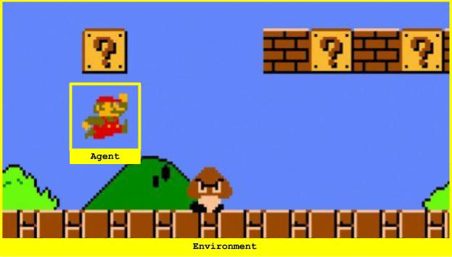
Reinforcement learning:
Agent
Environment
State
Action
Reward
Policy
Fig. a) Working of reinforcement learning model
Fig. b) Example of reinforcement learning

Slide 4
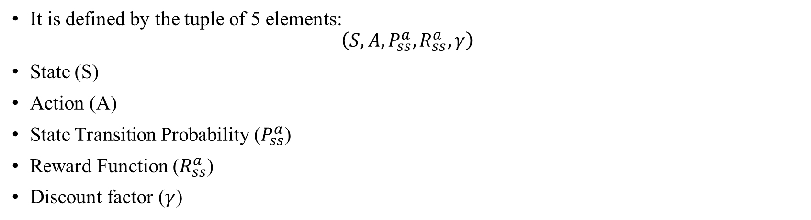
Markov Decision Process:
It is defined by the tuple of 5 elements:
$$\left(S,A, P_{ss}^{a}, R_{ss}^{a},γ\right)$$
State (S)
Action (A)
State Transition Probability ($P_{ss}^{a}$)
Reward Function ($R_{ss}^{a}$)
Discount factor ($γ$)
Advantages
Converges faster.
Better understanding of working of the algorithm.
Disadvantages
Need of state transition probability matrix
Need to provide each state before the execution of the program

Slide 5
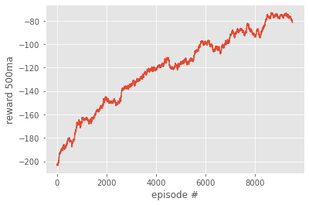
Q- Learning:
Model free reinforcement learning algorithm.
Explore every state of the environment and available actions in each state.
Create a table (matrix) of shape [state, actions].
Example of Q-Learning
 | Agent
 | Enemy
 | Food
Fig. b) Reward vs episode in Q-learning
Fig. a) Q-learning example

Slide 6
(a) Total magnetic field:
Problem Formulation:
1) Agent:
Coefficients to be predicted will work as agent for environment.
So the agent will be a number which will work in environment.
2) Actions:
Only two actions are allowed for each agent. It can be increased or decreased by a factor.
3) Reward:
Reward will be based on how much criteria a set of agents follow.
4) Environment:
The average change in total magnetic field due to coefficients of degree n=10 and n=13 is 27nT for the year 2000 to 2020.
The Model will try to reduce error to 30nT to satisfies the criteria.

Slide 7
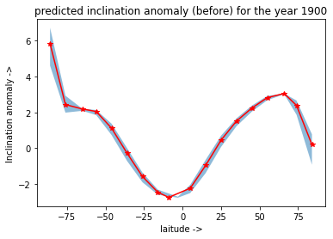

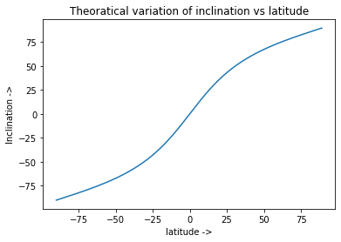
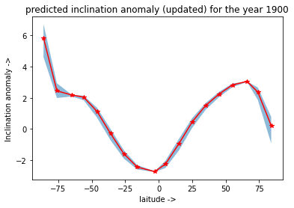
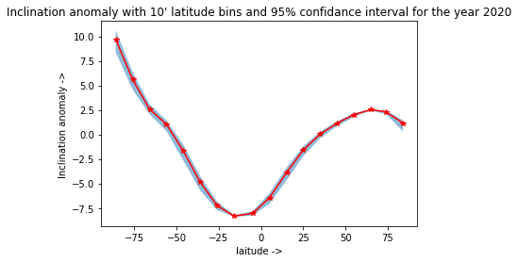


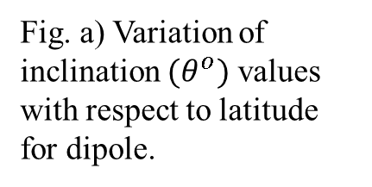
(b) Inclination anomaly:
Inclination due to geocentric axial
dipole is given by:
$\tan{I_{GAD}=2\tan{λ}}$
Fig. a) Variation of inclination ${(θ}^{o})$ values with respect to latitude for dipole.
Fig. c) Inclination anomaly ${(θ}^{o})$ from the coefficients.
Fig. b) Fisher mean of
inclination anomaly ${(θ}^{o})$
with 10’ latitude bins and
95% confidence interval
Fig. d) Inclination anomaly ${(θ}^{o})$ from the predicted coefficients.

Slide 8
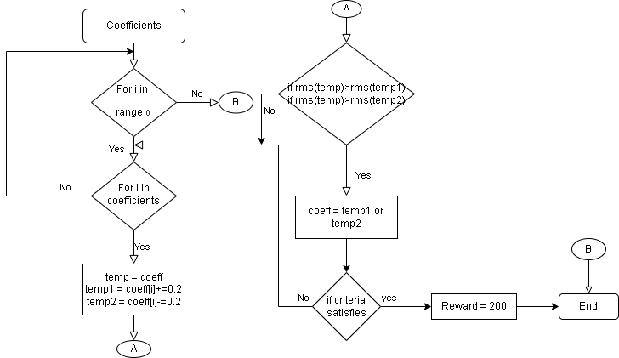
Working of Model:
Fig. a) Flow chart of working of the model

Slide 9
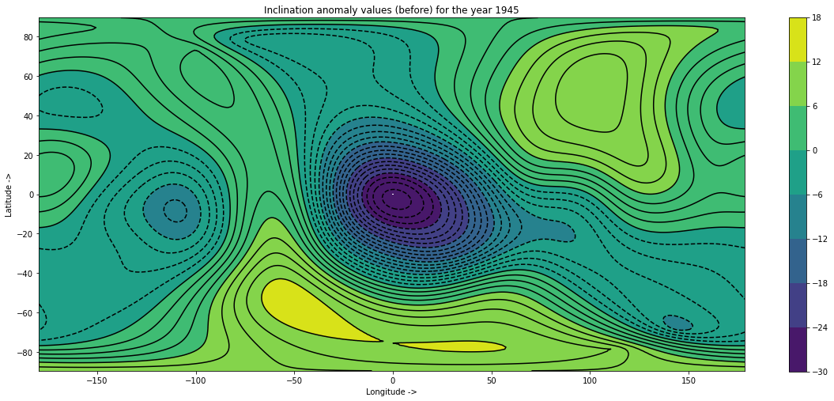

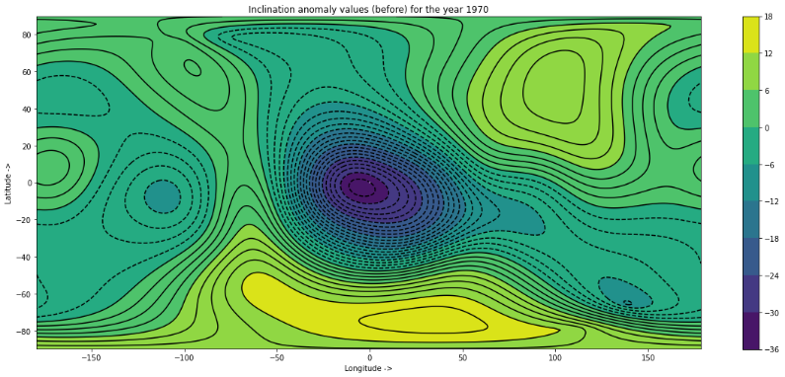





Results:
Inclination anomaly:
$$θ^{o}$$
$$θ^{o}$$
(a)
(b)
1945
$$θ^{o}$$
(d)
$$θ^{o}$$
(c)
1970
Fig: (a) and (c) corresponds to the inclination anomaly of available coefficients and (b) and (d) corresponds to the inclination anomaly for predicted coefficients

Slide 10
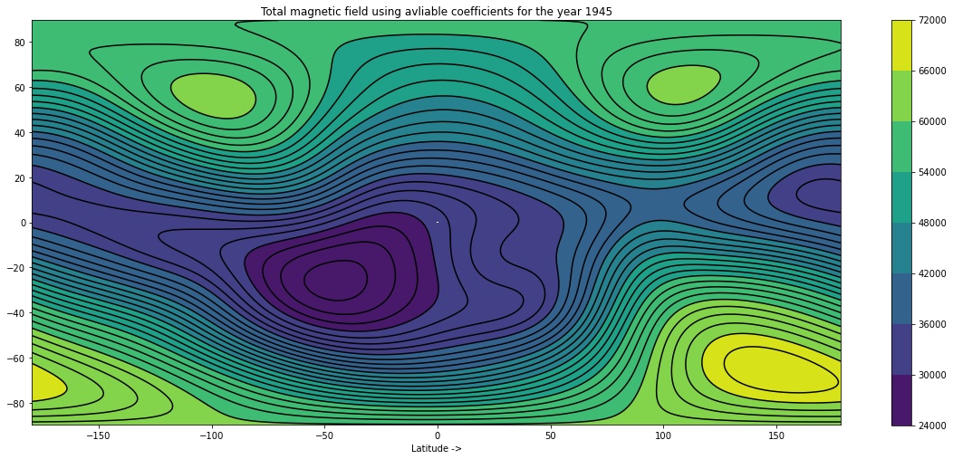

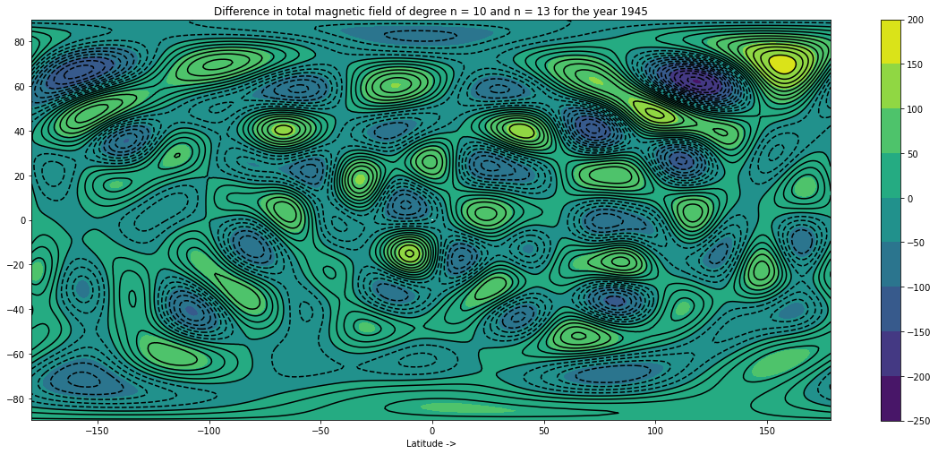
Total Magnetic field:
nT
nT
(a)
(b)
nT
(c)
Fig: (a) corresponds to the total magnetic field
using available coefficients,
(b) Corresponds to the total magnetic field
using predicted coefficients,
(c) The difference between predicted and
available magnetic field

Slide 11
Thank you
References:
Adams, J., 2007. Fisher statistics.
Alken, P., Thébault, E., Beggan, C.D., Amit, H., Aubert, J., Baerenzung, J., Bondar, T.N., Brown, W.J., Califf, S., Chambodut, A. and Chulliat, A., 2021. International geomagnetic reference field: the thirteenth generation. Earth, Planets and Space, 73(1), pp.1-25.
Olsen, N., Friis-Christensen, E., Floberghagen, R., Alken, P., Beggan, C.D., Chulliat, A., Doornbos, E., Da Encarnação, J.T., Hamilton, B., Hulot, G. and van den IJssel, J., 2013. The Swarm satellite constellation application and research facility (SCARF) and Swarm data products. Earth, Planets and Space, 65(11), pp.1189-1200.
Sprain, C.J., Biggin, A.J., Davies, C.J., Bono, R.K. and Meduri, D.G., 2019. An assessment of long duration geodynamo simulations using new paleomagnetic modeling criteria (QPM). Earth and Planetary Science Letters, 526, p.115758.
Sutton, R.S. and Barto, A.G., 2018. Reinforcement learning: An introduction. MIT press.
https://www.ngdc.noaa.gov/

