Slide 1

SMART PROCUREMENT &
FARMER ASSISTANCE PLATFORM
Team: Farm Tech | Problem ID: 26032
Ministry of Consumer Affairs

Slide 2
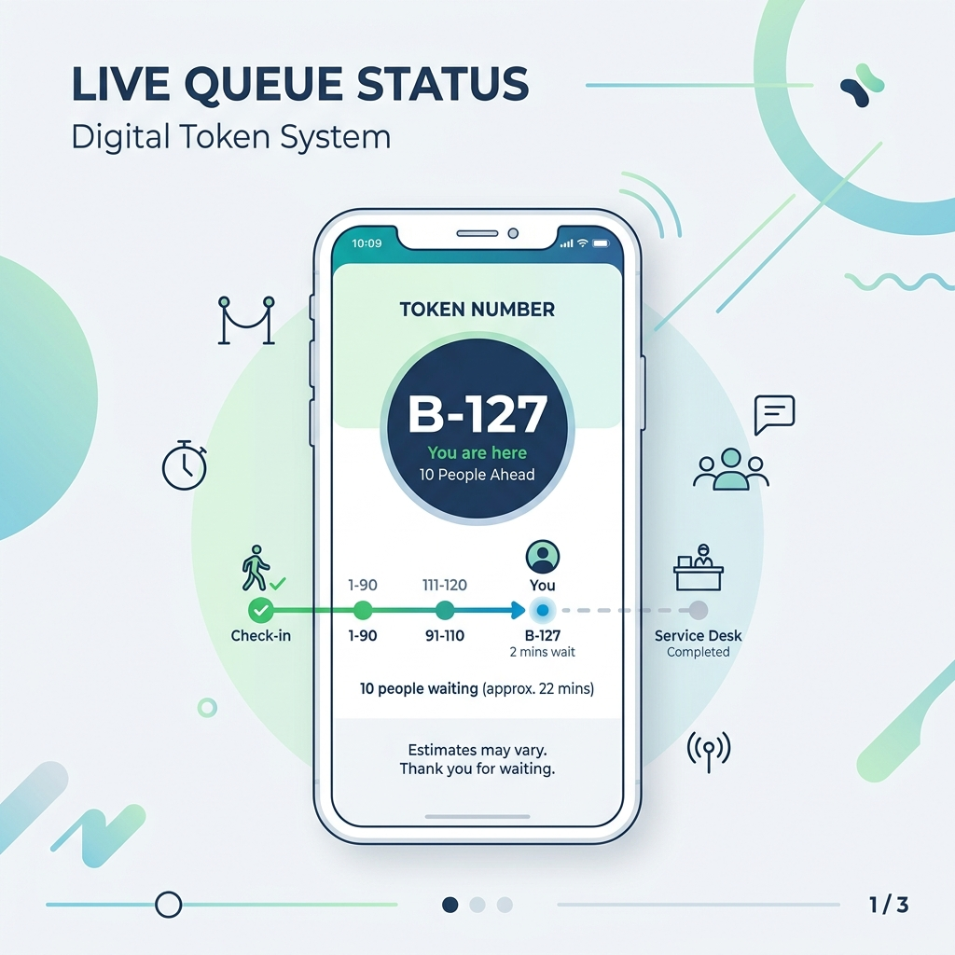
PROPOSED SOLUTION
• Register & Select Centre
• Book a Slot & Get Digital Token
• Track Live Queue & ETA
• Real-Time Payment Updates

Slide 3
TECHNICAL APPROACH
Farmer App:
Flutter
Admin Dashboard:
React.js
Backend:
Python + FastAPI
Database:
PostgreSQL
Real-Time Queue:
Redis / WebSockets
Notifications:
Firebase & SMS

Slide 4
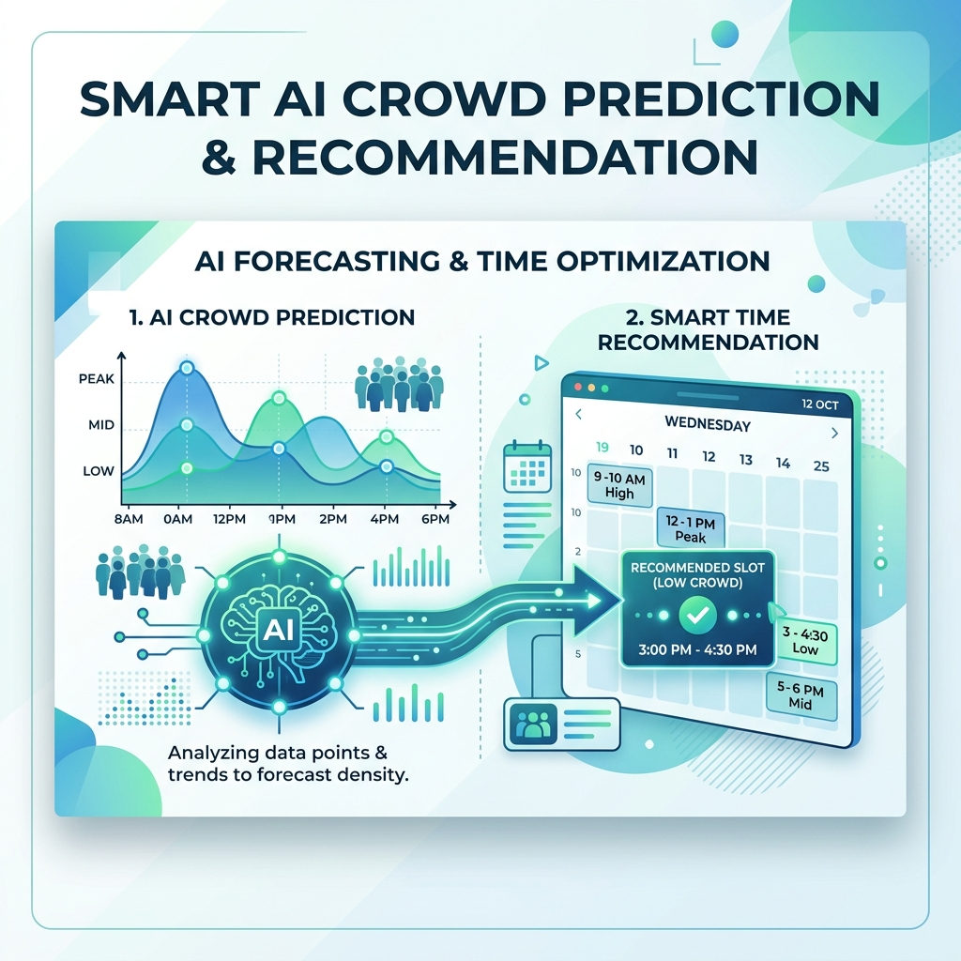
FEASIBILITY & INNOVATION
AI-Assisted Smart Slot Recommendation
• Predicts Crowd Density
• Recommends Less Crowded Times
• Ensures Zero Congestion

Slide 5
IMPACT AND BENEFITS
For Farmers:
• No more waiting in long lines
• Transparent tracking of payment
• Accessible via Mobile App & SMS
For Government:
• Efficient capacity management
• Data-driven procurement planning

Slide 6
RESEARCH AND REFERENCES
• Studied existing systems: Kisaan E-Mandi, MandiMithra, AgriSakha
• Built custom workflow tailored for Department of Consumer Affairs (DoCA)
• Future-proof architecture ready for integration with existing Govt portals

