Slide 1

Task 3 – Dashboard Presentation
Data Cleaning and Visualization Report
Presented by: Himanshu Sareen
Date: 07/06/2025

Slide 2

Introduction
Objective:
To analyze and visualize the dataset by creating a dashboard highlighting key metrics.
Tools Used: Microsoft Excel / Power BI

Slide 3

Overview of the Dataset
Data Source: Sample-superstore.csv (from kaggle.com)
Number of Rows and Columns
Types of Data Handled
Initial Challenges: - Null values - Duplicates - Inconsistent formatting

Slide 4

Data Cleaning Steps
Steps Taken:
- Removed duplicates
- Handled null values
- Standardized formats (dates, text, etc.)
Result: - Cleaner dataset suitable for analysis

Slide 5
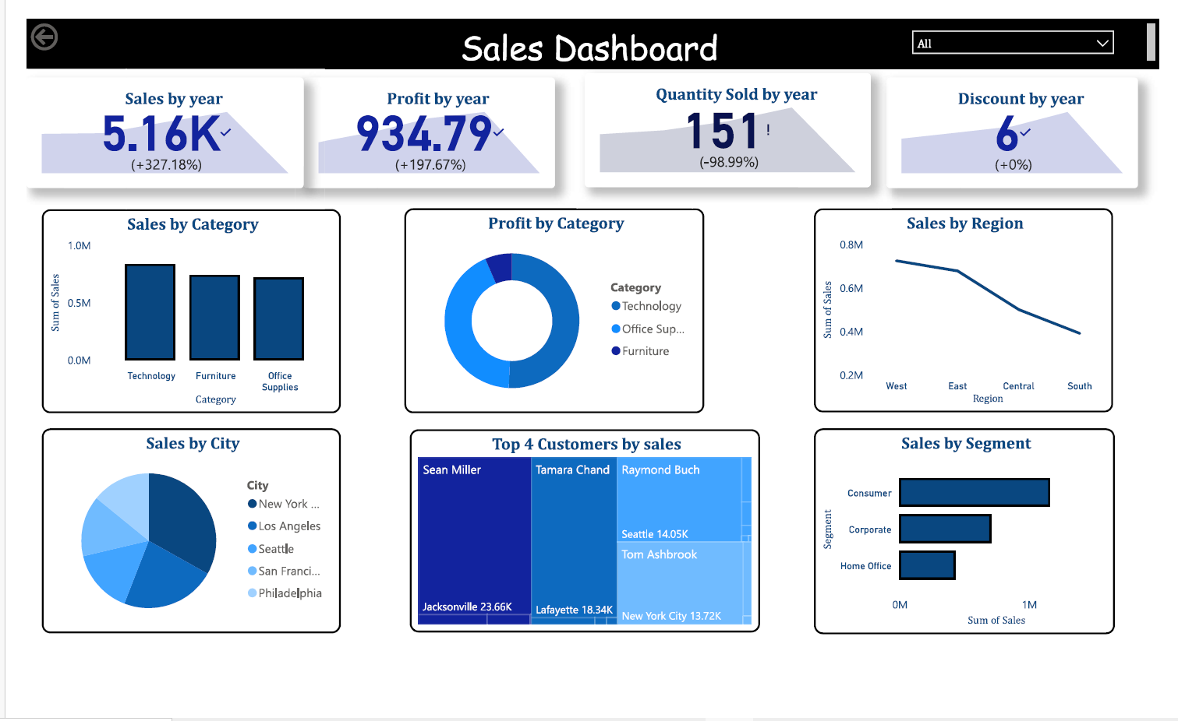
Dashboard with KPI and Slicers

Slide 6
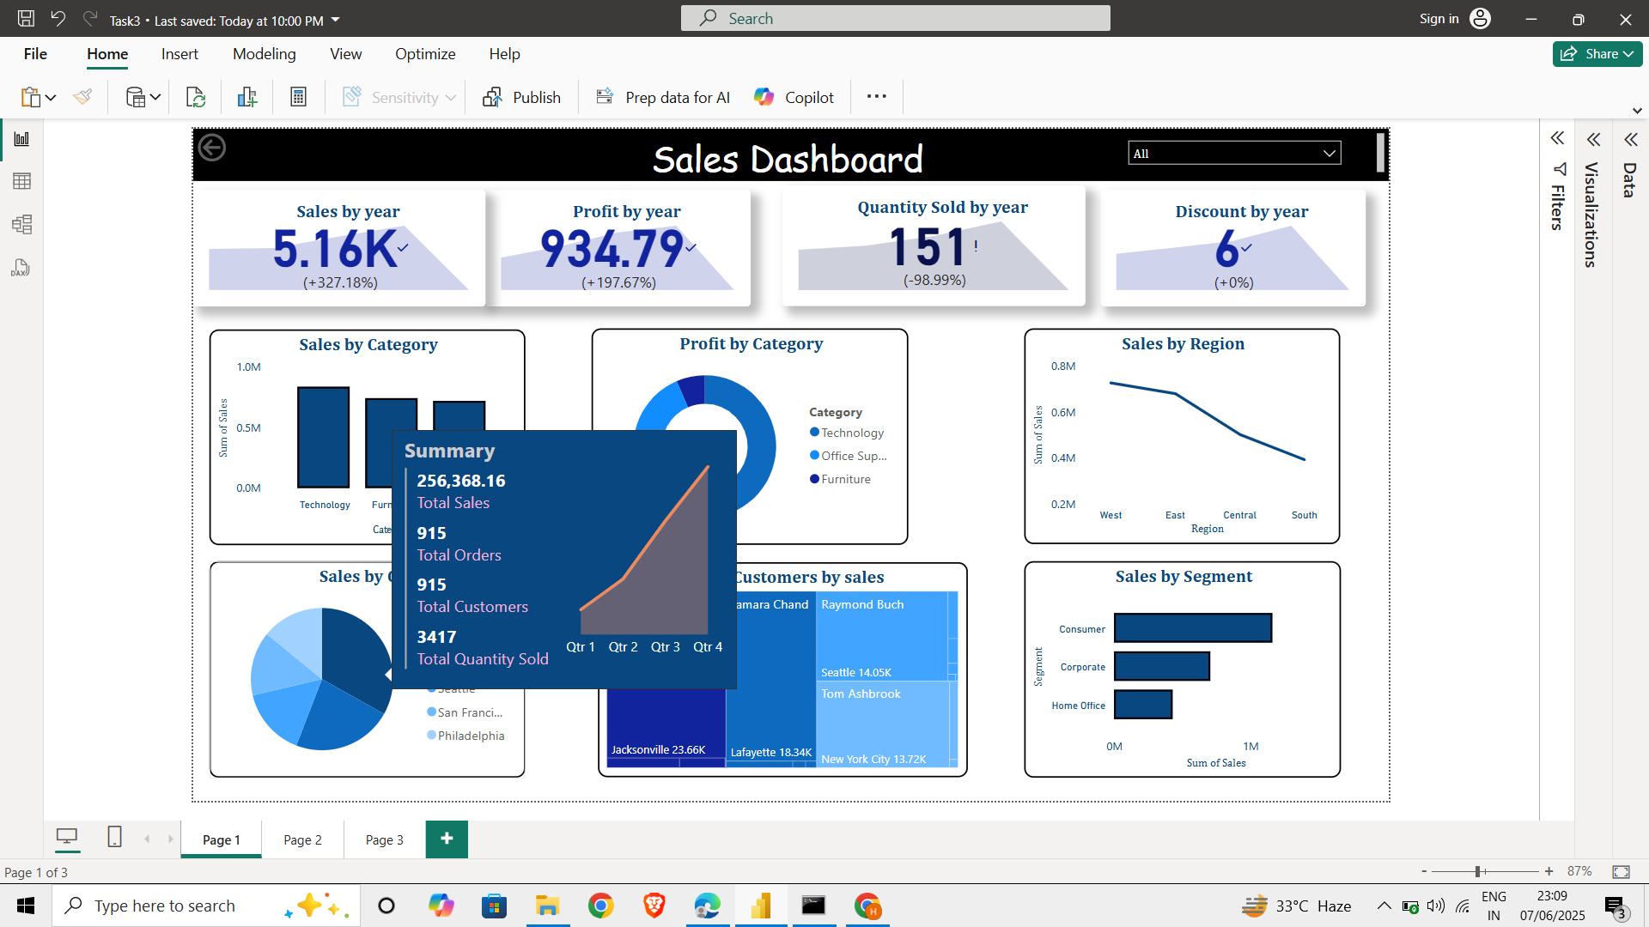
Dashboard showing Tooltip

Slide 7
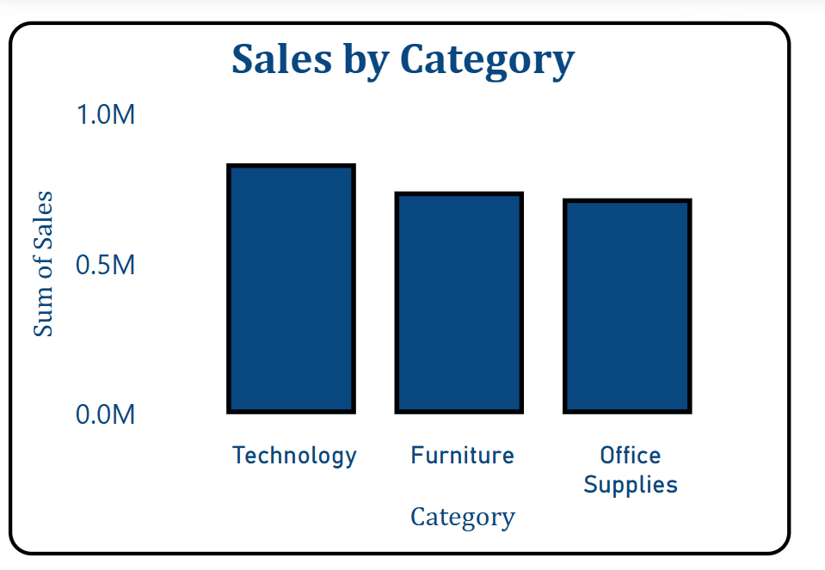
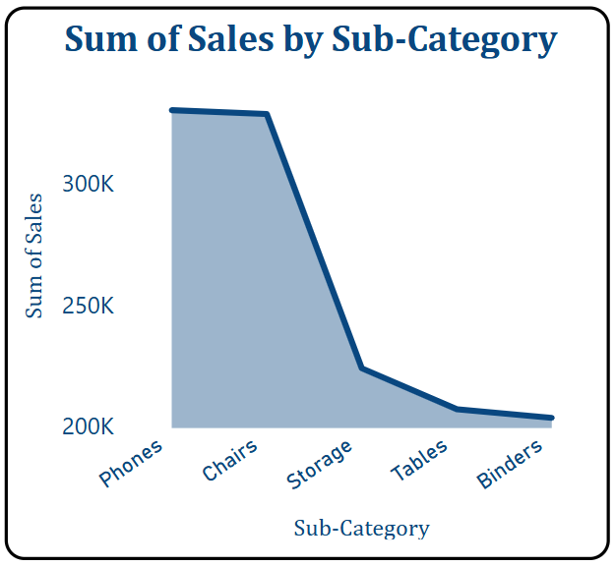
Chart of Sales by category
Insights Obtained :
Most sold Category is technology.
Focus should be more on increase in production of technology items especially phones.
Highest profit is also there in technology category.

Slide 8
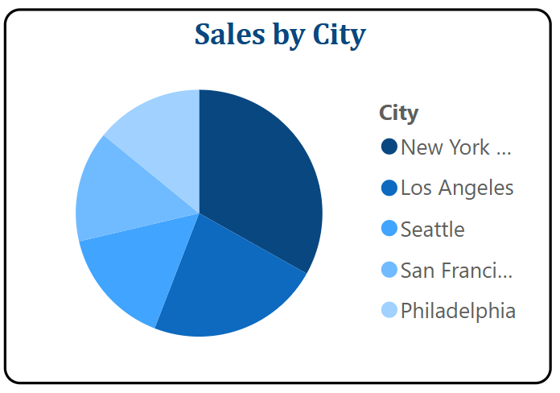
Sales by City
Insights :
Top Customers are from New York City.
So we should target customer needs in new York city band sell phones in this city in increased amount to increase our profits.

Slide 9
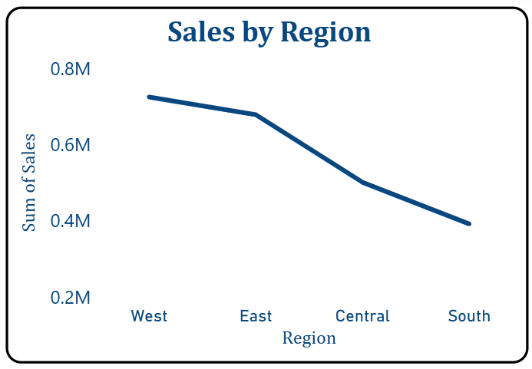
Chart of sales by region
Key Insights obtained :
Highest sales comes from west region of united states.
Followed by east central and south.
So we should target west region and increase our supply in that region.

Slide 10

Key Metrics Summary (Dashboard Overview)
- Total Revenue
- Total Profit
- Number of Orders

Slide 11

Conclusion
📊 Insights Summary:
✅ Most Sales Region: West
🗽 Top City: New York City
🛒 Business Model: Direct-to-Consumer (D2C) dominates
📱 Top Category: Technology → Phones
📈 Peak Sales Year: 2017
📉 Major Dip: 2018

Slide 12
Contd.
✅ Data-Driven Decisions Possible:
Region Focus:
Increase investment and marketing efforts in the West region to further strengthen market share.
Investigate if similar strategies can be replicated in underperforming regions.
City-Centric Strategy:
Run exclusive promotions or pilot programs in New York City to test new product lines or marketing campaigns.
Explore urban demographics like NYC for market expansion.
D2C Business Model Optimization:
Enhance the D2C customer experience (personalization, faster shipping, loyalty programs).
Invest in your D2C platform (website/app UX, digital advertising, customer support).
Product Strategy:
Prioritize inventory, marketing, and innovation around the Phones sub-category.
Explore bundling options or upgrades in the Technology category.
Sales Trend Analysis:
Analyze root causes for the 2018 sales dip—was it due to market trends, product availability, pricing, or external factors?
Use time series analysis to forecast future demand and avoid similar downturns.

Slide 13

Contd.
📌 Next Steps / Suggestions:
Drill Down Analysis:
Segment sales by customer demographics, pricing tiers, and promotional channels to identify growth levers.
Investigate low-performing regions and years to identify gaps or mistakes.
Enhance Forecasting:
Use historical trends (e.g., dip in 2018) to build more robust forecasting models for 2025 and beyond.
Customer Feedback Loop:
Collect and analyze customer feedback on phones & tech products to improve offerings and reduce churn.
Product Lifecycle Management:
Review product life cycle of top-selling phones—were 2018 dips due to outdated models or late launches?
Test Expansion Areas:
Try targeted campaigns in East or Central regions with similar demographics to West for controlled expansion.

Slide 14
Thank You

