Slide 1
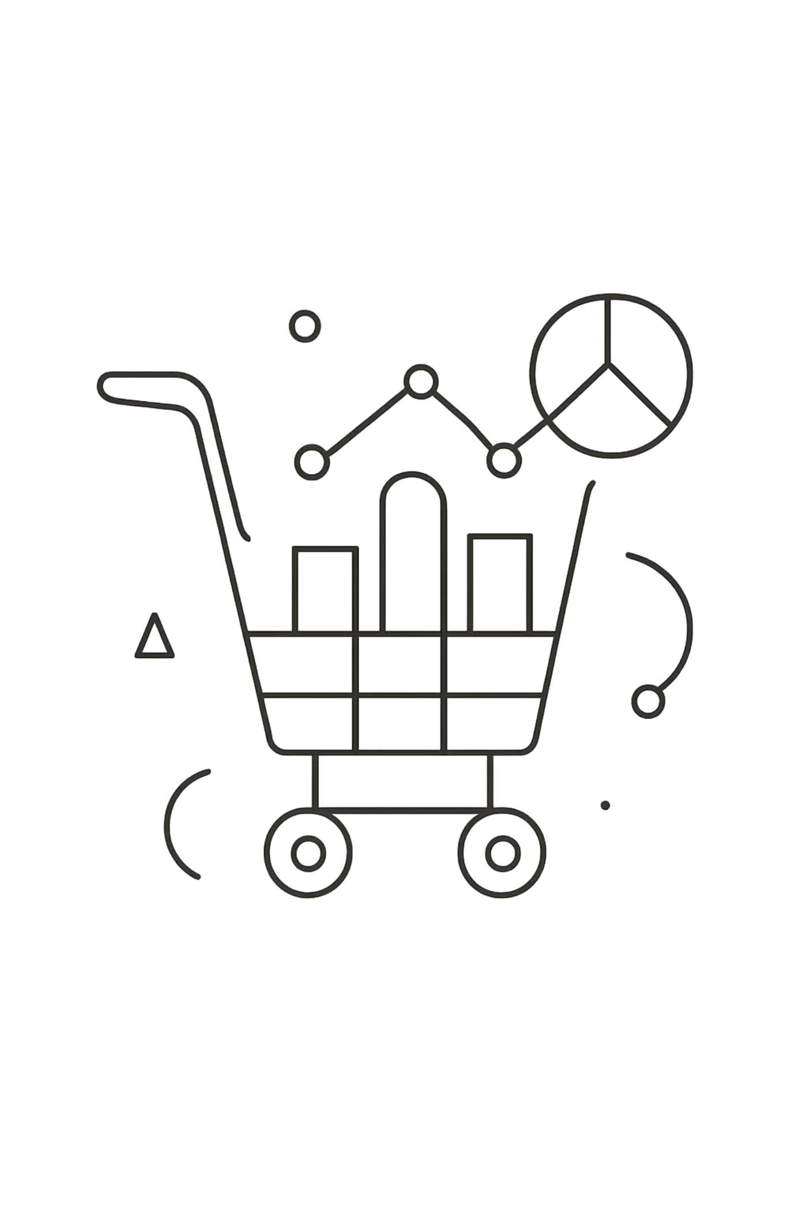
Customer Shopping Behavior Analysis
Analysis of 3,900 transactions to reveal spending patterns, segments, product preferences, subscription behavior, and strategic recommendations.

Slide 2
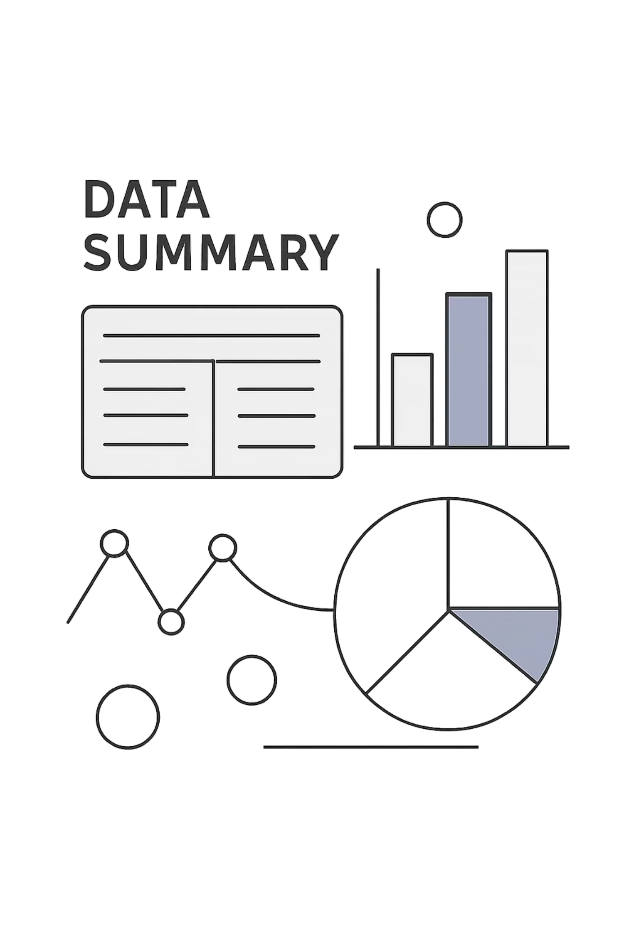
Dataset Snapshot
Rows & Columns
Key Features
Missing Data
3,900 rows · 18 columns
Demographics, purchase details, behavior, ratings, shipping, discount flags
37 missing values in Review Rating

Slide 3

Data Preparation (Python)
Loaded data with pandas; used df.info() and .describe(). Imputed missing Review Rating using category median, standardized column names to snake_case, created age_group and purchase_frequency_days, dropped promo_code_used as redundant, and loaded cleaned DataFrame into PostgreSQL.

Slide 4
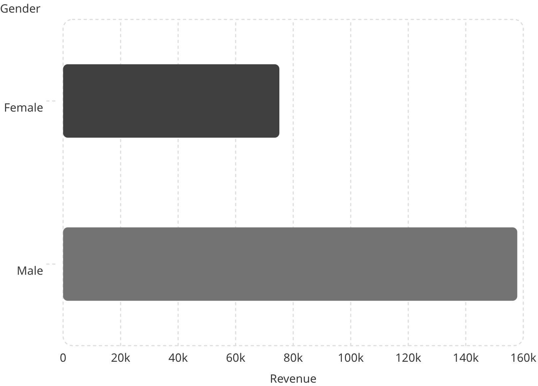

Revenue & Gender
Male customers generated higher total revenue (157,890) vs Female (75,191).
Use gender insights to tailor promotions and product mixes.

Slide 5
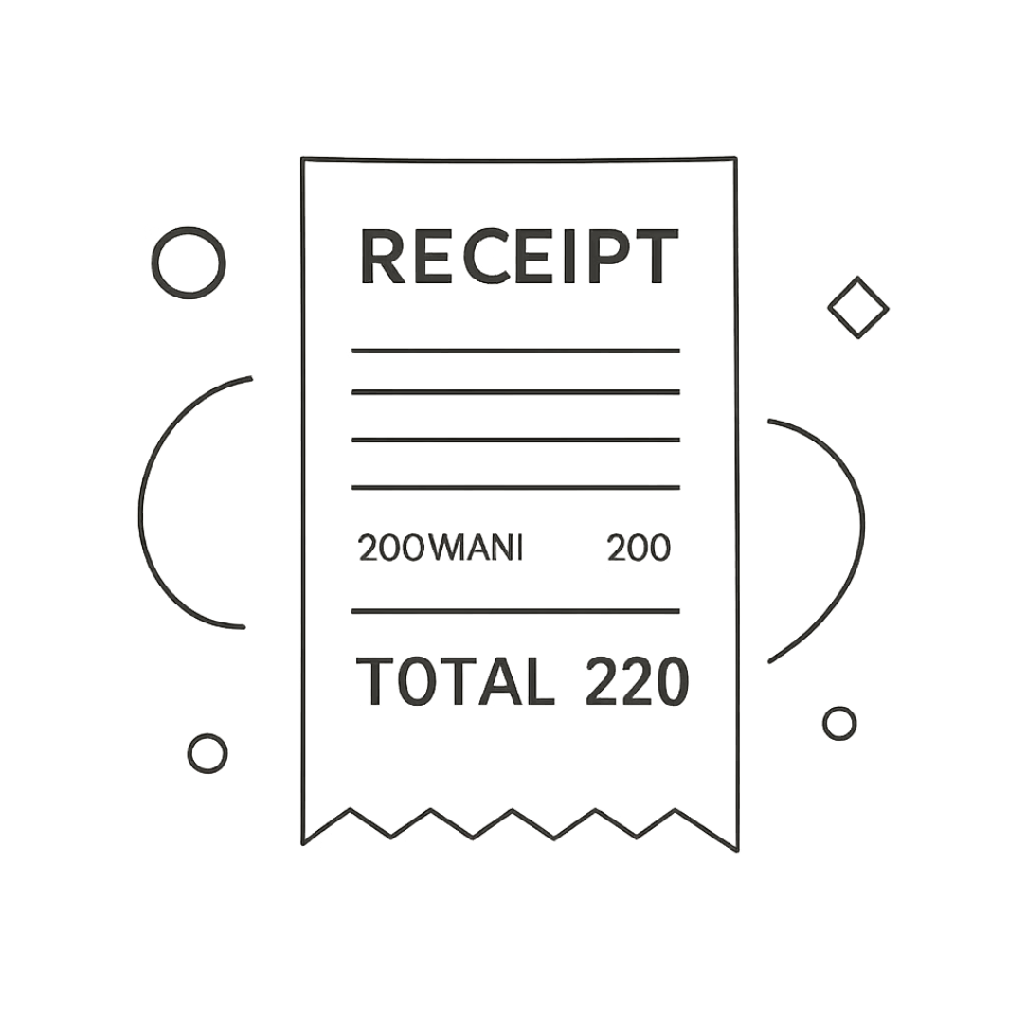

High-Spending Discount Users
Identified 839 rows where customers used discounts yet spent above the average purchase amount. Example purchase amounts include: 64, 73, 90, 85, 97, 68, 72, 81, 90, 62, 88.
Review discount strategy to protect margins while driving conversions.

Slide 6


Top Products & Discount Dependence
Top Rated
Discount-Dependent
Gloves (3.86), Sandals (3.84), Boots (3.82), Hat (3.80), Skirt (3.78)
Highest discount rates: Hat 50%, Sneakers 49.66%, Coat 49.07%, Sweater 48.17%, Pants 47.37%

Slide 7


Customer Segments & Repeat Behavior
Segments based on purchase history show majority are Loyal (3,116). Repeat buyers with >5 purchases are more likely to subscribe: repeat buyers — Yes 958, No 2,518.
Loyal 3,116
Returning 701
Focus loyalty programs on converting Returning and New segments.
New 83

Slide 8
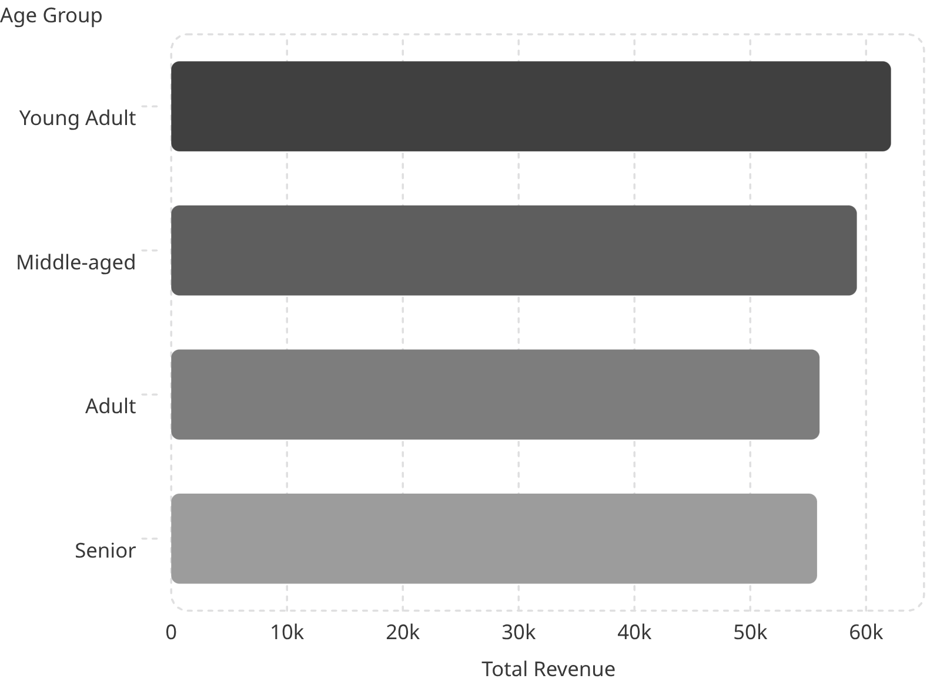
Revenue & Sales by Age Group
High-revenue age groups: Young Adults lead, followed by Middle-aged, Adult, and Senior. Tailor marketing to top-contributing groups.

Slide 9

Shipping, Subscriptions & Dashboard
Average purchase: $59.76 · Avg review rating: 3.75. Shipping comparison: Standard $58.46 vs Express $60.48. Subscription split: Yes 27% / No 73%.
Dashboard visualizes category revenue and sales, age-group breakdowns, and subscription impact.

Slide 10


Business Recommendations
Boost Subscriptions
Loyalty Programs
Review Discount Policy
Product Positioning
Promote exclusive benefits to increase subscriber share and recurring revenue.
Reward repeat buyers to move more customers into the Loyal segment.
Balance discount-driven sales with margin protection; target discount-dependent products.
Highlight top-rated and best-selling items (Gloves, Sandals, Boots, Blouse, Jewelry).
Targeted Marketing
Focus campaigns on high-revenue age groups and express-shipping users to maximize return.

