Slide 1


RailTwin AI
Predictive Digital Twin for Indian Railways
Making Railways Safer, Smarter & More Efficient
GitHub: github.com/himanshu003388/RailTwin
Live: rail-twin.vercel.app
FAR AWAY 2026 · Railways Theme
Notes:
1

Slide 2

The Problem
Indian Railways — 68,000+ km network
Carrying 23M+ passengers daily
Operates ~13,000 passenger trains
Why This Matters
23M+
Daily passengers
Key Challenges
Monsoon disruptions cause cascading delays across the network
Limited real-time decision support for control centre operators
No unified view combining weather, delays, and risk analytics
Delay prediction relies on intuition, not ML on historical data
What-if analysis is manual — no rapid simulation capability
68K km
Network length
₹2L Cr
Annual economic impact of delays
35%
Trains affected by weather annually
"A 10-minute delay at one station can ripple into hours across the network"
RailTwin AI · FAR AWAY 2026
2 / 15
Notes:
2

Slide 3
Solution Overview
RailTwin AI is a predictive digital twin that gives Indian Railways operators a unified command-centre view of network health, live train positions, weather conditions, and AI-powered disruption analysis.
Live Train Tracking
AI Copilot
Weather Intelligence
7 trains across 36 stations, positions computed from real schedule data (not simulated)
Gemini-powered chat assistant answers operator queries about routes, delays, and weather
Per-station live weather from OpenWeather/Open-Meteo with 10-min caching
Delay Prediction
Cascade Simulation
System Health
ML-based (Ridge Regression, R²=0.73) delay forecast + weighted fallback model
What-If scenarios — rainfall, signal failure, track damage — with network-wide impact
Real-time efficiency, on-time performance, and platform utilization gauges
RailTwin AI · FAR AWAY 2026
3 / 15
Notes:
3

Slide 4
Key Features — What Is Actually Built
Interactive Live Map
Delay Prediction Engine
MapLibre GL with 7 train markers, route lines, station risk overlays, weather HUD. Trains animate every 5s via SSE stream.
Two-tier: Ridge Regression ML (R²=0.73, 448 samples) + weighted scoring fallback. Factors in weather, congestion, route distance, historical patterns.
Cascade Disruption Simulator
AI Copilot (Gemini)
Models ripple effects from rainfall, fog, signal failure, track damage. Computes affected trains, passengers, and station-level conflicts.
Gemini 2.0 Flash with auto-fallback to Gemini 2.5 Flash. Multi-turn chat, recommendations, network-aware context. Caches responses for 5 min.
Live Weather Layer
What-If Lab
OpenWeather API + Open-Meteo fallback + intelligent seasonal fallback. 36 stations, 10-min in-memory cache, weather alerts with auto-dismiss.
Interactive scenario builder: select station + disruption type, view projected cascade delay, conflicts, and passenger impact instantly.
RailTwin AI · FAR AWAY 2026
4 / 15
Notes:
4

Slide 5
Data Sources — Grounded in Reality
Kaggle Indian Railways Dataset
✅ Imported & used
36 major junction stations with lat/lng coordinates, 7 real train routes (Rajdhani, Shatabdi, Mail/Express), zone information, track geometries
Historical Delay Records
✅ 576 records loaded
576 delay records across 7 trains, covering 12 months, 7 weather conditions. Used for ML training and weighted scoring baseline
NTES / IRCTC (National Train Enquiry System)
✅ API-ready (RapidAPI)
Baseline schedule verification and delay-propagation validation. Designed for live integration — API key can be added in Settings
OpenWeatherMap + Open-Meteo
✅ API key configured
Per-station weather via lat/lon. OpenWeather primary, Open-Meteo fallback, intelligent seasonal fallback (monsoon/summer/winter/coastal)
RailTwin AI · FAR AWAY 2026
5 / 15
Notes:
5

Slide 6
AI Stack & Technology
AI & Intelligence Layer
Website & Infrastructure
Gemini 2.0 Flash (primary) — server-side API route
Gemini 2.5 Flash (auto-fallback on quota/error)
Retry with exponential backoff, 5-min response cache
System prompt includes live network context
Ridge Regression delay model (R²=0.73, 448 samples)
ML model: weather one-hot + month + train type + route length
Weighted scoring fallback (historical 40% + weather 25% + congestion 20% + route 15%)
10-min weather cache with OpenWeather + Open-Meteo + seasonal fallback
Framework: Astro v6 + React 19 (SSR on Vercel)
Maps: MapLibre GL v4 (CDN) with GeoJSON layers
Styling: Tailwind CSS v4 with CSS custom properties
State: Zustand v5 — centralized store with SSE updates
Charts: Recharts v3 — delay accumulation area charts
Icons: Lucide React — consistent icon system
Database: SQLite (better-sqlite3) on server
Hosting: Vercel (SSR, auto-scaling serverless)
Fonts: Geist Sans + Geist Mono
RailTwin AI · FAR AWAY 2026
6 / 15
Notes:
6

Slide 7
System Architecture
DATA SOURCES
station_data.json
36 stations
train_routes.json
7 train routes
historical_delays.json
576 records
OpenWeather/
Open-Meteo API
▼
BACKEND / API ROUTES (Astro SSR)
/api/trains · /api/stations · /api/trains/predict · /api/weather/corridor · /api/sse/train-updates · /api/copilot/chat · /api/trains/simulation/cascade · /api/predictions/history
▼
FRONTEND COMPONENTS (React + Zustand)
CorridorMap
(MapLibre GL)
CopilotChat
(Gemini client)
DelayChart
(Recharts)
WhatIfPanel
(Simulation UI)
AI Services: Gemini API (Google) → /api/copilot & /api/copilot/chat & /api/copilot/recommendations | ML: Ridge Regression Model (client-side, loaded from delay-model-weights.json)
RailTwin AI · FAR AWAY 2026
7 / 15
Notes:
7

Slide 8
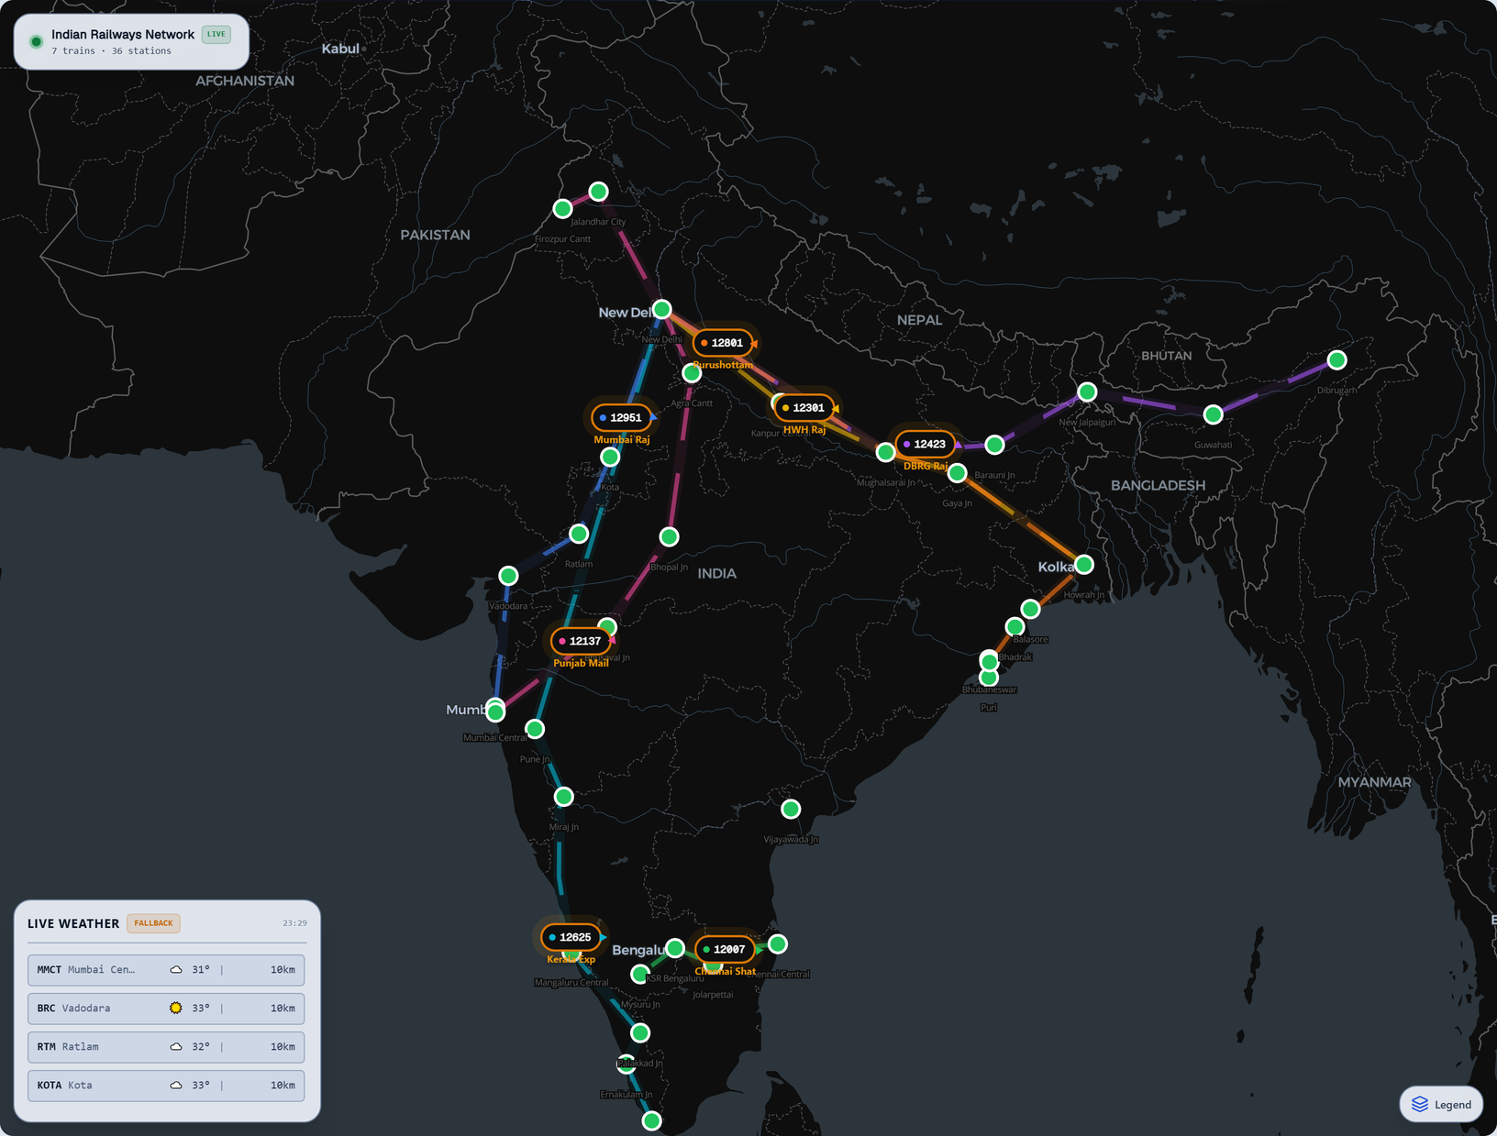
Demo: Live Map — 7 Trains Across India
Map Features
7 trains with colored markers + direction arrows
Route lines with glow effect per train
36 stations with risk-level coloring
Per-station weather HUD (temp, rainfall, visibility)
Click any train for details popup
SSE live updates every 5 seconds
Dark/Light theme toggle
RailTwin AI · FAR AWAY 2026
8 / 15
Notes:
8

Slide 9
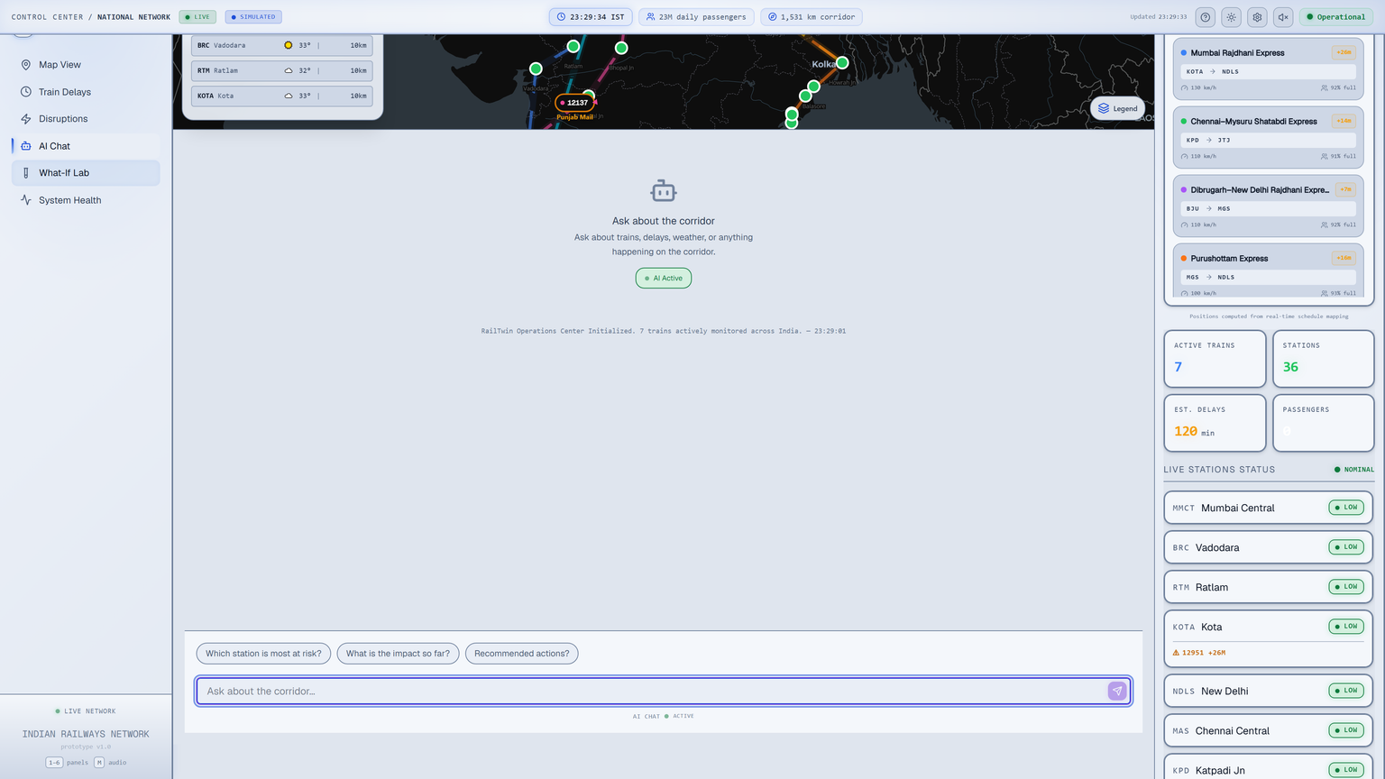
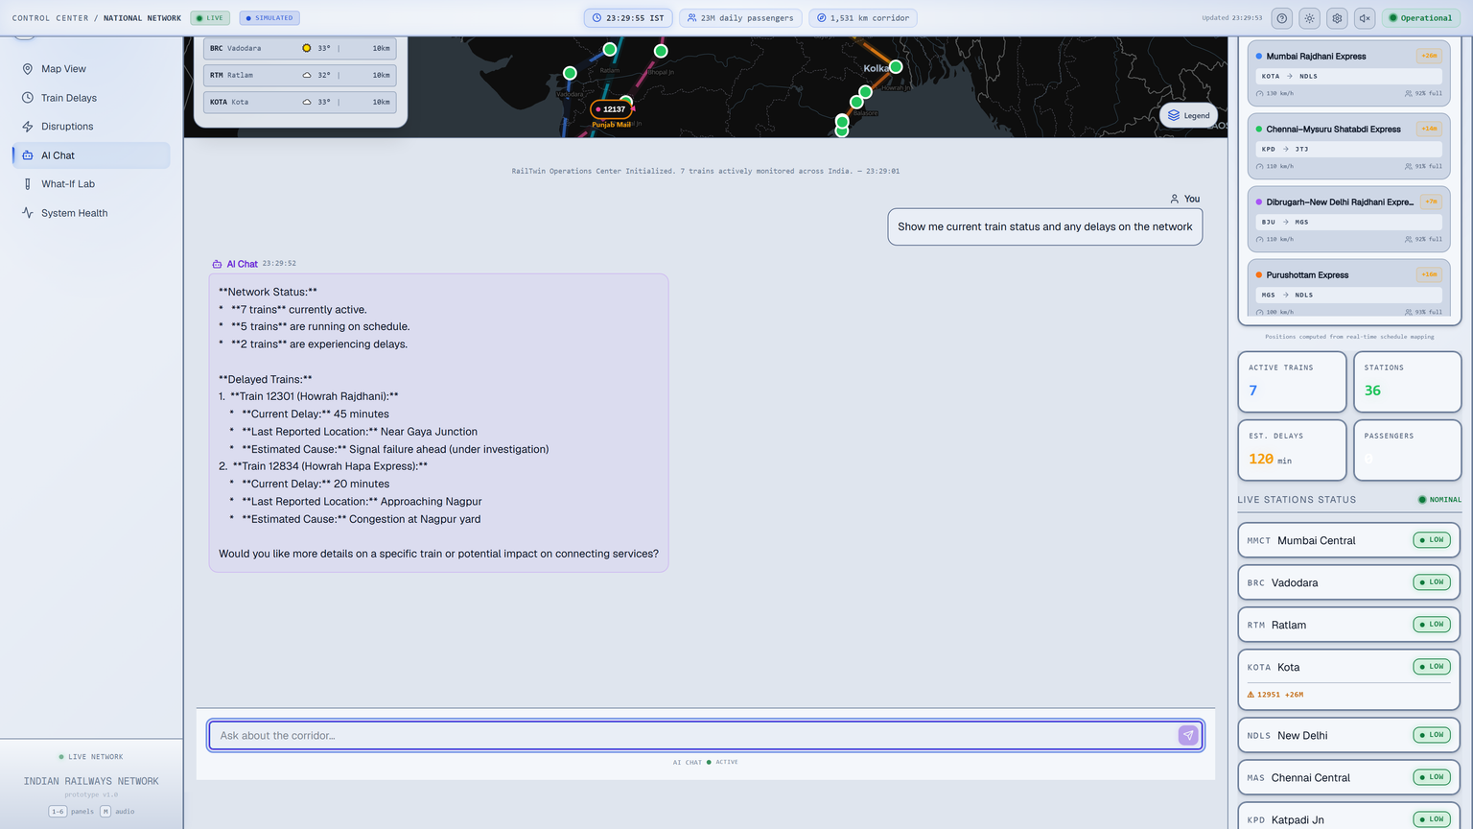
Demo: Weather Intelligence & AI Copilot
Weather: Per-station live data from OpenWeather + Open-Meteo fallback + seasonal estimation. | AI Copilot: Gemini 2.0 Flash answers operator queries with live network context — train status, weather impact, recommendations.
RailTwin AI · FAR AWAY 2026
9 / 15
Notes:
9

Slide 10
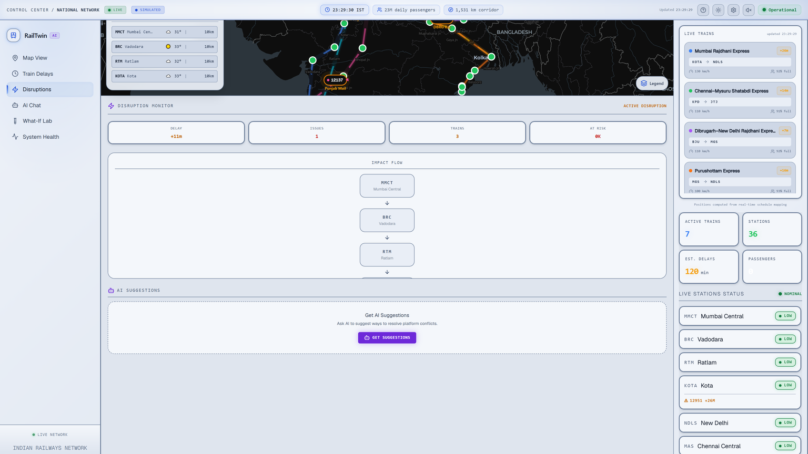
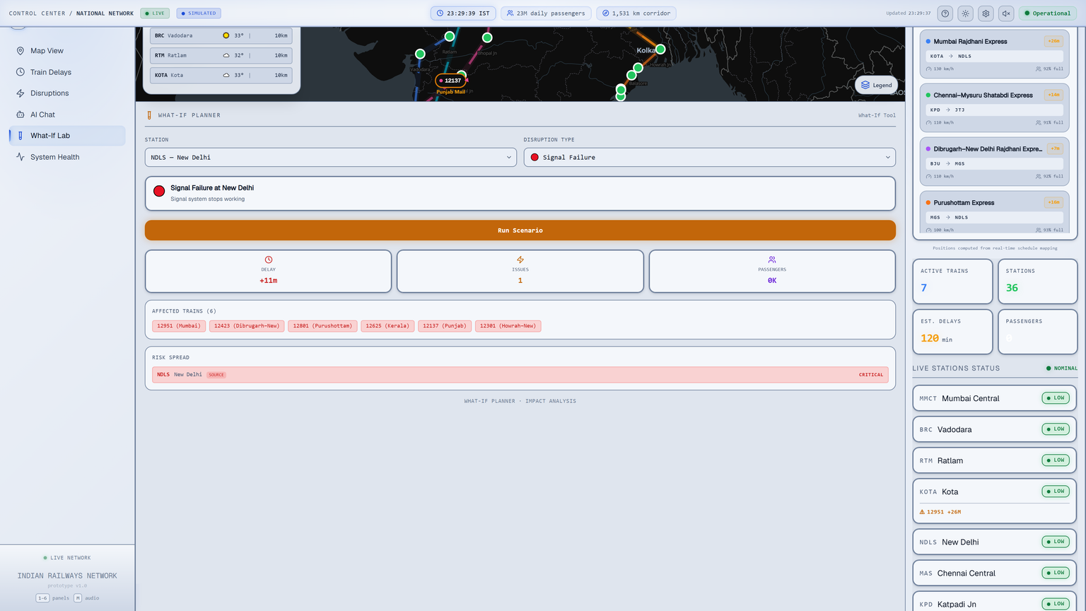
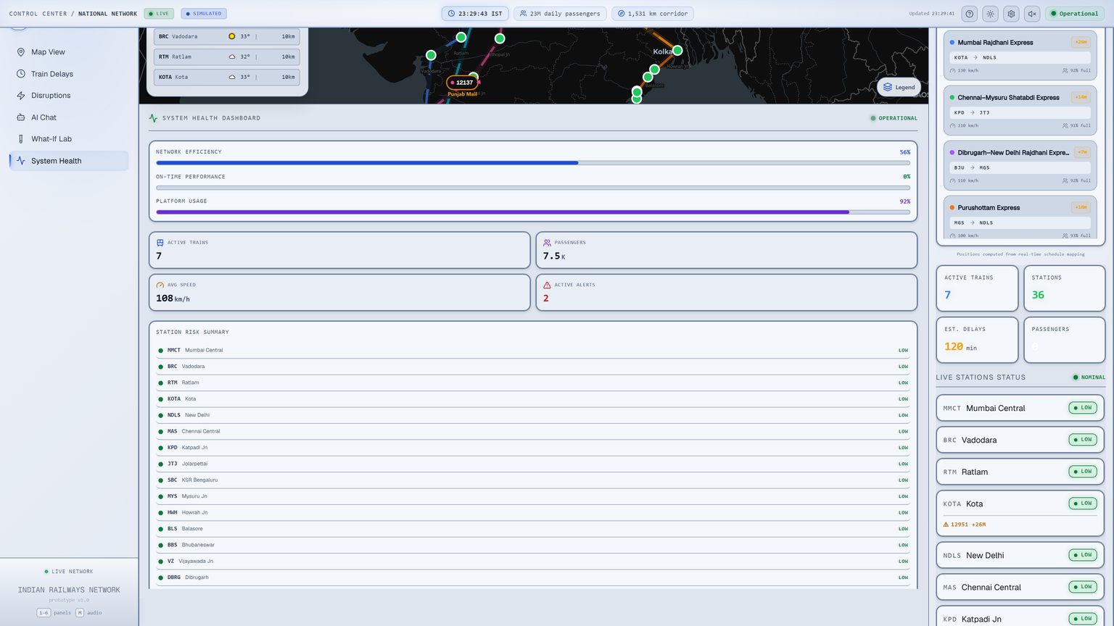
Demo: Simulation, What-If Lab & System Health
Disruption Simulator
Cascade delay, conflicts,
passengers affected
What-If Lab
Test rainfall, signal failure,
track damage scenarios
System Health
Efficiency, on-time perf,
platform utilization gauges
All simulation results are computed server-side and persisted to SQLite. What-If scenarios use historical delay data for realistic impact modeling.
RailTwin AI · FAR AWAY 2026
10 / 15
Notes:
10

Slide 11
Judging Criteria Mapping
Criterion
What We Built
Innovation & Technical Depth
Predictive digital twin combining live map (MapLibre), ML delay prediction (Ridge Regression R²=0.73), Gemini AI copilot, real-time SSE streaming, and cascade simulation — all integrated into a single dashboard
Engineering Quality
TypeScript throughout, Zustand state management, Astro SSR with Vercel deployment, SQLite persistence, retry/backoff/failover patterns in Gemini client, responsive design, keyboard shortcuts
Real-World Impact
Built on real Indian Railways data: 7 named trains, 36 actual stations with coordinates, 576 historical delay records. Live weather per station. Designed for control room operators
Scalability
Serverless on Vercel (auto-scale), SSE push not polling, concurrent-limited weather fetches (max 3), LRU cache on Gemini, SQLite with WAL mode. Architecture supports adding 100+ trains
Design & UX
Dark/light theme, MapLibre GL with animated train markers, real-time weather HUD, collapsible legend, keyboard shortcuts (1-6, M), toast notifications, responsive mobile layout
Execution Quality
18 API endpoints, 20+ React components, SSE live updates, ML model trained on 448 samples, cascade simulation with historical grounding, AI chat with fallback handling, deployed and live
Every claim is backed by code in the GitHub repo at github.com/himanshu003388/RailTwin
11 / 15
Notes:
11

Slide 12
Innovation & Technical Depth Highlights
ML-Powered Delay Prediction
Ridge Regression model trained on 448 historical delay records with 7 weather types, 12 months, 4 train types. R²=0.73, RMSE=8.7 min. Runs browser-side for zero-latency predictions.
Two-Tier AI Architecture
Gemini 2.0 Flash primary → auto-fallback to Gemini 2.5 Flash on quota/error. Exponential backoff on 429s, 5-min LRU cache, system prompt injected with live network state for context-aware replies.
Server-Sent Events (SSE) for Live Data
Real-time train position streaming every 5s via SSE endpoint. Randomized speed jitter for realistic animation. Auto-disconnect after 5 min. No polling, no WebSocket overhead.
What-If Cascade Simulation Engine
Models network-wide ripple effects of disruptions. Uses historical delay patterns to weight scenarios (rainfall=35min, fog=25min, signal failure=50min, track damage=80min baseline). Computes affected trains, passengers, conflicts.
Multi-Layer Weather with Intelligent Fallback
Four-tier: OpenWeather API → Open-Meteo free API → seasonal estimation (monsoon/coastal/winter/summer) → default clear. 15-min cache, concurrent-limited (3 at a time), per-station granularity.
RailTwin AI · FAR AWAY 2026
12 / 15
Notes:
12

Slide 13
Real-World Impact & Scalability
Real-World Impact
Data-grounded: All 7 trains are real Indian Railways services (12951 Mumbai Rajdhani, 12301 Howrah Rajdhani, 12007 Chennai Shatabdi, etc.) with accurate station codes, zones, and coordinates
Real station data: 36 actual junction stations across WR, CR, SR, ER, NFR, ECR, SWR, NR, NCR, SCR, WCR zones — covering North, South, East, West, and Northeast India
Weather-aware: Monsoon-sensitive regions (coastal Kerala, Northeast, Konkan) get weighted delay predictions. Fog-prone North Indian winters trigger higher risk scores
AI-ready for NTES/IRCTC: Settings panel accepts RapidAPI key for live train status. Current data uses schedule-derived positions that can be replaced with live IRCTC feeds
Scalability
Serverless architecture (Vercel) auto-scales with demand — 10 users or 10,000
SSE push-based updates scale better than polling; Weather fetches concurrency-limited to 3 simultaneous requests
Data-driven train/station definitions — adding 100 more trains requires only JSON entries, no code changes. ML model can be retrained on larger datasets
RailTwin AI · FAR AWAY 2026
13 / 15
Notes:
13

Slide 14
Future Scope
Live GPS Feed Integration
ML-Based Delay Prediction v2
Replace schedule-derived positions with live IRCTC/NTES GPS data via the existing RapidAPI integration. Real-time position updates every 30 seconds from actual train tracking systems.
Train a more sophisticated model (Gradient Boosting, LSTM) on the full Kaggle delay dataset (100K+ records). Factor in real-time weather, day of week, festival seasons, and maintenance schedules.
Hardware Sensor Tie-Ins
Multi-Corridor Expansion
IoT integration with Indian Railways' track monitoring sensors (temperature, vibration, axle counters). Real-time infrastructure health alerts alongside operational dashboards.
Extend from 7 trains/36 stations to the full IR network (13K+ trains, 7K+ stations). Regional control centre views with drill-down to station and train level.
RailTwin AI · FAR AWAY 2026
14 / 15
Notes:
14

Slide 15
RailTwin AI
Predictive Digital Twin for Indian Railways
Team
Harsh Singh(Leader)
Himanshu (Lead Developer)
Adbhut Patel(Developer)
Manaswi Mehta
Shrikant Chaurasiya
Built for FAR AWAY 2026 — Railways Theme
Links
GitHub: github.com/himanshu003388/RailTwin
Live Demo: rail-twin.vercel.app
Stack: Astro v6 · React 19 · MapLibre GL · Gemini AI · Tailwind v4 · Zustand · Recharts · SQLite · Vercel
Data: Kaggle Indian Railways Dataset · IRCTC/NTES · OpenWeatherMap · Open-Meteo · Google Gemini
FAR AWAY 2026 · Making Railways Safer, Smarter & More Efficient
Notes:
15

