Slide 1

FAR AWAY 2026 · RAILWAYS THEME · ROUND 2
RailTwin AI
Reconciliation: Drift Indicator
A predictive digital twin for Indian Railways that now knows when reality has drifted away from the recorded plan — and lets the operator pull it back.
STABLE 0–24
MINOR 25–49
SIGNIFICANT 50–69
CRITICAL 70–100
Live 4-factor drift score, computed every 5 seconds
Live rail-twin.vercel.app Judge replay rail-twin.vercel.app/?demo=replay&fast=1 GitHub github.com/himanshu003388/RailTwin

Slide 2
THE ROUND 2 BRIEF
The plan you recorded is not the railway you are running
OFFICIAL PROBLEM STATEMENT — RECONCILIATION: DRIFT INDICATOR
WHY IT MATTERS IN A CONTROL CENTRE
“Extend the MVP with a capability related to conflicting, duplicate, or partially matching information. Specifically, show when the current situation has drifted away from the originally recorded context.”
45 min
is all it takes for a static digital twin to become dangerously out of date during a monsoon disruption.
Over a 12-hour dispatcher shift, ground truth drifts silently away from the pinned timetable context:
conflicting weather feeds from different meteorological providers
duplicated transponder packets corrupting positions
garbled OCR / telegraphic station codes
and no indicator of how far live reality has diverged from plan.
Two weather providers disagree about the same station
CONFLICTING
The same NTES packet arrives twice with clashing coordinates
DUPLICATE
OCR reads “Kanpur Centrall” — which station is that?
PARTIAL MATCH
RailTwin AI · Round 2 — Reconciliation: Drift Indicator 2 / 16

Slide 3
WHERE ROUND 1 LEFT OFF
The MVP we are extending — not rebuilding
Live Corridor Map
ML Delay Prediction
Cascade Simulator
MapLibre GL · 7 real trains · 36 junctions · SSE ticks every 5 s
Ridge Regression, R² = 0.73 on 448 historical samples, browser-side
Monsoon / fog / signal-failure ripple across the network graph
Gemini AI Copilot
What-If Lab
Weather Intelligence
2.0 Flash → 2.5 Flash fallback, live network context injected
Scenario sandbox: pick station + disruption, see projected impact
OpenWeatherMap → Open-Meteo → seasonal fallback, per-station
THE GAP
Round 1 trusted every feed, assumed every packet was unique, silently defaulted unknown stations to New Delhi (NDLS) — and had no concept of a recorded baseline to drift away from.
RailTwin AI · Round 2 — Reconciliation: Drift Indicator 3 / 16

Slide 4
ROUND 2 SOLUTION
A closed loop: pin → reconcile → score → resolve → audit
1 · PIN BASELINE
2 · RECONCILE
3 · DRIFT ENGINE
Immutable shift snapshot: delays, timetable projections, weather across all 36 stations
→
Jaro-Winkler + route prior, dual-source weather arbitration, stream dedup
→
Explainable 4-factor 0–100 score per train + passenger-weighted corridor score
↓
5 · AUDIT
4 · RESOLVE
Resolution re-anchors the pinned baseline — drift collapses back to Stable
SQLite WAL log + 1-click shift handover briefing (.md / PDF)
←
Operator triage: Accept Live / Keep Baseline / Merge — re-anchors the twin
Substantial 24-hour extension, zero rebuild: 3 new pure TypeScript modules (drift-engine, reconciler, driftStore) + Drift Monitor panel + ghost map layer, wired into the existing Zustand/SSE spine.
RailTwin AI · Round 2 — Reconciliation: Drift Indicator 4 / 16

Slide 5
TASK IMPLEMENTATION
Conflicting · duplicate · partially matching — each solved head-on
CONFLICTING FEEDS
DUPLICATE PACKETS
PARTIAL MATCHES
Dual-source weather arbitration
Real-time stream deduplication
Two-Signal Station Matcher
OpenWeatherMap and Open-Meteo are polled per station. When they disagree (storm vs clear sky at Bhusaval), the conflict is flagged in the Triage Inbox — the operator arbitrates, and the chosen reading updates the whole network model.
Identical timestamp + train telemetry packets (duplicate NTES bursts, even with clashing coordinates) are detected and filtered before they can corrupt the live twin. Divergent duplicates are surfaced instead of silently overwritten.
Jaro-Winkler string similarity (p = 0.10, ℓ ≤ 4) combined with a +0.12 spatial route-plausibility prior resolves noisy OCR inputs. ≥ 0.90 auto-matches, 0.60–0.90 goes to triage, below 0.60 is rejected — no more silent NDLS fallback.
OWM: clear 0mm ↯ Open-Meteo: rain 42mm
→ TRIAGE: weather-conflict @ BSL
pkt#8842 12625 09:14:05 (10.02,76.31)
pkt#8842 12625 09:14:05 (10.94,75.99) ✕ dup
"Kanpur Centrall" → 0.87 + route boost
→ CNB · Kanpur Central ✓
RailTwin AI · Round 2 — Reconciliation: Drift Indicator 5 / 16

Slide 6
TASK COMPLEXITY
An explainable drift score — pure math, zero black box
Drift = 0.40·Schedule + 0.25·Position + 0.20·Prediction + 0.15·Weather ∈ [0, 100]
40%
Schedule
Adherence governs sectional slotting and junction line clearance
45 min → 100 pts
CORRIDOR DRIFT
|Delay_live − Delay_baseline|
Σ (Dᵢ · Pᵢ · Wᵢ)
─────────────
Σ (Pᵢ · Wᵢ)
25%
Position
Physical distance between GPS transponder and timetable position
120 km → 100 pts
Haversine(x_live, x_planned)
20%
Prediction
Do the ML model's environmental assumptions still hold?
class 60 + Δconf 40
Passenger-exposure weighted: Pᵢ = live capacity, Wᵢ = train priority (Rajdhani 1.3, Express 1.0). A drifting Rajdhani full of passengers moves the corridor needle more than an empty freight slot.
feature validity + Δconfidence
15%
Weather
Leading indicator of track adhesion and visibility degradation
class 60 + Δmm 40
condition shift + Δprecipitation
Recomputed every 5 s on the SSE telemetry tick · deterministic pure TypeScript · 15 dedicated unit tests
RailTwin AI · Round 2 — Reconciliation: Drift Indicator 6 / 16

Slide 7
FUNCTIONALITY & RELIABILITY
Four severity bands, each with a defined operational response
0 – 24
25 – 49
50 – 69
70 – 100
STABLE
MINOR
SIGNIFICANT
CRITICAL
Nominal
Advisory
Degraded
Severe
Normal operations. Standard 5-second telemetry polling continues.
Pre-warning state. Automated conflict triage is initiated in the inbox.
Sectional controller alerted. Ghost markers highlighted on the vector map.
Two-tone Web Audio alarm. Gemini mitigation auto-seeded. Resolution mandatory.
OPERATIONAL DESIGN CONSTANTS — CHOSEN FROM RAILWAY PRACTICE, NOT MAGIC NUMBERS
SCHEDULE_MAX 45 min — superfast slot ceiling POSITION_MAX 120 km — junction signalling block spacing SPATIAL_TOLERANCE 40 km — GPS/SSE jitter window
JW_AUTO_MATCH ≥ 0.90 · JW_REVIEW 0.60–0.90 · reject < 0.60 BASELINE_EXPIRY 12 h — controller shift cycle TICK 5000 ms
RailTwin AI · Round 2 — Reconciliation: Drift Indicator 7 / 16

Slide 8
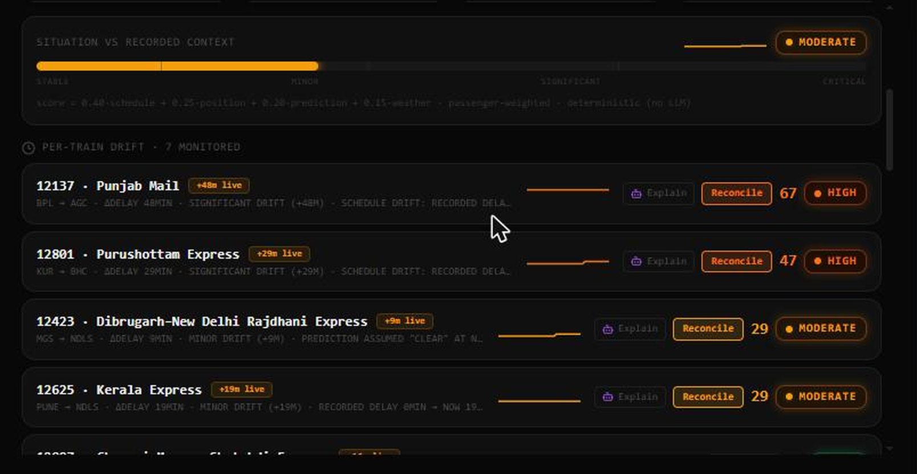
LIVE DEMO · KEY 7
The Drift Monitor — corridor score, per-train gauges, triage inbox
Corridor gauge
Passenger-weighted 0–100 score with live severity pill and sparkline history
Pin baseline
One click snapshots the shift's recorded context across all 36 stations
Per-train rows
4-factor breakdown per train — see exactly why a score is what it is
Triage inbox
Every conflict, duplicate and fuzzy match queued for operator arbitration
RailTwin AI · Round 2 — Reconciliation: Drift Indicator 8 / 16

Slide 9
SPATIAL DIGITAL TWIN · KEY 1
Ghost markers — the recorded plan haunts the live map
Ghost marker ◌
Dotted marker where the timetable says the train should be right now
NDLS
◌ GHOST · PLAN
AGC
Tether line
Dashed link from live train to plan position — length = visible drift
BSL storm cell
tether = +48 min of drift
PLAN VS LIVE — 12137 PUNJAB MAIL
BPL
12137 LIVE
delay 0 min → +48 min
position near AGC → near BPL
weather clear → torrential
Plan vs Live card
Click the ghost: side-by-side diff of delay, position and weather
Severity coloring
Computed, not guessed: ghost coordinates are interpolated along the real track geometry from the pinned timetable — verified by unit tests (“computes ghost marker spatial coordinates along track vectors”).
Marker and tether escalate green → amber → red with the drift band
RailTwin AI · Round 2 — Reconciliation: Drift Indicator 9 / 16

Slide 10
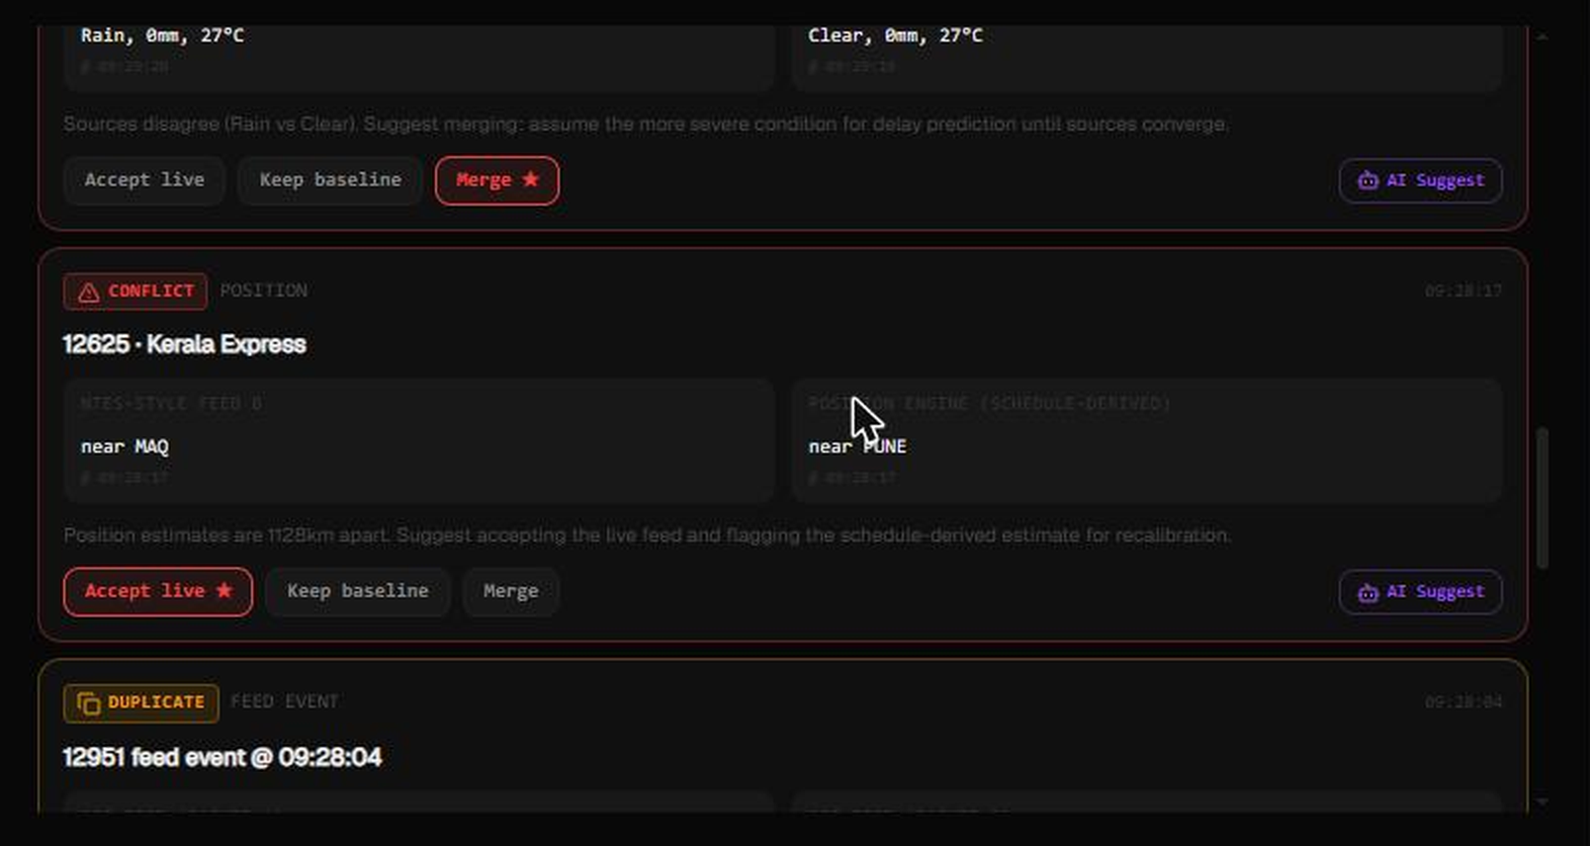
LIVE DEMO · TRIAGE INBOX
Every conflict queued for arbitration — and judges can add their own
TRY IT LIVE
Judges can paste any malformed telemetry string:
Kanpur Centrall,
1295l, +35m delay
…and watch it flow through parsing → Jaro-Winkler matching → route prior → Triage Inbox in real time.
No staged inputs.
No mocked pipeline.
Live parser + matcher, the same code paths as the SSE feed.
RailTwin AI · Round 2 — Reconciliation: Drift Indicator 10 / 16

Slide 11
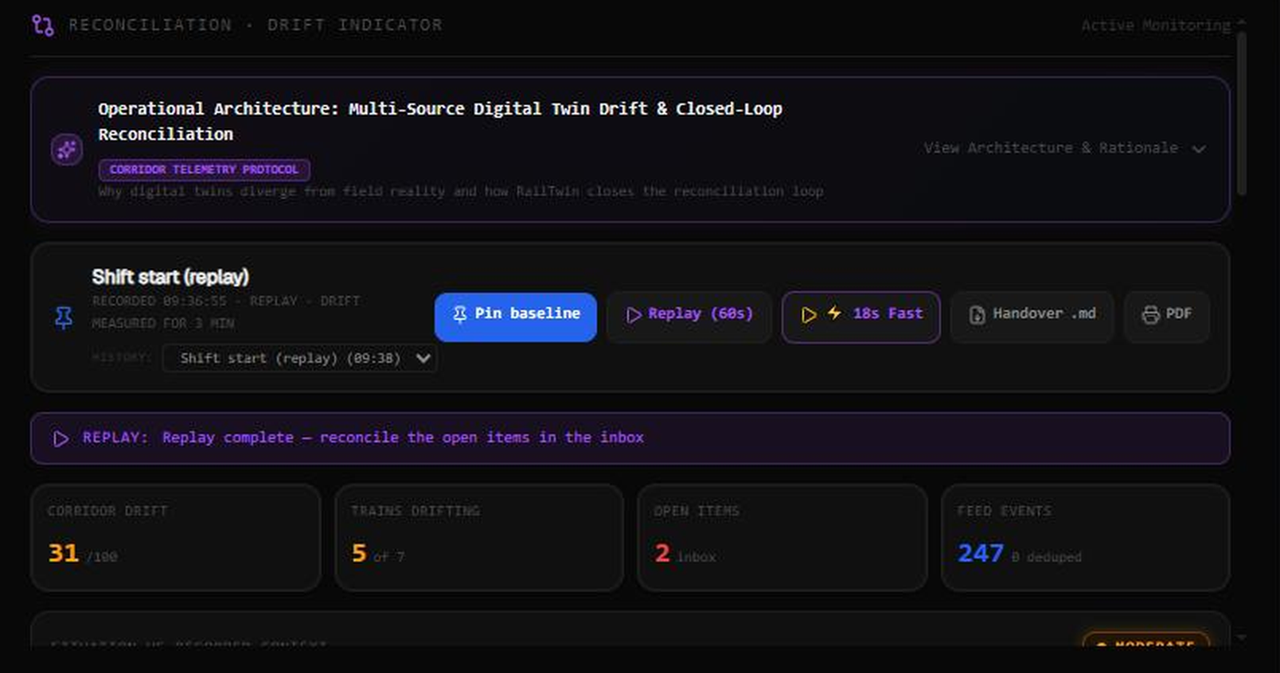
CLOSED-LOOP RESOLUTION
Not a passive dashboard — decisions mutate the twin
EVERY DECISION AUDITED
SQLite WAL audit trail of every operator action
1-click Shift Handover briefing — Markdown + print-ready PDF
Covers baseline diffs, peak drift, zone signal integrity, resolutions taken
Baseline snapshots persisted across server DB and browser storage
✓ ACCEPT LIVE
◉ KEEP BASELINE
⇄ MERGE
Re-anchor the plan to reality: baseline adopts live delay + coordinates. Drift collapses to Stable, tether vanishes, chime confirms.
Trust the recorded context: live feed flagged as suspect, drift stays visible until telemetry agrees.
Field-by-field arbitration for weather conflicts and partial matches — operator picks per-signal winners.
RailTwin AI · Round 2 — Reconciliation: Drift Indicator 11 / 16

Slide 12
INNOVATION & CREATIVITY
A deterministic 60-second replay, built for judging
Same disruption, every run. No waiting for luck to produce drift — the replay injects a scripted monsoon scenario through the real pipeline.
t = 0 s
t = 18 s
t = 44 s
t = 60 s
Baseline pinned
Punjab Mail +28 min
Duplicate NTES packet
Operator resolves
Corridor 0/100 · STABLE
Signal hold-ups inside the storm cell
Kerala Express clashing coords — flagged, twin intact
Accept Live → back to STABLE
t = 8 s
t = 30 s
t = 50 s
Weather conflict @ Bhusaval
Drift crosses 50
Punjab Mail +48 min
Open-Meteo: torrential rain · OWM: clear → triage
SIGNIFICANT — ghost markers highlighted
CRITICAL ≥ 70 — two-tone alarm sounds
FOR THE 3-MINUTE PITCH
WHY IT'S NOVEL
?demo=replay full 60-second cinematic run
?demo=replay&fast=1 ⚡ 18-second fast mode for tight judging slots
The replay is not a video — it feeds scripted telemetry through the identical reconciler and drift engine that live SSE data uses. Judges see the real system react, deterministically, in either 60 or 18 seconds.
RailTwin AI · Round 2 — Reconciliation: Drift Indicator 12 / 16

Slide 13
ROUND 1 → ROUND 2
Every weakness of the MVP, answered
ROUND 1 (MVP)
ROUND 2 (RECONCILIATION & DRIFT)
Unknown stations
Silent fallback to NDLS
Two-Signal Matcher: Jaro-Winkler + spatial route prior
Data feeds
Single trusted feed assumed
Dual-source weather arbitration + stream deduplication
Baseline
Static timetable
Immutable shift snapshots (SQLite WAL + browser storage)
Drift awareness
None — divergence invisible
Continuous 4-factor 0–100 engine, passenger-weighted
Map
Live markers only
Ghost plan markers ◌ + tether lines + Plan-vs-Live diff
Operator role
Passive read-only viewing
Closed-loop Accept Live / Keep Baseline / Merge
Alerting
Visual banners only
Web Audio two-tone critical alarm + resolution chime
Audit
Ephemeral browser state
SQLite WAL trail + 1-click handover .md / PDF
Demo
No standard demo
Deterministic 60 s replay + ⚡ 18 s fast mode
Verification
Manual browser checks
48 / 48 Vitest unit + store integration tests
RailTwin AI · Round 2 — Reconciliation: Drift Indicator 13 / 16

Slide 14
TECHNICAL EXECUTION & ARCHITECTURE
Deterministic pure core, probabilistic edges, tested throughout
CLIENT — Astro SSR · React 19 · Tailwind v4
PROOF, NOT PROMISES
MapLibre ghosts ◌ · Recharts panels · Copilot & triage chips
48 / 48
↓
STATE — Zustand v5
demoStore + driftStore · SSE telemetry ticks every 5 s
Vitest unit & store integration tests passing
↓
15 drift-engine tests — weights, ceilings, severity transitions, ghost coordinates, corrupted packets
27 reconciler tests — OCR typo matching, route priors, dedup, weather divergence, merge rules
6 store tests — baseline pinning, SSE score updates, closed-loop re-anchoring, replay, exports
O(T×C) scoring: < 15 ms CPU for all 13,000 IR trains — partitioned by trainId/zone for Kafka/Flink scale-out
PURE LOGIC — deterministic TypeScript
drift-engine · reconciler (Jaro-Winkler, dedup, arbitration) · ML ridge regression
↓
API & PERSISTENCE — 18 Astro endpoints
SQLite WAL · /api/baseline · /api/reconciliation · SSE stream
↓
EXTERNAL — graceful fallback everywhere
OpenWeatherMap → Open-Meteo → seasonal · Gemini 2.0 → 2.5 Flash · NTES-ready
RailTwin AI · Round 2 — Reconciliation: Drift Indicator 14 / 16

Slide 15
JUDGING PARAMETERS
Scorecard mapping — where to look for each criterion
Task implementation
Task complexity
Conflicting, duplicate & partial data all handled end-to-end; drift vs recorded context is the product's core loop
Jaro-Winkler + spatial priors, 4-factor weighted scoring, haversine geometry, browser ML, graph cascade — all deterministic TypeScript
Technical execution
Innovation & creativity
48/48 tests · zero silent fallbacks · graceful API degradation · SQLite WAL persistence · typed end-to-end
Ghost-marker spatial diffing, live ingestion playground for judges, deterministic replay, audio telemetry alarms
Functionality & reliability
Documentation & presentation
Severity bands with defined OCC responses; replay proves the full loop works the same way every run
README with math formulation + DEMO.md 3-min script + DESIGN.md system tokens + this deck
Software extras — architecture, code quality, UX, scalability: layered pure-core design · typed modules with unit coverage · keyboard-first OCC UX (keys 1–7, M) · serverless + partition-ready reconciler.
RailTwin AI · Round 2 — Reconciliation: Drift Indicator 15 / 16

Slide 16
RailTwin AI
The digital twin that knows when it's wrong — and how to fix it.
TEAM
SEE IT LIVE
Harsh Singh — Leader
Himanshu — Lead Developer
Adbhut Patel — Developer
Manaswi Mehta
Shrikant Chaurasiya
rail-twin.vercel.app
rail-twin.vercel.app/?demo=replay&fast=1 ⚡ 18 s judge mode
github.com/himanshu003388/RailTwin
Astro · React 19 · MapLibre GL · Zustand · Gemini · Recharts · SQLite · Vercel · Vitest
FAR AWAY 2026 · Railways Theme · Round 2 — Reconciliation: Drift Indicator
Built on real IR data: 7 named trains · 36 junction stations · 11 zones · 576 historical delay records

