Slide 1
ANDROID
A P P
P R E S E N T A T I O N
BY: GROUP 10
HIMANSHU MADAN

Slide 2
INTRODUCTION
Cricket Chirp Thermometer
Curious about the temperature outside but don't have a thermometer or weather app on hand? You can roughly calculate the temperature outside using cricket chirps.
Count the chirps to get the temp. of the surroundings rather than consulting the thermometer.

Slide 3
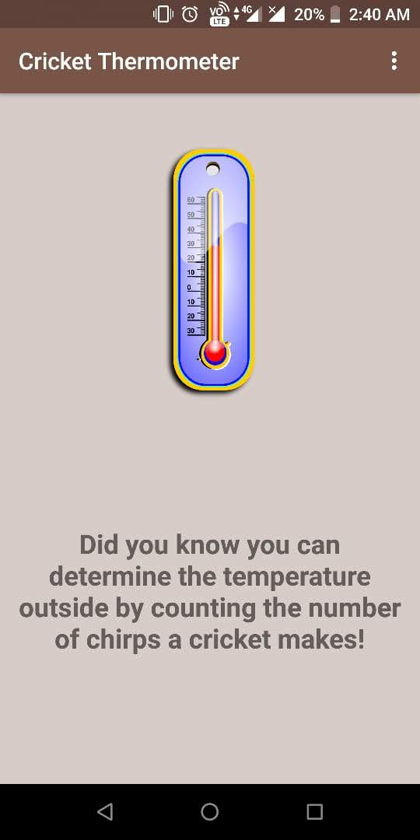
APP’S HOME SCREEN:
-THIS IS THE FIRST SCREEN THAT APPEARS WHEN THE APP OPENS.
-IT GIVES THE USER A BRIEF DISCRIPTION ABOUT WHAT THE APP DOES.

Slide 4
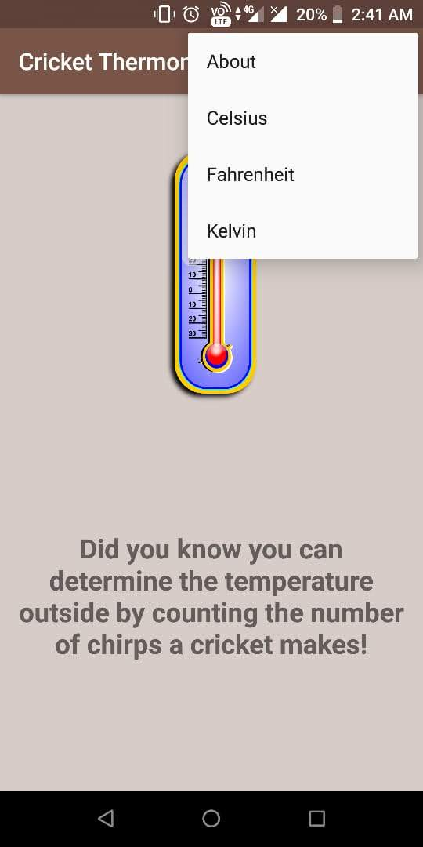
THREE DOT MENU:
-This menu appears when the user clicks on the three-dot provided at the Right-Top of screen.
-It has 4 buttons that takes the user to different screens where they can learn about the app or get the temperature in Celsius, Fahrenheit or Kelvin scale

Slide 5
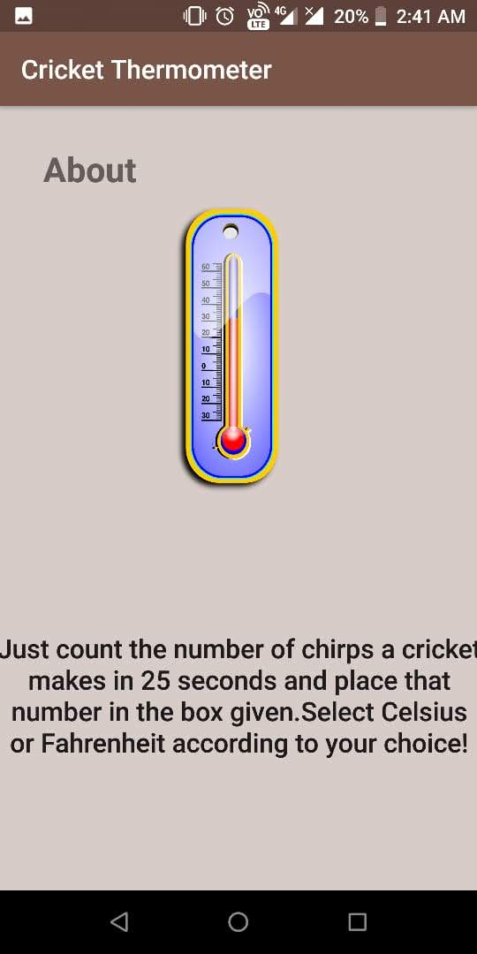
ABOUT SCREEN:
-This screen opens if user clicks on the "about" button.
-It instructs user on how to use the app.

Slide 6
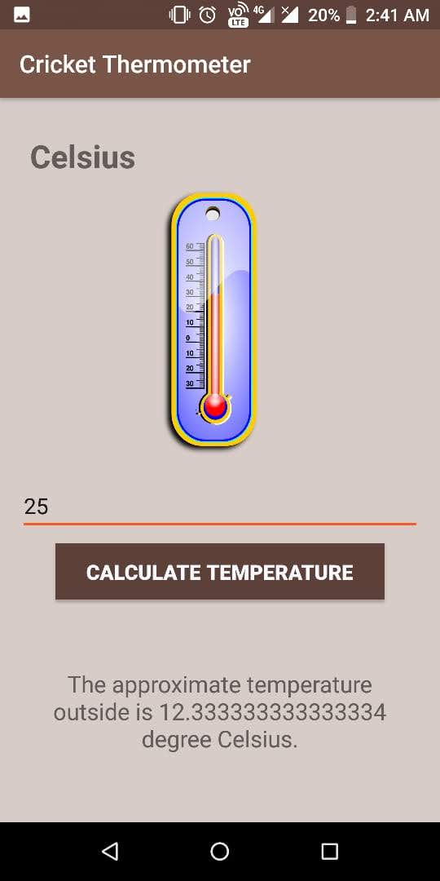
CELSIUS SCREEN:
-This screen opens if user clicks on the “CELSIUS" button.
- It gives user the converted temperature of surrounding in Celsius scale.
Enter the chirps count and click on calculate temperature button.

Slide 7
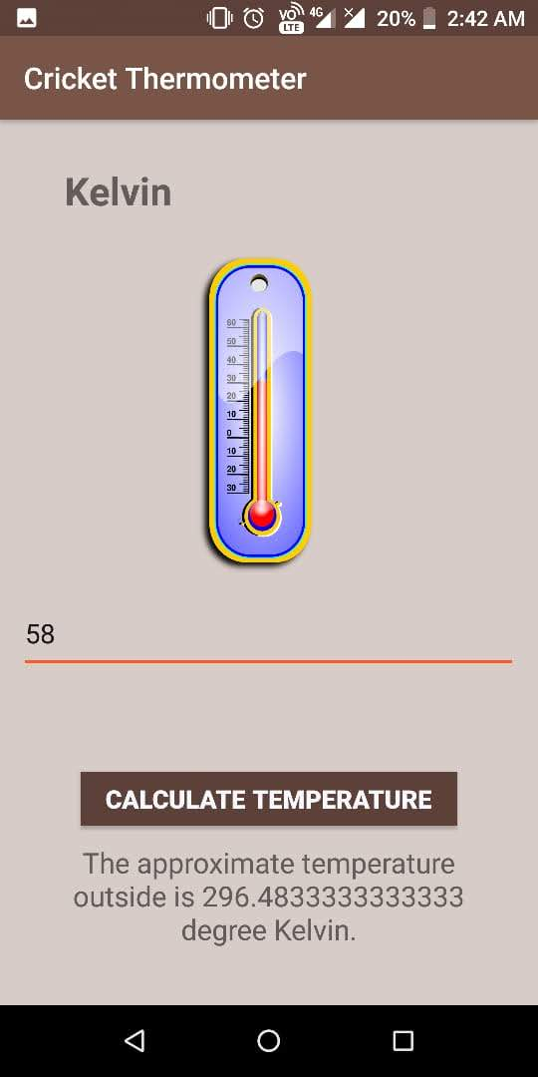
KELVIN SCREEN:
-This screen opens if user clicks on the “KELVIN" button.
- It gives user the converted temperature of surrounding in kelvin scale.
Enter the chirps count and click on calculate temperature button.

Slide 8
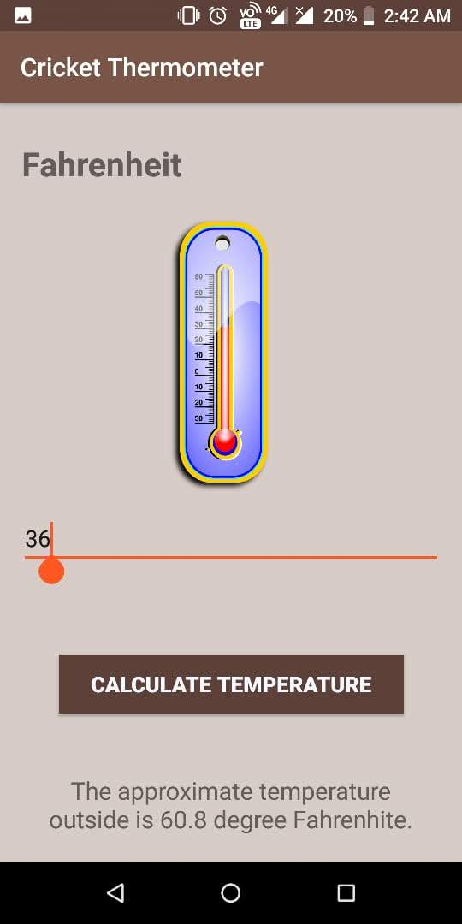
FAHRENHEIT SCREEN:
-This screen opens if user clicks on the “FAHRENHEIT" button.
- It gives user the converted temperature of surrounding in Fahrenheit scale.
Enter the chirps count and click on calculate temperature button

Slide 9
THANKYOU
THE END!

