Slide 1
WELCOME
ABOUT US
PROJECT
SOLUTION
THANK YOU
PROJECT
PROJECT
PROJECT
SOLUTION

Slide 2
WELCOME
ABOUT US
WELCOME
PROJECT
SOLUTION
THANK YOU
PROJECT
PROJECT
PROJECT
SOLUTION
- by CODINGBOND007

Slide 3



CODINGBOND007 TEAM
WELCOME
PROJECT
SOLUTION
ABOUT US
THANK YOU
PROJECT
PROJECT
PROJECT
SOLUTION
HIMANSHU
2nd year B.E ECE
VASANTH KUMAR G
1st year B Tech IT
PIYUSH
2nd year B.E CSC

Slide 4
WHATS THE PROBLEM?
Hi, I am Mayank. I am studying 10th standard in Government School. I used to have
virtual classes via some platforms. While taking class, my teacher tells us to surf in the browser at the same time. So it was difficult for me to keep on changing the tab and at the same time to see what my teacher is teaching. I faced this problem for a long time. Then I decided to approach CODEBONDING007 to solve my problem.
WELCOME
PROJECT
ABOUT US
THANK YOU
PROJECT
PROJECT
PROBLEM
PROJECT
SOLUTION

Slide 5

So, what would CODINGBOND007 do??
WELCOME
PROJECT
ABOUT US
THANK YOU
PROJECT
PROJECT
SOLUTION
PROJECT
SOLUTION

Slide 6
CHROME EXTENSION
WELCOME
PROJECT
Google Chrome extensions are programs that can be installed into Chrome in order to change the browser's functionality. This includes adding new features to Chrome or modifying the existing behaviour of the program itself to make it more convenient for the user.
PROJECT
ABOUT US
THANK YOU
PROJECT
SOLUTION
PROJECT
SOLUTION

Slide 7
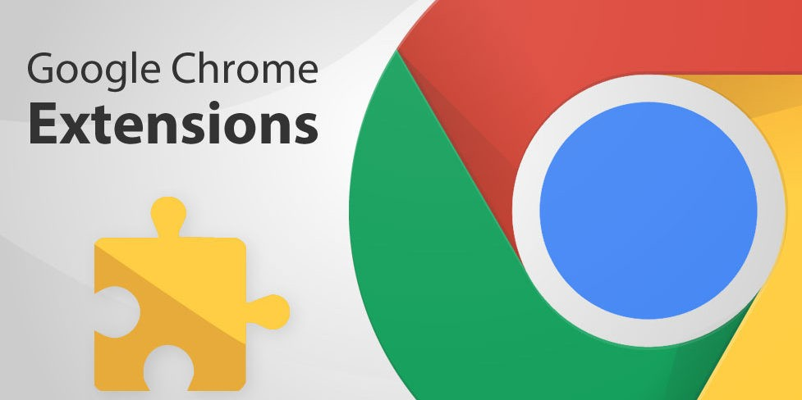
MINI-SCREEN
WHAT DOES THIS MINI-SCREEN DO??
Its generally a chrome extension.
With this chrome extension we can
override the existing tab with a small window. It just looks like a pop-up window. It has many features. Lets see the features of the MINI-SCREEN in the upcoming
slide…
WELCOME
ABOUT US
THANK YOU
PROJECT
PROJECT
SOLUTION
PROJECT
PROJECT
SOLUTION

Slide 8
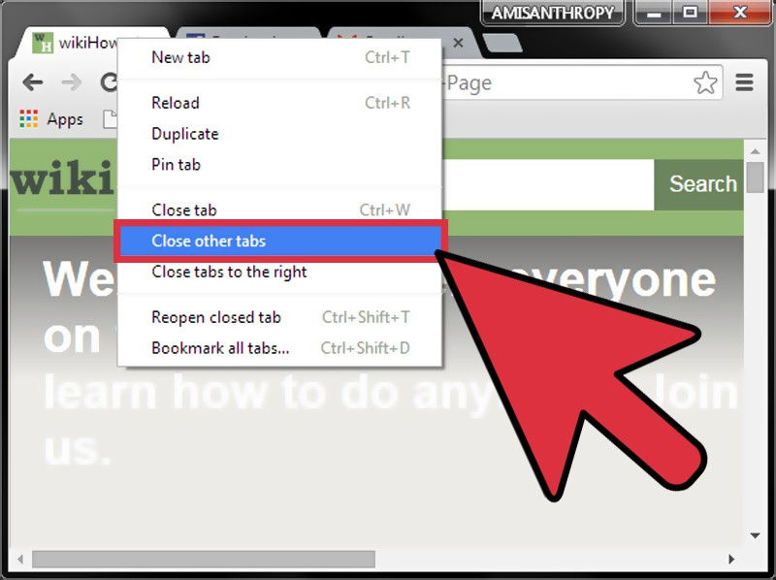
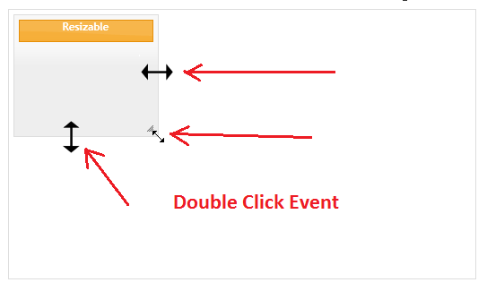
FEATURES :
By using the “MINI-SCREEN” extension, the user is free from switching tabs from one to other.
WELCOME
ABOUT US
THANK YOU
PROJECT
SOLUTION
PROJECT
PROJECT
PROJECT
SOLUTION
It can be resizable according to the user needs up-to half the size of the window.

Slide 9
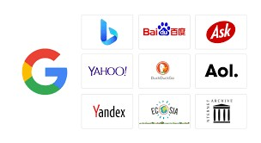
It doesn’t depend on a single search engine. Search engine can be changed according to the user’s interest.
WELCOME
ABOUT US
THANK YOU
PROJECT
SOLUTION
PROJECT
PROJECT
SOLUTION
PROJECT
Hope this helps you Mayank!

Slide 10
WELCOME
ABOUT US
PROJECT
SOLUTION
PROJECT
THANK YOU!
SOLUTION
THANK YOU
PROJECT
PROJECT

