Slide 1
Development Project “Rise of Civilizations”
Andriy Serafyn
Adil Qaisar
Akhil Kateja
Himanshu Anand

Slide 2
Product Overview The problem it addresses
The Rise of Civilization, is a turn based strategy game, wherein the player has an option to play either against an AI or against other players on your local area network.
The game requires players to build a base where they build their buildings and units and eventually defeat all of the other players that are not in their team.
The situation that triggered the development effort of the project is that in today’s world, where we are surrounded by technology, students have lost the ability to think abstractly or logically.
This, in-turn, is impacting their ability of problem solving and abstract thinking.
Contd..

Slide 3
Product Overview The problem it addresses
Currently there are many desktop based and web based historical games based on similar themes of building civilizations but they are not modeled around real historical facts. This game also introduces a “Student Mode” which allows students to re-create real history through many different eras. This game also allows players to play in groups within empires.

Slide 4
Why our product is needed?
Rise of Civilizations will provide the students with a platform to apply strategies in guiding troops, conquering territories, performing trade and managing resources, which will, in process, enhance their cognitive power.
It will provide an opportunity to people to apply strategies and conceptualize things.
It will involve substantial and well defined planning, together with right actions which will lead to the strategy’s success.
Contd..

Slide 5
Why our product is needed?
The Rise of Civilizations will have game scenarios modeled around real historical facts which includes land, army units, virtual currency and goods associated with that civilization and time period.
The game will serve as a great platform for the user to learn about different civilizations and time periods and have fun at the same time.
It will keep the people engaged and engrossed and free from boredom.

Slide 6
Who is our audience?
People in the age group 10+ who like playing strategy games.
A key tenet of the game is that it can potentially motivate students to learning by making learning fun.
This will be an effective tool in preparing people to better plan their future and to take critical decisions.
The students will be able to appreciate the geography in historical development, the impact of trade and economics, resource availability and expenditure.

Slide 7
Scenarios: Game Start
A new user is given the option to select the time period and civilization in which he would like to begin his gameplay.
In addition, player has an option to add his real-world colleagues as “game-advisors”, so they could play against a common enemy and help him(the player) to rule the civilization.
For a returning user, the game retrieves the user’s current holdings in the game and displays the virtual money, goods, land and army units that were owned by him at the end of his last game play.
On selecting the time period and civilization, the game will load with the look and feel specific to that time period and civilization and the user is assigned with some virtual money, land, goods and army units specific to that time period.

Slide 8
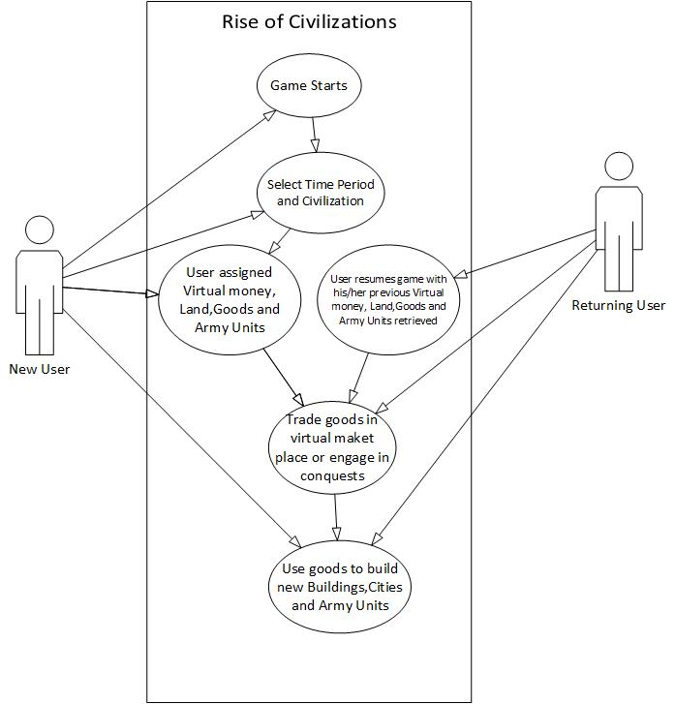

Slide 9
Scenarios: Players Engage in Trade
After beginning the game, players may wish to engage in trade via the virtual market place
This gives the players an opportunity to strategically involve in trade with their opponents who help them build new buildings, cities, army units, expand their current holdings and hence improve their current standing in the game.

Slide 10
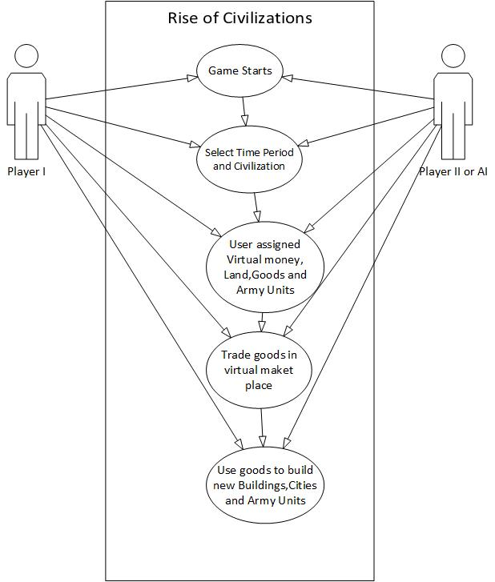

Slide 11
Scenarios: Players Engage in Conquests
After beginning the game, players may wish to increase their current holdings by the means of attacking each other and acquire the other person’s holdings
Attacking the other player will be strategic decision and will involve a thorough analysis of not only the player’s own worth in terms of army units and manpower but also a prediction of the opponents power in terms of the same .
The game will give the players, an opportunity to use their knack in terms of how many and which army units to deploy at appropriate fronts.
During a conquest, a user may wish to use his current holding and engage in trade with other players in order to enhance his position in terms of army units and manpower. The winner of the conquest acquires the holdings of the opponent, thereby, increasing his/her worth in the game.

Slide 12
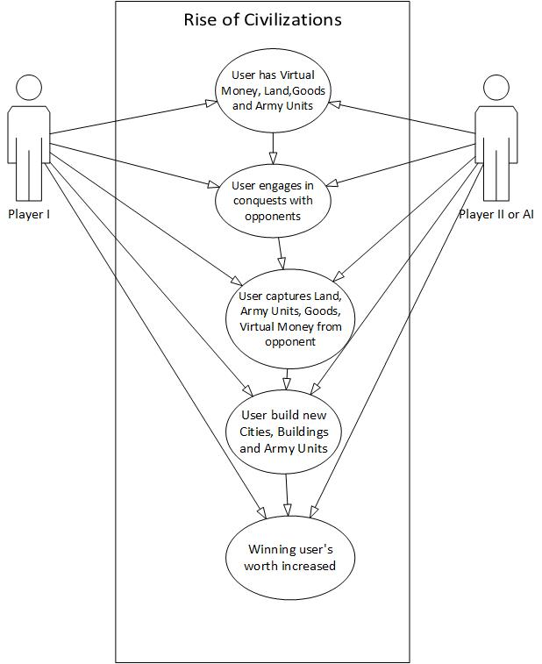

Slide 13
Scenarios: Multiple Players Create Pacts
During the gameplay, the players may decide to make pact and use their collective holding from here on to build new cites, buildings, army units or involve in trade collectively with other players.
They may also strategically plan to attack other players and engage in conquests with them. From there on, the players may continue to play the game collectively, collaborating in each of their strategic decisions and putting their collective worth to improve their standing the game

Slide 14
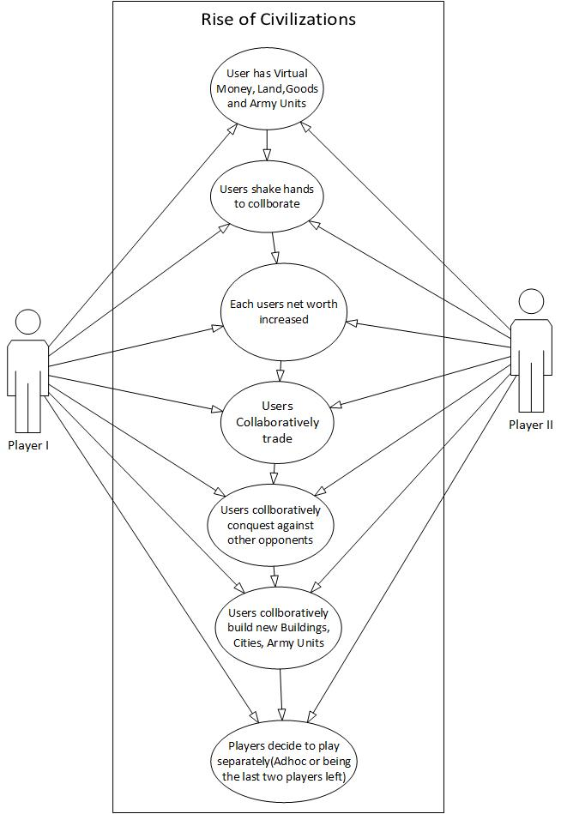

Slide 15
Scenarios: End Game
Rob and John can continue playing the game till there are no more opponents or no more lands, goods, army units left to trade or conquer.

Slide 16
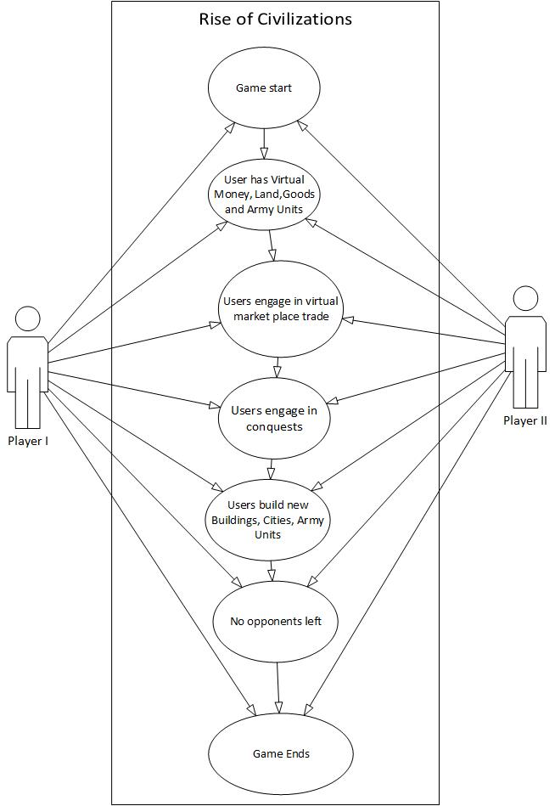

Slide 17
Features: Time Limit and Day
Time limit:The game is a turn based game. We added a 5 minute time limit onto the game turns. After this amount of time the turn is said to be ended. Meaning that the player is unavailable to make any moves and it switches to the next player. When it returns to this player again they receive more money and are able to move all units again.
Day:This is to add some competitive spirit into single player games. The number increments after 1 full day has taken player. A day has taken place when all players have clicked the end turn button once.

Slide 18
Features: Player Money, Current Player and Team Color
Player Money:Player money is how much you have to build new units and buildings. You gain more money from a) killing an opponent's unit b) killing an opponent’s unit c) when it’s next your turn.
Current Player:This just lists who’s currently playing the game. This is also shown in the team colour. When on a network game or with UI players this will switch to show it’s currently their move.
Team Colour:This is a quick reference so you remember who your team colour is. You can only move or edit your own team units and buildings.

Slide 19
Artificial Intelligence
There are three main objectives that that AI attempts to do when it is its turn to play these are to maintain buildings, recruit units and attack enemies.
This is the order in which the AI prioritizes its actions, maintaining buildings is top priority because buildings are required to train units and thus maintain an army. Secondary priority goes to unit recruitment so that the AI is always spending money on troops and finally attacking is done last.

