Slide 1

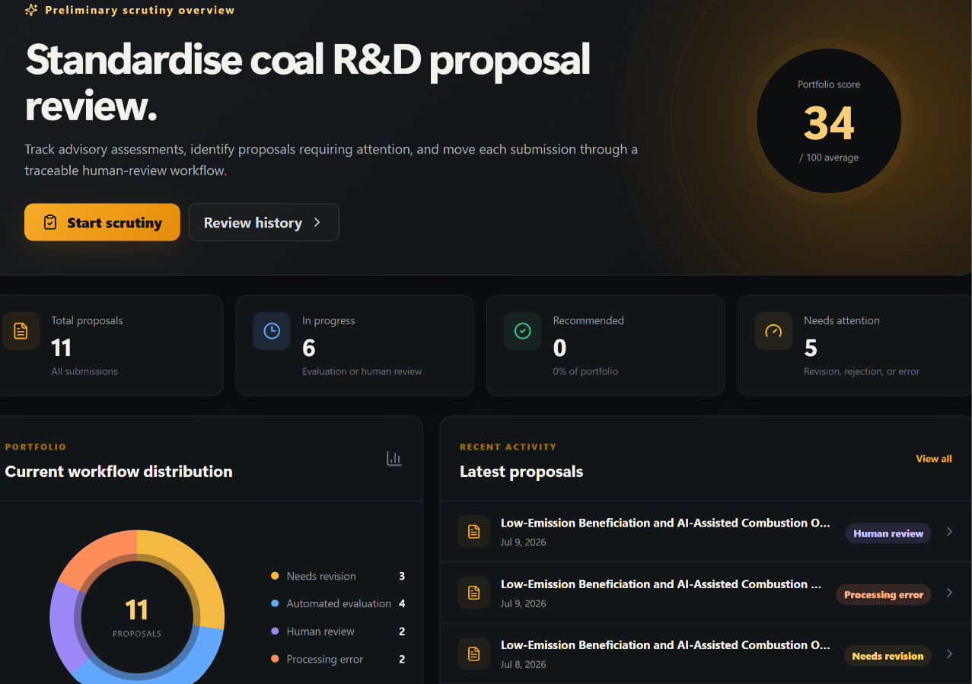
MULYANKAN
EVIDENCE-GATED AI PROPOSAL SCRUTINY
Preliminary Science & Technology proposal review support
WHAT IT DOES
Turns proposal documents into traceable evidence, rule findings and advisory reviewer reports.
Domain: Education & AI
Team: Algonauts
Presented by: Himanshu Shukla
Ajeet, Abishek & Dhruv
Mulyankan 0.8.0 | Hack Matrix | 01

Slide 2

THE PROBLEM
Preliminary scrutiny is evidence-heavy, document-heavy and hard to standardise.
Core issue
Experts should judge proposals not spend time hunting for scattered facts.
1
2
3
4
Multiple documents
Manual extraction
Reviewer variation
Weak audit trail
Proposal, budget, CVs, declarations and annexures use different formats.
Duration, budget, eligibility, methodology and outcomes must be searched repeatedly.
Different reviewers may focus on different evidence passages.
Missing facts, rule warnings and score rationale are difficult to reconstruct.
Desired institutional capability
Controlled intake → evidence-linked extraction → explicit rule states → reviewer-verifiable advisory report
Mulyankan 0.8.0 | Hack Matrix | 02

Slide 3
WHY THIS PROBLEM EXISTS
The current approach turns proposal review into repeated evidence collection instead of focused judgement.
CAUSE 1
Unstructured proposal packages
CAUSE 2
FRICTION
DELAY / COST
LOW REVIEWER CONFIDENCE
POOR AUDITABILITY
Manual fact extraction
CAUSE 3
No standard evidence contract
CORE PROBLEM
Important proposal facts are not captured, checked and cited in one controlled workflow.
Current method → friction → delay / risk → inconsistent preliminary outcome
Mulyankan 0.8.0 | Hack Matrix | 03

Slide 4
OUR SOLUTION
Introducing Mulyankan: an evidence-gated, human-in-the-loop scrutiny platform.
Mulyankan enables reviewers to verify evidence quickly by converting proposal packages into structured fields, rule findings, cited evidence and advisory reports.
USER
INTAKE
EXTRACT
RULES
EVIDENCE
REPORT
REVIEW
Submits proposal package
Manifest + package hash
Canonical fields + source refs
Pass / fail / warning / insufficient
Approved docs + sections only
Advisory result or withheld score
Human authority decides
01
Controlled package
02
Evidence contracts
03
Score release gate
File roles, hashes and confirmed submission prevent silent document drift.
Each criterion uses only permitted documents and sections.
Weak evidence leads to withheld/unsupported status, not manufactured confidence.
Design principle: organise evidence first; score only when evidence coverage allows.
Mulyankan 0.8.0 | Hack Matrix | 04

Slide 5
PROTOTYPE / PRODUCT EXPERIENCE
A clear reviewer journey from proposal upload to traceable advisory output.
01 — CREATE
Applicant creates a proposal version and selects the scheme.
Large prototype principle
02 — UPLOAD
Files are uploaded into mandatory / optional document slots.
Show real workflow states and report logic; avoid fake screenshots until UI captures are available.
03 — VERIFY
System checks file type, size, ownership and SHA-256 hash.
04 — PROCESS
Extractor identifies sections, tables and canonical fields.
05 — REVIEW
Reviewer receives rule states, evidence citations and advisory findings.
Input → Verified package → Processing → Evidence report → Human review
Mulyankan 0.8.0 | Hack Matrix | 05

Slide 6
WHAT MAKES US DIFFERENT?
Mulyankan is differentiated by governed evidence use and transparent abstention — not by saying “AI-powered”.
DIMENSION
CURRENT / BASIC APPROACH
MULYANKAN
Evidence source control
Reviewer manually searches across files
Criterion-level approved docs + sections
Rule handling
Eligibility issues can be buried in prose
Explicit pass / fail / warning / insufficient states
Weak evidence
Unclear whether missing evidence affected result
Score withheld or marked unsupported with reason
Traceability
Difficult to reconstruct why a warning appeared
Package hash, file ID, page ref, rule-set and model version
Human authority
Recommendation may look like a final decision
Advisory output separated from competent authority
Most important line: Mulyankan does not ask only “What does the model think?” — it asks “What evidence was it allowed to use?”
Mulyankan 0.8.0 | Hack Matrix | 06

Slide 7
TECHNICAL ARCHITECTURE
A professional, auditable stack connecting UI, orchestration, evidence storage and advisory intelligence.
FRONTEND
React interface for submission, tracking, reports and reviewer dashboards
BACKEND
FastAPI for authentication, submission checks and evaluation orchestration
PROCESSING
Redis + ARQ worker for background extraction and evaluation jobs
DATA / STORAGE
PostgreSQL for structured records; MinIO for private proposal documents
AI / ML
Model registry + artifact hash checks before advisory scoring
Applicant
React UI
FastAPI
Worker
DB + MinIO
Report
submits
captures
orchestrates
extracts
stores
explains
Trust layer: file hashes, package hash, audit events, rule versions, evidence-contract versions and model identity.
Mulyankan 0.8.0 | Hack Matrix | 07

Slide 8
FEASIBILITY + IMPACT
Built with available technologies and designed to improve reviewer speed, consistency and auditability.
FEASIBILITY
IMPACT
• React / FastAPI / PostgreSQL / MinIO / Redis stack is implementable and scalable.
• Existing document parsing handles digital PDF, DOCX and text files; OCR can be added where approved.
• Deterministic rule states are easier to audit than free-form model judgement.
• Model registry and artifact hash checks support version control before scoring.
• Faster preliminary scrutiny through standardised extraction.
• Better consistency because criteria cite allowed evidence sources.
• Improved audit trail for missing information, rule warnings and advisory rationale.
• Reduced false confidence by withholding scores when evidence is insufficient.
Prototype
Reviewer MVP
Reviewer Pilot
Scale to Schemes
Mulyankan 0.8.0 | Hack Matrix | 08

Slide 9
IMPLEMENTATION ROADMAP
Clear separation between what is demonstrable now and what should be hardened before real deployment.
NOW
NEXT
LATER
SCALE
Hackathon Prototype
Reviewer MVP
Reviewer Pilot
Institutional Rollout
• Controlled package upload
• Extraction + rule flow
• Evidence-linked report
• Functional reviewer demo
• Real UI screenshots
• Scheme configuration
• Reviewer feedback loop
• Reliability improvements
• Historical/demo proposal cases
• Domain-expert review
• Policy-owner feedback
• Security + data handling
• More schemes
• More document roles
• Analytics dashboard
• Deployment + integrations
Critical point: show built workflow honestly; label future hardening clearly.
Mulyankan 0.8.0 | Hack Matrix | 09

Slide 10
TEAM + EXECUTION
Why this team can execute the solution and what support is needed next.
WHY WE CAN BUILD THIS
NEXT STEP REQUEST
The team combines software engineering, AI/ML thinking and workflow design to convert complex proposal packages into auditable reviewer support.
Review the prototype workflow, provide scheme-rule feedback, and help define a controlled reviewer-facing MVP.
AI-assisted extraction
Governed rules
Evidence-first reports
Human authority
Canonical fields + uncertainty
Pass / fail / warning / insufficient
Cited rationale for reviewers
Decision remains institutional
Outcome sought: a clear, professional path from working prototype to safe institutional decision-support readiness.
THANK YOU
Mulyankan 0.8.0 | Evidence-gated AI proposal scrutiny
Mulyankan 0.8.0 | Hack Matrix | 10

