Slide 1

Spectral–Spatial Feature Selection for Hyperspectral Land-Cover Classification
PATTERN RECOGNITION · MONSOON 2026
97.1%
Using an Enhanced SVM — FRSS-SVM evaluated on WHU-Hi-LongKou
Himanshu Sinha · S20240020290
Ghule Yash Mahesh · S20240020288
mean held-out accuracy
across 5 seeds
3 November 2026 · WHU-Hi-LongKou dataset · 550×400 px, 270 bands

Slide 2

Problem & Objective
A hyperspectral pixel packs hundreds of narrow, closely spaced spectral bands — rich signal, but heavily redundant and costly to process in full. Spatial context can resolve local ambiguity, at the risk of smoothing class boundaries.
9
agricultural land-cover classes (plus background)
Research questions
270
Does redundancy-aware band selection preserve accuracy with far fewer inputs?
Do local spatial statistics (mean / std) improve recognition beyond spectral-only features?
How do selected bands compare with PCA and noise-adjusted (MNF) reduction, under a shared budget?
What trade-offs arise between SVM and Random Forest in accuracy, feature count and runtime?
narrow spectral bands per pixel
CPU-only
classical pattern recognition — no GPU, no deep learning for the main result

Slide 3
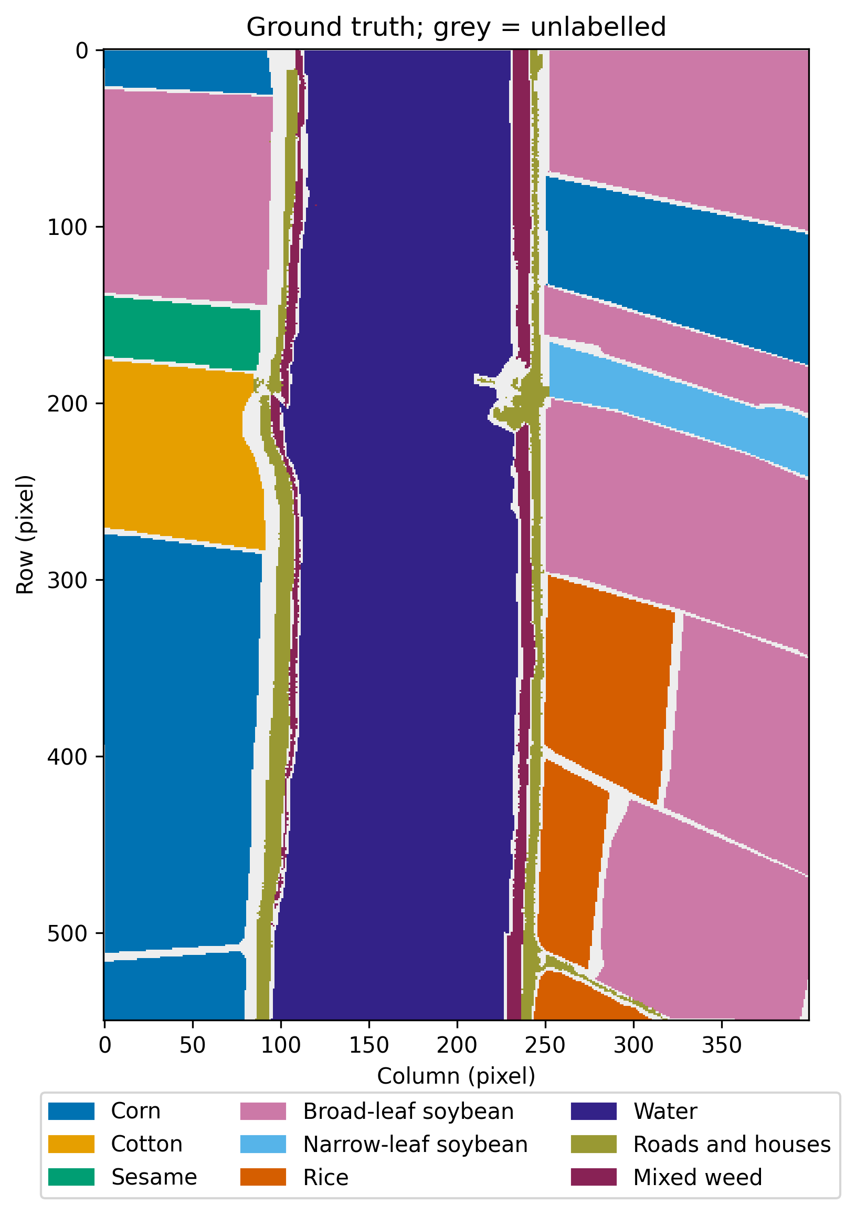
Dataset: WHU-Hi-LongKou
550×400
270
Source: official WHU-Hi resource page (Hu et al., 2021); label 0 is background and is excluded from fitting and scoring.
scene pixels
spectral bands
204,542
15,458
labelled pixels
background (excluded)
Class | Pixels
Corn | 34,511
Cotton | 8,374
Sesame | 3,031
Broad-leaf soybean | 63,212
Narrow-leaf soybean | 4,151
Rice | 11,854
Water | 67,056
Roads and houses | 7,124
Mixed weed | 5,229
Ground truth, nine classes

Slide 4

Evaluation Protocol
1
Stratified split
Five fixed seeds (7, 19, 42, 73, 101); 70% pool / 15% validation / 15% test per seed.
Zero statistical leakage
Every fitted mean, Fisher score, correlation and covariance uses the capped training set only — the test set is touched once.
2
Shared training cap
At most 1,000 pixels per class pooled into one 9,000-pixel fitting set, reused by every method.
3
Train-only fitting
9,000
30,682
Scaling, Fisher ranking, correlation pruning, PCA and MNF are all fit on training pixels only.
training pixels
test pixels
4
Validation selection
Hyperparameters and feature counts are chosen by validation macro-F1, never by test scores.
30,681
143,179
5
Test once
validation pixels
training pool
The single winning configuration per seed is scored once on 30,682 held-out test pixels.

Slide 5

Seven Classical Pipelines, Compared Fairly
Method | Feature representation | Classifier
E0 | Majority reference — no informative features | Dummy (most frequent class)
E1 | All 270 spectral bands | RBF SVM
E2 | PCA — 20 or 50 components | RBF SVM
E3 | MNF — 20 or 50 noise-adjusted components | RBF SVM
E4 | Fisher-ranked, correlation-pruned bands (15–60) | RBF SVM
E5 (FRSS-SVM) | Selected bands + 3×3 local mean / std | RBF SVM
E6 | Same spatial feature family | Random Forest (100 / 200 trees)
Every candidate in E1–E6 is fit once on the same training set and selected by validation macro-F1; the winner is scored once on test — no refit after selection.

Slide 6

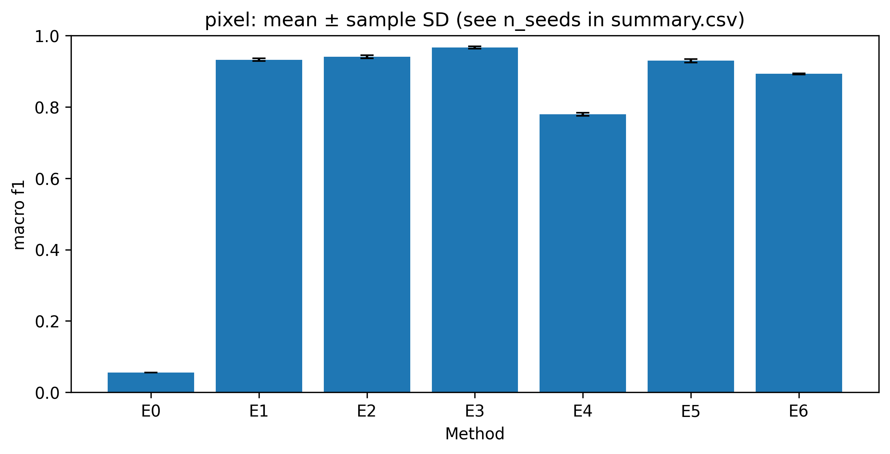
Overall Results — FRSS-SVM
97.13% ± 0.20%
mean test accuracy, 5 seeds
92.94% ± 0.48%
mean macro-F1, 5 seeds
18 vs 270
Figure. Five-seed test macro-F1 by method, with sample SD. Highest mean macro-F1: MNF-SVM (E3) at 96.67%.
classifier input features — 93% fewer than full-spectrum

Slide 7

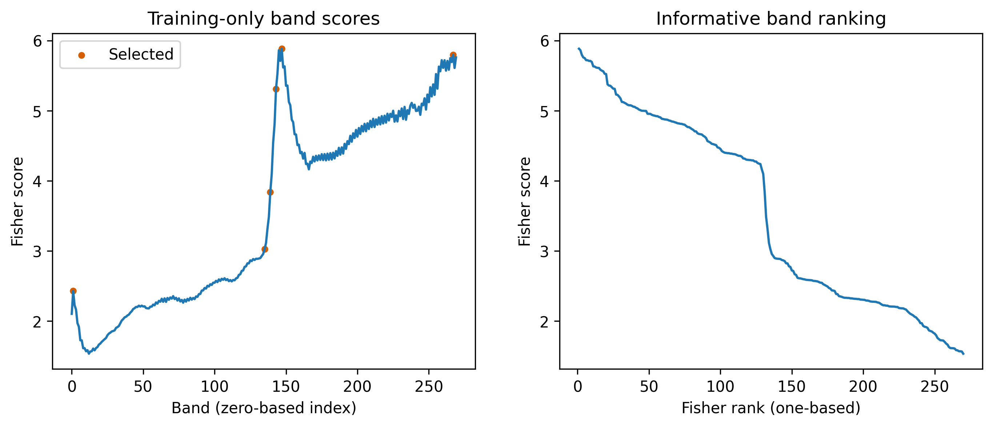
Feature Selection & Paired Ablation
Comparison | Δ Accuracy | Δ Macro-F1
E4 − E1 | -7.14 ± 0.46 | -15.30 ± 0.74
E5 − E1 | +0.16 ± 0.33 | -0.31 ± 0.75
E5 − E4 | +7.31 ± 0.20 | +14.99 ± 0.25
Adding local mean / std recovers +14.99 macro-F1 points lost to aggressive band pruning (E4), landing within 0.31 points of the full 270-band SVM while using 93% fewer features.
Figure. Training-only Fisher scores and selected bands, seed 7.

Slide 8

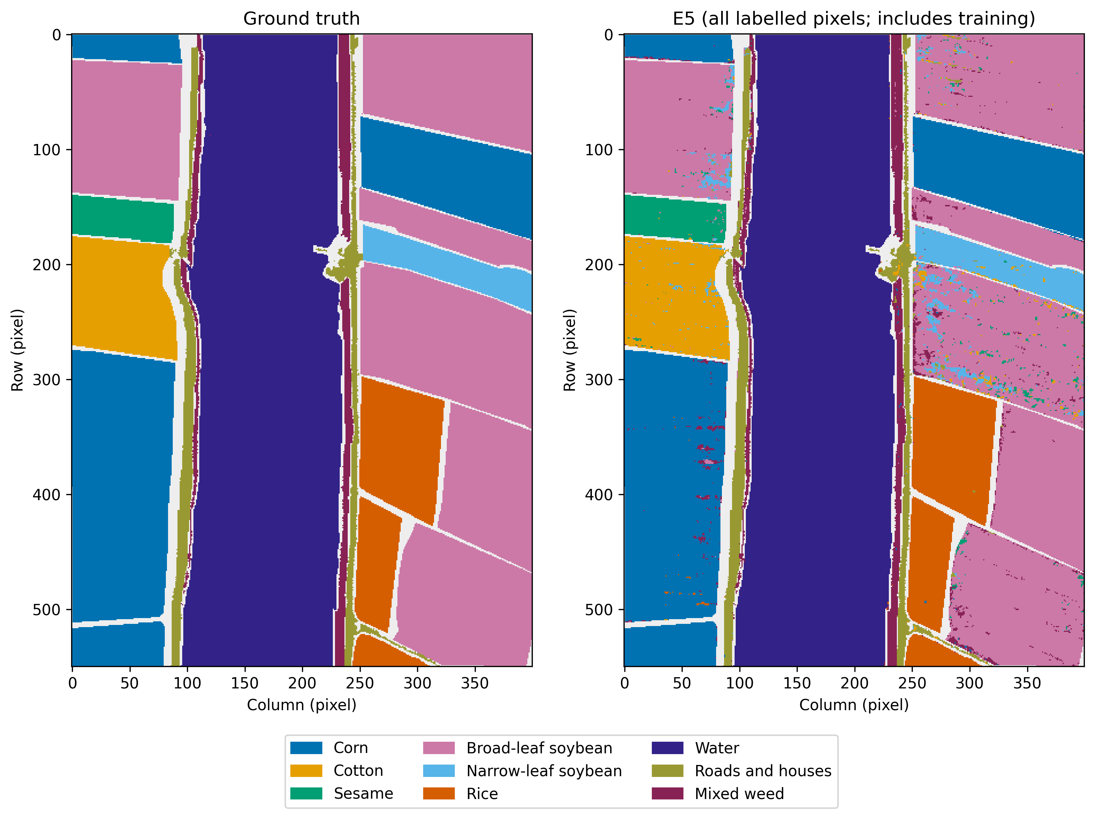
Class-Level Performance & Confusion
Weakest precision classes
66.6%
74.0%
Narrow-leaf soybean precision (95.4% recall)
Mixed weed precision (96.0% recall)
Largest directed test errors (E5, pooled)
Broad-leaf soybean → Narrow-leaf soybean — 1,292 predictions
Broad-leaf soybean → Mixed weed — 850 predictions
Broad-leaf soybean → Sesame — 489 predictions
A large class’s errors can noticeably lower a smaller class’s precision — the gap between high accuracy and lower macro-F1.
Ground truth vs. FRSS-SVM prediction, seed 7 (descriptive; test metrics use held-out pixels only).

Slide 9

Limitations & Threats to Validity
Transductive, same-scene evaluation
Random-pixel splits can share spatial context across train/validation/test partitions; geographic autocorrelation can inflate accuracy.
Geographic split not achieved
The block-based spatial protocol failed class coverage on 3 of 5 predeclared seeds — no independent-region claim is made.
Altered class priors
The nearly balanced 9,000-pixel training cap shifts the scene’s original class proportions.
Small validation grid
A modest hyperparameter grid may miss better-performing configurations.
Split sensitivity, not scene uncertainty
Five-seed SD measures sensitivity to random splits of one scene, not generalization to a new scene or sensor.

Slide 10




Conclusion & Contributions
All 35 method × seed evaluations (155 candidate fits) completed and independently re-verified against saved held-out predictions.
Equal contribution — 50% / 50%
FRSS-SVM reaches 97.13% accuracy / 92.94% macro-F1 with 18 features — 93% fewer than the full 270-band SVM, within 0.31 macro-F1 points of it.
Himanshu Sinha · S20240020290
Problem formulation · Fisher ranking & correlation pruning · spectral/spatial SVM methodology · ablation interpretation
Ghule Yash Mahesh · S20240020288
Dataset provenance & validation · split/leakage protocol · PCA/MNF/RF comparisons · metric auditing & reproducibility
Future work: a class-covering geographic split, an independent scene, and a strictly matched-band spatial ablation.
github.com/himanshu09120/Spectral-Spatial-Feature-Selection-for-Hyperspectral-Land-Cover-Classification-Using-an-Enhanced-SVM

