Slide 1

B.Tech Project Final Evaluation, VIIIth Sem Project Title – Secure Online Auction System
Presented by :-
Himanshu Goyal, 2019001426
Muskan Kundnani, 2019657007
Under the Supervision of:-
( Prof. Murari Kumar)
Sharda University, Gr. Noida
DEPARTMENT OF COMPUTER SCIENCE & ENGINEERING
SCHOOL OF ENGINEERING AND TECHNOLOGY
1

Slide 2
APPROVAL FROM GUIDE FOR THE EVALUATION

Slide 3
GANTT CHART
 | Phase 1 |  |  |  |  |  |  | Phase 2
 | 1 | 2 | 3 | 4 | 5 | 6 | 7 | 8 | 9 | 10 | 11 | 12 | 13 | 14
Requirement Analysis
Feasibility Study |  |  |  |  |  | ◆
Getting core team
Selection of Language for code |  |  |  |  |  |  |  |  |  |  | ◆
Model to approcahed for project |  |  |  |  |  |  |  |  | ◆
Setting up datasets
Creating report of all case scenarios
Writing Research Paper

Slide 4

CONTENT
INTRODUCTION
FORWARD AUCTION PROCESS\
3. BLOCK DIAGRAM
4. USE CASE DIAGRAM
5. ALGORITHMS
6. FUNCTIONS AND STAGES
7. CONCLUSION

Slide 5

Secure Online Auction System
INTRODUCTION

Slide 6
Online Auctions for the items are profitable and are rising in demand in the current industries. Online Auctions have many advantages over face-to-face or offline auction systems, the most important advantage is flexible timing and locations for the buyers and sellers. We are constructing an online auction system where people may register as buyers, sellers, or as both. Our online Auction System also has admins whose work will be to determine whether a product is genuine or not, there might not be any fraud users (seller or buyer), to provide solutions to the complaint filed by the users. It will be more secure than any other Auction Systems till date. It will act as a platform for the sellers to sells the items and buyers to buy the items.
What is SOAS?

Slide 7
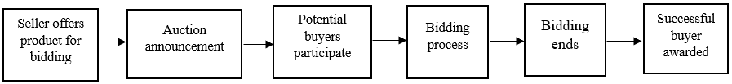
FORWARD AUCTION PROCESS

Slide 8
HOW THE AUCTION WORKS?
Seller place the product for Bidding.
Auction Announcement is made.
Buyers who want to buy product participates.
Bidding Process is started.
After time over, Bidding ends.
The Buyer with maximum amount of Bid will be rewarded the product.
Auction ended.

Slide 9
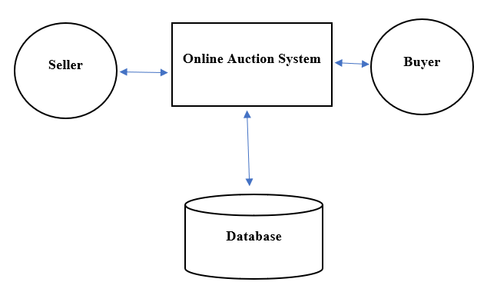
BLOCK DIAGRAM

Slide 10
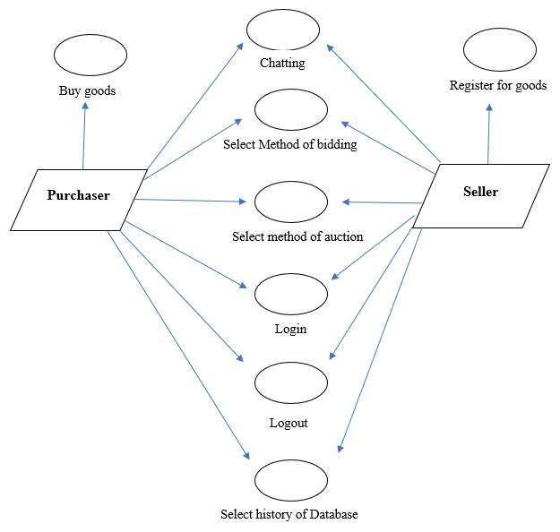
USE CASE DIAGRAM

Slide 11
ALGORITHMS (HOW TO MAKE IT SECURE?)

Slide 12
Public Key Cryptography (PKC):
PKC is a type of encryption that uses two keys, a public key and a private key, to secure communication. In online auction systems, PKC can be used to encrypt the communication between the user and the system, ensuring that the information being transmitted is confidential and cannot be intercepted by unauthorized parties.
Digital Signatures:
Digital signatures are used to verify the authenticity of a message or data. In online auction systems, digital signatures can be used to ensure that the bids placed by users are authentic and have not been tampered with.

Slide 13
3. Hash Functions:
Hash functions are used to create a unique digital fingerprint of a message or data. In online auction systems, hash functions can be used to ensure the integrity of the bids placed by users.
4. Two-Factor Authentication (2FA):
2FA is a method of authentication that requires users to provide two forms of identification, such as a password and a security code sent to their phone, to access the system. In online auction systems, 2FA can be used to increase the security of user accounts and prevent unauthorized access.

Slide 14
5. Secure Sockets Layer (SSL) or Transport Layer Security (TLS):
SSL or TLS is a protocol for establishing secure links between networked computers. In online auction systems, SSL or TLS can be used to encrypt the communication between the user and the system, ensuring that the information being transmitted is confidential and cannot be intercepted by unauthorized parties.
6. Access Control:
Access control algorithms are used to restrict access to a system based on user credentials. In online auction systems, access control algorithms can be used to restrict access to sensitive information, such as user bids, to only authorized users.

Slide 15
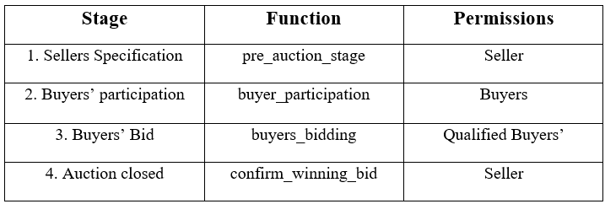
FUNCTIONS AND STAGES

Slide 16
CONCLUSION
Here we present our design and Implementation for Online Auction System. The trust issues found in an online auction site is due to the susceptibility found on the system. So, we have proposed an online auction system where there will be very less chances of fraudulent non-genuine such as fraud users, non- genuine products and so more. So, this project hopes to clear all such doubts as per the user’s perception and provide the best design available till date.

Slide 17
Research Paper has been Accepted

Slide 18
THANK YOU

