Slide 1

J component Project
On
“CNN Based Wall Crack Detection”
Under guidance of
Dr. Sridhar V G
Department of Mechatronics Engineering
Presented By
Himanshu Sharma (20MMT1017)
Prashant Powar (20MMT1019)

Slide 2
Content
Introduction
Objective
Methodology
Block Diagram

Slide 3
Objective
To develop wall crack detection system.

Slide 4
Introduction
Early detection of cracks in building walls it is quite important as these are early indicators for the ageing, decaying or any internal structural fault. This project aims to develop an automatic inspection system based on deep learning model and image processing to identify cracks. Transfer learning models of convolutional neural networks (CNNs) are used to learn the intrinsic features of cracks using the images of the surfaces, which help them for the automatic classification into cracked/un-cracked classes.

Slide 5
Methodology:
Finding Problem
Literature Survey
Collection of Data
Train CCN Model
Testing
Optimize

Slide 6
Block Diagram:
Image acquisition
Pre-processing
Segmentation
Feature Extraction
Classifier

Slide 7
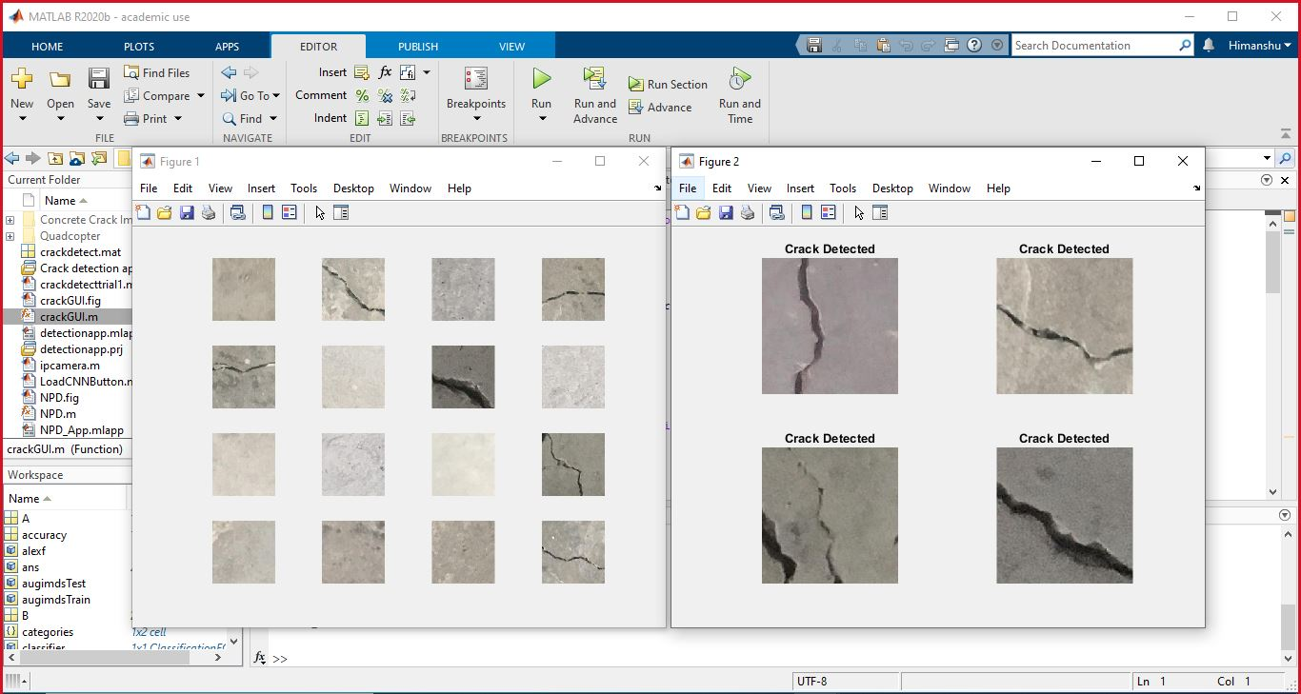
MATLAB Output:

Slide 8
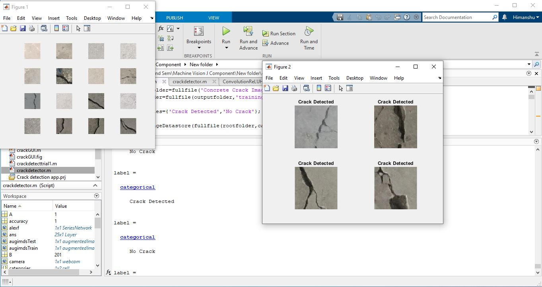

Slide 9
Thank You

