Slide 1
Approach
Himanshu Verma
9588041654
Email : himsan11235@gmail.com

Slide 2
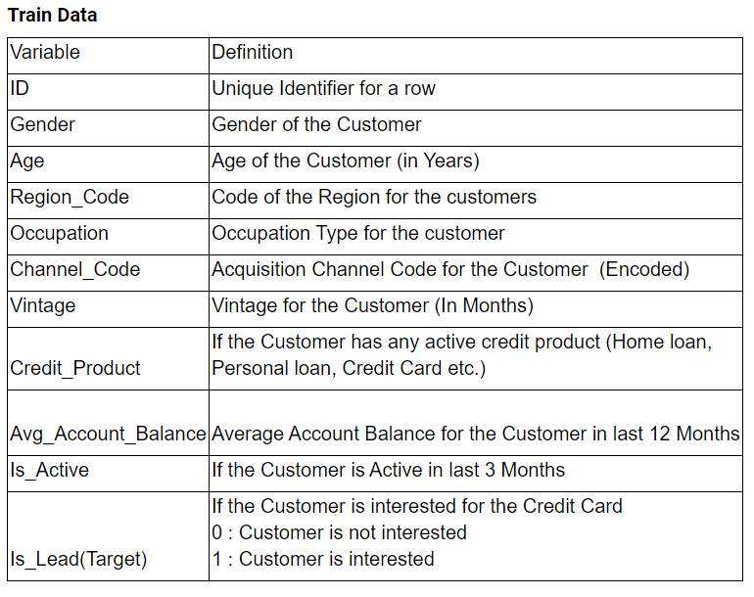
Data
Contained 9 variables and 1 target variable.
The following picture shows the variable structure.

Slide 3
1st approach(Deep neural network)

Slide 4
Data preprocessing And model training
Assumed (Gender, Occupation, Channel Code, Credit Product, Is Active and Region Code) as categorical variables, while (Age, Vintage, Avg_Account_Balance) as numerical variables.
Imputed the Credit_Product with a new category called “NA“.
Normalised the numerical variables.
Converted the categorical variables to one hot vectors and concatenated these one hot vectors and the numerical variables to make a input vector for each data point.
Built a deep neural network for outputting a value in the range 0 to 1 for each data point, used Adam Optimiser, and trained the model, got 0.69 on the test set.
Looking at the magnitudes of the weights for first hidden layer, figured out the least important variable, (Gender, Avg_Account_Balance, Region_Code) were the least important factors. Also the correlation of the target variable and Gender and Avg_Account_Balance was around 0.015, hence very less.
Dropped the least important factors, and retrained the model, and tuned the model hyper parameters(the number of layers, learning rate, the activation function of each layer), this time got a little improved score(0.86)

Slide 5
2nd approach(Partitioning the data)

Slide 6
Preprocessing and model building
S = (Occupation, Channel Code, Credit Product, Is Active)
Imputed the Credit_Product with a new category called “NA“.
Made subsets of the training set belonging to each possible combination of S
Trained a KNN model on the remaining A = (Age, Vintage, Region_Code) variables on each of possible combination of S and saved it in a dictionary mapping each combination of S to the corresponding trained model.
Similarly used the corresponding model for the corresponding combination in the test dataset.
Tuned the S subset, and the A subset, and the KNN model parameters.
Got 0.834 on the test set.

Slide 7
3rd approach (Separate models for datapoints where credit_product is nan)

Slide 8
Preprocessing and the model
Did not impute the Cresit_Product
Created two subsets of the train set, First, containing the data points where the credit product is given and Second where the value of credit product is nan.
On first set, trained the Light gbm model on the variables V1 =( Occupation, Channel Code, Credit Product, Is Active, Region_Code, Age, Vintage)[I tuned this set and this one gave best performance].
On second set, trained other lightgbm model on variables V2 = (Occupation, Channel Code, Is Active, Region_Code, Age, Vintage).
Divided the test set in similar manner and used corresponding model for prediction. Achieved 0.872 on test set.

Slide 9
4th Approach(imputing the credit_product with separate model)

Slide 10
Preprocessing and model
Using the V = (Occupation, Channel Code, Is Active and Region Code) as categorical variables, Age, Vintage), on the subset of data where the credit product was given, trained a classifier to generate the Credit_Product target.
Using the classifier, imputed the Credit product model.
Then trained a lightgbm model on S = (Occupation, Channel Code, Credit Product, Is Active, Region Code, Age, Vintage).
Optimised the S ti improve performance.
Got 0.8727.

Slide 11
5th approach(binning and Converting age and vintage as categorical variables)
Imputed the Credit_Product with a new category called “NA“.
Converted the Age and Vintage to categorical variables by binning them through visual inspection of the count plot graph.
Trained the light gbm model on the variables V = (Occupation, Channel Code, Credit Product, Is Active and Region Code, Age, Vintage). Tuned the V for best performance.
Got 0.8719

Slide 12
Final Approach(Catboost)

Slide 13
Preprocessing and model
V = (Gender, Occupation, Channel Code, Credit Product, Is Active and Region Code, Age, Vintage, Avg_Account_Balance)
Imputed the Credit_Product with a new category called “NA“.
Trained the catboost model on different subsets of V and found that subset S = (Occupation, Channel Code, Credit Product, Is Active and Region Code, Age, Vintage) to get the best performance.
Got a score of 0.8728 on test set.

Slide 14
Thank you

