Slide 1

INDIAN INSTITUTE OF INFORMATION TECHNOLOGY BHAGALPUR
SOFTWARE ENGINEERING PROJECT
ON
INTERNAL COMPLAINT MANAGEMENT SYSTEM (CS311-P7)
UNDER GUIDANCE OF
DR. BISWAJIT R. BHOWMIK
(COURSE INSTRUCTOR CS-311)

Slide 2
Team Introduction
Project Leader:
Abhishek Kumar (170101003)
Project Members:
Himanshu Ranjan (170101017)
Suraj Kumar (170101052)
Hitesh Kumar Sahu (170102019)

Slide 3
Project Introduction
Internal Complaint Management System(ICMS) provides services for arrived complaint of Student, Faculty, Staff and Others to Student Affairs and Faculty Affairs.
ICMS allows user to register complaints i.e. ragging, sexual assault, faculty related and others.
It has login page to sign in where user enters username and password to register a complaint.
New user sign up to register a complaint. This project contains sign-up form that is to be filled by the users.
Project also provides complaint number with details.
All the complaints arrived from users are distributed to the different departments according to the complaint category.
Users can know the currently processing status of their complaints.

Slide 4

WHY ?
About Existing Internal Complaint Management System
People must goes to College Administration for their complaints.
All the arrived complaints are submit to respective Boards(Student Affairs Board/Faculty Affairs Board).
Boards member solve the complaint and note the complaint status on paper(registers) manually.

Slide 5
WHY ? Contd…
Limitations of Existing Internal Complaint Management System
No proper management of information.
Redundancy in data(same complaint may be solved several times).
Possibility of Loss of Complaint records.
Time consulting problem.
Lots of paper work.

Slide 6






WHY Online ICMS ?
Speedy
Open 24 Hrs
Disabled-Go
Save Paper Save Tree
Human Errors

Slide 7
Features of Proposed System
The proposed system automates the existing system. It decreases the paper work and easier record maintenance by having a Online Database for complaint managements.
The Internal Complaint Management System reduces the over work and time duration. It provide an easy, maintained and systematic environment for the higher authority (Student/Faculty Affairs Board) for the approval of complaints .
Account Security by the OTP Verification during Sign Up and Password Recovery.
Mailing System for the Users and Higher Authority for the Notifications.
Users and Higher Authority can download PDF of respective complaint with all required details.

Slide 8
Tools:
PHP(Hypertext Pre-processor)
PHP is widely-used open source general purpose scripting language that is especially suited for web development and can be embedded into HTML.
PHP scripts are executed on the server.
PHP files are returned to the browser as plain HTML.
PHP INTERPRETER
PHP Interpreter processes the page, communicating with file systems, databases and Email servers as necessary and then delivers a web page to the web server to return to the browser.
PHP Interpreter extract code within enclosing and closing tags.
MySQL
MySQL is a database server.
MySQL is ideal for both small and large applications.
MySQL is free to download and use.

Slide 9
Tools Contd..
SERVER
A computer or device on a network that manages network resources. There are many types of servers. For Example:
Database Server: A computer system that processes database queries.
File Server: A computer and storage device dedicated to storing files. Any user on the network can store files on the server.
BROWSER
A web browser is a software application for retrieving, presenting and traversing information resources on the World Wide Web.

Slide 10
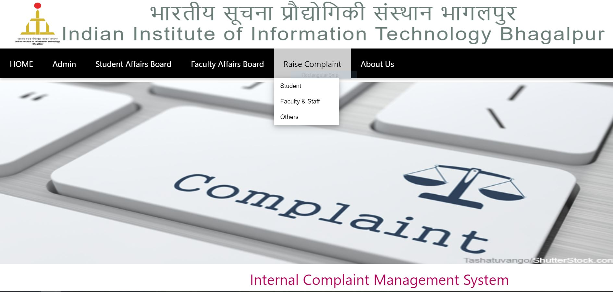
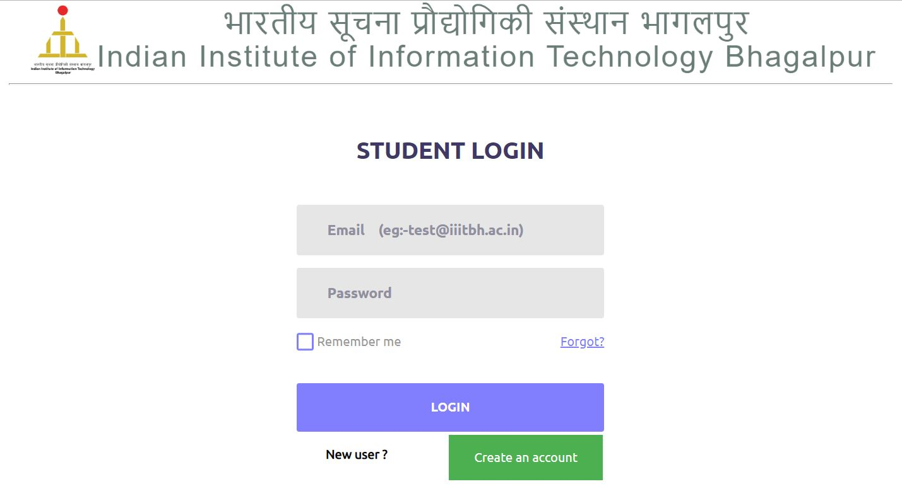
Outputs

Slide 11
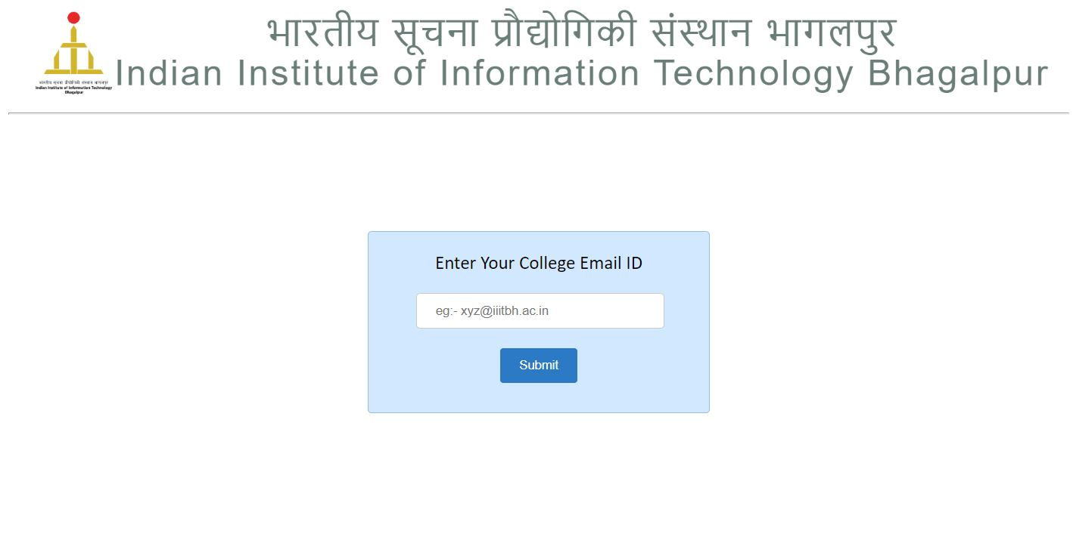
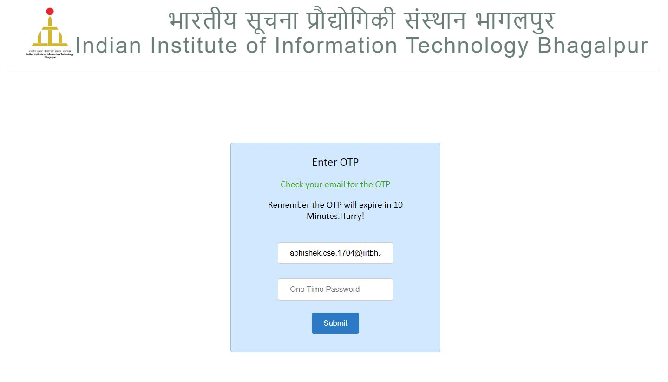

Slide 12
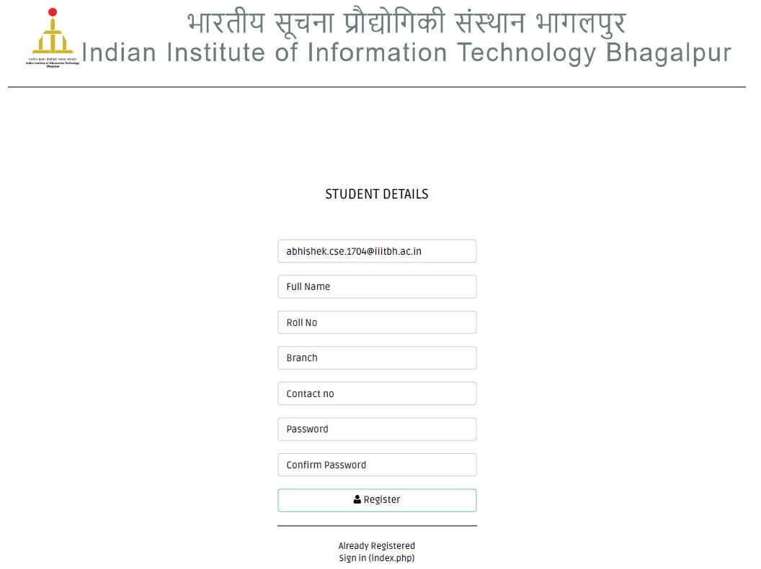

Slide 13
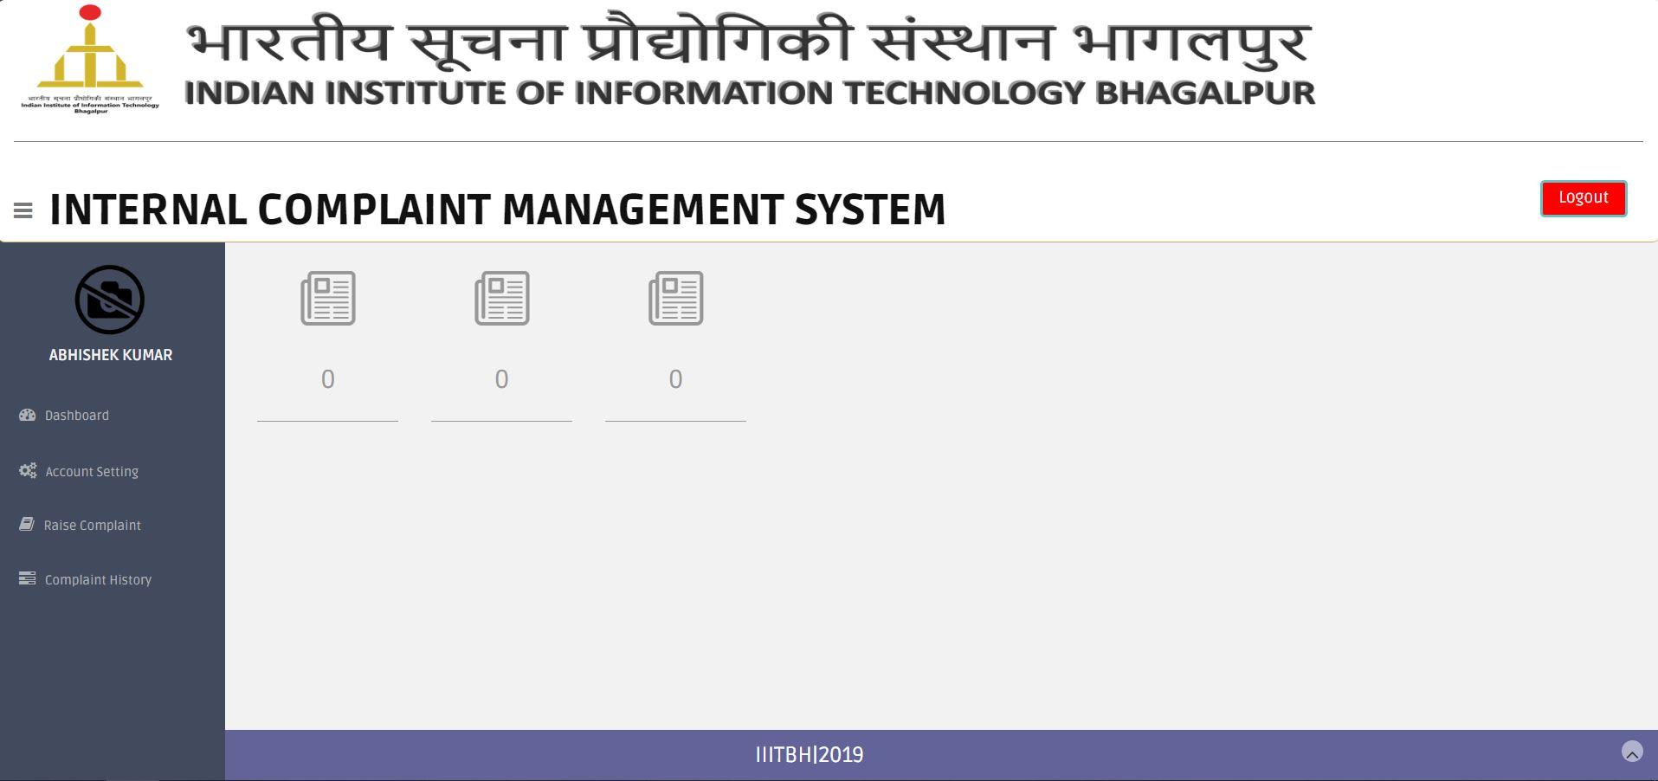

Slide 14
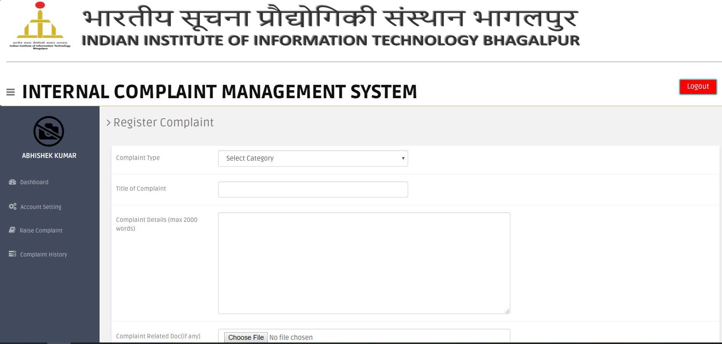

Slide 15
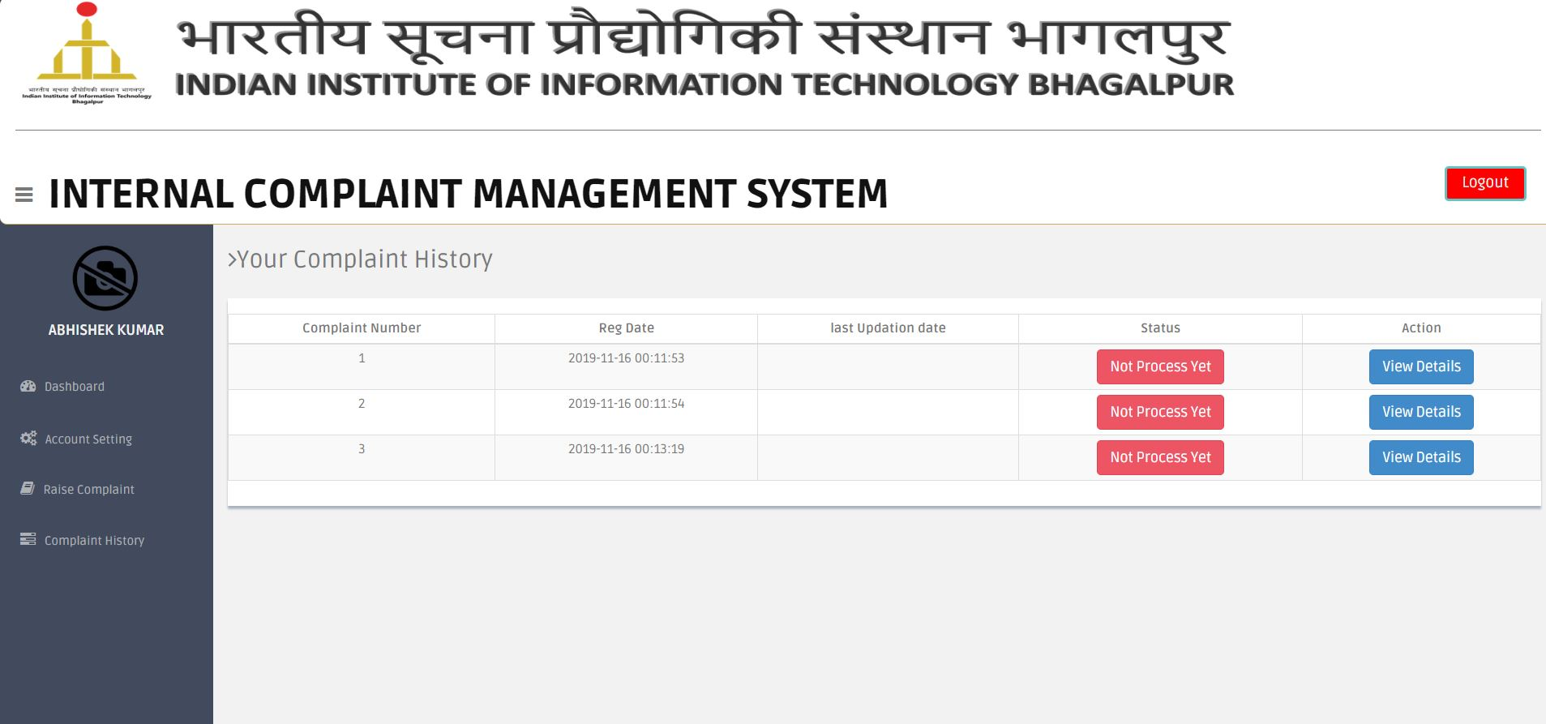

Slide 16
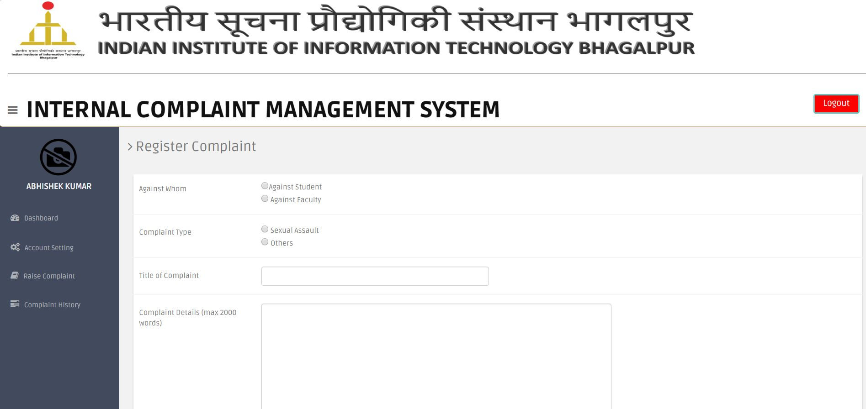

Slide 17
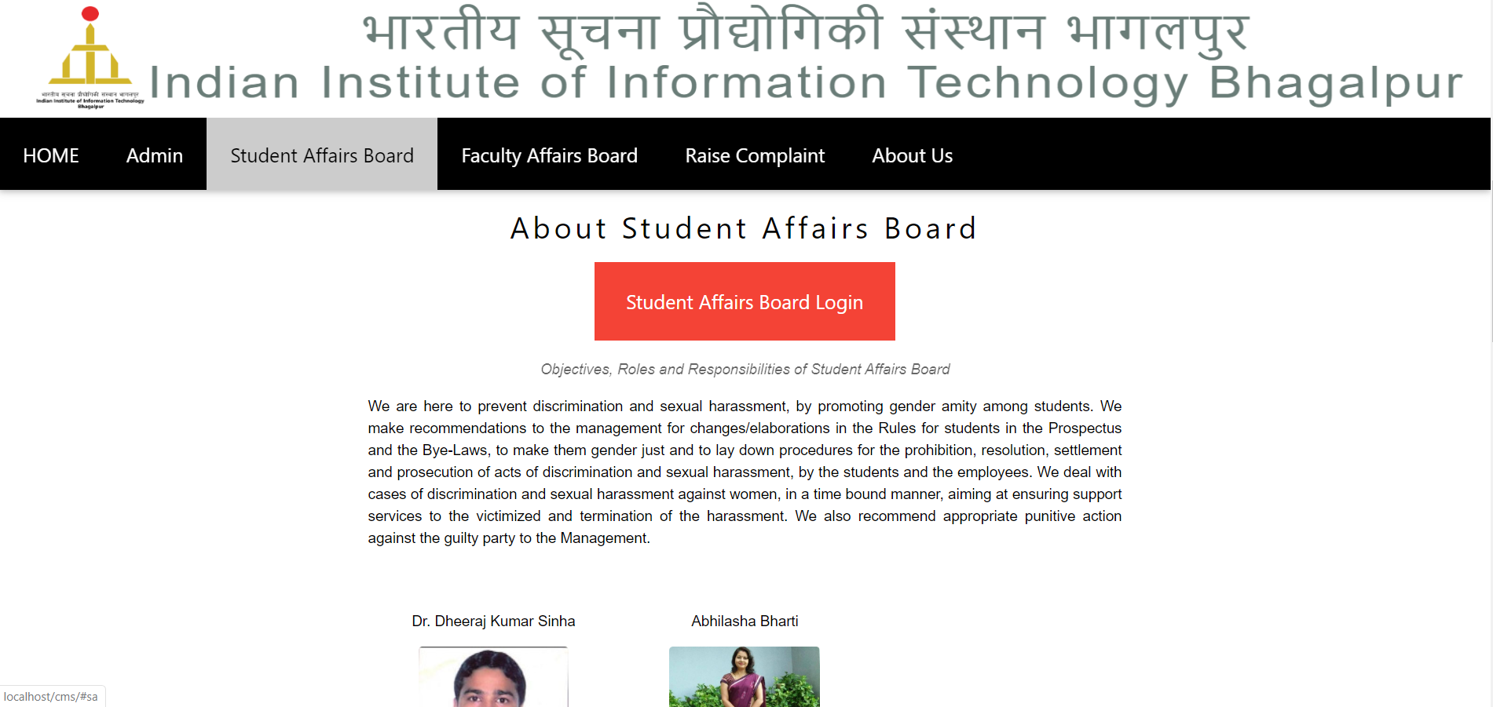

Slide 18
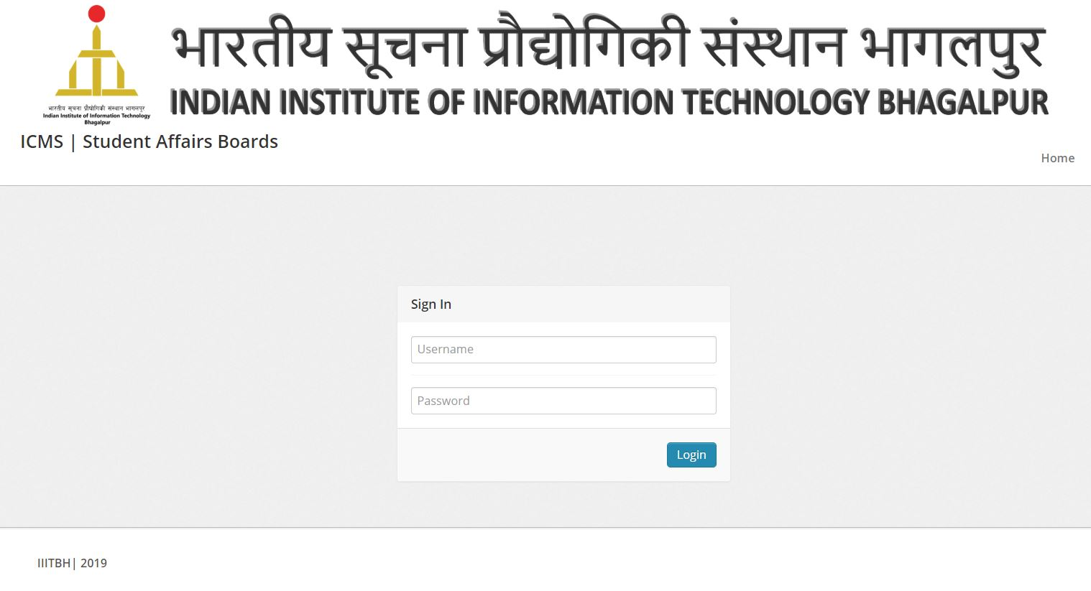

Slide 19
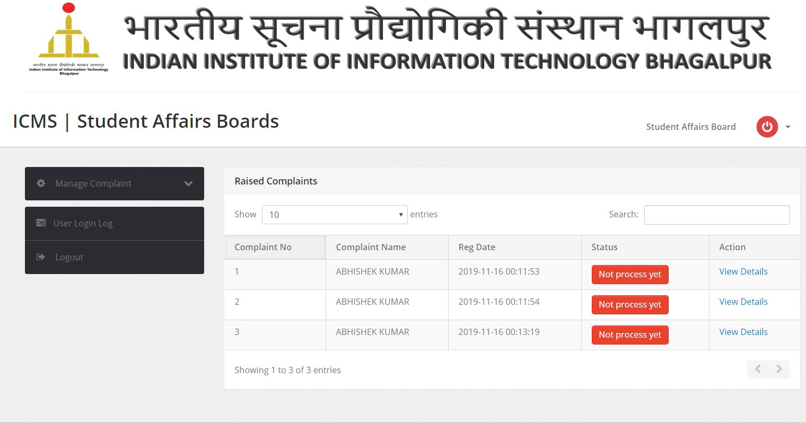

Slide 20
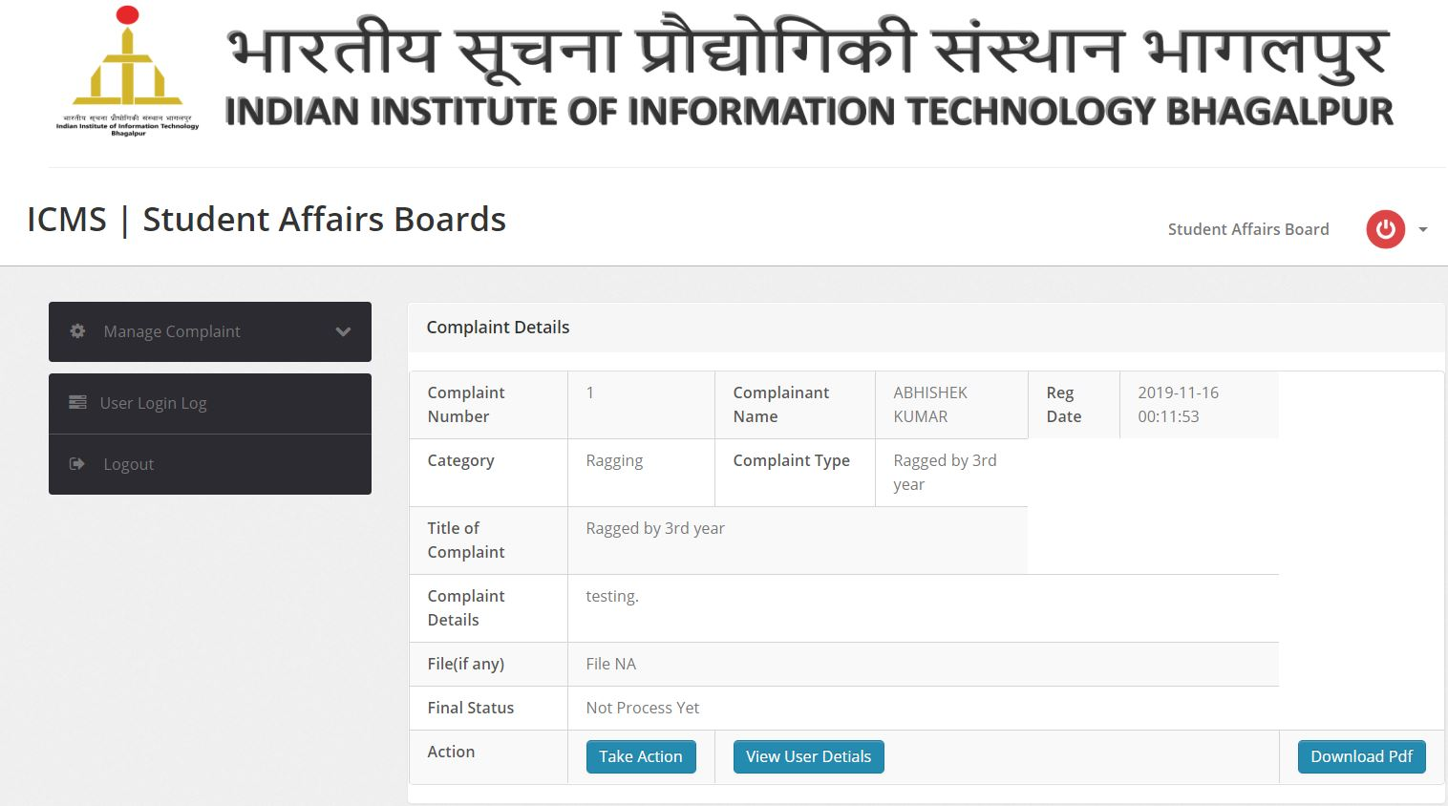

Slide 21
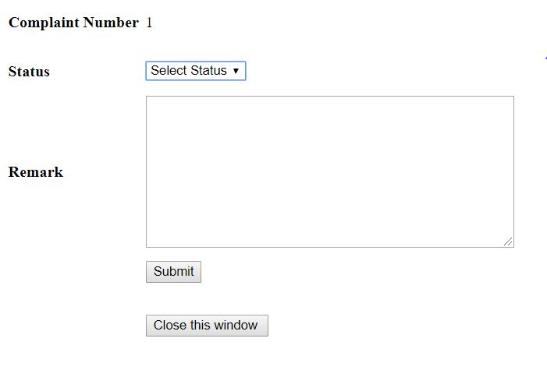
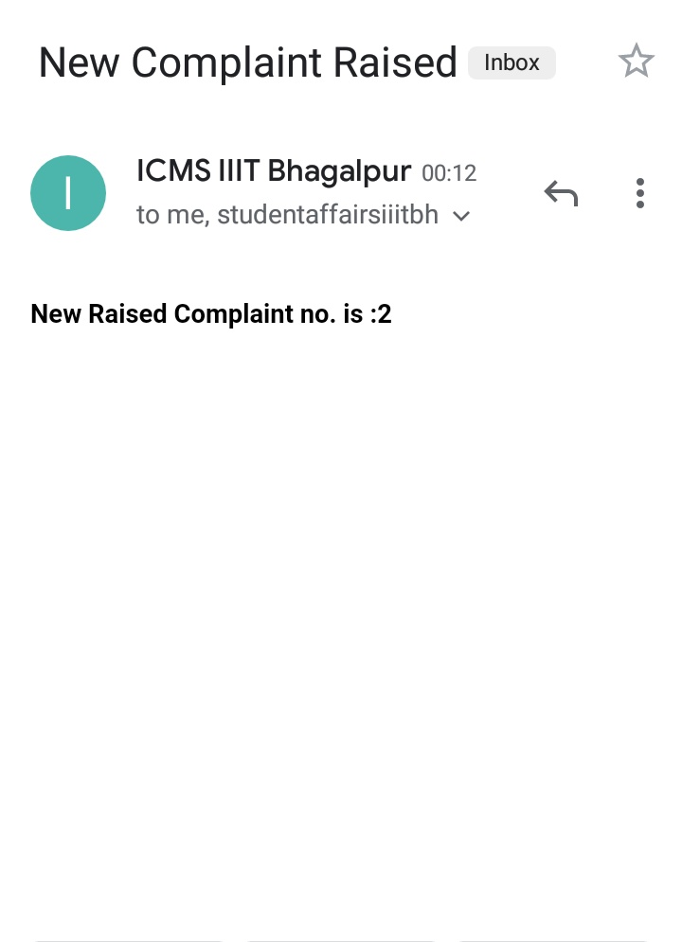
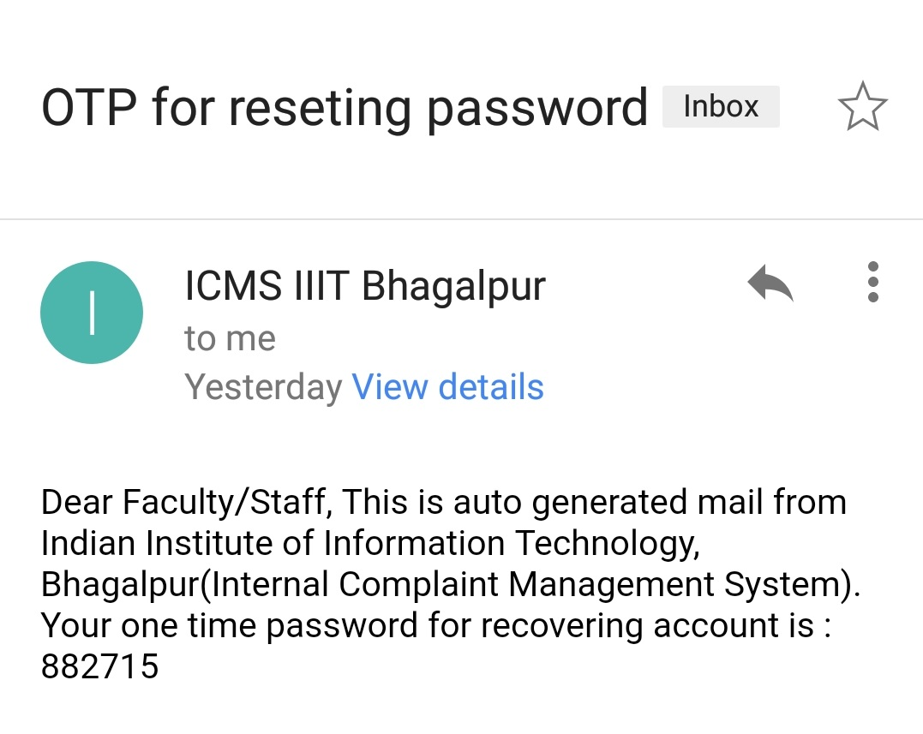
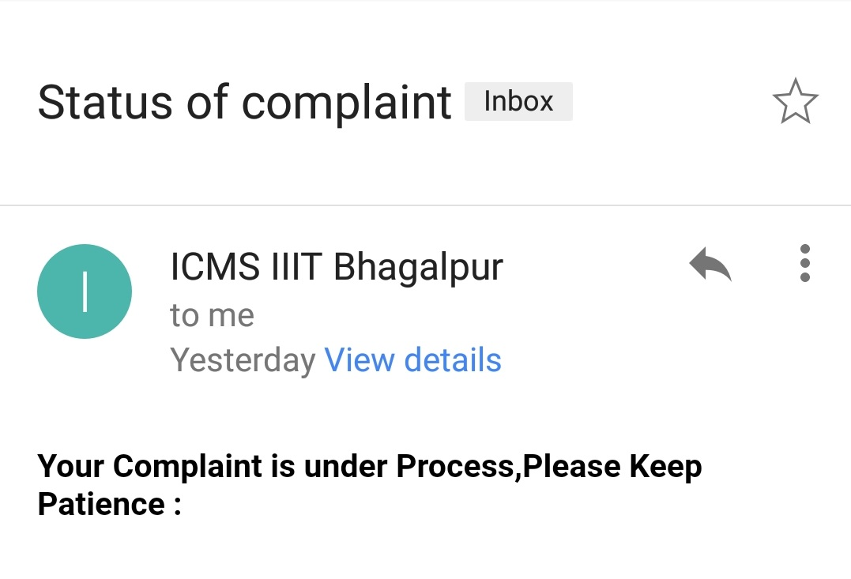

Slide 22
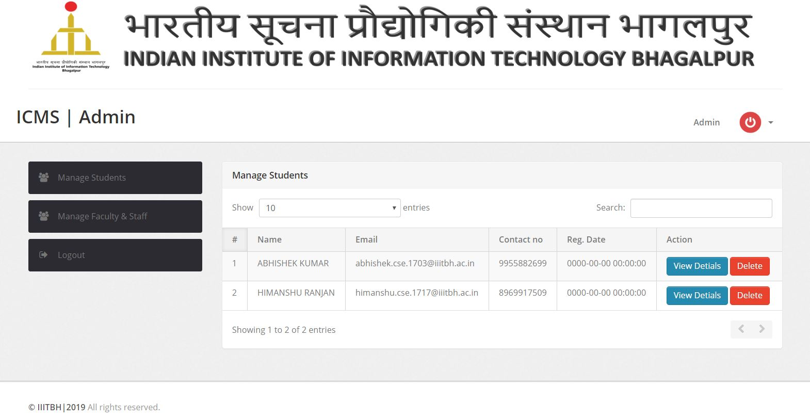

Slide 23
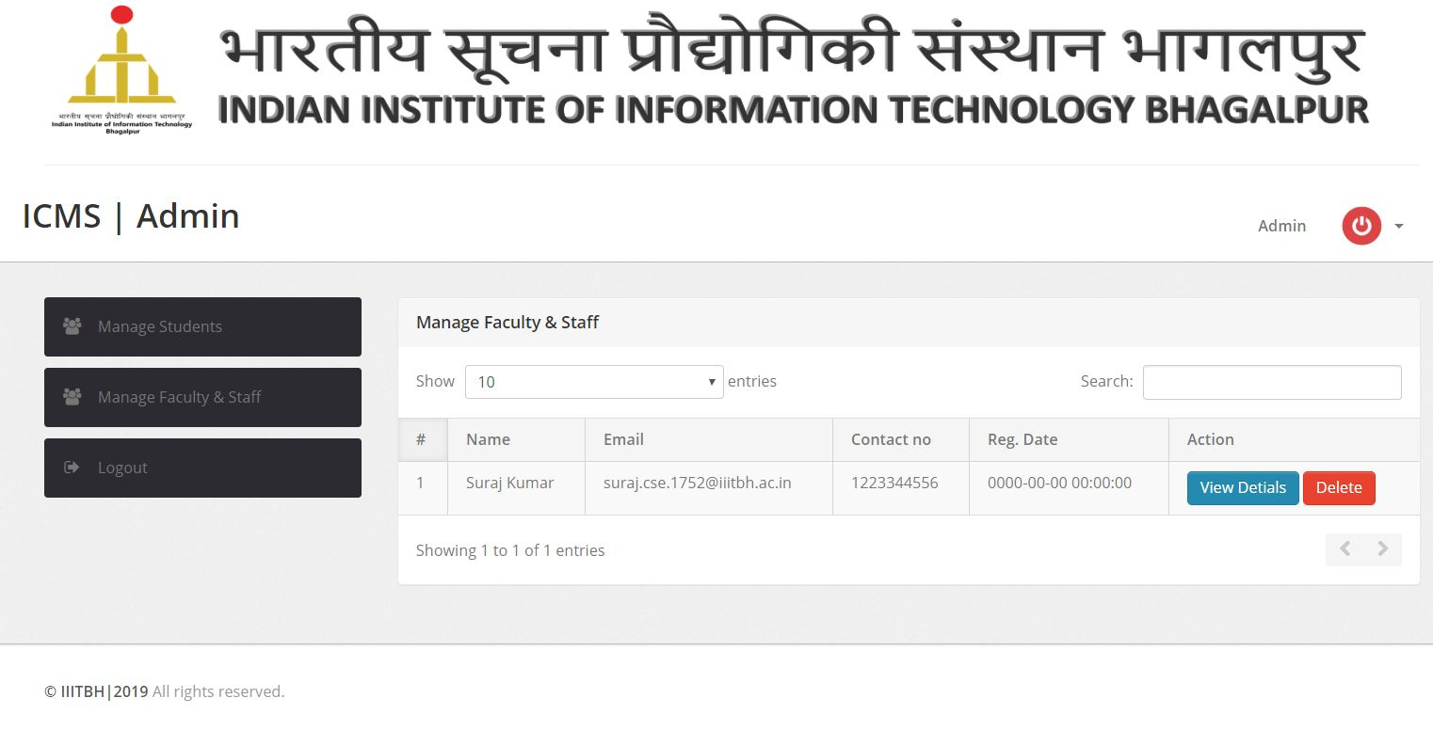

Slide 24
Conclusion
Internal Complaint Management System is very useful for college to maintain the internal complaint records of the students, faculty, staff and others.
This system maintains the complaint details of the users and the complaint mailing system .
All the information of the complaints are saved in the Database.
Respective authorities may accept or reject the complaint applications requested by the users.
Thus this system maintains the excess amount of job done by college to maintain the complaint and thus ,saves the paper.
One of most important thing is that we have learnt that, how to do proper work in group within less time.

Slide 25
Future Aspects
Image recognition/processing can be involved to check the supported documents uploaded by users regarding their complaint.
Android app can be developed for easier use.

Slide 26
Thank You !

