Slide 1

INDIAN INSTITUTE OF INFORMATION TECHNOLOGY, BHAGALPUR
INDIAN INSTITUTE OF INFORMATION TECHNOLOGY,
IIINDF JVN BHAGALPUR
SEmester VIII Internship
Click2school Pvt. Ltd.
Team members:-
Aman Mishra ( 170101008 )
Manish Nandan ( 170101022 )
SeMESTER VIII INTERNSHIP
YSCHOLAR TECHNOLOGY LLP
Team members:-
Abhishek Kumar(170101003)
Himanshu Ranjan(170101017)
Suraj Kumar(170101052)

Slide 2
INTRODUCTION
Yscholar Technology LLP is a very early-stage company working on building next generation EdTech products. To give a brief summary of what they do.
It is specialists in text analytics and NLP.
It is developing products to improve knowledge representation and knowledge acquisition.
Their input is primarily texts from books corpora, articles and other open source as well as proprietary text corpus and do text modelling and are building products which leverage them.
They also focus on India's specific needs and culture and applying our techniques to understanding India's historical literature and texts.

Slide 3
We got this internship opportunity at Yscholar Technology LLP as a Back End Software Developer intern.
The position was fully remote and began on Jan. 4th, 2021. We successfully completed our 16-week internship session during the academic session 2020-2021 B. Tech 8th semester.
We were given a task “Natural Language Processing (NLP) Data Analysis for low resource Indo-European languages using Python” which we completed successfully.

Slide 4
Objective:-
The purpose of this project is to analyze the available data and prepare datasets for Natural Language Processing of Indo-European language. Natural Language Processing, or NLP for short, is broadly defined as the automatic manipulation of natural language, like speech and text, by software. The study of natural language processing has been around for more than 50 years and grew out of the field of linguistics with the rise of computers.

Slide 5
Natural language Processing is used for data analytics purpose, to extract meaningful information from lots of data. Sentiment classification and analysis is performed in python using NLTK module. Python has special module NLTK to do tasks in natural language processing. It supports multiple languages like English, Hindi, Chinese etc. to do classification of text or data into something meaningful. Text Classification can be performed in following ways: 1. Sentiment-Classification 2. Features-based-Sentiment-classification 3. Summarization-of-sentiments

Slide 6
Work Style – Agile Sprint Cycle
We followed a 2-week sprint cycle, with biweekly stand up meetings.
One stand up at the start of the Sprint cycle for planning the cycle’s tasks and finalizing our main objectives followed by our incremental work.
Then in the middle of the cycle, we had a stand up to discuss the progress and removing the blockers. Then our Incremental work continued.
Then one stand up during the second week, which is then followed by the testing and debugging phase for our work.
And finally one last stand up by the end of the sprint cycle for the review and retrospection of our sprint.

Slide 7
TOOLS, LANGUAGES AND APPLICATIONS USED :- Application -
VS Code : Visual Studio Code is a lightweight but powerful source code editor which runs on your desktop and is available for Windows, macOS and Linux. It comes with built-in support for JavaScript, TypeScript and Node.js and has a rich ecosystem of extensions for other languages (such as C++, C#, Java, Python, PHP, Go) and runtimes (such as .NET and Unity).
GitHub : GitHub provides hosting for software development version control using Git. It offers all of the distributed version control and source code management (SCM) functionality of Git as well as adding its own features. It provides access control and several collaboration features such as bug tracking, feature requests, task management for every project.

Slide 8
Language-
Python: it is an interpreted high-level general-purpose programming language. Python's design philosophy emphasizes code readability with its notable use of significant indentation. Its language constructs as well as its object-oriented approach aim to help programmers write clear, logical code for small and large-scale projects.
Pandas: pandas is a software library written for the Python programming language for data manipulation and analysis. In particular, it offers data structures and operations for manipulating numerical tables and time series. It is free software released under the three-clause BSD license.

Slide 9
Tools:-
Operating System – Windows 10
Hardware Configuration -
Processor: Core i5, 2.4GHz
Hard Disk: 150 GB
RAM: 2GB
Resolution: 1280 X 700

Slide 10
Project Plan:-
The project has been done in four phases, namely:
• Survey Existing Data
• Collect available data
• Pre-process the data
• Analyze the data
The time spent on these phases is 10%, 10%, 30% and 30%. The rest 20% was spent on incremental development of this project and testing.
The project followed the Incremental model.

Slide 11
Code Structure
Basic feature extraction using text data
Number of Words
Number of Characters
Average Word Length
Number of Stopwords
Number of Special Characters
Number of Numerics
Number of Uppercase Words

Slide 12
Basic Text Pre-processing of text data:-
Lower casing
Punctuation removal
Stopwords removal
Frequent words removal
Rare words removal
Spelling correction
Tokenization
Stemming
Lemmatization

Slide 13
Processing Data:-
There are 4 main important steps for the processing of data.
• Splitting of the data set in Training and Validation sets
• Taking care of Missing values
• Taking care of Categorical Features
• Normalization of data set

Slide 14
Train Test Split:-
Train Test Split is one of the important steps in Machine Learning. It is very important because your model needs to be evaluated before it has been deployed. And that evaluation needs to be done on unseen data because when it is deployed, all incoming data is unseen.
The main idea behind the train test split is to convert original data set into 2 parts
• Train
• Test

Slide 15
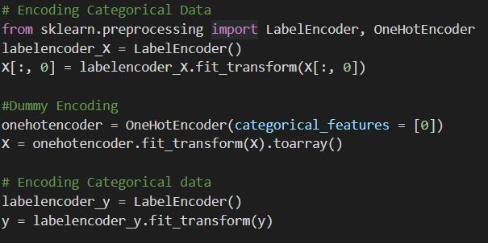
Taking Care of Missing Values :-
There is a famous Machine Learning phrase which is Garbage in Garbage out.
If our data set is full of NaNs and garbage values, then surely our model will perform garbage too. So, taking care of such missing values is important.
Taking care of Categorical Features :-
We can take care of categorical features by converting them to integers. There are 2 common ways to do so.
1. Label Encoding
2. One Hot Encoding

Slide 16
Normalizing the Dataset:-
This brings us to the last part of data pre-processing, which is the normalization of the dataset.
Data normalization is the process of rescaling one or more attributes to the range of 0 to 1. This means that the largest value for each attribute is 1 and the smallest value is 0.
It is proven from certain experimentation that Machine Learning and Deep Learning Models perform way better on a normalized data set as compared to a data set that is not normalized.
The goal of normalization is to change values to a common scale without distorting the difference between the range of values.

Slide 17
Dataset Preparation

Slide 18
Word Similarity Dataset:-
Brief overview of Datasets-
This dataset contains similar words and their similarity count which lies between 0-10.
With the advent of word representations, word similarity tasks are becoming increasing popular as an evaluation metric for the quality of the representations. In this task, we present manually annotated monolingual word similarity datasets of six Indian languages - Urdu, Telugu, Marathi, Punjabi, Tamil and Gujarati.
Datasets Size - Size of training & testing sets -
Size of training set-200
Size of testing set-100
Different classes of labels and their counts:-
Word1, Word2,Similarity Count

Slide 19
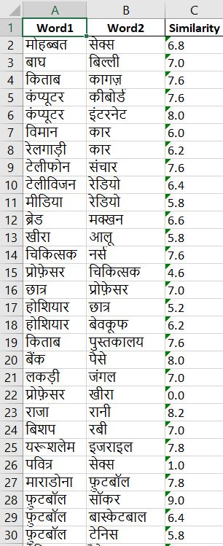
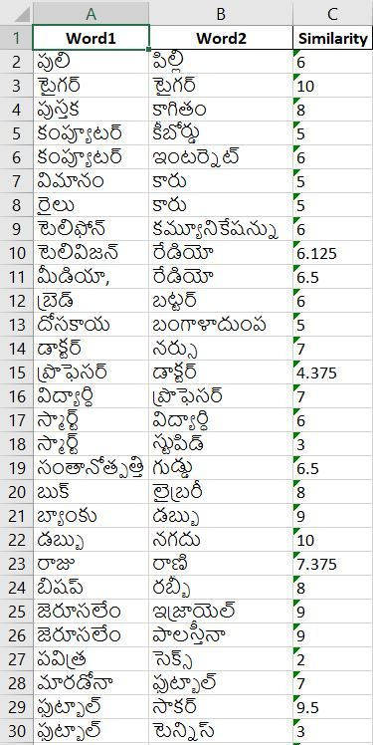
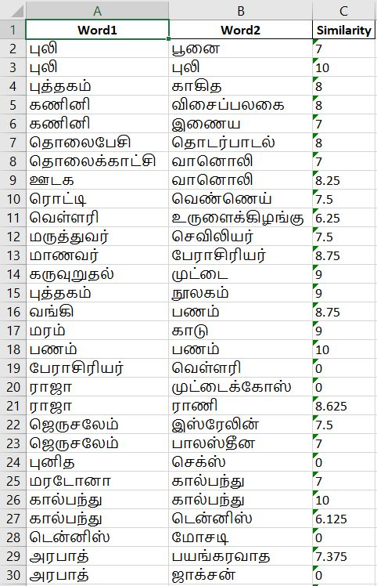
HINDI
TELUGU
TAMIL

Slide 20
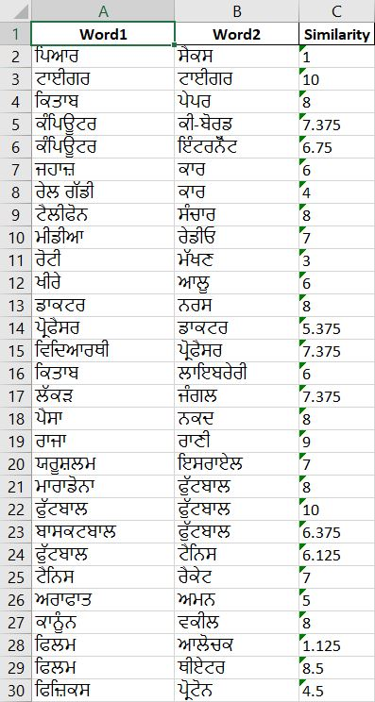
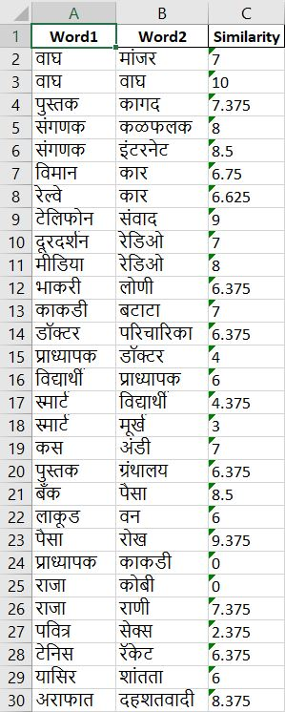
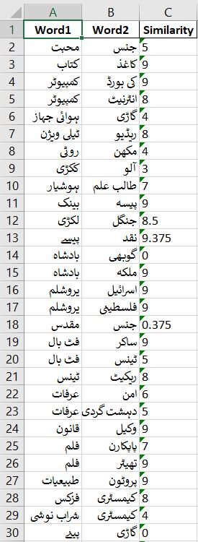
PUNJABI
MARATHI
URDU

Slide 21
Paraphrase Detection Dataset:-
Brief overview of Datasets -
This dataset contains Paraphrase with active and passive form.
Sub Task 1: Given a pair of sentences from newspaper domain, the task is to classify them as Paraphrases (P) or Not Paraphrases (NP).
For Sub Task 1:
Size of training set-30000
Size of testing set-13500

Slide 22
Sub Task 2 :
Given two sentences from newspaper domain, the task is to identify whether they are completely equivalent (E) or roughly equivalent (RE) or not equivalent (NE). This task is similar to the subtask 1, but the main difference is 3-point scale tag in paraphrases.
For Sub Task 2 :
Size of training set-4200
Size of testing set-2100
Different classes of labels and their counts:

Slide 23
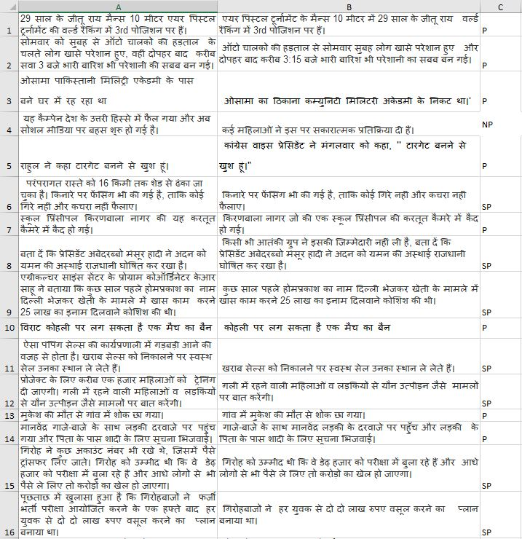
HINDI

Slide 24
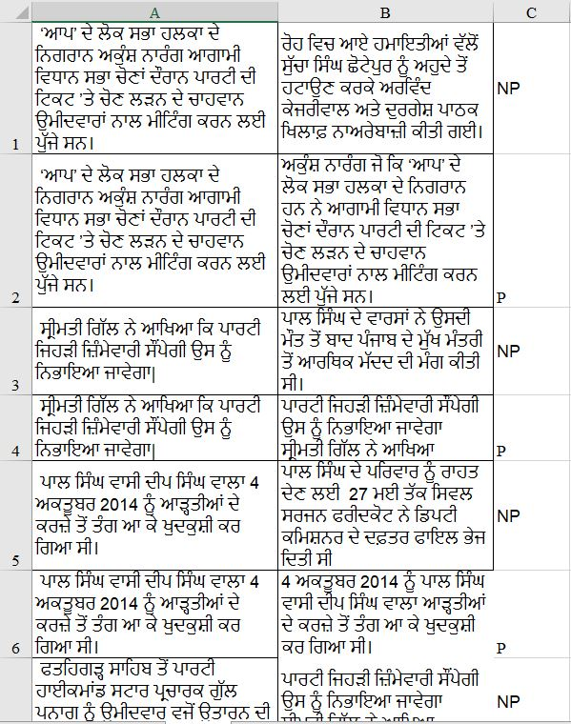
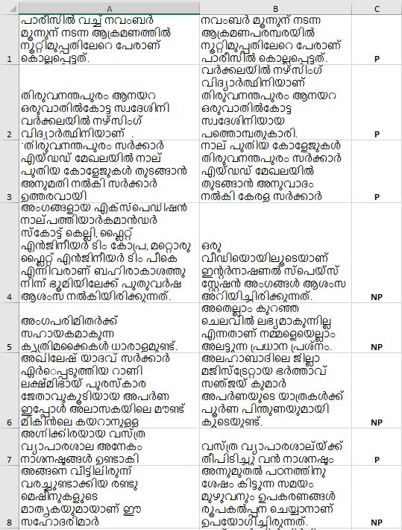
PUNJABI
MALYALAM

Slide 25
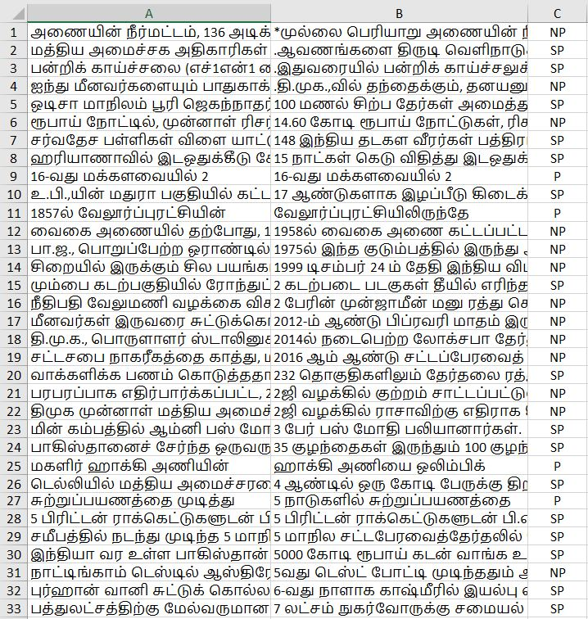
TAMIL

Slide 26
Language Identification Dataset:-
Brief overview of Datasets -
This task was aimed at identifying 5 closely-related languages of Indo-Aryan language family – Hindi (also known as Khari Boli), Braj Bhasha, Awadhi, Bhojpuri and Magahi.
These languages form part of a continuum starting from Western Uttar Pradesh (Hindi and Braj Bhasha) to Eastern Uttar Pradesh (Awadhi and Bhojpuri) and the neighboring Eastern state of Bihar (Bhojpuri and Magahi).
Datasets Size - Size of training and testing sets:
Size of training set-70351
Size of testing set-19692

Slide 27
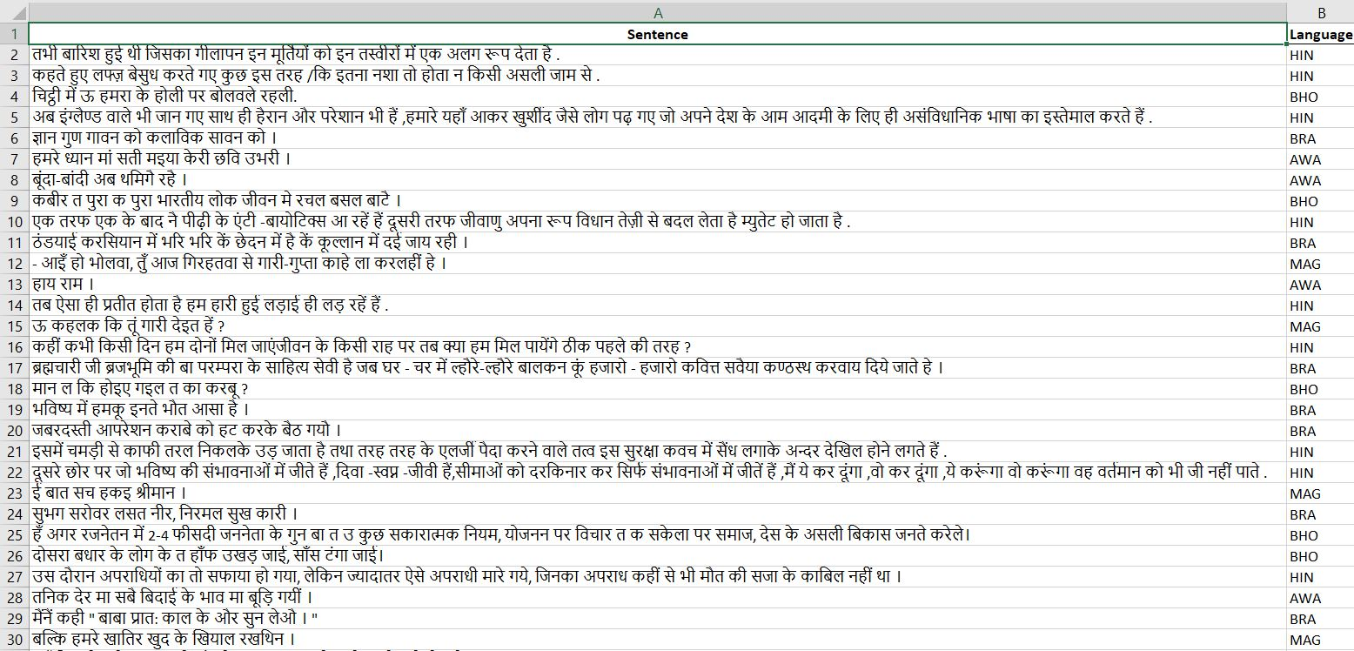

Slide 28
Hate Speech and Offensive Content Identification:-
Brief overview of Datasets -
There are two sub-tasks in each of the languages. Below is a brief description of each task.
Sub-task A: Identifying Hate, offensive and profane content.
This task focuses on Hate speech and Offensive language identification offered for English, German, and Hindi.
Sub-task B: Discrimination between Hate, profane and offensive posts.
This sub-task is a fine-grained classification offered for English, German, and Hindi. Hate-speech and offensive posts from the sub-task A

Slide 29
Datasets Size - Size of training and testing sets:
Size of English training dataset-5853
Size of English testing dataset-1954
Different classes of labels and their counts:
Text ID, Text
Language: Hindi (HIN), German (GMN), English (ENG)

Slide 30
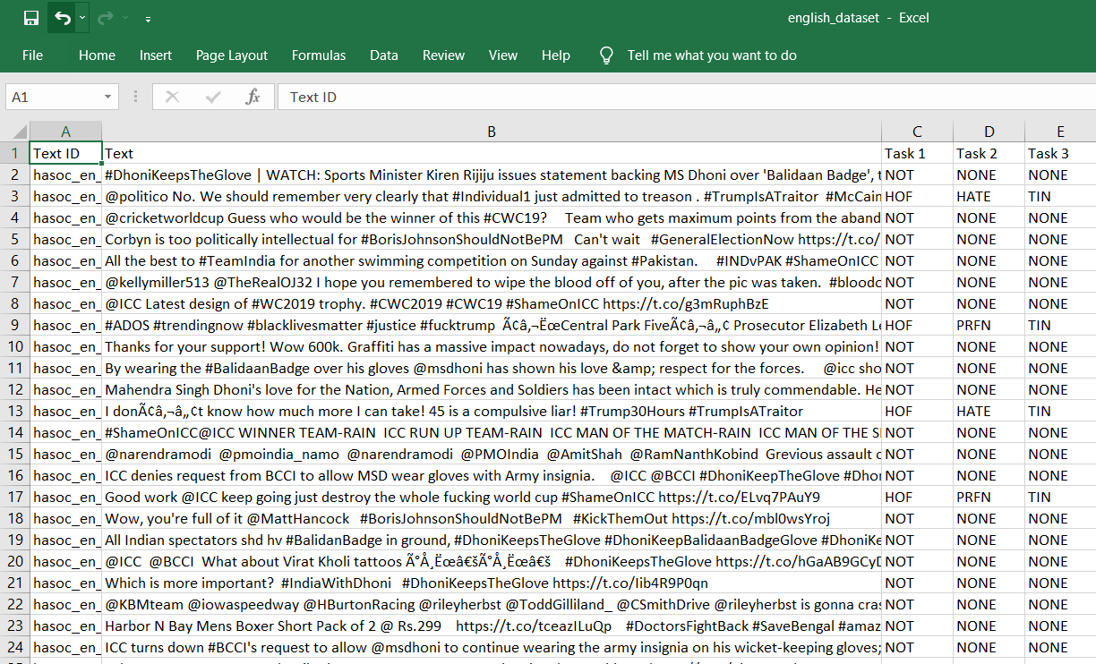
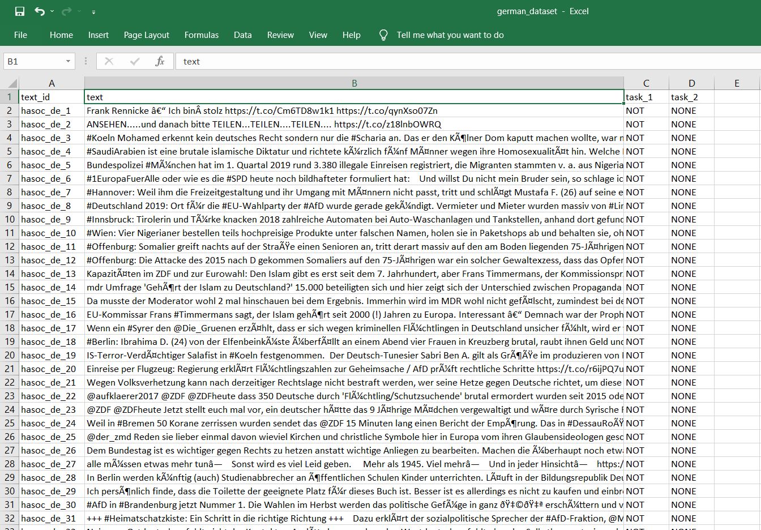
English Language Based Dataset
German Language Based Dataset

Slide 31
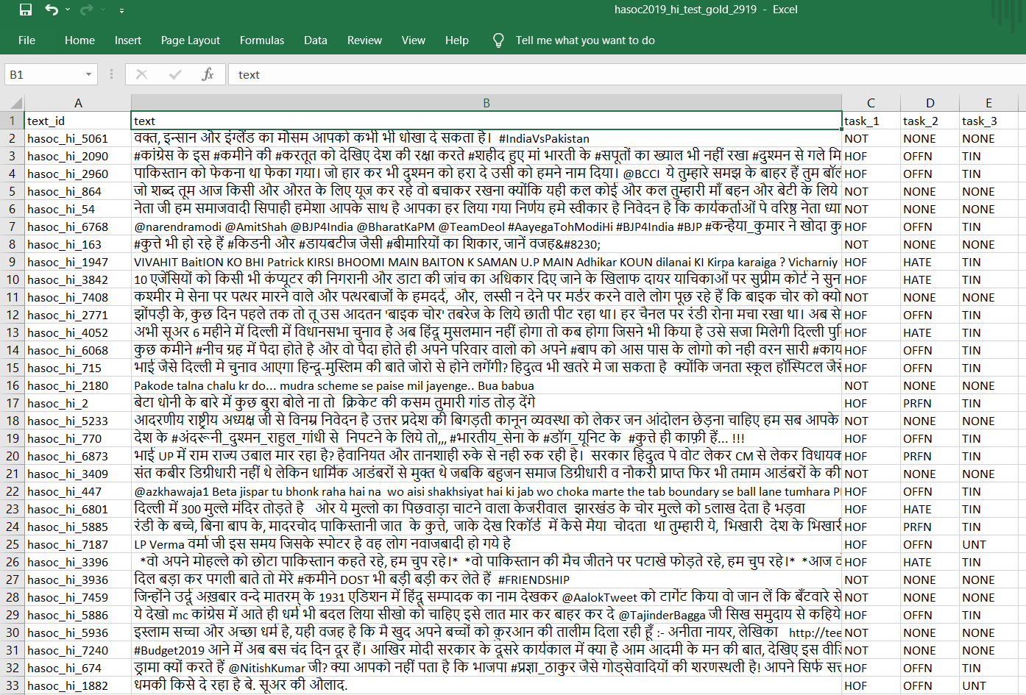
Hindi Language Based Dataset

Slide 32
Sentiment Analysis Dataset:-
Brief overview of Datasets -
This dataset is based on Movie Review sentiment dataset for sentence level sentiment classification Review sentiment dataset for Aspect term extraction and sentiment classification Aspect term category detection and sentiment classification sentence level sentiment classification.
In this dataset every sentence is assigned in Hindi language.
Datasets Size - Size of training and testing sets:
Size of Movie Review training dataset-2352
Size of testing set-1143
Different classes of labels and their counts:
id, polarity, text
Language: Hindi (HIN)

Slide 33
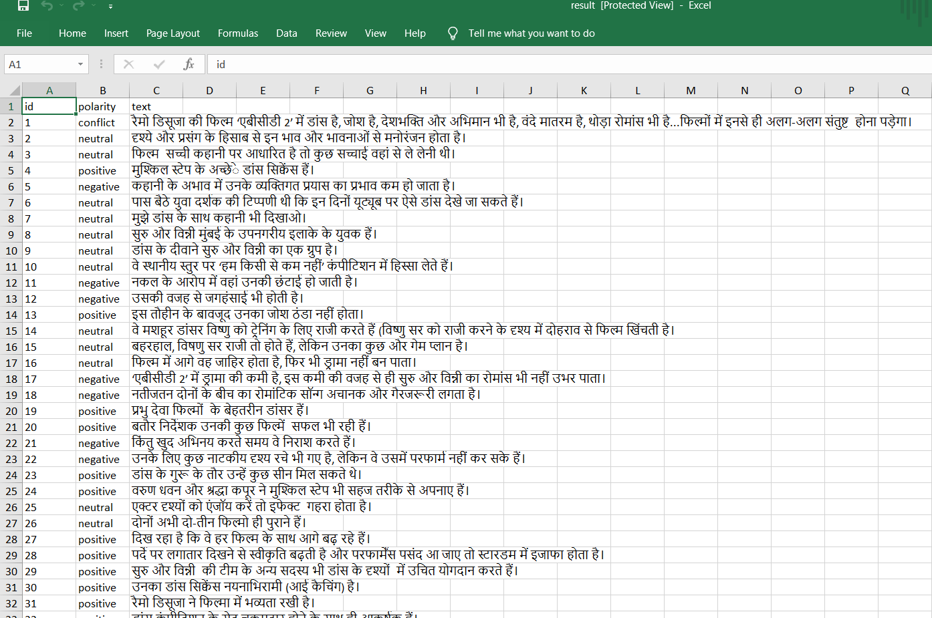
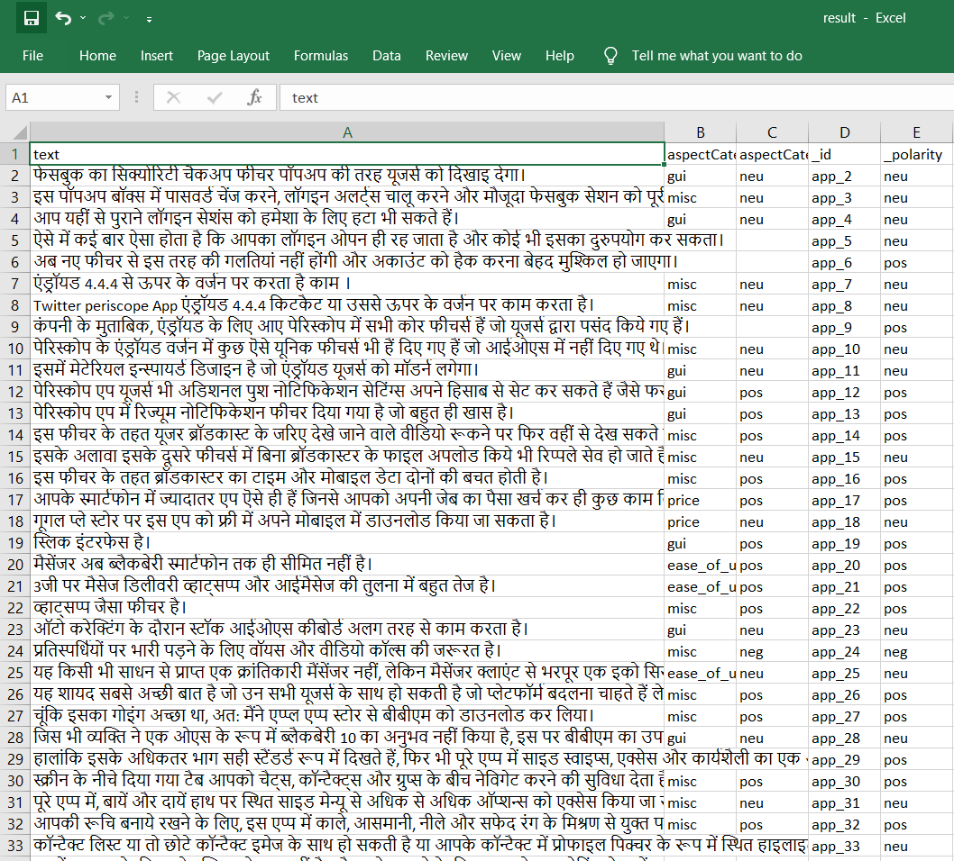

Slide 34
Parallel Translation Dataset:-
Brief overview of Datasets -
The IIT Bombay English-Hindi corpus contains parallel corpus for English-Hindi as well as monolingual Hindi corpus collected from a variety of existing sources and corpora developed at the Centre for Indian Language Technology, IIT Bombay over the years. This page describes the corpus. This corpus has been used at the Workshop on Asian Language Translation Shared Task since 2016 the Hindi-to-English and English-to-Hindi languages pairs and as a pivot language pair for the Hindi-to-Japanese and Japanese-to-Hindi language pairs.
Datasets Size - Size of training and testing sets:
Size of training set-106858
Size of testing set-49692
Different classes of labels and their counts:
Text
Language: Hindi (HIN), English (ENG)

Slide 35
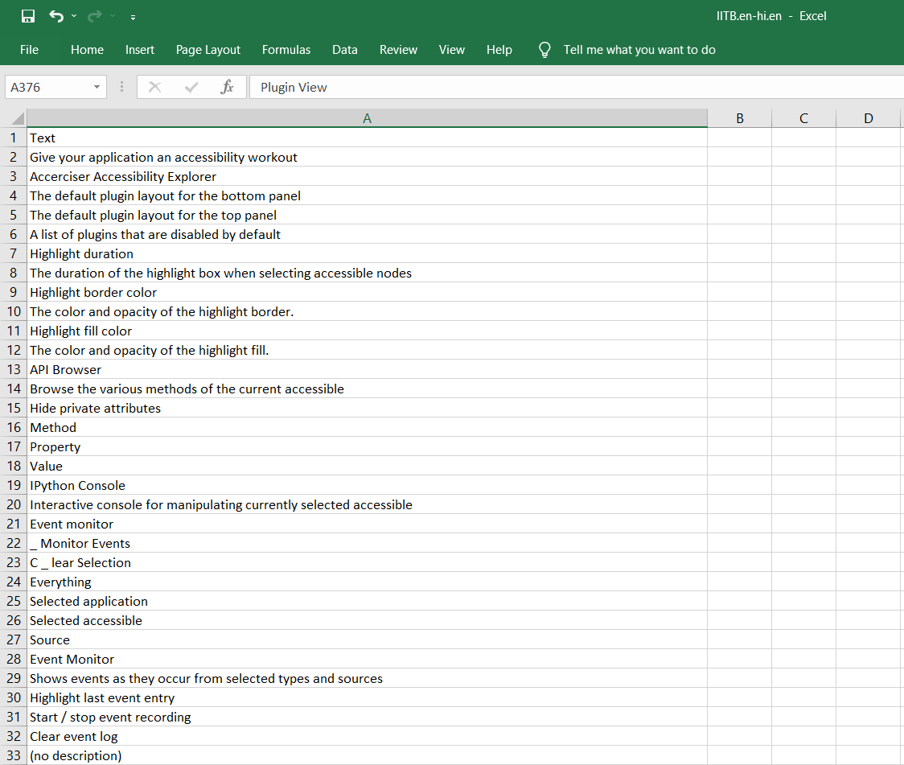
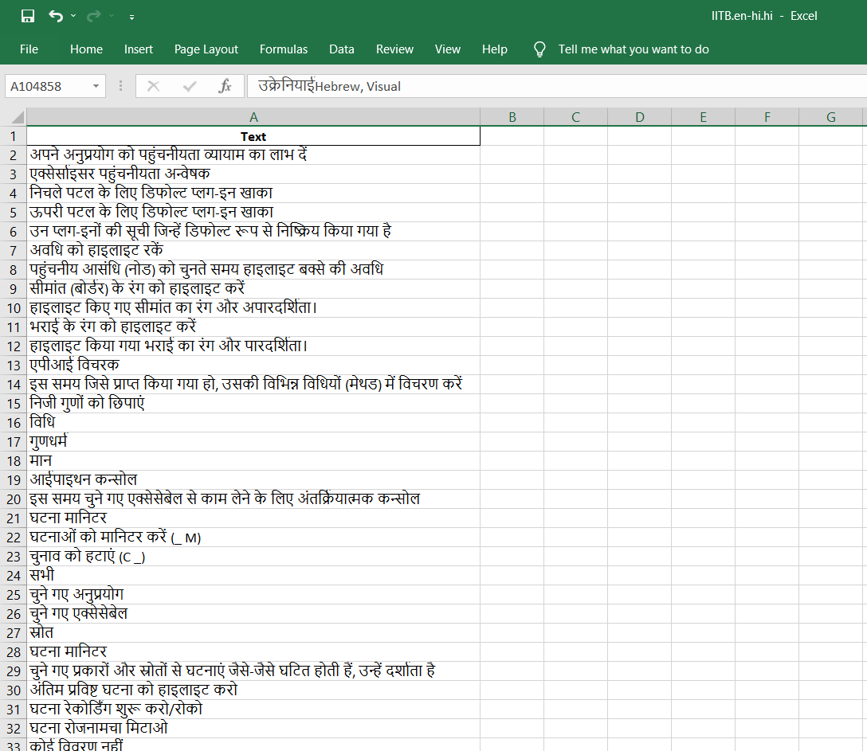

Slide 36
HindEnCorp 0.5 Dataset:-
Brief overview of Datasets -
HindEnCorp parallel texts (sentence-aligned) come from the following sources: Tides, which contains 50K sentence pairs taken mainly from news articles. This dataset was originally collected for the DARPA-TIDES surprise-language con- test in 2002, later refined at IIIT Hyderabad and provided for the NLP Tools Contest at ICON 2008 (Venkatapathy, 2008).
Commentaries by Daniel Pipes contain 322 articles in English written by a journalist Daniel Pipes and translated into Hindi.
Datasets Size - Size of training, testing and dev sets –
Size of training set-120000
Size of testing set-47692

Slide 37
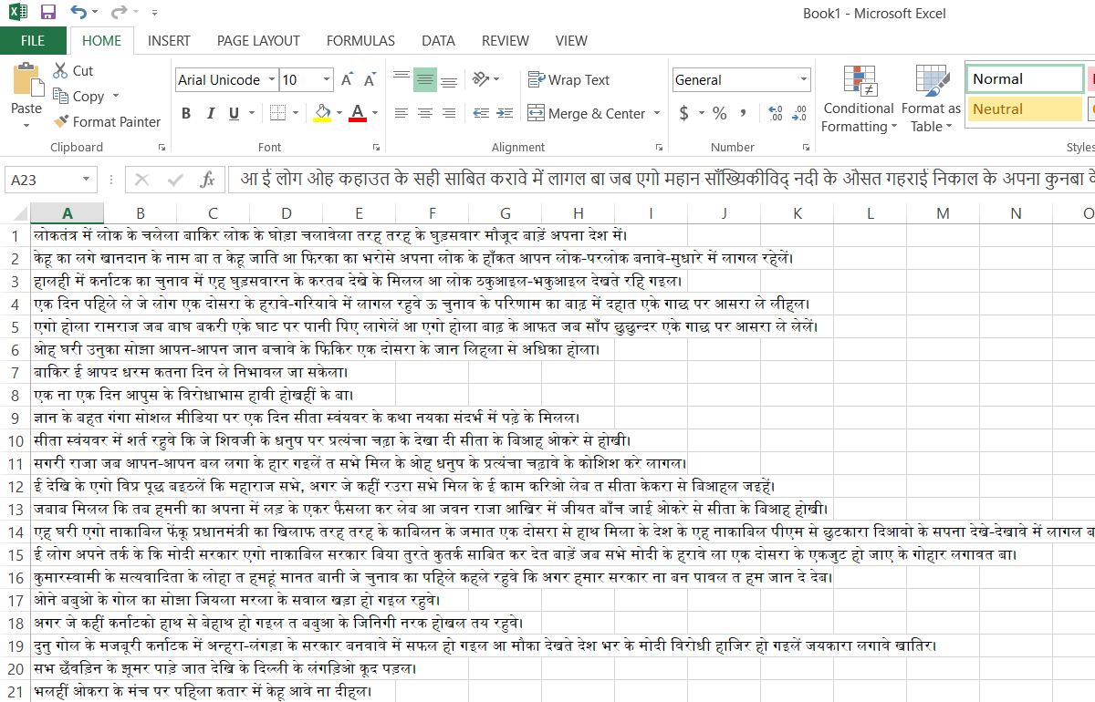
Bhojpuri

Slide 38
Word Similarity Dataset:-
Brief overview of Datasets -
Distributional semantics in the form of word embeddings are an essential ingredient to many modern natural language processing systems. The quantification of semantic similarity between words can be used to evaluate the ability of a system to perform semantic interpretation. To this end, a number of word similarity datasets have been created for the English language over the last decades.
Datasets Size - Size of training and testing sets –
Size of training set-1045(each language)
Size of testing set-370(each language)

Slide 39
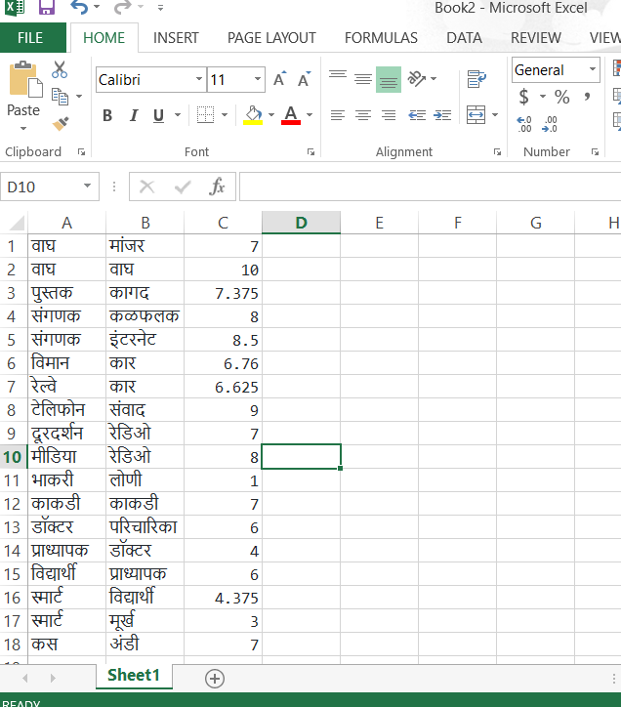
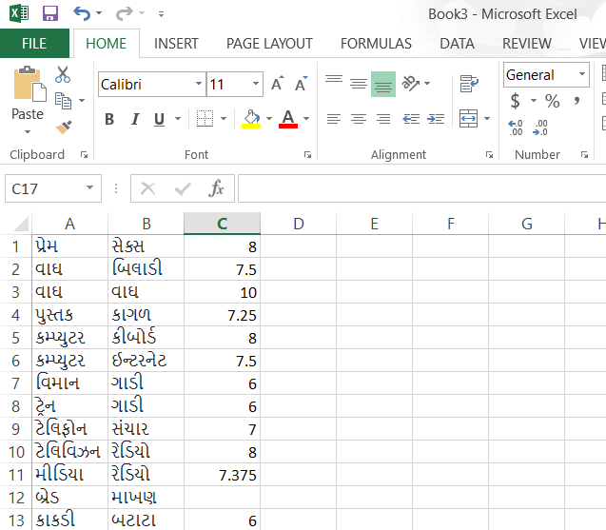
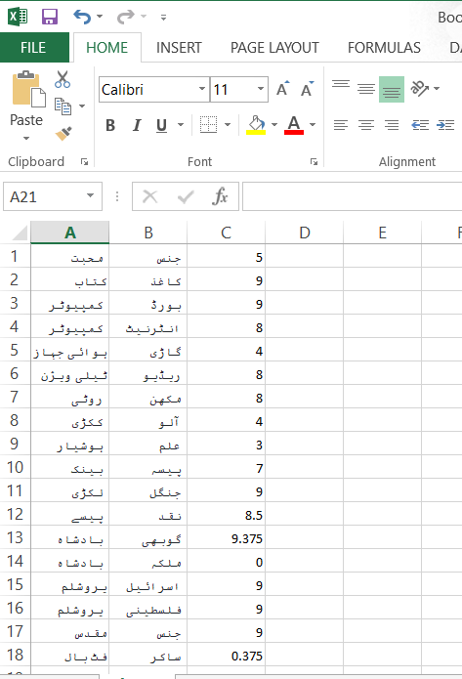
MARATHI
GUJARATI
URDU

Slide 40
NER Hindi Dataset:-
Brief overview of Datasets -
Named Entity Recognition (NER) Refers to automatic identification of named entities in a given text document. Given a text document, named entities such as Person names, Organization names, Location names, Product names are identified and tagged. Identification of named entities is important in several higher language technology systems such as information extraction systems, machine translation systems, and cross-lingual information access systems.
Datasets Size - Size of training and testing sets –
Size of training set-48586
Size of testing set-32066

Slide 41
Language | Team SystemID | Precision | Recall | F-Measure
Bengali | ISI Kolkata Sys 1 | 23.69 | 28.02 | 25.68
 | ISI Kolkata Sys 2 | 28.61 | 16.09 | 20.59
English | TRDDC Sys 1 | 64.79 | 67.23 | 65.99
 | TRDCC Sys 2 | 64.92 | 68.63 | 66.73
 | ISM Sys 1 | 14.89 | 32.02 | 20.33
 | ISM Sys 2 | 39.33 | 34.46 | 36.74
Hindi | TRDCC | 47.51 | 68.35 | 56.06
 | IITB | 83.68 | 74.14 | 78.62
 | MNIT | 01.72 | 04.82 | 02.53

Slide 42
Text Classification Dataset:-
Brief overview of Datasets -
The AI4Bharat-IndicNLP dataset is an ongoing effort to create a collection of large-scale, general-domain corpora for Indian languages. Currently, it contains 2.7 billion words for 10 Indian languages from two language families. We share pre-trained word embeddings trained on these corpora. We create news article category classification datasets for 9 languages to evaluate the embeddings. We evaluate the IndicNLP embeddings on multiple evaluation tasks.
Datasets Size - Size of training and testing sets –
Size of training set-9949
Size of testing set-6267

Slide 43
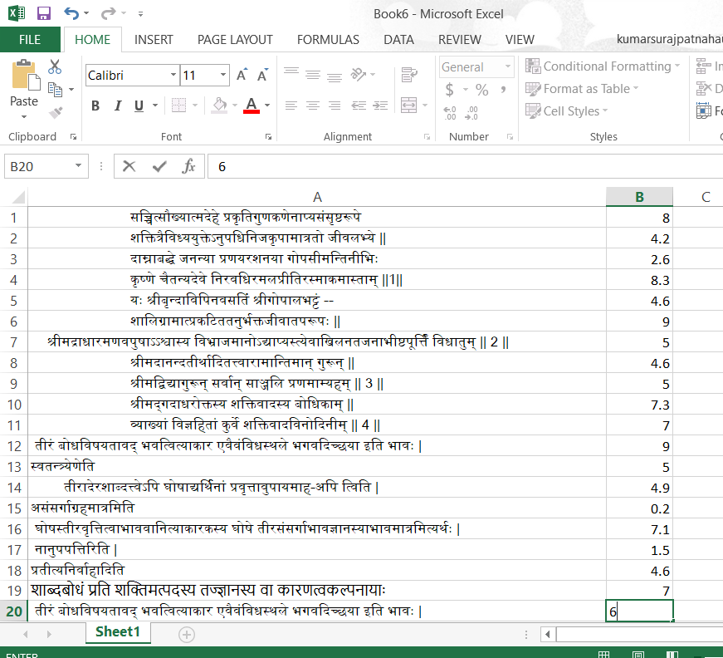
SANSKRIT

Slide 44
Conclusion
In a nutshell, this internship has been an excellent and rewarding experience. We can conclude that there have been a lot We have learnt from our work at YScholar. We have completed our tasks in stipulated time interval.
Two main things that we have learned the importance of time-management skills and self-motivation.

Slide 45
References
1. https://www.kaggle.com/agrawaladitya/step-by-step-data-preprocessing-eda
2. https://www.nltk.org/
3. https://spacy.io/usage/models
4. https://www.coquery.org/
5. https://www.analyticsvidhya.com/blog/2018/02/the-different-methods-deal-text-data-predictive-python/
6. https://www.geeksforgeeks.org/python-efficient-text-data-cleaning/
7. https://www.kdnuggets.com/2018/03/text-data-preprocessing-walkthrough-python.html
8. https://medium.com/towards-artificial-intelligence/natural-language-processing-nlp-with-python-tutorial-for-beginners-1f54e610a1a0#3be2
9. https://realpython.com/natural-language-processing-spacy-python/

