Slide 1
Eagle Eye
TEAM
FOR_THE_CAUSE
By:
Vivek Chowdhury
Harsha Telanakula
Himanshu Sharma
Vignesh Ram
Rajesh Manickam

Slide 2
Contents:
Problem Statement.
Project Description.
Proposed Solution.
2

Slide 3
Problem Statement
Across several Countries, Forest fires or wildfires are caused due to Human Negligence, Lightning, Arson etc. A natural disaster consisting of a fire which destroys a forested area, and can be a great danger to people who live in forests as well as wildlife.
Forest fires are caused by the drying out of branches, leaves and therefore becomes highly flammable.
Fires can do weird things including:
1)Crawling - spreads from bush to bush.
2)Crown - spread at an incredible pace through the top of the forest. These are dangerous as it can deprive people under the fire of oxygen to feed the fire.
3)Jumping / Spotting - Burning branches and leaves carried away by wind.
3

Slide 4
Project Description
The aim of this project is to detect the forest or wild fires and help civilians stuck in the forest to get to safety.
It will also help in mitigation and prevention of wildfire.
4

Slide 5
Proposed Solution
The plan is to detect fire and smoke in the forest using real-time image/object detection techniques using cameras installed in a drone.
Alerting the closest Fire Fighting team and concerned authorities.
Alerting any nearby civilians of the fire.
It will also help civilians trapped inside the forest to evacuate to safety by providing network for civilians to connect and share their locations and get updates on the direction in which the fire is spreading.

Slide 6









Proposed Design

Slide 7
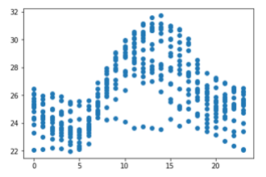
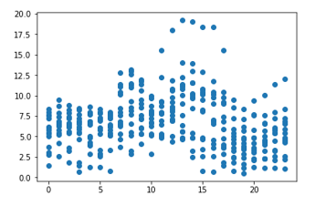
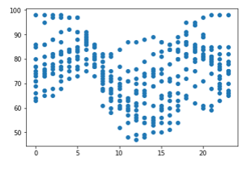
Mapping Data
Hour vs Temperature
Hour vs Wind Speed
Hour vs Humidity

Slide 8
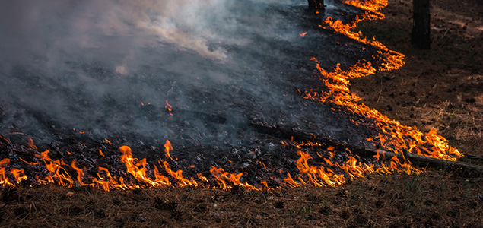
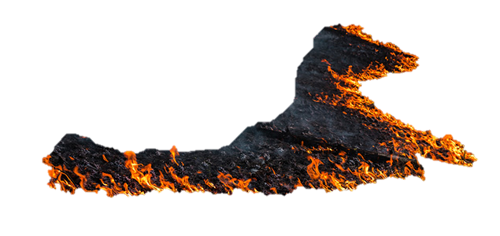

Slide 9
Thank you

