Slide 1

SHARED INVESTIGATOR PLATFORM
By Team
High-Voltage

Slide 2
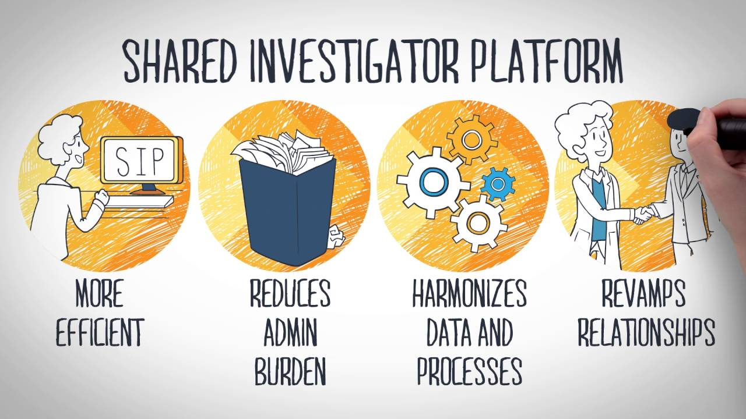
What is SIP?
The Shared Investigator Platform (SIP) is a single platform that facilitates investigative site collaboration with multiple clinical trial sponsors. The SIP has been designed to lessen the administrative burden on site staff by reducing redundant requests for information and training and increasing automation and the re-use of data.

Slide 3



Concept to reality
Sip was a idea that in the future we would have a multi-tenant multi-vendor outlook that make life of the investigator sites easier when they do clinical trials.
One of the typical thing that gets in our way of getting new medicines are in clinical trials much of this is paperwork, much of it is administrative work.
Obtaining all the paper manual, documenting, completing them routing for signatures and tracking down people making sure that they sign the documents and returning those back to the sponsor for their own particulate research.
SIP is a cloud based solution that allows a central point of access for investigator sites with a single sign-in for them to be able to access multiple sponsored site.

Slide 4
Why The Shared Investigator Platform
Very few doctors serve as clinical investigators (approximately 3%), which means many investigators work with multiple sponsor organizations. Each sponsor organization has its own site-facing IT systems and business processes, meaning that these investigators need to remember which URLs, login credentials, and processes to use for which sponsor/study – on top of their patient interactions and other administrative duties.
Clinical trial sites were heavily burdened by using many different platforms, each requiring unique login credentials, to perform clinical trial responsibilities and communicate with their sponsors. In addition to the high costs and redundant efforts involved in developing and maintaining individual sponsor portals, the existence of disparate processes and tools within these portals increased both risk of error and support needed for site users

Slide 5
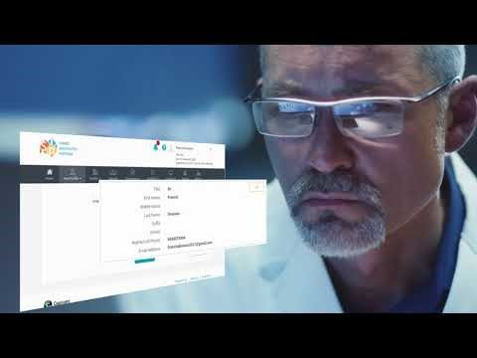

Slide 6
Benefits
Benefits for Sites:
Increased efficiency and reduced administrative burden due to centralized point of access more unified experience, harmonized content and services
Reduced study startup time and redundant training
More time with patients due to a decrease in redundant requests for information (e.g.: feasibility surveys), essential documents, and training
Benefits for Member Companies:
Streamlined processes, regulatory compliance and capacity
Better data quality in sponsor systems
Increased intra-company collaboration
Benefits for Regulators:
Increased efficiency in accessing study data and information about trials

Slide 7
TransCelerate & Cognizant
The Shared Investigator Platform (SIP) was built as a cross-industry solution designed to address these challenges and ultimately enhance efficiency during clinical trial planning and execution. TransCelerate Member Companies that choose to adopt the SIP can increase engagement with investigative sites and eliminate the need to develop and maintain company-specific portals. Additionally, the system will allow expanded insights to clinical trials for regulatory bodies.

