Slide 1

VOICE CONTROLLED
Pattern Reconfigurable
WLAN Antenna
Smart. Low-Cost. Voice-Driven.
Notes:
Introduce the project and its core value proposition.

Slide 2
Project Overview
This project is a low-cost, voice-controlled directional antenna system. A user speaks LEFT, RIGHT, or CENTER into a mobile app; the command travels over Bluetooth to an ESP32 microcontroller, which switches a relay to route a 2.40 GHz RF signal into one of two custom-built microstrip patch antennas — physically steering where the signal radiates strongest, without any costly phased-array or beamforming hardware. An OLED display confirms the active mode in real time, and the whole loop runs continuously off a battery-powered ESP32 platform.
FREQUENCY BAND
2.40 GHz
(WLAN / ISM)
ANTENNA TYPE
Microstrip
Patch (FR4)
CONTROLLER
ESP32
(Bluetooth)
SWITCHING
SPDT
Relay
CONTROL INPUT
Voice →
Speech-to-Text

Slide 3



The Problem
Fixed Radiation
Complex Solutions
No Smart Control
Conventional antennas broadcast in all directions, wasting signal power and causing interference in unwanted areas.
Phased array antennas and beamforming are accurate but extremely costly, complex, and out of reach for low-budget projects.
Existing directional systems require manual operation — there is no intuitive, hands-free way to control signal direction.
Notes:
Explain why existing solutions are insufficient for small-scale or educational deployment.

Slide 4




Our Solution
A low-cost, voice-controlled antenna system that dynamically switches radiation direction using Bluetooth and relay-based switching — no expensive RF hardware required.
Voice Commands
ESP32 Controller
Relay Switching
Patch Antennas
Say LEFT, RIGHT or CENTER via mobile app
Processes Bluetooth commands in real-time
Routes RF signal to selected patch antenna
Dual FR4 microstrip antennas at 2.4 GHz
Notes:
Walk through each component — voice → ESP32 → relay → antenna.

Slide 5

How It Works
01
02
03
04
05
Voice Command
Bluetooth TX
ESP32 Processes
Relay Switches
Antenna Active
User speaks LEFT, RIGHT or CENTER into mobile app
App converts speech-to-text and sends via Bluetooth
Microcontroller receives and interprets the command
GPIO drives relay ON/OFF to select active antenna
RF signal transmitted through selected patch antenna
Notes:
Walk through the 5-step signal and control flow from voice input to antenna selection.

Slide 6
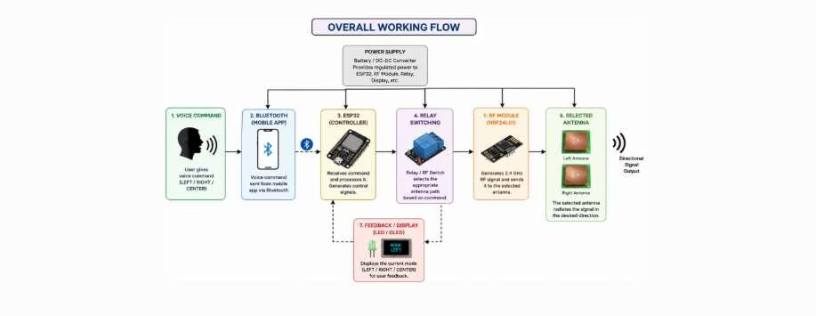
System Architecture
From spoken command to directional RF transmission — a fully embedded, closed-loop control chain
Voice Command → Bluetooth App → ESP32 Controller → Relay Switching → NRF24L01 → Selected Antenna → OLED Feedback

Slide 7
Antenna Design Specifications
PATCH ANTENNA — TOP VIEW
Physical Dimensions
Operating Frequency:
2.40 GHz (WLAN band)
Patch Width (W):
38 mm
W = 38 mm
L = 29 mm
Patch Length (L):
29 mm
Substrate Thickness (h):
1.6 mm
Ground Plane:
60 × 60 mm
Materials & Fabrication
Conductor:
Copper foil, ~0.05 mm
Substrate:
FR4 (εr ≈ 4.4)
Ground plane / FR4 substrate: 60 × 60 mm
SMA inset feed, 50 Ω matched
Feed / Connector:
SMA, 50 Ω matched
Fabrication:
Manual patch-and-ground lamination

Slide 8
Antenna Design & Performance
Design Parameters
−19.89dB
1.2253
Frequency:
2.40 GHz (WLAN band)
Type:
Microstrip Patch Array
Return Loss (S₁₁)
VSWR at 2.40 GHz
Substrate:
FR4 (dual-element)
Feed:
Inset-fed microstrip
≈ 3.2 dB
Connector:
SMA (50 Ω matched)
Peak Gain
Simulation:
ANSYS HFSS
✓ TM₁₀ mode confirmed via E-field distribution | Broadside radiation pattern
Notes:
Highlight S11 = −19.89 dB as excellent matching. VSWR of 1.22 is near-ideal. Gain of 3.2 dB confirms directionality.

Slide 9
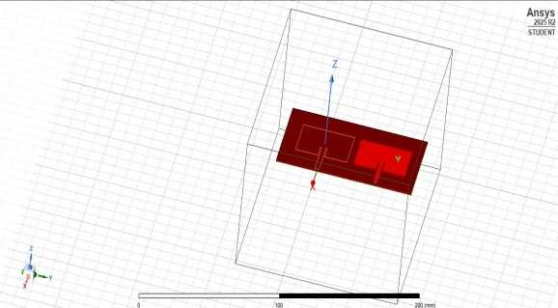
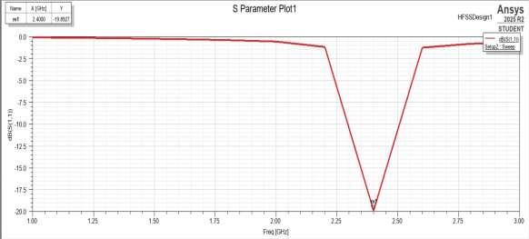
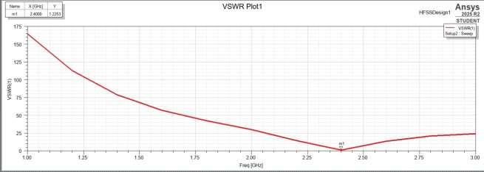
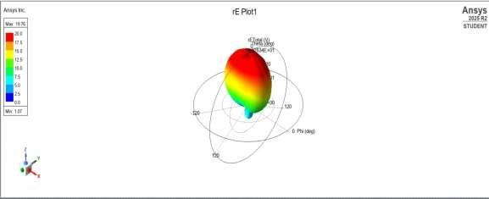
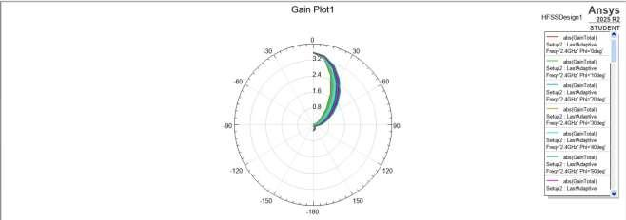
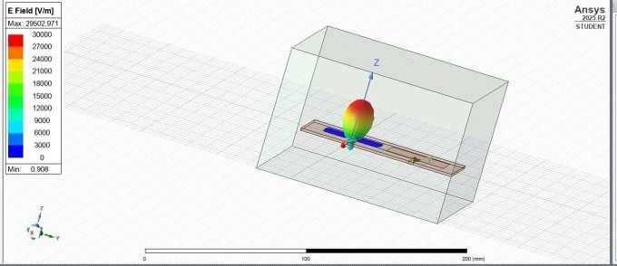
Simulation Results — ANSYS HFSS
HFSS ANTENNA MODEL
RETURN LOSS (S11) — -19.89 dB
VSWR — 1.2253 @ 2.40 GHz
3D RADIATION PATTERN
GAIN PLOT — ~3.2 dB PEAK
E-FIELD DISTRIBUTION

Slide 10





Technology Stack
ESP32
Mobile App
Relay Module
Central controller
Bluetooth + Wi-Fi
Speech-to-text
Voice interface
Antenna selection
Electromechanical switch
NRF24L01
OLED Display
Arduino IDE
2.4 GHz RF
transceiver module
SSD1306 I2C
Mode feedback
Embedded C++
Firmware development
Notes:
Mention protocols: Bluetooth (voice), SPI (NRF24L01), I2C (OLED), GPIO (relay/LEDs).

Slide 11
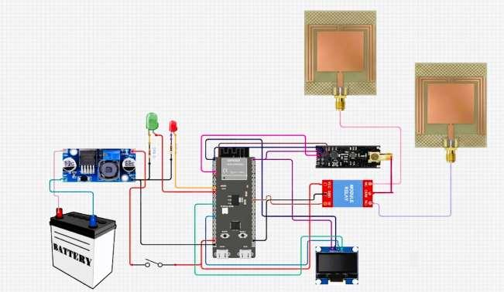
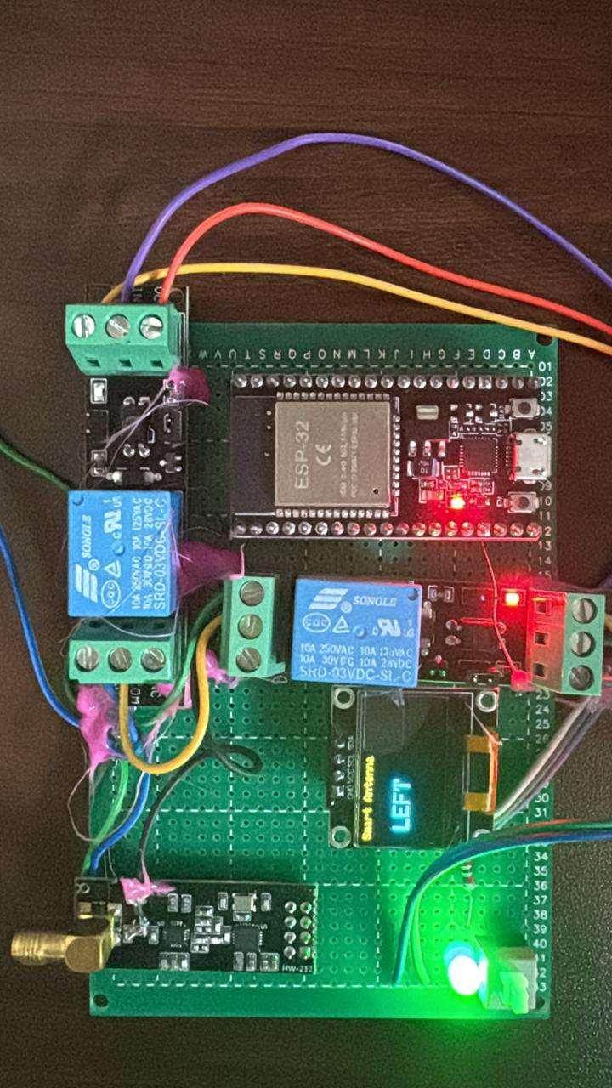
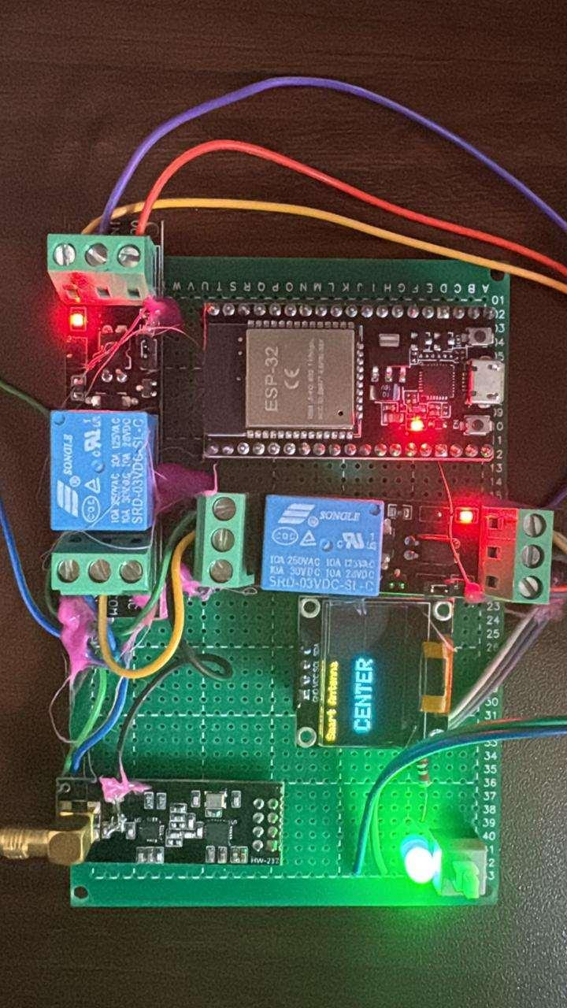
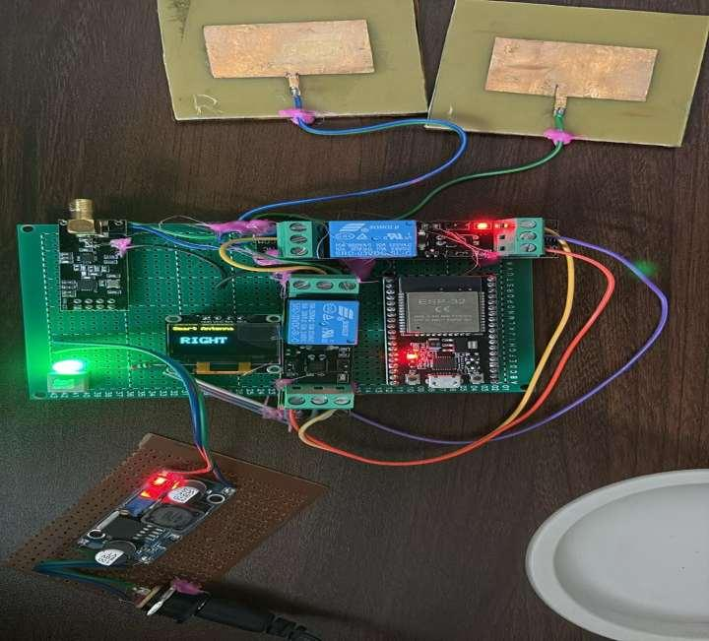
Hardware Prototype
SYSTEM WIRING DIAGRAM
LEFT MODE
CENTER MODE
RIGHT MODE

Slide 12
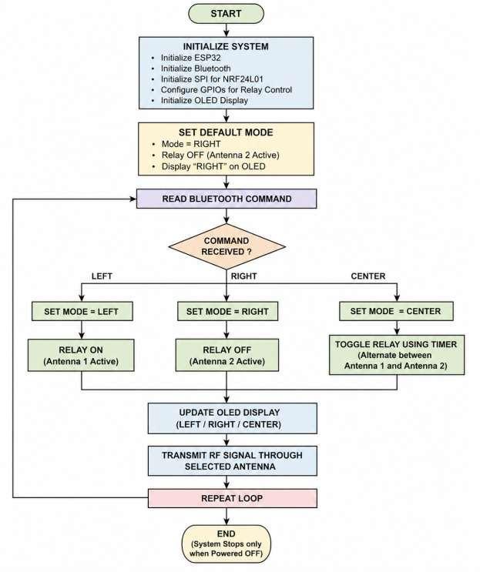
Firmware Snapshot
DECISION LOGIC FLOW
// main control loop — ESP32
if (cmd == "left") {
mode = "left";
showDisplay("LEFT");
}
else if (cmd == "right") {
mode = "right";
showDisplay("RIGHT");
}
else if (cmd == "center") {
mode = "center";
showDisplay("CENTER");
}
// Drive relay + transmit
if (mode == "left") {
digitalWrite(RELAY1, HIGH);
digitalWrite(RELAY2, LOW);
sendRF("LEFT");
}
Arduino C++ on ESP32 · BluetoothSerial · RF24 (NRF24L01) · Adafruit SSD1306 OLED

Slide 13
Firmware — Full Source (1/3)
// Includes, globals & pin setup
// NRF/OLED init & startup screen
#include <BluetoothSerial.h>
#include <SPI.h>
#include <RF24.h>
#include <Wire.h>
#include <Adafruit_GFX.h>
#include <Adafruit_SSD1306.h>
// OLED
Adafruit_SSD1306 display(128, 64, &Wire, -1);
// Bluetooth
BluetoothSerial SerialBT;
// NRF
RF24 radio(4, 5);
const byte address[6] = "00001";
// Relays
#define RELAY1 25
#define RELAY2 26
// Modes
String mode = "right"; // default
void setup() {
Serial.begin(115200);
SerialBT.begin("Smart_Antenna");
pinMode(RELAY1, OUTPUT);
pinMode(RELAY2, OUTPUT);
digitalWrite(RELAY1, LOW);
digitalWrite(RELAY2, LOW);
// NRF
radio.begin();
radio.openWritingPipe(address);
radio.setPALevel(RF24_PA_HIGH);
radio.stopListening();
// OLED
if(!display.begin(SSD1306_SWITCHCAPVCC, 0x3C)) {
Serial.println("OLED init failed");
}
display.clearDisplay();
display.setTextColor(WHITE);
// Startup Screen
display.setTextSize(1);
display.setCursor(0,20);
display.println("Electronic Switch");
display.setCursor(0,35);
display.println("Based Antenna");
display.display();
Serial.println("System Starting...");
delay(5000);
display.clearDisplay();
display.display();
}

Slide 14
Firmware — Full Source (2/3)
// loop() — read Bluetooth command
// loop() — drive relay & transmit
void loop() {
// Read Bluetooth
if (SerialBT.available()) {
String cmd = SerialBT.readString();
cmd.trim();
cmd.toLowerCase();
Serial.print("Command: ");
Serial.println(cmd);
if (cmd == "left") {
mode = "left";
showDisplay("LEFT");
Serial.println("Mode: LEFT");
}
else if (cmd == "right") {
mode = "right";
showDisplay("RIGHT");
Serial.println("Mode: RIGHT");
}
else if (cmd == "center" || cmd == "centre") {
mode = "center";
showDisplay("CENTER");
Serial.println("Mode: CENTER");
}
else {
Serial.println("Invalid Command");
}
}
// MODE EXECUTION
if (mode == "left") {
digitalWrite(RELAY1, HIGH);
digitalWrite(RELAY2, LOW);
sendRF("LEFT");
}
else if (mode == "right") {
digitalWrite(RELAY1, LOW);
digitalWrite(RELAY2, HIGH);
sendRF("RIGHT");
}
else if (mode == "center") {
digitalWrite(RELAY1, HIGH);
digitalWrite(RELAY2, HIGH);
sendRF("CENTER");
}
}

Slide 15
Firmware — Full Source (3/3)
// Display + RF helper functions
Control Algorithm
// OLED DISPLAY
void showDisplay(String text) {
display.clearDisplay();
display.setTextSize(1);
display.setCursor(0,0);
display.println("Smart Antenna");
display.setTextSize(2);
display.setCursor(10,25);
display.println(text);
display.display();
}
// NRF SEND FUNCTION
void sendRF(const char* msg) {
radio.write(msg, strlen(msg) + 1);
}
1. Initialize ESP32, Bluetooth, NRF24L01 (SPI) and OLED.
2. Set default mode = RIGHT (Antenna 2 active); show startup screen.
3. Continuously poll for an incoming Bluetooth command.
4. Parse command: "left" / "right" / "center" (or "centre").
5. LEFT → Relay ON, Antenna 1 active.
6. RIGHT → Relay OFF, Antenna 2 active.
7. CENTER → relay toggled to alternate both antennas.
8. Update OLED with the active mode for instant feedback.
9. Transmit an RF signal through the NRF24L01 on the
selected antenna path.
10. Repeat indefinitely; stops only when powered off.

Slide 16

Results
LEFT Mode
RIGHT Mode
CENTER Mode
Relay 1 ON → Antenna 1 active
Signal directed left
Relay 2 ON → Antenna 2 active
Signal directed right
Both relays toggle via timer
Alternating coverage
Key Outcomes
Real-time antenna switching verified for all three voice commands
OLED display confirmed correct mode after every command
No instability or unintended state changes during repeated tests
Relay electromechanical delay noted — addressable with PIN diode switching in future
Notes:
Share prototype photos in the LinkedIn post comments.

Slide 17






Applications
Smart WLAN
Industrial IoT
Smart Homes
Focus Wi-Fi signal toward active conference rooms or zones
Directional links between wireless sensors and controllers
Redirect signal to active rooms for better smart device coverage
Secure Comms
Sensor Networks
Future: 5G/AI
Reduce signal leakage in defense and surveillance environments
Optimize WSN data transmission, saving energy and reducing interference
Extensible toward 5G mmWave, massive MIMO, and AI-driven beam control
Notes:
Emphasize that the architecture is scalable — same concept can extend to more antennas, 5G, etc.

Slide 18
Future Scope & Enhancements
01
PIN Diode / RF MEMS Switch
Replace mechanical relay with solid-state switching to eliminate latency and increase reliability
02
360° Beam Steering
Expand to circular antenna arrays enabling full angular coverage and precise sector selection
03
AI-Based Auto Beam Selection
Machine learning models that auto-select the optimal antenna based on real-time signal quality metrics
04
5G / Millimeter Wave
Scale the architecture to 5G mmWave frequencies and massive MIMO configurations
05
Smart Mobile App
Companion app with signal strength visualization, manual override, and cloud monitoring dashboard
Notes:
Connect future scope to current trends: 5G, AI, smart buildings — shows the project has real growth potential.

Slide 19

Thank You!
Voice Controlled Pattern Reconfigurable WLAN Antenna
Proving that smart, directional wireless communication doesn't need expensive hardware.
Key Takeaway
A smart, low-cost approach to directional wireless communication — combining voice control, embedded systems, and antenna design into one seamless system.
#WLANAntenna #EmbeddedSystems #IoT #ESP32 #VoiceControl #AntenaDesign #Wireless
Notes:
Share your LinkedIn profile in comments. Use the hashtags for maximum reach.

