Slide 1


DATA SCIENCE LAB · MINOR PROJECT
SmartSpend
Budget Management for College Students
Student Name
UID / Section
Himanshu
26BCD10378 · 26BCD-6-B
Submitted to-
Simranjeet sir
Submission Date
2 November 2026
Slide No- 1
Notes:
Introduce the SmartSpend project: a focused Minor Project for the Data Science Lab evaluating personal finance tracking for students through spreadsheet automation.

Slide 2
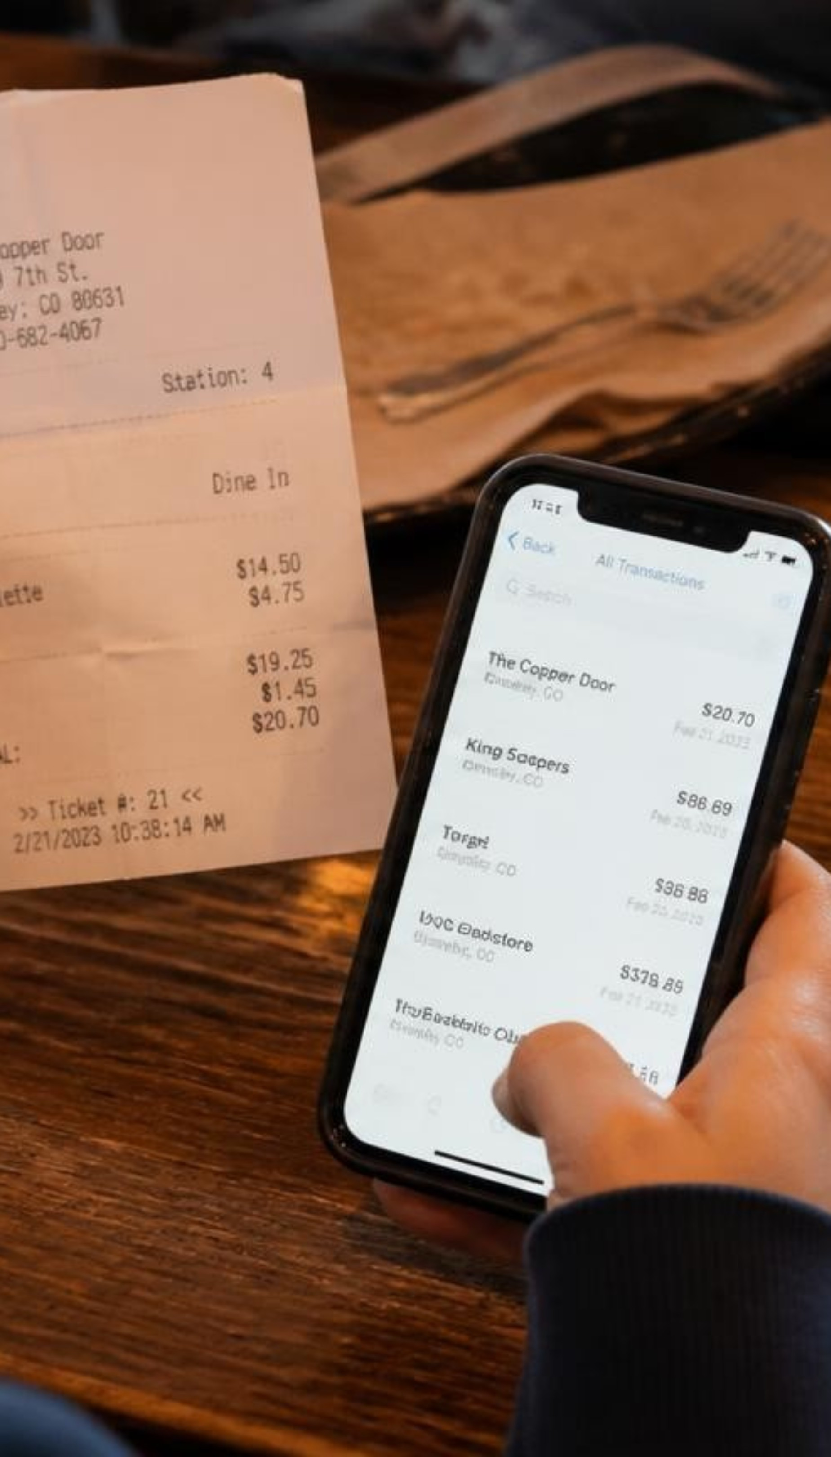




Students struggle to see where their money goes
Daily expenses are hard to track
Food, shopping, and entertainment lead to overspending
The remaining monthly balance is unclear
Regular saving is hard to maintain
Slide no- 2
Notes:
Review the core challenges students face: four recurring friction points that lead to mid-month budget depletion.

Slide 3






SYSTEM GOALS
Six objectives guide SmartSpend
Record income and expenses systematically
Categorize spending
Calculate total income, total expenses, remaining balance, and savings rate
Compare actual spending with planned budgets
Identify overspending using automatic alerts
Encourage financial awareness and responsible spending
Slide no- 3
Notes:
Present the 6 core functional objectives designed into the workbook, from structured logging to behavioral habit formation.

Slide 4
TECHNICAL STACK
Built with Excel, Word, and PowerPoint
Leveraging accessible desktop productivity software to build an integrated analysis and reporting pipeline.
CORE ENGINE
DOCUMENTATION
PRESENTATION
Microsoft Excel
Microsoft Word
PowerPoint
The interactive computation backbone managing ledgers, formulas, and visual reporting.
Comprehensive project laboratory report documenting system architecture and design logic.
Visual presentation slide deck engineered for viva defense and laboratory demonstration.
Formula suite: SUMIF, SUMIFS, IF, IFERROR
Dynamic conditional formatting rules
Native doughnut & bar distribution charts
Formal lab minor project submission dossier
Detailed schema and formula explanations
Structured methodology and validation steps
Structured viva evaluation walkthrough
Worksheet architecture breakdown
Summary findings and scope boundaries
Slide no-4
Notes:
Highlight the software components: Excel performs the live calculation logic, Word holds the lab report, and PowerPoint frames the viva presentation.

Slide 5
From transaction entry to spending charts
Enter
Categorize
Calculate
1
2
3
Enter date, description, category, transaction type, amount, and payment method.
Categorize transactions into expense categories.
Excel formulas calculate totals automatically.
Compare
Display
4
5
Compare actual expenses with category budgets.
Display spending patterns using charts.
Slide no-5
Notes:
Walk through the data journey from raw input on the tracker sheet to aggregated KPI outputs on the summary dashboard.

Slide 6
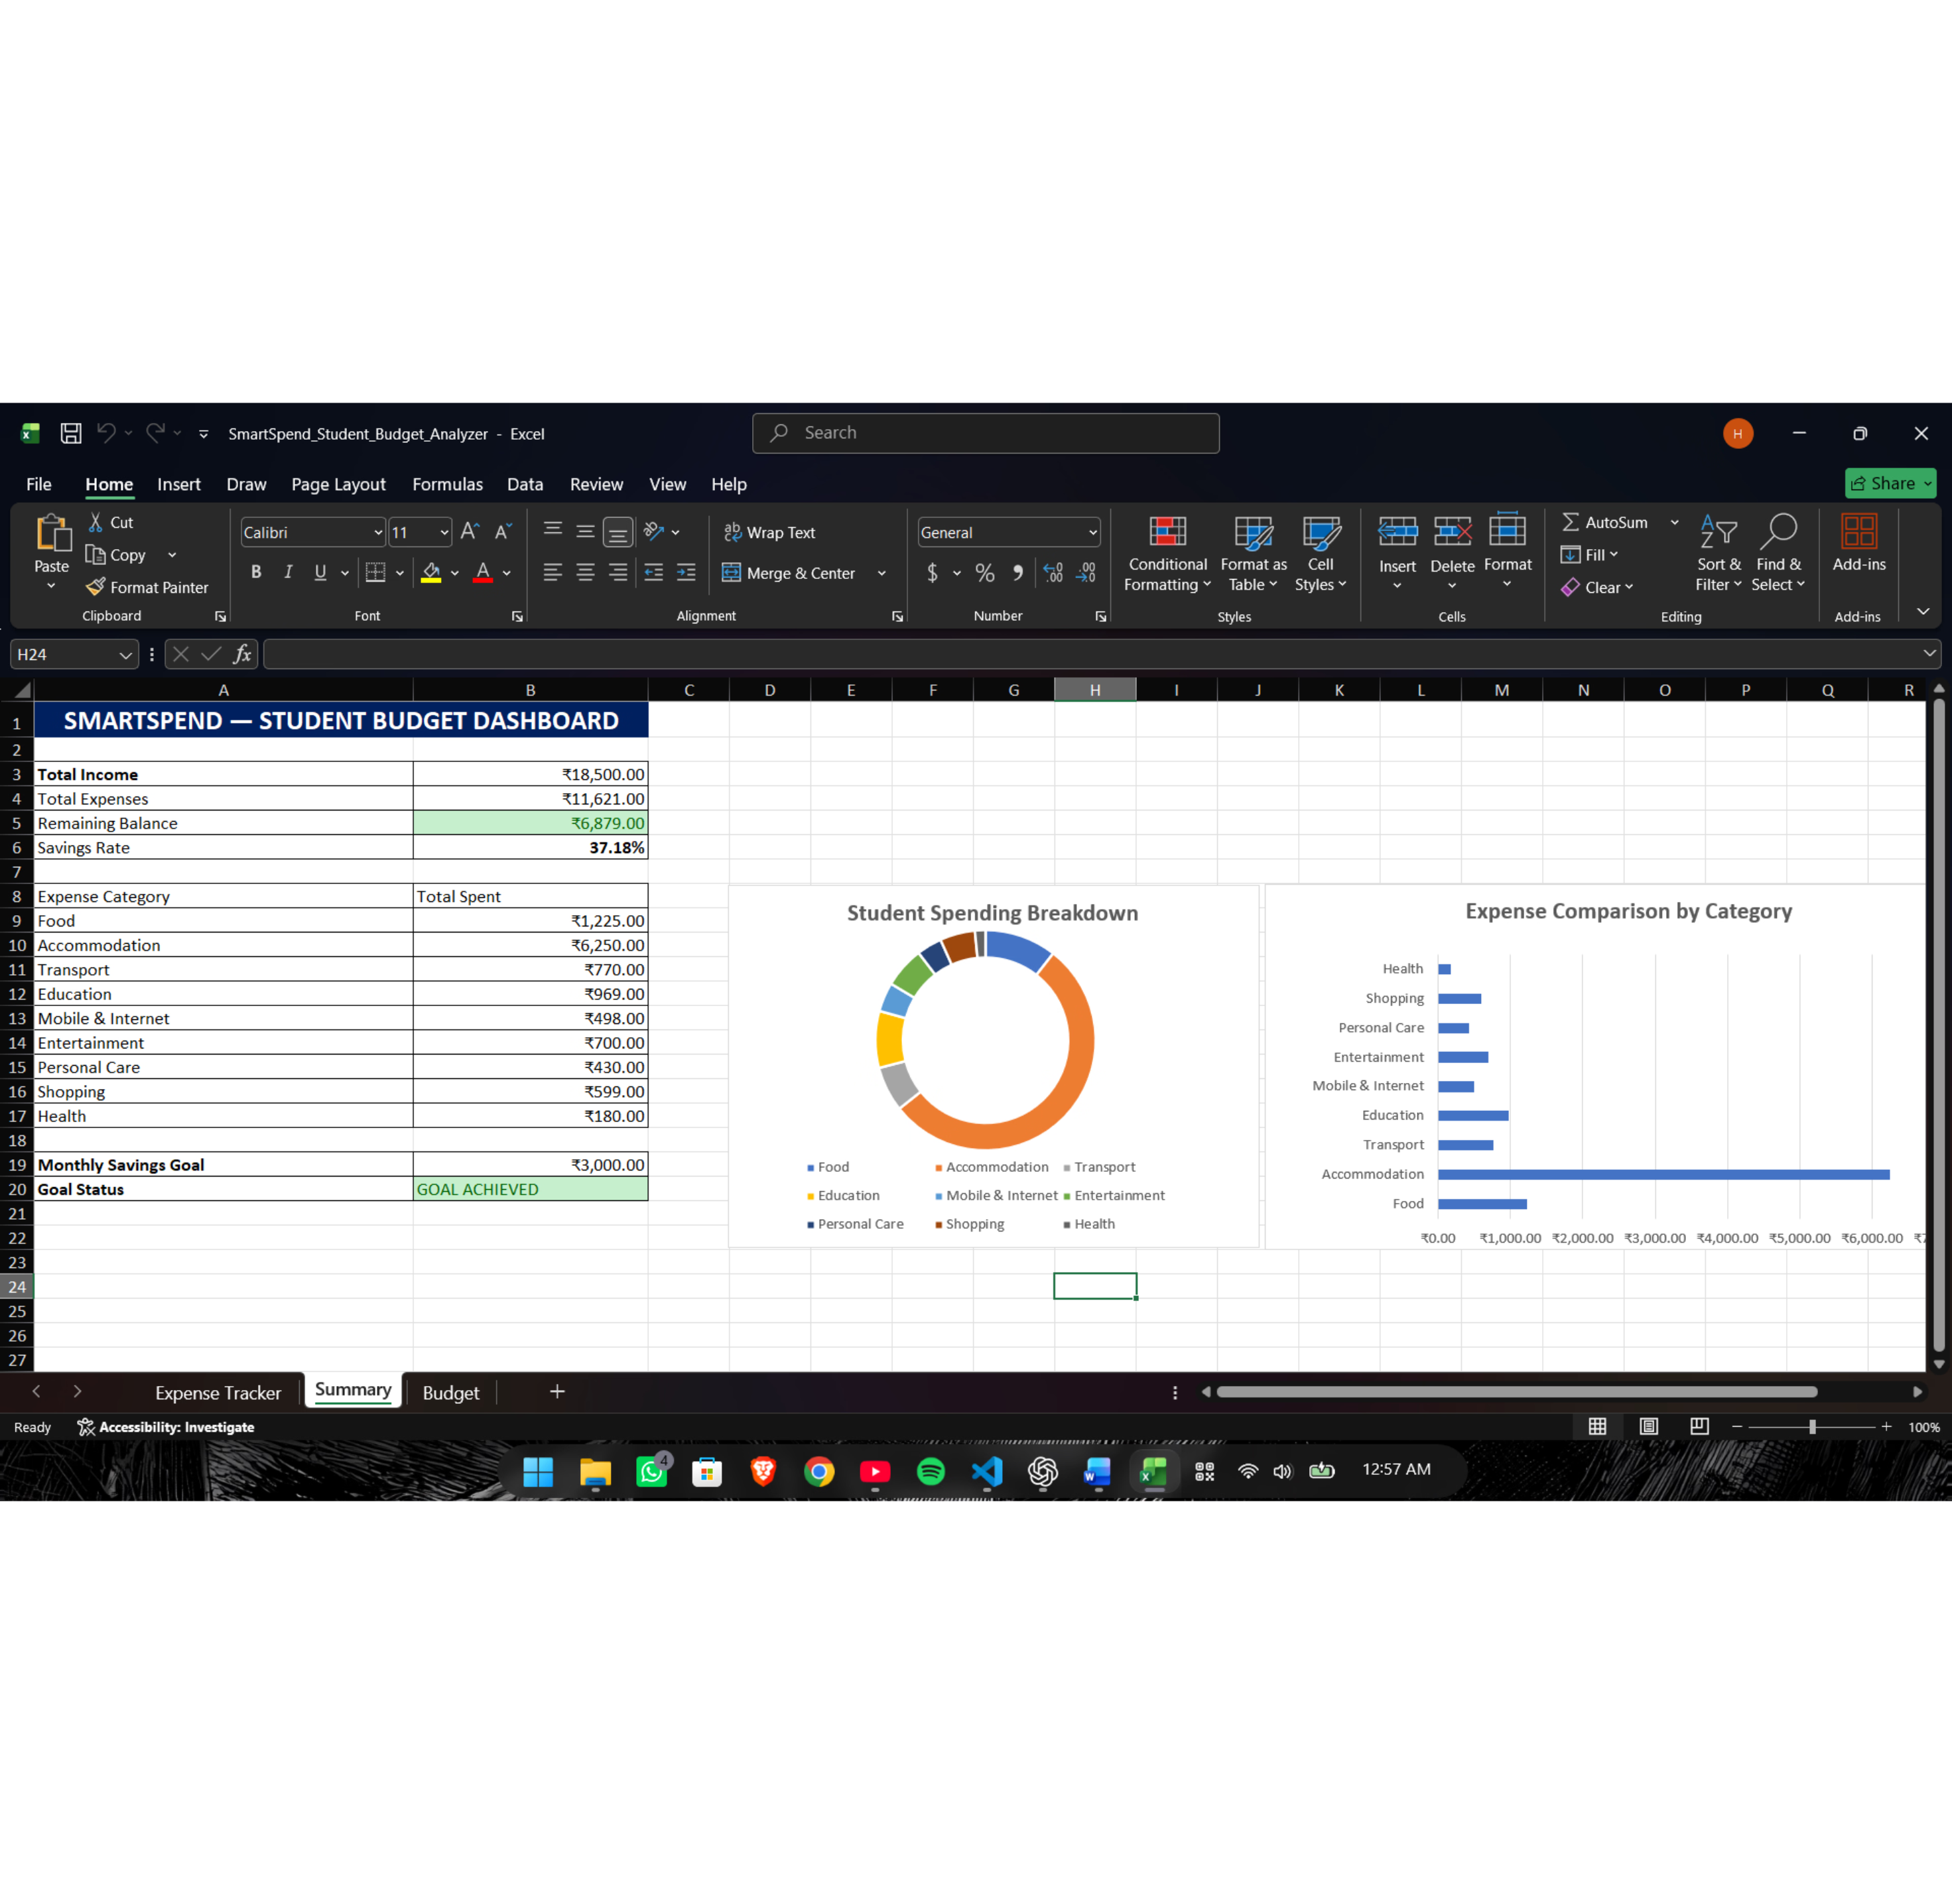

CORE INTERFACE
The SmartSpend dashboard at a glance
The Summary sheet brings key student budget metrics and spending visuals together.
Key Financial Indicators
Total Income, Total Expenses, Remaining Balance, and Savings Rate.
Visual Distribution
Category-wise spending doughnut chart and expense comparison bar chart.
Monthly Savings Goal
Monthly savings goal and status.
Slide no-6
Notes:
Present the primary Excel Summary sheet screenshot. Emphasize that all numbers are demonstration data modeling student cash flow.

Slide 7
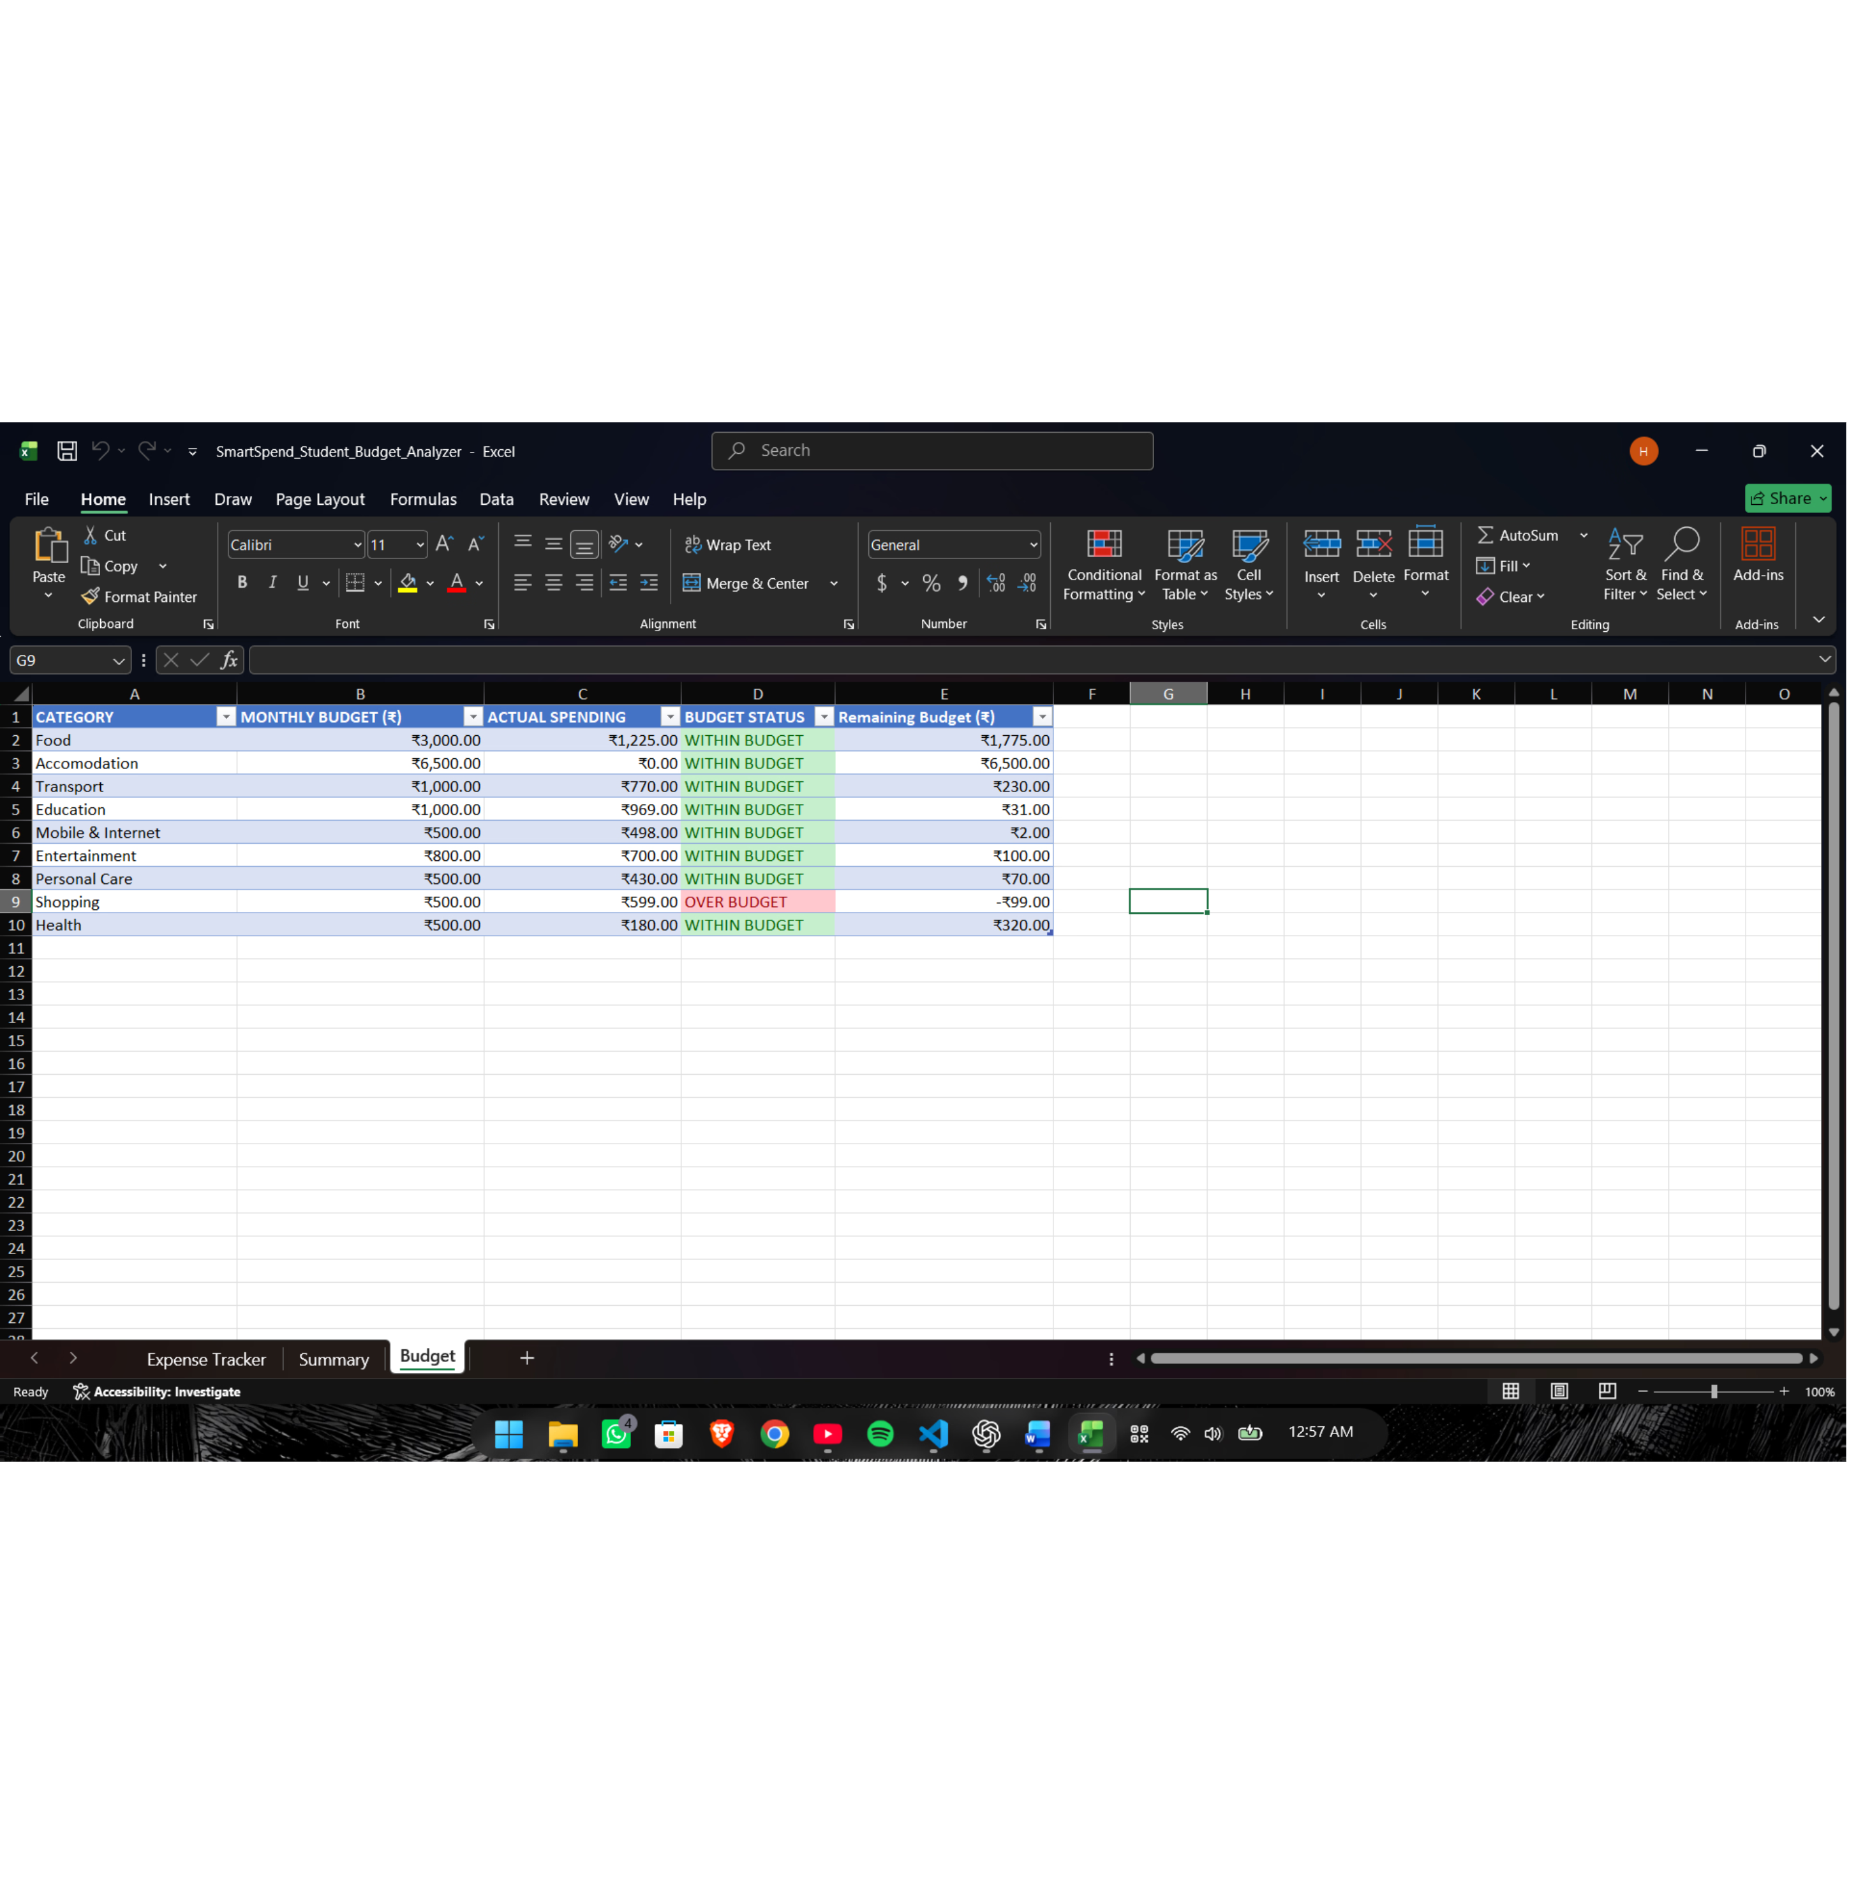
WORKBOOK STRUCTURE
Three worksheets, one budget workflow
Three linked sheets keep transaction records, analysis, and budgets organized.
Expense Tracker
Stores transaction records.
Summary
Calculates financial indicators and visualizes spending.
Budget
Compares planned budgets with actual spending.
WITHIN BUDGET
OVER BUDGET
Slide no-7
Notes:
Explain how the three worksheets connect: data entered in Tracker flows to Summary and evaluates against limits set in Budget.

Slide 8







BEST PRACTICES
Seven habits that keep a student budget on track
Practical rules for healthy money management through the academic term.
1. Set a realistic monthly budget
5. Limit impulse purchases
Set realistic monthly caps from known allowances, not optimistic ideals.
Use a 24-hour wait before finalizing non-essential buying.
2. Separate needs from wants
6. Review spending at month end
Prioritize course books, rent, and groceries over recreational spending.
Inspect category variances to re-align next month’s limits.
3. Record expenses regularly
7. Plan for unexpected expenses
Log every cash or card spend the same day to eliminate tracking debt.
Keep an unexpected contingency cushion: a 10% emergency buffer for medical, tech, or transit emergencies without breaking your budget.
4. Set a savings target
Make minimum savings a mandatory initial expense at month start.
Slide no- 9
Notes:
Present the actionable budgeting habits that turn the technical Excel tool into sustained daily behavioral discipline.

Slide 9
EVALUATION & ROADMAP
What the prototype shows, and where it stops
A transparent evaluation of current capabilities, operational constraints, and development horizons.
CAPABILITIES
BOUNDARIES
HORIZONS
Demonstrated
Limitations
Future Scope
Automated real-time income and expense calculation
Clear category-wise breakdown of outflows
Immediate visual alerts on budget overruns
Transparent savings rate calculation
Evaluated strictly on fictional sample data
Requires manual transaction entry discipline
Standalone desktop spreadsheet prototype
No automated live bank API syncing
Multi-month historical trend comparison
Slicers and interactive dashboard filters
Exportable PDF monthly performance cards
Optional student survey on budgeting habits
Slide No- 9
Notes:
Demonstrate academic rigor by clearly distinguishing current working features from design limits and proposed next steps.

Slide 10

PROJECT CONCLUSION
Thank You
SmartSpend shows how Excel formulas, conditional formatting, and data visualization support personal budget management, helping students monitor expenses, plan budgets, and build better saving habits.
Questions?
Slide no- 10
Notes:
Conclude the presentation, summarize how spreadsheet tools deliver practical financial literacy, and invite questions from the evaluators.

