Slide 1
Optimizing Tour Routes
Prescriptive Modelling and Optimization : GENBUS 730
Presented by –
Himanshu Malik
Shivam Bhat

Slide 2
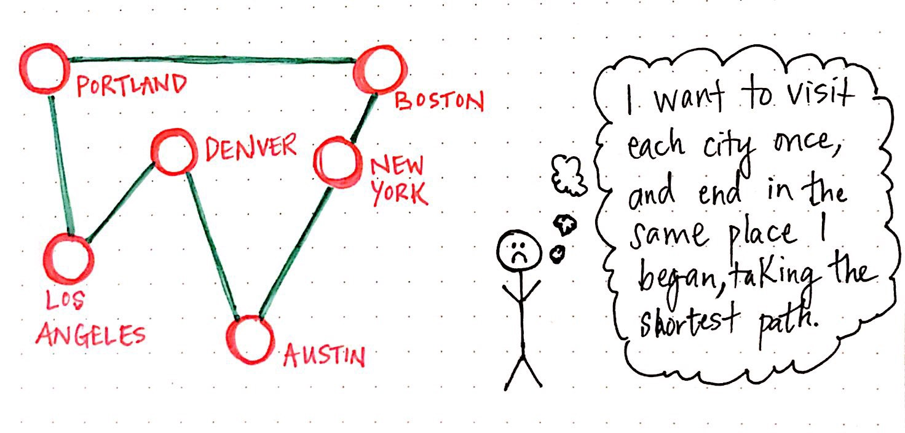
BUSINESS BACKGROUND
Our bus tours & travels company XYZ operates across the United States and offers multiple travel packages to its customers
We are tasked with finding the most economical way to tour a select number of cities with few restrictions
However the management is concerned that our travel packages are not efficiently covering locations
You must visit each city once and only once
You must return to the original starting point
The management wants to know if there is a way to find optimal routes for our travel packages

Slide 3
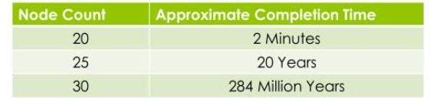
The Travelling Salesman Problem
The TSP is NP-complete i.e. for N cities, there are (N-1)! Number of possibilities – exponential growth
Our business problem can be formulated as an instance of the famous travelling salesman problem
Given a finite number of cities with the distance/cost between each pair of them, the task is to find the shortest route to travel through all of them and to return to the starting city.
Brute Force Approach
The TSP is interesting because if we find an algorithm that does not take exponential time, the other problems that are NP-complete will also be solved, and vice-versa

Slide 4
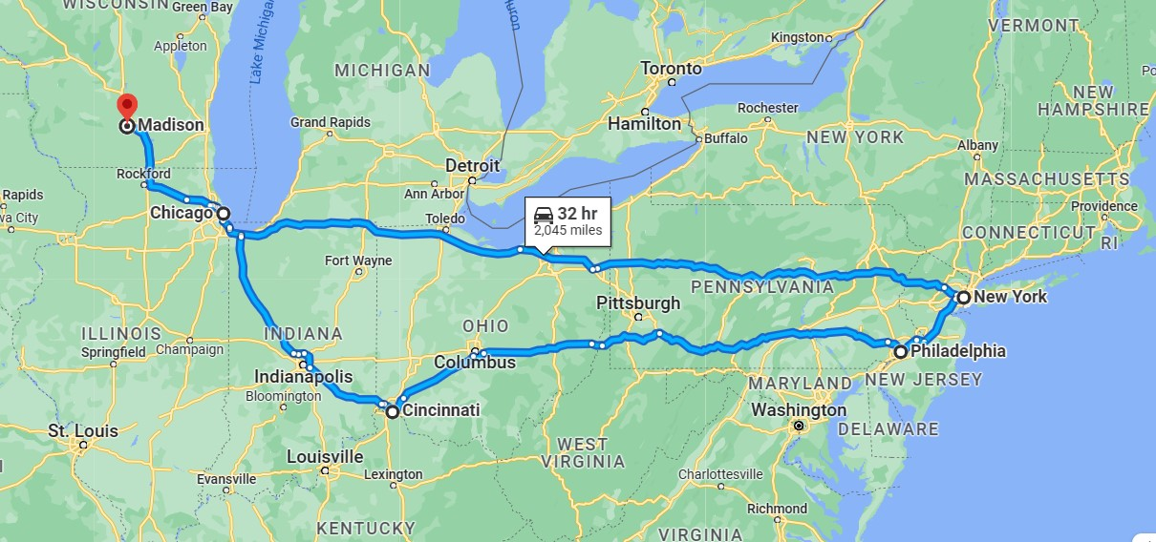


Objective
We want to build a model that takes in as input the names of cities that we would like to travel, and the model should tell us the optimal economic path of travelling all the cities. For illustration below is the list of cities we provided as input to our model
Madison
Chicago
New York
Philadelphia
Cincinnati
Our
Magic
Model

Slide 5
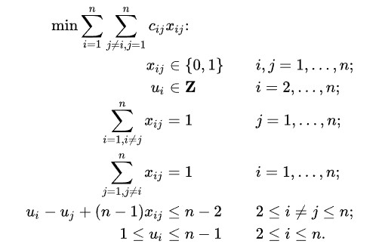
Model Formulation
To solve this problem we made use of python and Pyomo, which is a Python-based open-source optimization modeling language with a diverse set of optimization capabilities. Pyomo allows us to choose from a variety of solvers
The TSP can be written as following Integer Linear Program =>
The first set of equalities requires that each city is arrived
at from exactly one other city, and the second set of
equalities requires that from each city there is a departure
to exactly one other city. The last constraints enforce that
there is only a single tour covering all cities, and not two
or more disjointed tours that only collectively cover all cities
credit: https://en.wikipedia.org/wiki/Travelling_salesman_problem

Slide 6
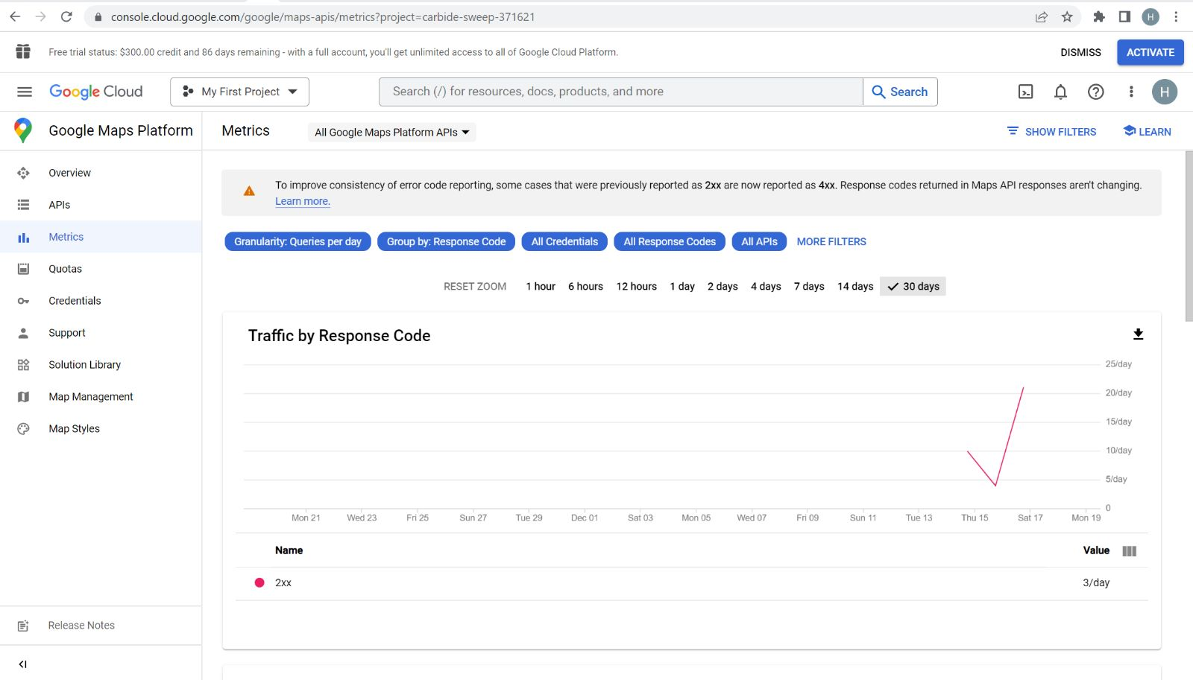
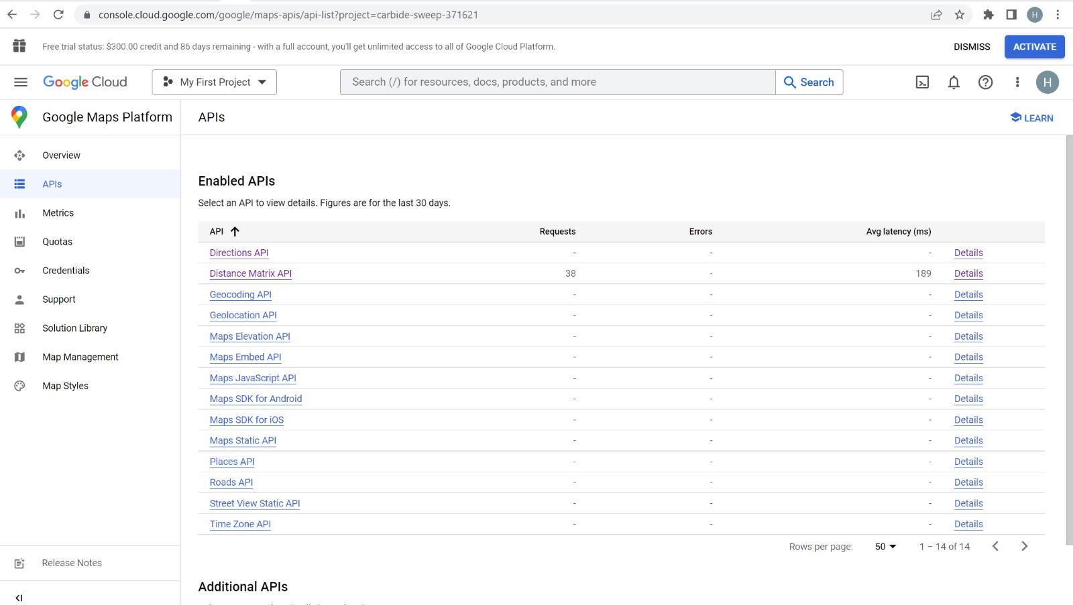
Google Distance API
We are proud to highlight that we were successful in leveraging Google distance API to compute the distance matrix associated with different cities
The API return information based on the recommended route between start and end points. We can request distance data for different travel modes, request distance data in different units such kilometers or miles, and estimate travel time in traffic
We can also keep track of the usage count of the API using the Google API dashboard as shown on right
Figure: Google API Dashboard

Slide 7
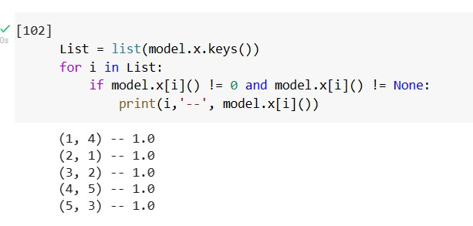
Solution
To solve our model, we have used pyomo’s glpk solver. Our python model provides solution in the format as given below
1. Madison
4 New York
5. Philadelphia
3. Cincinnati
2. Chicago
This means that the optimal tour is =>

Slide 8
Some other applications of our TSP solution
Manufacturing
Logistics
Circuit boards assembling by robots can be optimized through TSP solutions
What path should trucks follow to ensure they fill the order from warehouses in smallest amount of time ?
Plane Routing
Travelling Salespeople
Finding optimal paths for flights
How can a salesperson visit customers in most efficient manner ?
Telephone Routing
DNA Sequencing
Optimal route for routing telephone lines
Modified versions of TSP appear as sub-problems in medical fields

Slide 9
Challenges
If we had used Excel to retrieve distance matrix for our model, it would result in very limited locations dataset. In order to scale up our solution, we used python and leveraged Google API to calculate distance matrix in runtime
There are many places with same name, so sometimes google API interprets the wrong location. So in order to avoid this we have to input the location name as precisely as possible (with state and country name)
The Google API used in our model calculates the distance matrix based on land distance. Hence, if we input locations spread globally connected through sea or air routes, the API will not be able to calculate the distance matrix for those cities and will result in an error
Our model would have been better if we had created a Graphical User Interface, so users would have easy accessibility and wouldn't have to run code to get the results.
Limitations
Next Steps

Slide 10

APPENIDX
Implementation Details

Slide 11
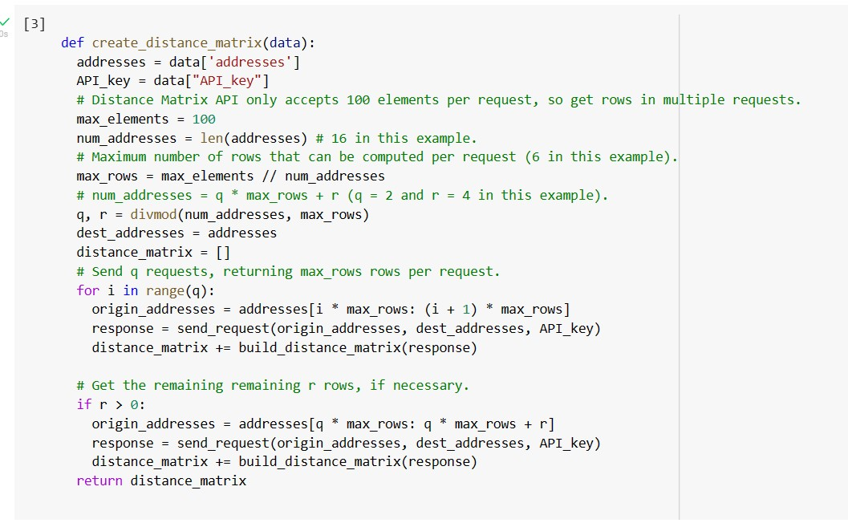
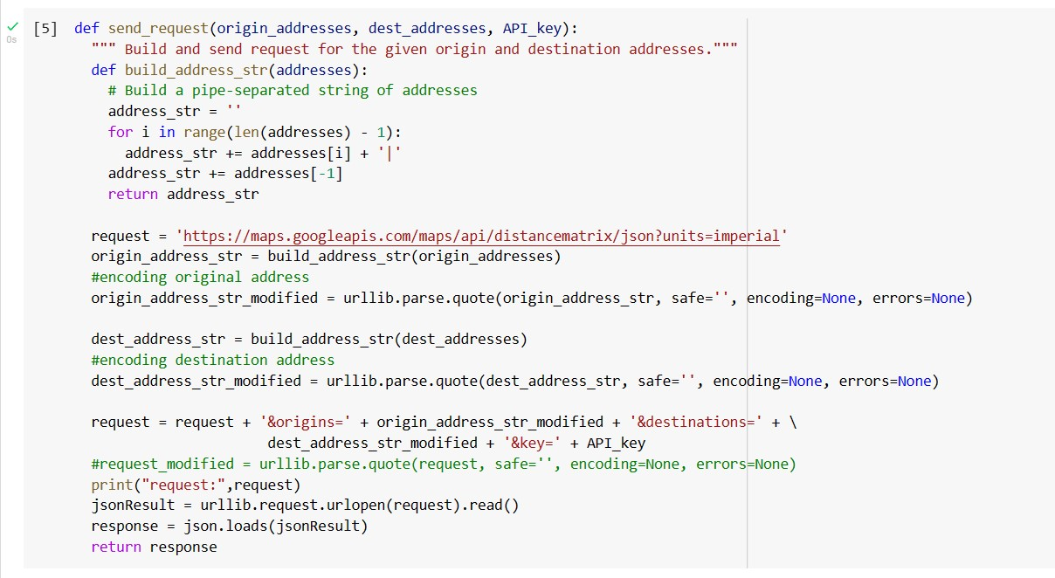
Inputting Data
The first step is to enter the data, this means to provide the model the Cost Matrix. We are using the Google Distance Matrix API to produce the Cost Matrix.
Here, the variable distance_matrix contains the
Cost matrix and we will be able to call this element
when defining constraints
credit: https://developers.google.com/optimization/routing/vrp#entire_program1

Slide 12
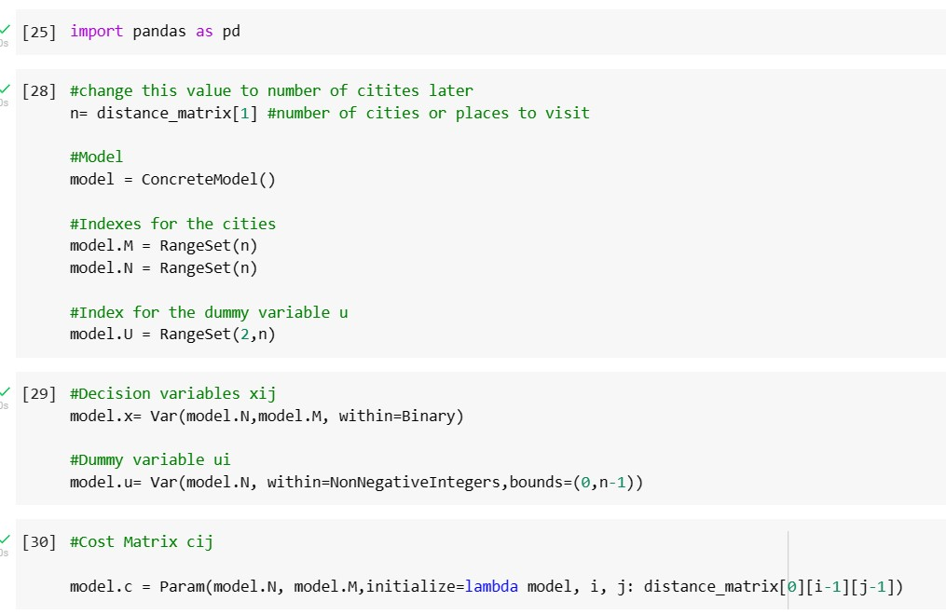
Model Formulation
Initializing the model
ConcreteModel()- Creates the model
RangeSet(n)- Creates an index from 1 to n
RangeSet(2,n)- Creates an index from 2 to n
Creating Decision Variables
Model.x creates N binary decision variables of size M
Model.u Creates N Non negative integer decision
variables that can only assume values
between 0 and n-1.
Model.c provides the cost matrix to the model

Slide 13
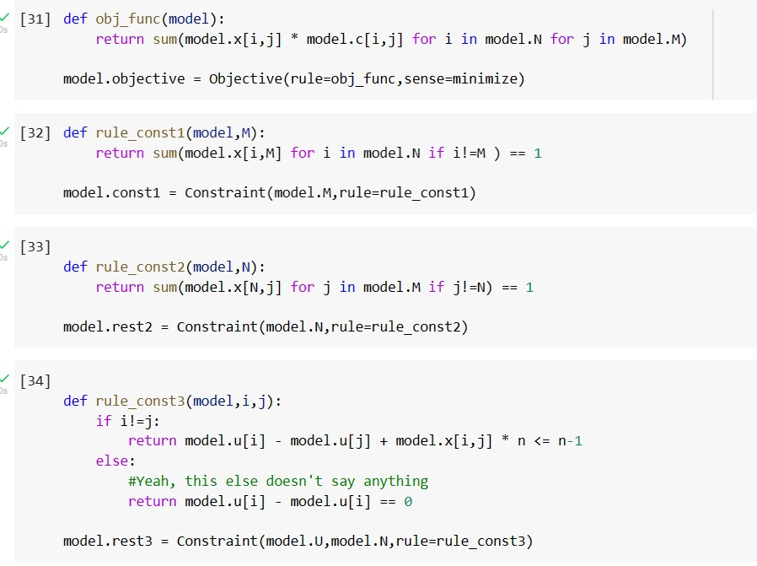
Constraints
The objective function tries to minimize the cost of selected routes subject to below constraints
The first constraint rule_const1 ensures that only 1 leaves each city
The second constraint rule_const2 which ensures that each city receives only 1 visit
The third and last constraint rule_const3 enforce that there is only a single tour covering all cities, and not two or more disjointed tours that only collectively cover all cities.

Slide 14
THANK YOU

