Slide 1



CAPSTONE PROJECT
Tools Used - Automation Testing Framework with Selenium, TestNG, Jenkins, Git, Cucumber and Jira
Project - nopCommerce Automation
By Himanshu Gupta
https://demo.nopcommerce.com/

Slide 2

SELF INTRODUCTION
Name: Himanshu Gupta
Technical Strengths:
Proficient in Java, Selenium WebDriver, TestNG, Maven, Git, Jenkins, and Jira.
Skilled in developing automation frameworks and integrating CI/CD pipelines.
Experienced in test management using Jira (Zephyr) and reporting using ExtentReports.
01

Slide 3
TYPE OF TESTING UTILISED
► 1. Manual Testing
Executed in Jira Zephyr.
Test Cases created manually for:
Positive Scenarios
Negative Scenarios
Edge Cases
Defects logged directly in Jira when tests fail.
► 2. Automated Testing
Implemented using:
Selenium WebDriver → Automates browser interactions.
TestNG Framework → Manages test flow and data-driven tests.
Page Object Model (POM) → Modular code structure.
Core Automated Functionalities:
Login & Registration
Product Search & Filter
Add to Cart & Checkout
Wishlist & Password Reset
► 3. CI/CD Based Testing
Integrated with Jenkins for Continuous Integration:
Automatically executes tests on every GitHub commit.
Generates ExtentReports with screenshots for every pass/fail step.
02

Slide 4
PROJECT DESCRIPTION – NOPCOMMERCE AUTOMATION CAPSTONE
The objective of this capstone project is to develop a robust, end-to-end automated testing framework for the nopCommerce demo e-commerce application (https://demo.nopcommerce.com/).
The framework focuses on automating key functional areas such as:
User Registration & Login
Product Search & Filter
Add to Cart & Checkout Process
Wishlist, Review, and Password Reset functionalities.
The solution ensures efficient regression, sanity, and smoke testing using a modular approach (Page Object Model), and executes automated test cases in a CI/CD pipeline using Jenkins.
All requirements, test cases, and defects are tracked in Jira (with Zephyr) for full traceability and collaboration across development and QA teams.
03

Slide 5
DESCRIPTION OF MY WORK
Designed and implemented a robust Selenium WebDriver + Java automation framework using TestNG and Cucumber BDD for the nopCommerce demo web application.
Applied Page Object Model (POM) design pattern with reusable utilities for WebDriver setup, waits, logging, reporting, and data-driven testing via Apache POI.
Managed requirements, user stories, and test cases in Jira (Zephyr) with full traceability and execution tracking.
Integrated Git/GitHub for version control and collaborative development, ensuring clean branching and commit workflows.
Configured Jenkins CI/CD pipelines to automatically pull code, execute TestNG/Cucumber test suites, and publish ExtentReports with embedded screenshots after each build.
Performed cross-browser testing on Chrome and Firefox to validate application compatibility and stability.
Delivered detailed execution reports, defect logs, and final project documentation to provide end-to-end QA coverage.
04

Slide 6
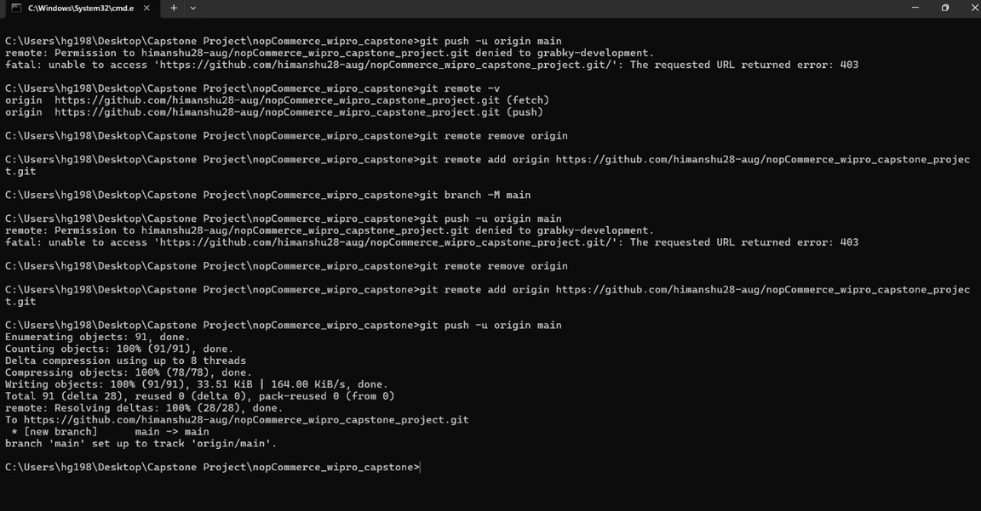
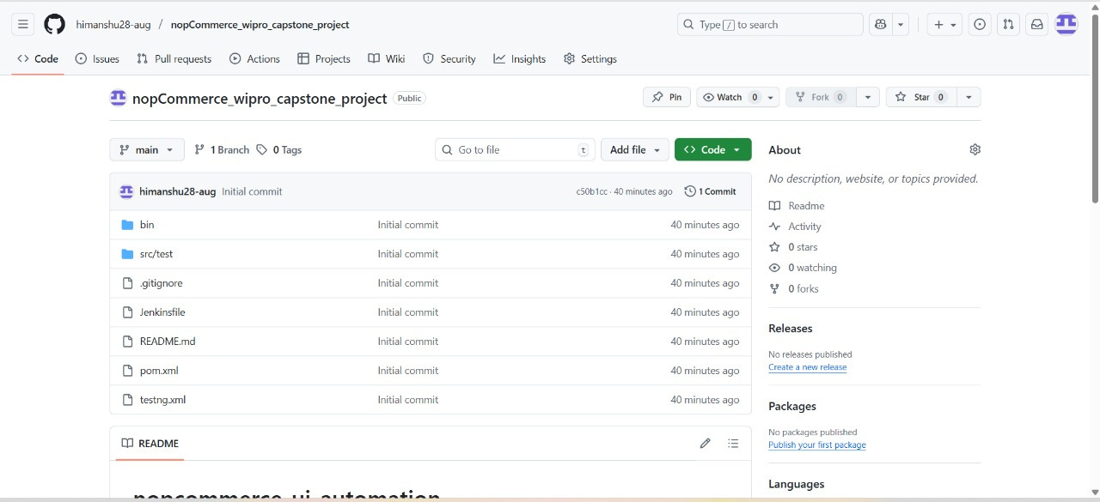
AUTOMATION FRAMEWORK SCREENSHOT FROM GIT REPOSITORY
05

Slide 7
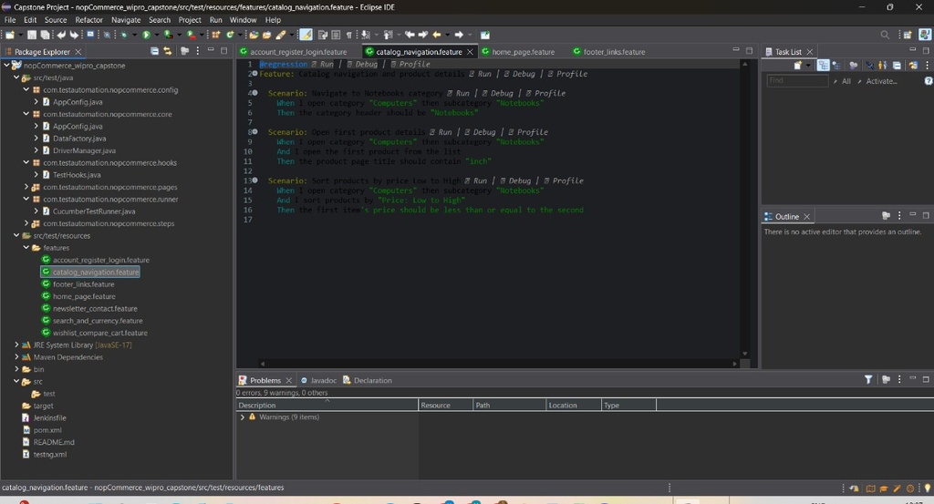
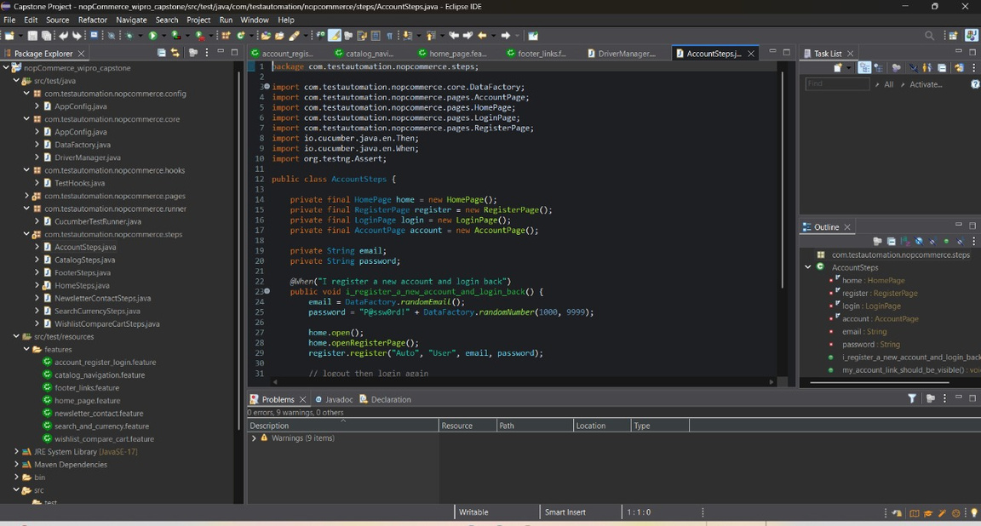
AUTOMATION APPROACH,PAGE OBJECT MODEL AND DATA DRIVEN TESTING SCREENSHOT
06

Slide 8
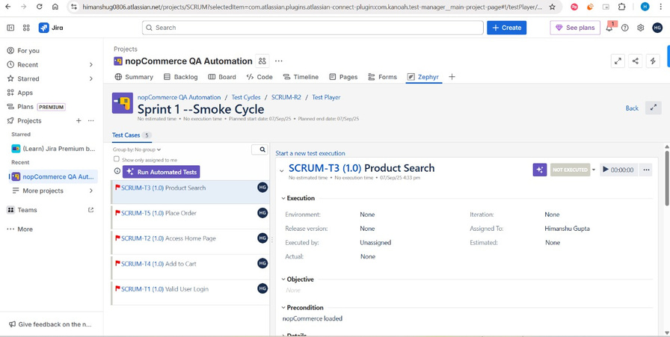
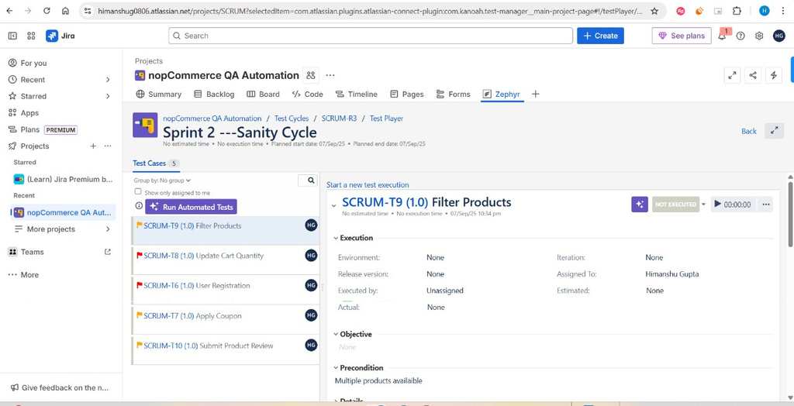
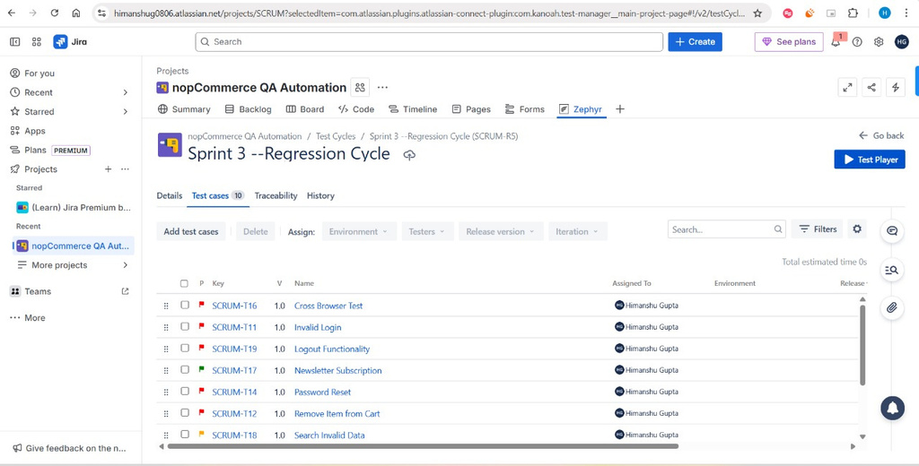
ZEPHYR BOARD - SMOKE CASE, SANITY CASE AND REGRESSION CYCLE
07

Slide 9
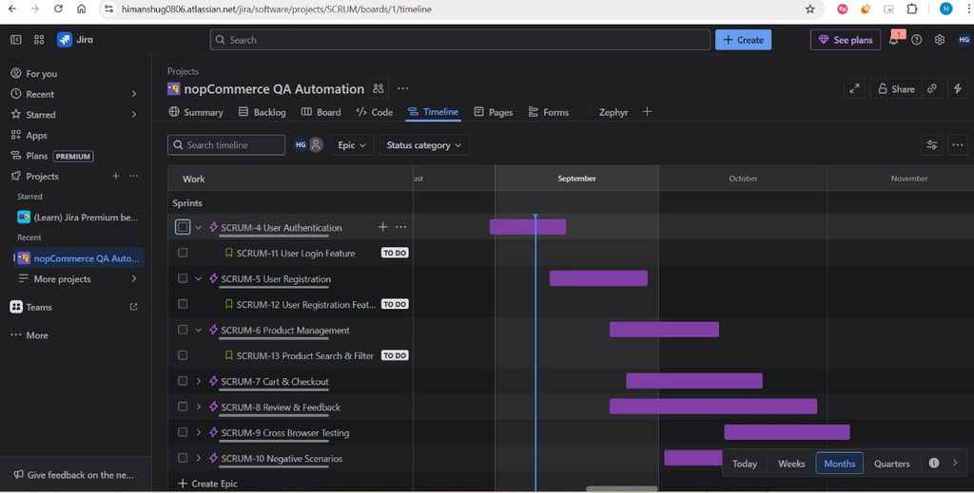
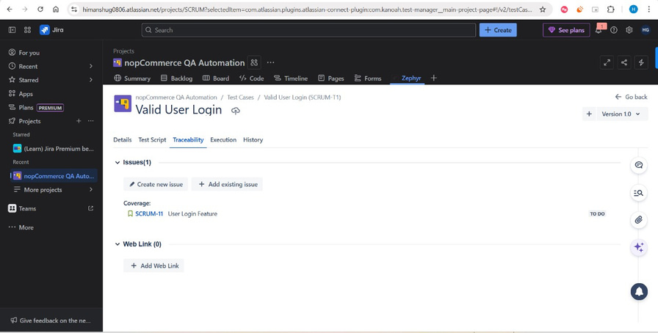
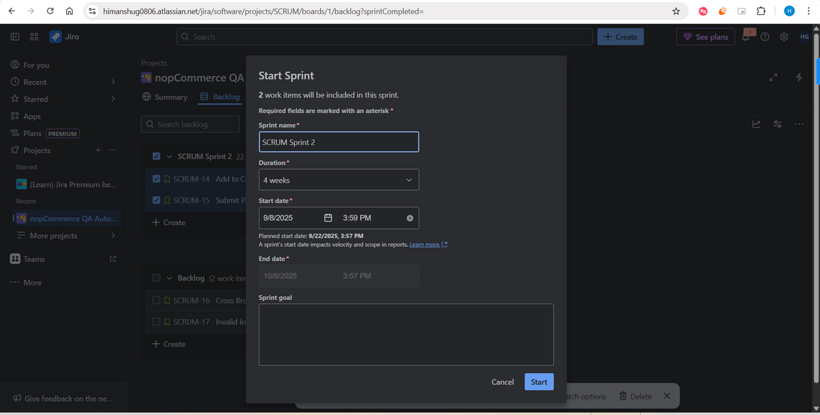
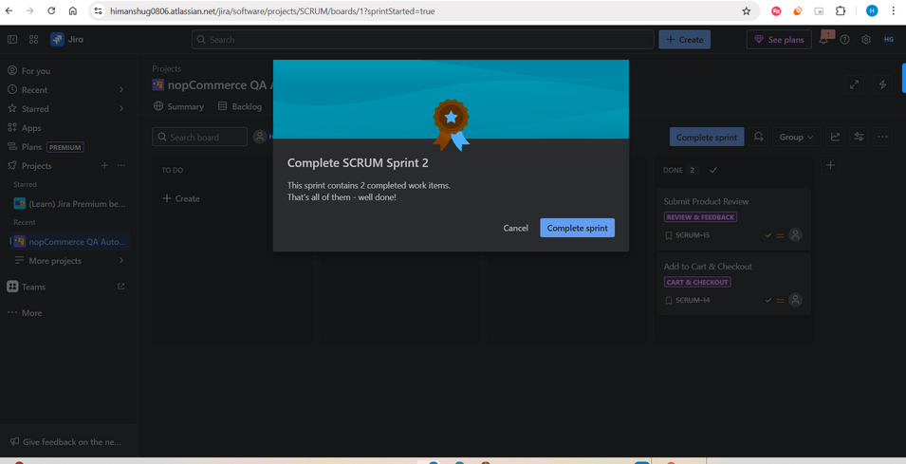
JIRA BACKLOG SCREENSHOT AND DESCRIPTION ONE LINE TO SHOW AGILE WORK IN SPRINT
08

Slide 10
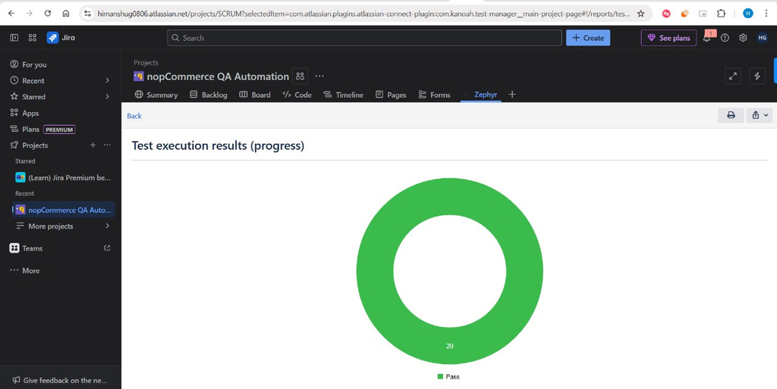
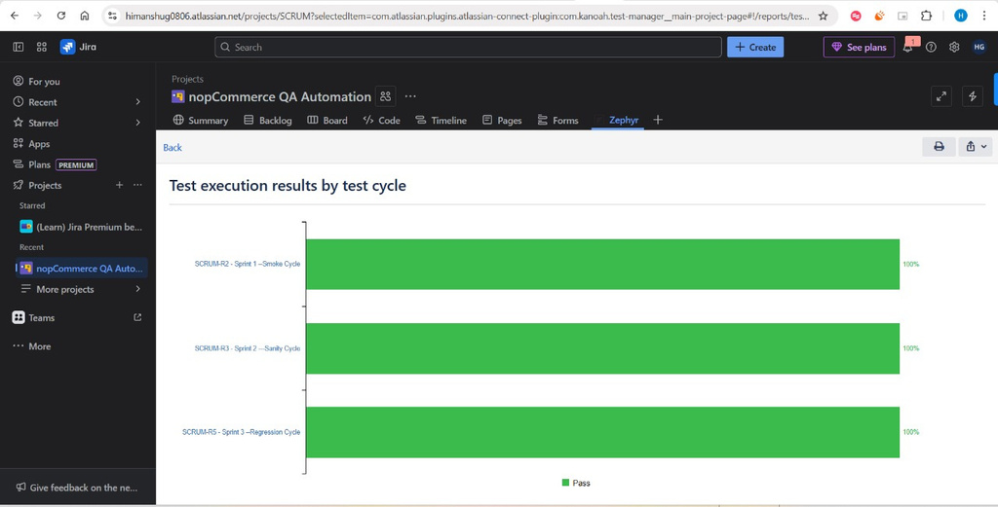
TEST REPORT FROM ZEPHYR - SCREENSHOT
09

Slide 11
THANK YOU
10

