Slide 1
Javascript/Typescript Training
GM QA Capabilities Team

Slide 2
What is Javascript ?
01

Slide 3

What is Javascript ?
Javascript is a lightweight , cross platform , object –oriented programming language.
It is one of the three core technologies of web development.
It is most commonly used as a part of webpages
Today ,Javascript can be used in different places :
Client – It was traditionally only used in browser
Server- Side- Using Node.js , we can use Javascript on the server side as well.
It adds logic and interactivity to a webpage- Dynamic effects , animations etc.

Slide 4
Understand the role of HTML , CSS and Javascript
01

Slide 5

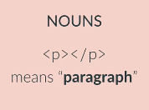
HTML
HyperText Markup Language
Defines the structure of a webpage
"put an image here“
"put a form here“
The "nouns" of a webpage

Slide 6
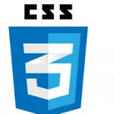
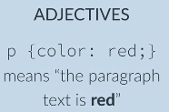
CSS
Cascading Style Sheets
Defines the style of HTML
"make all text purple“
"give the first image a yellow border“
The "adjectives" of a webpage

Slide 7
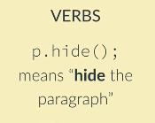
Javascript
Adds logic and interactivity to a page
"Do some math“
"Change color when the user clicks“
"Load new data from twitter“
The actions or "verbs" of a webpage

Slide 8
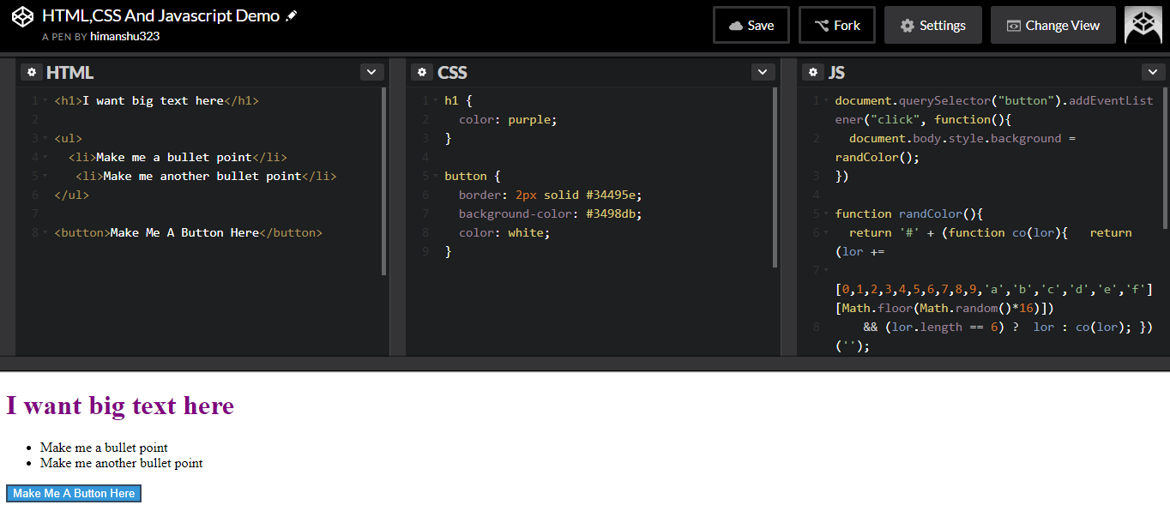
Demo

Slide 9
Javascript Basics – Primitive Data Types and Variables
01

Slide 10
Objectives
Introduce the 5 primitive data types
Work with numbers and numeric operators
Work with strings and common string methods

Slide 11
Primitive Data Types
Numbers – Integers and Floating point numbers for decimals
String – Sequence of characters used for text enclosed with double/single quotes
Boolean – Logical Data Type that can be either true or false.
Undefined –Data type of a variable which does not have a value yet.
Null – Data type of a variable which is explicitly set to null . Also means ‘non – existent’

Slide 12
Numbers
// Numbers
8, -10 , 9.8
// Mathematical operations on numbers
9-6 , 18/9 , 3+4 , 5*6
// Modulo-remainder operator
10 % 3
25 % 5
11 % 7

Slide 13
Strings
// Single or Double Quotes
“Hello World”
‘Hello World’
// Concatenation
“ David” + “Smith” // DavidSmith
//Escape Characters start with "\“
“Hello \“Please enter your order id\" "
"This is a backslash: \\”

Slide 14
//Strings have a length property
“Hello David".length //11
//Access individual characters using [] and an index
"hello"[3] //“l"
"hello"[0] //“h"

Slide 15
Primitive Data Types
Numbers – Integers and Floating point numbers for decimals
String – Sequence of characters used for text enclosed with double/single quotes
Boolean – Logical Data Type that can be either true or false.
Undefined –Data type of a variable which does not have a value yet.
Null – Data type of a variable which is explicitly set to null . Also means ‘non – existent’

Slide 16
Exercise
//1.
100 % 9
//2.
(“Test" + “Robot")[6]
//3.
“Test".length % "hi my name is \”Rob\”\\".length

Slide 17
Variables
Containers that store values using var keyword.
Left side of assignment operator contains var keyword followed
by container name
Right side of assignment operator contains the value stored. It could be any of the data types
var yourVariableName = yourValue;
//They can store all of the values we've seen
var name = “David";
var employeeId = 93;
var isFound = true;

Slide 18
//Recall the stored value by calling the variable name
var name = “David";
"hello there " + name //"hello there David“
var num = 23;
num + 5 + 10 //38
//We can also update existing variables
var name = “Rohit";
name = “Sam";

Slide 19
Null and undefined
Undefined – Variables that are declared but are not initialized falls under undefined
Some examples :
var colors;
var employees;
Null – Variables explicitly set to “null” falls under this data type
var color =“red”;
color=“null”;

Slide 20
Boolean Logic
Evaluate statements that corresponds to either true or false. Based on the results we perform the desired action.
Operator | Name | Example ( x=10) | Result
> | Greater than | X>12 | false
>= | Greater than or equal to | X >=10 | true
< | Less than | X<-20 | false
<= | Less than or equal to | X <=100 | true
== | Equal to | X==“10” | true
!= | Not equal to | X !=“b” | true
=== | Equal value and type | X ===“5” | false

Slide 21
Equality Operators ( == vs ===)
var x=25;
x ==“25” //true
x ===“25” //false
var y =null;
y == undefined //true
y === undefined //false
When we use == operator , type coercion is performed

Slide 22
Logical Operators : AND , OR and Not
And ( && ) => true if all are true
OR ( || ) => true if one is true
Not ( !) => inverts true/false value
Assuming X=12 and Y=15
Operator | Name | Example | Result
&& | AND | X<12 && X!==12 | false
|| | OR | Y>15 || X===12 | true
! | NOT | !( X===Y) | true

Slide 23
Exercise
Var x=10;
Var y=“E”
Y===“e” || x!==“10”
var x = 7;
var y = 10;
!(x == “7" || x === y) && !(y != 10 && x <= y)

Slide 24
Truthy and Falsy Values
Values that are not true or false but when evaluated in a Boolean content are treated as truthy
or falsy values
! “ Test robot”
! ””
! Null
! 0
! -1
! NaN

Slide 25
Falsy Values :
false
0
""
null
undefined
NaN
Everything else is Truthy

Slide 26
Exercise
var str = ""
var msg = “Test!"
var isFunny = "false"
!(( str || msg ) && isFunny)

Slide 27
Loops
01

Slide 28
Print numbers 1-10 using JS
console.log(1);
console.log(2);
console.log(3);
console.log(4);
console.log(5);
console.log(6);
console.log(7);
console.log(8);
console.log(9);
console.log(10);
What about 1-10,000?
This is where loops come in!

Slide 29
DRY- Don’t Repeat Yourself
Keep the code as dry as possible. It saves a lot of time and effort , also enhances the readability.
"I Will Not Repeat My Code"
"I Will Not Repeat My Code"
"I Will Not Repeat My Code"
"I Will Not Repeat My Code"
"I Will Not Repeat My Code"
"I Will Not Repeat My Code"
"I Will Not Repeat My Code"
"I Will Not Repeat My Code"

Slide 30
While Loops
It repeats block of code WHILE a condition is evaluated to true
While(testCondition){
//if true
// run some code}
Similar to IF statement except it repeats a given code block instead of just running it once.

Slide 31
While Loops
Print numbers from 1-10
While(count < 10){
console.log("count is: " + count);
count++;
}
// count is :1……….count is :10

Slide 32
While Loops
Printing each character in a string
//string we're looping over:
var str = "hello";
//first character is at index 0
var count = 0;
while(count < str.length) {
console.log(str[count]);
count++;
}
//"h"
//"e"
//"l"
//"l"
//"o"

Slide 33
While Loops
Infinite loops occur when the terminating condition is never true
var count = 0;
while(count < 10) {
console.log(count);
}
The above example prints "0" over and
over because count is never incremented

Slide 34
For loops
Infinite loops occur when the terminating condition is never true
var count = 0;
while(count < 10) {
console.log(count);
}
The above example prints "0" over and
over because count is never incremented

Slide 35
Exercise
var str = ""
var msg = “Test!"
var isFunny = "false"
!(( str || msg ) && isFunny)

Slide 36
C# (C-Sharp)

Slide 37
Classes and Objects
Class:
C# is a object oriented programming language. All of the logic for a C# Application is contained in classes and structs.
Classes are blueprints or templates from which we can create objects.
class <classname>
{
}
Objects:
An Object is an instance of class
If Class is like a template, object is an item you create by using the template.
Class is the definition of an item; object is the item itself.
<classname> <objectname> = new <classname>()
The new keyword does two things:
Causes the CLR to allocate memory for the object.
Invokes a constructor to initialize the Object

Slide 38
Members of a Class:
Members define the data and behavior of the class.
They can be :
Fields
Methods
Fields:
Fields are like variables that are scoped to the class.
All methods that are defined in the class can access the field.
Each field has a name, a data type and an access modifier.
Methods:
A method is a procedure/function used to implement the behavior of a class.
Each method has a name, parameter list, a return type and an access modifier.
Methods encapsulate operations on the fields in the class.
Method has complete and unrestricted access to all the other members in the class.

Slide 39
Properties:
Using properties, we can allow the code outside of a class to retrieve and set the values of the variables of the class. We can implement the properties by using the get and set accessors.
We can create a property by specifying a name and then writing the get and set accessors to implement the property.
The get accessor is used to retrieve the value of the variable represented by a property and the set accessor is used to assign new value to the variable.
class PropertyExample
{
Private string employeeName;
Public string EmployeeName
{
get { return employeeName;}
set { employeeName = value;}
}
}

Slide 40
Access Modifiers
Access Modifiers are used to define the accessibility level of Class members
Access Modifier | Definition
public | Access not limited. Can be used in current and other assemblies.
private | Access limited to the containing class
internal | Access limited to the currently assembly
protected | Access limited to the containing class and to types derived from containing class
protected internal | Access limited to containing class, derived classes
If you don’t specify any access modifiers, Default Access Modifiers are:
Class – internal
Methods and Fields – private
Constructor - Internal

Slide 41
Constructors
A Constructor is a method that is called when an object of a class is called. It is used to initialize class members whenever a new object of the class is created.
Main features of a Constructor:
It has the same name as the name of the class in which it is declared.
It doesn’t have any return type, implying it doesn’t return any value.
It is always public.
A class can have multiple Constructors.
It is not mandatory to declare a constructor, the default constructor of a class is automatically called when we create a new object of a class.

Slide 42
Constructor Types:
Default Constructor:
The constructor doesn’t have any parameters.
Parameterized Constructor:
The Constructor with parameters. Each time creating object through the parameterized constructor, it will assign different value to variables.
Copy Constructor:
The constructor has parameter of same class type. We are passing a copy of same class while creating object.
Class Employee
{
Public Employee (Employee employee)
{
}
}
Private Constructor:
Private constructor is used to prevent the class to be inherited or for creating object.

Slide 43
Static Constructor:
A static constructor does not take access modifiers or have parameters.
A static constructor cannot be called directly.
The user has no control on when the static constructor is executed in the program.
A class can have one and only one Static Constructor.
The Static constructor will be executed only one time irrespective of number of objects created
The Static Constructor executes before any of the instance level constructors.
Runtime invokes the Static Constructor when it creates an instance of the class or before the first static member being accessed.

Slide 44
Data types
Value types:
A value type has a fixed size, that is, a variable of value type occupies a fixed number of bytes in the memory.
If we don’t assign any initial value to a variable of value type, then a default value is used as the initial value of the variable
Type | Size(bits) | Default Value
Byte | 8 | 0
int | 32 | 0
long | 64 | 0
float | 32 | 0.0f
double | 64 | 0.0D
decimal | 128 | 0.0M
bool | 8 | false
char | 16 | ‘\0’

Slide 45
Enumerations:
An enumeration type or enumeration is represented by enum keyword.
It is a user-defined value type that provides a list of values called the enumeration list.
Each value in the enumeration list is called an enumerator, element or member and is used to represent an integral constant, and the value doesn’t change throughout the execution of the program.
The constants that the enumerators represent are of int data type. However they can be of any value type other than char type.
By default, the first constant in the enumerator list contains value 0, and the value for each of the other constants is determined by incrementing the value of its preceding constant by one.
Ex: public enum Color {Red =1, Yellow, Green};

Slide 46
Reference Types:
Reference types are those data types that work with the reference or memory addresses of data rather than data itself.
Variables of reference types are called objects and are stored on the heap or managed heap, which is an area of memory reserved for storing large amount of data.
Objects of reference types have variable lengths, two objects of the same reference type can occupy different number of bytes in memory.
Pre-defined Reference Types:
The Object Type: Represents the fundamental data type from which all other data types are created or derived. This is the base for both pre-defined and user-defined data types.
The String Type
User-defined reference types:
Classes, Interfaces, Arrays.

Slide 47
Nullable Types:
In c#, variables of value types cannot contain the null value. However, when working with databases we may require using the null value with variables. For such situations, c# provides the nullable type, which is represented by the predefined System.Nullable<T> struct.
Nullable types can only be applied to variables declared as value type.
Data type? Variable name;
Ex: int? Marks;
Marks = null;
Declaring Variable as constant
const data type name = value;
Ex: const int marks = 100;
We cannot use a variable to initialize a constant.
Ex: int length = 10;
const Int breadth = length //will generate an error.

Slide 48
Demo
Create a class with Fields and methods
Create Objects for the Class and access the members of the class
Demonstrate different constructor types
Create Fields and Methods with different Access Modifiers

Slide 49
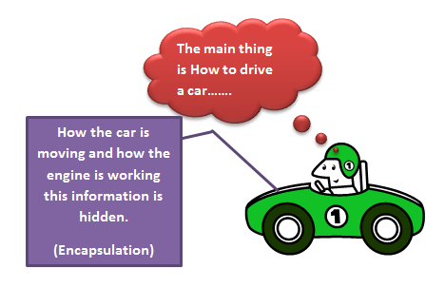
Pillars of Object Oriented Programming:
Encapsulation
Encapsulation is the process of showing only the relevant information of a specific object and hiding the irrelevant information from the user. It binds the variables and the functions together into a single unit called Class.
For Example, When a customer goes to purchase a refrigerator, the customer looks for its colour, Functionalities and the storage capacity; whereas, its internal working and wiring system is hidden from the customer. This process of hiding internal facts is known as Encapsulation.
Encapsulation provides a way to preserve the integrity of an object’s state data.
Rather than defining public fields, which can lead to data corruption:
Define get (accessor) and set (mutator) methods
Define a public .Net property

Slide 50
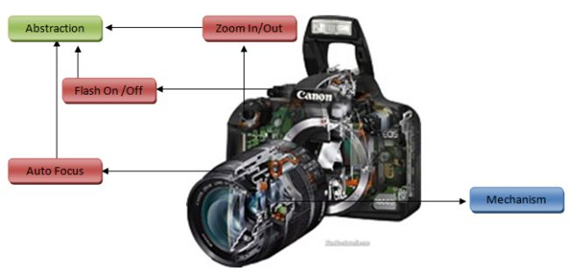
Abstraction
Abstraction is the process of providing essential features of an object to a user and hiding its background details.
Abstraction is the process of refining away all the unneeded/Unimportant attributes of an object and keep only the characteristics best suitable for your domain.
For Example, If you develop a module of software to track payroll information, you would probably want to create an employee object. An employee can have different information such as name, age, qualification, hobbies, rank, serial number, address, marital status and bank account. However, in terms of the payroll information the relevant information of an employee is a name, age, serial number, qualification and address, while the other information is not relevant to the application.
Determining only the required information among a variety of information is known as Abstraction.

Slide 51
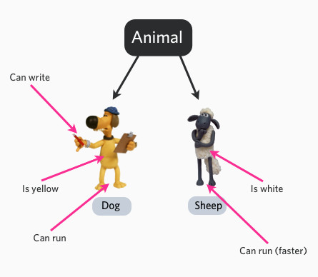
Inheritence
It is a mechanism to design or construct one class from another. Inheritance is a concept involving a base class and some derived classes where all the classes inherit some or all the features of the base class and also contain their unique features.
Example: Animal is a base class in which we are defining common features for all the animals. After that we create some derived classes named cat, dog, and cow. All these derived classes share some common features which they inherit from base class. This way, we don’t need to define all the features of Cat, dog and Cow in their respective classes and define only features which are only unique for each of them.
To derive a class from a base class, you place a colon (:) after the derived class name, followed by the name of the base class.
C# doesn’t support Multiple Inheritance because if both the base classes has same method names with same signature, then child class object will get ambiguity error while calling the methods.

Slide 52
Criteria for Inheritence:
To inherit, a base class should have a default constructor with public access modifier.
Execution of the child class will start from the default constructor of the parent class.
Child class object can access all the members of parent class but parent class object cannot access any child class members.
We can pass child class object to the parent class reference, but the parent class instance cannot access child class member.
Child child = new Child();
Parent p = child;
We can typecast child class object as parent class.
Child child1 = p as Child;
Calling base versions of functions:
C# has a special syntax for calling base versions of a method from a derived class:
base. <Method Name > ();

Slide 53
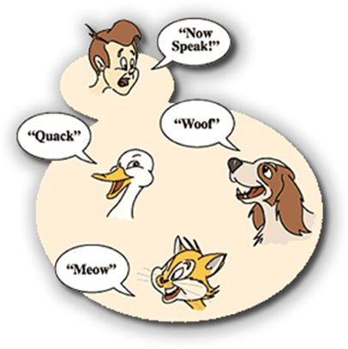
Polymorphism
Polymorphism means one name, different Forms. Using polymorphism, we can use one method in many ways based on our requirements.
Example, We can write a method to calculate the area of a geometrical Figure and use the same method to calculate the Area of a Circle, Triangle, rectangle using different values and type of parameters.
Polymorphism can be implemented in two ways:
Compile-Time Polymorphism: When the compiler compiles a program, the compiler has the information about the method arguments. Accordingly, compiler binds the appropriate method to the respective object at the compile time itself. This process is called Compile-time polymorphism or early binding.
Run-Time Polymorphism: In Run-Time polymorphism, the compiler binds the method to an object while program is being executed and not when the program is being compiled.

Slide 54
Compile-time Polymorphism:
Method Overloading: If we implement more than one method with same name inside same class,
by changing signature of the method, it is called Method Overloading.
A Method signature compromises the following attributes:
By changing the number of parameters
By changing Data type of parameters.
By Re-arranging data type of parameters.
The order in which the parameters are passed.
Note: Method Overloading cannot be implemented by changing only the return types.
Operator Overloading: Operator Overloading is a mechanism of assigning new functionality to an operator, in
addition to the already specified functionality of the operator.
In Operator Overloading, method should be static and signature should be:
Static return type Operator op (parameters)
{
}

Slide 55
Runtime Polymorphism:
Method Overriding:
Method Overriding allows to create virtual methods, which can be overridden in a derived class.
Virtual Keyword is used to declare a virtual method, and override keyword is used to declare a method that overrides the virtual method.
The new method replaces the implementation of the virtual method in the derived class.
The method name, number of parameters, and the types of parameters remain same for the methods defined in both the base and derived classes.
Note: Neither member fields nor static functions can be declared as virtual.
Method Hiding:
If a method with the same signature is declared in both base and derived classes, but the methods are not declared as virtual and override, respectively, then the derived class version is said to hide the base class version.
“new” keyword is used for hiding a method.
In Method Hiding, we can change the return type of base class Method in derived class method.
If the derived class method is not specified with new keyword, the compiler picks up on the fact that it’s hiding a base class method without being instructed to do so and will generate a warning.

Slide 56
Demo
Demonstrate OOP concepts with examples
Demonstrate Method Overloading, Overriding and Hiding

Slide 57
Static class and Methods
Static classes:
Static classes are used to define methods that can be accessed without creating an instance of the class.
Static keyword is used to define a class and its members as static. We can use the class name to access the members of a static class.
Characteristics:
It can contain only static members.
It cannot be instantiated. It cannot have instance constructors.
It cannot be inherited.
Static Methods:
Static methods cannot call non-static methods directly. To call a non-static method from a static method, we need to create an object of the class in which the non-static method is defined. Similarly non-static methods cannot call static methods directly. We need to use the name of the class.

Slide 58
Sealed class
We declare a class as sealed, if we want to prevent other users from creating a derived class from that class.
A sealed class is a class that cannot be inherited.
To access sealed class members, we can create an object of that class and access the members.
sealed class FinalClass
{
}
class DerivedClass: FinalClass // wrong. Will give compilation error
{
}
The most likely situation in which we’ll mark a class or method as sealed is if the class or method is internal to the operation of the library, class, or other classes that you are writing, so that you ensure that any attempt to override some of its functionality will lead to instability in the code.
You might also mark a class or method as sealed for commercial reasons, in order to prevent a third party from extending your classes in a manner that is contrary to the licensing agreements.

Slide 59
Sealed Methods
By using sealed modifier to a method, we can prevent that method to be overridden in the derived classes. By default all the methods are sealed, it means if a method is not declared virtual we cannot override that method.
In order to use the sealed keyword on a method or property, it must have first been overridden from a base class. If we do not want a method or property in a base class overridden, then we don’t mark it as virtual.
class MyClass: MyClassBase
{
public sealed override void FinalMethod()
{}
}
class DerivedClass: MyClass
{
public override void FinalMethod() // wrong. Will give compilation error
{ }
}

Slide 60
Abstract Class
Abstract classes are classes that contain only the declaration of the method; whereas the method is defined in the class derived from the abstract class.
Abstract classes are similar to base classes except that the methods declared inside the abstract classes known as abstract methods, don’t have method bodies.
Characteristics of abstract classes:
An abstract class is declared by using abstract keyword.
An abstract class is always public.
An abstract class can contain both abstract and non-abstract methods.
An abstract class must have one abstract method.
Each class derived from an abstract class must provide implementation for all the abstract methods of the abstract class.
We cannot create an object of an abstract class. To use the functionality specified in an abstract class, we need to derive a new class from the abstract class.

Slide 61
Interfaces
An interface can only contain declarations of methods, properties, indexers, and events.
An interface is a collection of abstract data members. We cannot create an object of an interface.
You can never instantiate an interface; it contains only the signatures of its members. An interface has neither constructors (how can you construct something that you can’t instantiate?) nor fields (because that would imply some internal implementation).
It is also not permitted to declare modifiers on the members in an interface definition. Interface members are always implicitly public, and cannot be declared as virtual or static. That’s up to implementing classes to decide. Therefore, it is fine for implementing classes to declare access modifiers.
C# doesn’t support the feature of multiple inheritance for classes; however it supports the multiple inheritance feature by supporting the concept of Interfaces.

Slide 62
Demo
Demonstrate usage of abstract class and Interfaces
Demonstrate inheriting multiple interfaces
Demonstrate static and sealed keywords

Slide 63
Arrays
An array is a singular collection of several values of same data type.
In the memory, array is represented as a contiguous block of memory space. The amount of memory that an array occupies depends on the size and data type of its elements.
Array need to be declared and initialized before they are used in a program.
Array Declaration:
An array is declared by defining the type of elements inside the array followed by empty brackets and a variable name.
int [] myArray;
Array Initialization:
You do this by initializing the variable of the array using the new operator with the type and the number of elements inside the array.
myArray = new int [4];
int [] myArray = new int [] {4, 7, 11, 2};
Int [] myArray = {4, 7, 11, 2};

Slide 64
Accessing Array Elements:
After an array is declared and initialized, you can access the array elements using an indexer.
If we use a wrong indexer value where no element exists, an exception of type IndexOutOfRangeException is thrown.
int [] myArray = new int [] {4, 7, 11, 2};
int v1 = myArray[0]; // read first element
int v2 = myArray[1]; // read second element
myArray[3] = 44; // change fourth element
Using Reference types:
In addition to being able to declare arrays of predefined types, you can also declare arrays of custom types.
public class Person
{
public string FirstName { get; set; }
public string LastName { get; set; }
}
Person[] myPersons = new Person[2];
myPersons[0] = new Person { FirstName="Jack", LastName=“Sparrow" };
myPersons[1] = new Person { FirstName="Michael", LastName="Schumacher" };

Slide 65
Two Dimensional Arrays:
A multidimensional array is indexed by two integers.
Declaring two - dimensional array with C# is done by putting a comma inside the brackets. The array is initialized by specifying the size of every dimension (also known as rank).
The array elements can be accessed by using two integers with the indexer.
You cannot change the rank after declaring an array.
int [,] twodim = new int [3, 2];
twodim [0, 0] = 1;
twodim [0, 1] = 2;
twodim [1, 0] = 3;
twodim [1, 1] = 4;
twodim [2, 0] = 5;
twodim [2, 1] = 6;

Slide 66
Jagged Arrays:
A jagged array is more flexible in sizing the array. With a jagged array every row can have a different size.
int [] [] jagged = new int [3] [];
Jagged [0] = new int [2] {1, 2};
Jagged [1] = new int [6] {3, 4, 5, 6, 7, 8};
Jagged [2] = new int [3] {9, 10, 11};
Iterating through all elements of a jagged array can be done with nested for loops. In the outer for loop every row is iterated, and the inner for loop iterates through every element inside a row.
for (int row = 0; row < jagged.Length; row++)
{
for (int element = 0; element < jagged[row].Length; element++)
{
Console.WriteLine("row: {0}, element: {1}, value: {2}",
row, element, jagged[row][element]);
}
}

Slide 67
Demo
Demonstrate creating, initializing, adding and modifying array
Demonstrate array initializer syntax
Demonstrate two dimensional and Jagged Array
Demonstrate looping through an array

Slide 68
Decision Making – Conditional Statements
Decision making structures requires the programmer to specify one or more conditions to be evaluated, along with a statement or statements to be executed if the condition is determined to be true, and optionally, other statements to be executed if the condition is determined to be false.
Statement | Description
If | An if statement consists of a boolean expression followed by one or more statements
If….else | An if statement can be followed by an optional else statement, which executes when the boolean expression is false.
nested | You can use one if or else if statement inside another if or else if statement(s)
switch | A switch statement allows a variable to be tested for equality against a list of values
nested switch | You can use one switch statement inside another switch statement(s)
?: (ternary) | Used to replace if…else statements. Exp1? Exp2: Exp3

Slide 69
Loops
A loop statement allows us to execute a statement or a group of statements multiple times.
Loop Type | Description
while | It repeats a statement or a group of statements while a given condition is true. It tests the condition before executing the loop body
for | It executes a sequence of statements multiple times and abbreviates the code that manages the loop variable
do...while | It is similar to a while statement, except that it tests the condition at the end of the loop body
nested | You can use one or more loop inside any another while, for or do…while loop

Slide 70
Loop Control Statements
Loop control statements change execution from its normal sequence. When execution leaves a scope, all automatic objects that were created in that scope are destroyed
Control statement | Description
break | Terminates the loop or switch statement and transfers execution to the statement immediately following the loop or switch.
continue | Causes the loop to skip the remainder of its body and immediately retest its condition prior to reiterating

Slide 71
Demo
Demonstrate all the Conditional and loop statements
Demonstrate the usage of break and continue statements
Demonstrate the difference between while and do while loop

Slide 72
Collections
Collection classes are specialized classes for data storage and retrieval. The following are the various commonly used classes of the System.Collection
Class | Description and Usage
Array List | It represents ordered collection of an object that can be indexed individually. It is basically an alternative to an array. However, unlike array you can add and remove items from a list at a specified position using an index and the array resizes itself automatically. It also allows dynamic memory allocation, adding, searching and sorting items in the list.
Hashtable | It uses a key to access the elements in the collection. Each item in the hash table has a key/value pair. The key is used to access the items in the collection.
SortedList | It uses a key as well as an index to access the items in a list. A sorted list is a combination of an array and a hash table. It contains a list of items that can be accessed using a key or an index. If you access items using an index, it is an ArrayList, and if you access items using a key , it is a Hashtable. The collection of items is always sorted by the key value.

Slide 73
Class | Description and Usage
Stack | It represents a last-in, first out collection of object. It is used when you need a last-in, first-out access of items. When you add an item in the list, it is called pushing the item and when you remove it, it is called popping the item.
Queue | It represents a first-in, first out collection of object. It is used when you need a first-in, first-out access of items. When you add an item in the list, it is called enqueue and when you remove an item, it is called deque.
Bit Array | It represents an array of the binary representation using the values 1 and 0. It is used when you need to store the bits but do not know the number of bits in advance. You can access items from the BitArray collection by using an integer index, which starts from zero.

Slide 74
System.Collections.Generic
Generic Collection Types allow strongly typing your collections.
Consider this array list which we want to contain Bikes
ArrayList bikes = new ArrayList();
bikes.Add(new Bike(“Ducati”));
If you want to get the first item out, you need to cast the result, since Bike bike = bikes[0] won’t work
Bike bike = (Bike)bikes[0];
But the compiler also allows this:
Car car = (Car)bikes[0];
Generics allow you to do this:
List<Bike> bikes = new List<Bike>();
bikes.Add(new Bike(“Ducati”));
Bike bike = bikes[0];
See No casting. We don’t have to help the compiler understand there can only be bikes inside that list.

Slide 75
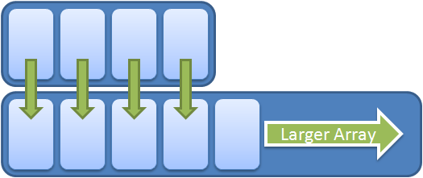
List<T>:
It is an unsorted collection (but supports sorting)
Items can be added, removed or inserted at a specific index.
We can add ranges, perform binary searches, perform sequential searches, built in sorting, get the count of items and check for items within it etc
List<T> is internally implemented as a simple array, and as we add more and more items to the list, if the array fills up , then an entirely new array is allocated and the items in the current array are copied over into the new array, and the new item is added.
The default length of the array inside of a List<T> is 4, and it only doubles in size each time it fills up(so it goes like this 4,8,16,3 etc)

Slide 76
var list = new List<string>();
list.Add("one");
list.Add("two");
list.Add("three");
list.AddRange(new[] {"four", "five", "six"});
//insert item at index 2
list.Insert(2, "seven");
//removes first occurrence of "seven"
list.Remove("seven"); //returns true
//removes all occurrences of "seven"
list.RemoveAll(s => s == "seven");
//checks is list contains two
list.Contains("two"); //returns true
//finds the first item which matches predicate
string value = list.Find(s => s == "three");
//finds all items which match predicate
List<string> values = list.FindAll(s => s == "three");
//in-place sort of list
list.Sort();
//performs a binary search of a sorted list to find index of item
int index = list.BinarySearch("three"); // must sort first!
//removes all elements
list.Clear();

Slide 77
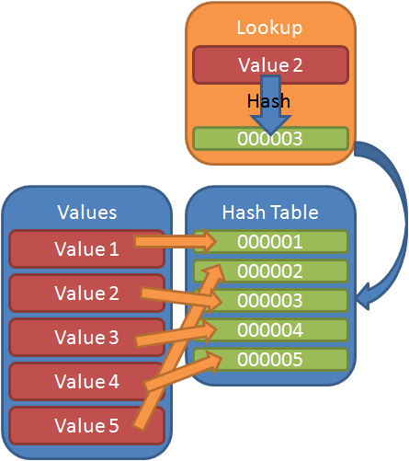
Dictionary<Key, value>
A Dictionary class represents a dictionary in C# that is used to represent a collection of keys and values pair of data.
The Dictionary class uses a hash table as its backing store, this means that the data stored inside of the dictionary is looked up by a hash value (meaning that the keys must be unique). This allows for individual items to be looked up extremely quickly by hashing it, and then looking up its hash inside the hash table.
Because of this, finding a range of values would require you to iterate over all of the values in the dictionary and look for your values. It also means that the data stored in the Dictionary, when iterated over, comes back in an non-determinant order.
As other collection classes, the Dictionary class has Add, Remove, Clear and other collection methods. The Key and Value property are used to extract a key and a value from an item in a Dictionary.

Slide 78
var dictionary = new Dictionary<int, string>(); dictionary.Add(1, "one"); dictionary.Add(2, "two"); dictionary.Add(3, "three"); dictionary.Add(4, "four"); // returns true dictionary.ContainsKey(1); // returns true dictionary.ContainsValue("two"); // remove by key dictionary.Remove(3); // lookup by key string indexedValue = dictionary[4]; string value; if (dictionary.TryGetValue(4, out value)) //do something foreach (int key in dictionary.Keys) { } //removes all elements dictionary.Clear();

Slide 79
foreach statement
The foreach statement repeats a group of embedded statements for each element in an array or an object collection that implements the System.Collections.IEnumerable or System.Collections.Generic.IEnumerable<T> interface.
The foreach statement is used to iterate through the collection to get the information that you want, but can not be used to add or remove items from the source collection to avoid unpredictable side effects. If you need to add or remove items from the source collection, use a for loop.
The embedded statements continue to execute for each element in the array or collection. After the iteration has been completed for all the elements in the collection, control is transferred to the next statement following the foreach block.
At any point within the foreach block, you can break out of the loop by using the break keyword, or step to the next iteration in the loop by using the continue keyword.
A foreach loop can also be exited by the goto, return, or throw statements.

Slide 80
Demo
Demonstrate all the Collection types and use the loop statements to iterate through the collection
Demonstrate the difference between for and foreach loops
Demonstrate adding collection to a collection. For Example: adding a dictionary to a list

Slide 81
Exceptions
An exception is a problem that arises during the execution of a program
Exceptions are used to avoid system failure in an unexpected manner.
All the exceptions in the .Net framework are derived from the Sytem.Exception class. The Exception class is the base class for all other Exception class provided by .Net framework.
The Exception object has some important properties:
Property | Usage
Message | Gives detailed information about the message
StackTrace | Gives the function stack to show where exception is thrown
Targetsite | Shows which method throws the exception

Slide 82
Handling Exceptions:
Exceptions provide a way to transfer control from one part of a program to another.
C# exception handling is built upon four keywords: try, catch, finally, and throw.
try: A try block identifies a block of code for which particular exceptions is activated. It is followed by one or more catch blocks.
catch: A program catches an exception with an exception handler at the place in a program where you want to handle the problem. The catch keyword indicates the catching of an exception.
finally: The finally block is used to execute a given set of statements, whether an exception is thrown or not thrown. For example, if you open a file, it must be closed whether an exception is raised or not.
throw: A program throws an exception when a problem shows up. This is done using a throw keyword.

Slide 83
try
{
// statements causing exception
}
catch( ExceptionName e1 )
{
// error handling code
}
catch( ExceptionName e2 )
{
// error handling code
}
finally
{
// statements to be executed
}

Slide 84
Custom Exceptions:
Although the .NET framework contains all kinds of exception types which are sufficient in most cases, it can make sense to define custom exceptions in your own applications. They can greatly simplify and improve the error handling and thus increase the overall code quality.
For Implementing Custom Exception Handling, we need to derive the class CustomException from the System.Exception
Steps to Create Custom Exception
Implement error handling in the user interface.
Create and implement custom error messages.
Create and implement custom error handlers.
Raise and handle errors.

Slide 85
Demo:
Handling Exceptions in a program with try…catch and finally blocks
Implement a Custom Exception and demonstrate the usage

