Slide 1
AUTOMOBILE ENGINEERING
6th SEM

Slide 2
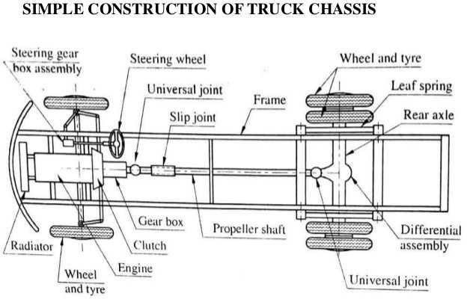
UNIT 1
Introduction
An automobile is a self - propelled vehicle which is used for the transportation over the ground.
Self-propelled vehicle means the vehicle runs with its own
power.
Automobile can be used for transportation of passengers and cargo.
Components of AN Automobile
Chassis
Body
Automobile Chassis

Slide 3
Automobile History and development
The early history of the automobile can be divided into a number of eras, based on the prevalent means of propulsion. Later periods were defined by trends in exterior styling, size, and utility preferences.
In 1769 the first steam-powered automobile capable of human transportation was built by Nicolas-Joseph Cannot.
In 1808, François Isaac de Rivaz designed the first car powered by an internal combustion engine fueled by hydrogen.
In 1870 Siegfried Marcus built the first gasoline powered combustion engine, which he placed on a pushcart, building four progressively sophisticated combustion-engine cars over a 10-to-15-year span that influenced later cars. Marcus created the two-cycle combustion engine[citation needed]. The car's second incarnation in 1880 introduced a four-cycle, gasoline- powered engine, an ingenious carburetor design and magneto ignition. He created an additional two models further refining his design with steering, a clutch and brakes.
The four-stroke petrol (gasoline) internal combustion engine that still constitutes the most prevalent form of modern automotive propulsion was patented by Nikolaus Otto. The similar four-stroke diesel engine was invented by Rudolf Diesel. The hydrogen fuel cell, one of the technologies hailed as a replacement for gasoline as an energy source for cars, was discovered in principle by Christian Friedrich Schönbein in 1838. The battery electric car owes its beginnings to Ányos Jedlik, one of the inventors of the electric motor, and Gaston Planté, who invented the lead–acid battery in 1859.[citation needed]

Slide 4
In 1885, Karl Benz developed a petrol or gasoline powered automobile.[2] This is also considered to be the first "production" vehicle as Benz made several other identical copies. The automobile was powered by a single[citation needed] cylinder four-stroke engine.
After producing and selling the Model A in 1903, Ford Motor Company's Model T became the first mass-produced automobile in 1908, focusing on affordability for the average consumer. By 1927 Ford produced over 15,000,000 Model T automobiles and only then developed the Model A.
At the turn of the 20th century electrically powered automobiles were a popular method of automobile propulsion[citation needed], but their common use did not last long, and they diminished to a niche market until the turn of the 21st century.
Unit 2
Power system
Fuel supply system for petrol engine
The fuel system of an internal combustion Engine is intended to produce a combustible mixture composed of the fuel stored

Slide 5
in the fuel tank and atmospheric air, and then deliver both to the cylinders. Petrol engine use light grade gasoline fuel while the Diesel Engines utilize heavy diesel fuel, therefore fuel supply systems and their differ greatly in petrol and diesel engine Fuel Pump is used to supply petrol from the petrol Tank to the Carburetor. The fuel pump may be of mechanical or electrical type. If mechanical fuel pump is employed, it has to be placed on the engine since it is driven by the engine camshaft through an eccentric. However, the electrically operated fuel pump may be placed anywhere on the vehicle. When the engine is cranked (started), vacuum is produced inside the cylinder. The atmospheric air rushes in to the vacuum through the air cleaner.
Main parts of the Fuel Supply System of Petrol Engine:
Fuel Tank
Fuel Pump
Carburetor
Fuel Filter
Fuel Tank: The Fuel Tank used in a 4 Wheeler is different from that of a 2 Wheeler in location, construction and control of fuel flow. A 4 Wheeler is not provided with a fuel tap whereas it is invariably used 2 Wheeler. Details of Fuel Tank in common use, is given below. We shall study fuel tanks for both categories of vehicles.
The Fuel Tank is fabricated from sheet or aluminum alloy. Use of Aluminium
metal of steel alloy tank is
advantageous due to its lightweight and good resistance to corrosion.
The Fuel is filled in through a filler tube, which can be closed by a filler cap. Provision of Lock is generally made on this cap. Provision of lock is generally made on this cap. A

Slide 6
number of baffles (plate) are fitted inside to help in preventing the violent fuel surging during acceleration, cornering and braking. The bottom surface of the tank is made sloppy so that even the last drop of fuel may collect here for pumping. For periodic removal of the sediment, a screwed drain plug is provided at bottom f the tank. A vent hole is provided in the filler tube or the filler cap through which the air enters into the tank and occupies the space left vacant by the pumped fuel.
Fuel Filters: The Fuel is filtered at different stages in a fuel supply system. Therefore, many fuel filters are used in the fuel circuit. The fuel filters serve the purpose of filtration in the delivery system by preventing foreign particles from entering into the fuel pump and the carburetor. The modern filtration practice employs a combination of coarse and fine filters. These Filters are generally located at the following positions.
Coarse filter (or gauge filter) incorporated within the fuel tank.
Medium coarse filter outside the fuel tank and on the inlet side of the pump.
Fine filter of built in surface type at inlet of fuel pump’s pumping chamber.
Fine filter in pipeline between fuel pump and the carburetor.
Fuel Pump: A Fuel Pump is used to deliver fuel from the Fuel Tank to the float chamber of Carburetor. It is generally mounted on the side of engine block near the eccentric end of the camshaft. In V-type engines, it may be mounted between

Slide 7
the two rows of the cylinders. Main types of Fuel Pumps commonly used in auto vehicles are given as follows.
Pumps commonly used in auto vehicles are given as follows.
A.C. Mechanical Pump
Diaphragm Type
Plunger Type
Rotary Type
S. U. Electrical Type
Electromagnetic Type
Combined Type
Functions of a Carburetor:-
A carburetor is required to perform the following functions.
It maintain a small quantity of petrol in the float chamber at
constant head (height) to ensure an uninterrupted supply for vaporization.
It vaporizes (atomizes) the petrol i.e. converts liquid petrol into vapour from for convenient mixing with the air.
It does carburetion i.e. prepares a homogeneous mixture of air and vaporized petrol (air + fuel).
It delivers correct air-fuel mixture inside the engine through inlet manifold, under varying conditions of load and speed of the engine.
Float chamber
Pipeline from fuel pump
Needle valve
A hollow float
Throttle valve
Mixing chamber
Venturi or diffusor
Fuel nozzle or pulverizer
i. Metering jet or jet tube

Slide 8
The float is allow and lightweight part made of thin metal sheet. The float chamber maintains the fuel at a constant level, which is necessary for normal operation of the carburetor. The fuel is delivered into this chamber along pipeline 2 by a fuel pump, or under gravity from the tank. The latter method is more common with 2-wheelers where a tap is used to allow or step the flow of petrol from fuel tank to the carburetor. The float chamber is vented through a hole to communicate with the atmosphere.
When the fuel level sinks, the float goes down, opens the
needle valve and admits fuel into the chamber. And when the fuel level reaches its normal level, the float goes up, closes the needle valve and stop inflows of the fuel. A normal level is reached when the fuel in the chamber is 1-2 mm below the edge of nozzle 8. This level ensures easy suction of fuel from the nozzle and prevents leakage when the carburetor is inoperative.
Jet tube 9, with a calibrated hole of definite diameter, meters
out the amount of fuel to be supplied. The pulverizer, which takes the form of a thin tube, communicates with float chamber through the jet. Mixing chamber 6 is straight or bent tube, one of whose ends is connected to the engine intake pipe and the other to the air cleaner. The fuel is mixed with air precisely in this chamber. Venturi 7, mounted in the mixing chamber at the end of the nozzle, increases the velocity of the sir stream in the mixing chamber and thereby provides a more intensive atomization of fuel. Throttle 5 changes the cross- section presented to the combustible mixture. The throttle is controlled by the driver from the cab (driver’s cabin). The degree to which the throttle is opened determines the amount

Slide 9
of mixture passed and accordingly changes the power of the engine.
As the crankshaft rotates, the rarefaction built up during
admission strokes causes atmospheric air to flow through the carburetor. The velocity of air increases considerably in the Venturi and a strong rarefaction appears above pulverizer. Due to the difference in pressure, fuel is sprayed out of the pulverizer, and mixes and evaporators in the high velocity airflow. The combustible mixture prepared in this manner is drawn in to the cylinders during admission strokes, the amount being adjusted by the position of the throttle.
A simple carburetor can provide a required composition of fuel and air mixture only for a particular duty. It is because if the number of engine revolutions and the load are increased, the mixture supplied by the carburetor will become richer since the rarefaction at the diffusor will also increase.
Requirement of Air: Fuel Mixture:
A petrol engine driven vehicle (whether moped, scooter,
motorcycle or a car) runs in city and on highways under different conditions of speed load and weather.
These can be:
Cold Starting in winter season.
Starting of vehicle in icy situation.
Pickup of a vehicle with fully loaded, partially loaded or in unloaded condition.
Idling speed at road crossing, traffic single crossing, or a
situation where speed of the vehicle has to be lowered-down.
A speed suitable for driving in city and its markets.
A cruising speed on highway and expressways.

Slide 10
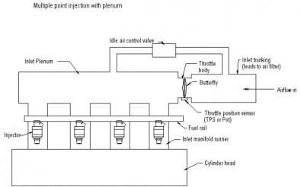
Multi Point Fuel Injection (MPFI)
The MPFI is a system or method of injecting fuel into internal combustion engine through multi ports situated on intake valve of each cylinder. It delivers an exact quantity of fuel in each cylinder at the right time. There are three types of MPFI systems – Batched, Simultaneous and Sequential.
In the batched MPFI system fuel is injected to the groups or batches of the cylinders without bringing their intake stroke together. In the simultaneous system, fuel is inserted to all cylinders at the same time, while the sequential system injection is timed to overlap with intake stroke of each cylinder.
CRDI (Common Rail Direct Injection)
CRDI stands for Common Rail Direct Injection meaning, direct injection of the fuel into the cylinders of a diesel engine via a single, common line, called the common rail which is connected to all the fuel injectors.
Whereas ordinary diesel direct fuel-injection systems

Slide 11
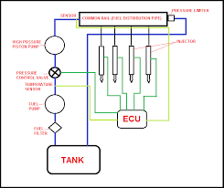
have to build up pressure anew for each and every injection cycle, the new common rail (line) engines maintain constant pressure regardless of the injection sequence. This pressure then remains permanently available throughout the fuel line. The engine's electronic timing regulates injection pressure according to engine speed and load. The electronic control unit (ECU) modifies injection pressure precisely and as needed, based on data obtained from sensors on the cam and crankshafts. In other words, compression and injection occur independently of each other. This technique allows fuel to be injected as needed, saving fuel.
OHV means Overhead Valve - an engine design where the camshaft is installed inside the engine block and valves are operated through lifters, pushrods and rocker arms. For this reason, an OHV engine is also known as a "Pushrod" engine. The OHV design has been successfully used for decades.
The main disadvantage of an OHV design is that it's difficult to precisely control the valve timing at high rpm. This means, that an OHV design is better suited for V8 or larger engines, where large engine volume offers higher torque at lower

Slide 12
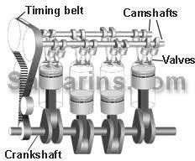
rpms.
It's also technically more difficult to install more than 2 valves per cylinder, or implement Variable Valve Timing - something that could be easily done in a DOHC engine.
UNIT 3
Transmission system
Clutch- In a car with a manual transmission the clutch is operated by the pedal using a hydraulic or cable connection from the pedal to the clutch mechanism. The clutch is located between the engine and the gearbox, mounted directly to the face of the engine's flywheel.
The clutch connects and disconnect two rotating shafts (drive shafts or line shafts), one shaft is typically attached to an engine (the driving member) while the output shaft (the driven member) provides output power for work.

Slide 13
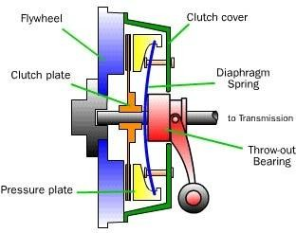
Single Plate Clutch
Main Parts Of clutch :
1) The driving members consist of a flywheel mounted on the engine crankshaft. The fly wheel is bolted to a cover which carries a pressure plate or driving disc, pressure springs and releasing levers. Thus the entire assembly of the flywheel and the cover rotate all the times. The clutch housing and the cover provided with openings dissipate the heat generated by the friction during the clutch operation.
2 ) The driven members consists of a disc or plate, called the clutch plate. It is free to slide lengthwise on the splines of the clutch shaft. It carries friction materials on both of its surface. When it is griped between the flywheel and the pressure plate, it rotates the clutch shaft through the splines.
3) The operating members consist of a foot pedal, linkage, release or throw-out bearing, release levers and the springs necessary to insure the proper operating of the clutch.
Working- It is the most common type of clutch used in motor vehicles. Basically, it consists of only one clutch plate,

Slide 14
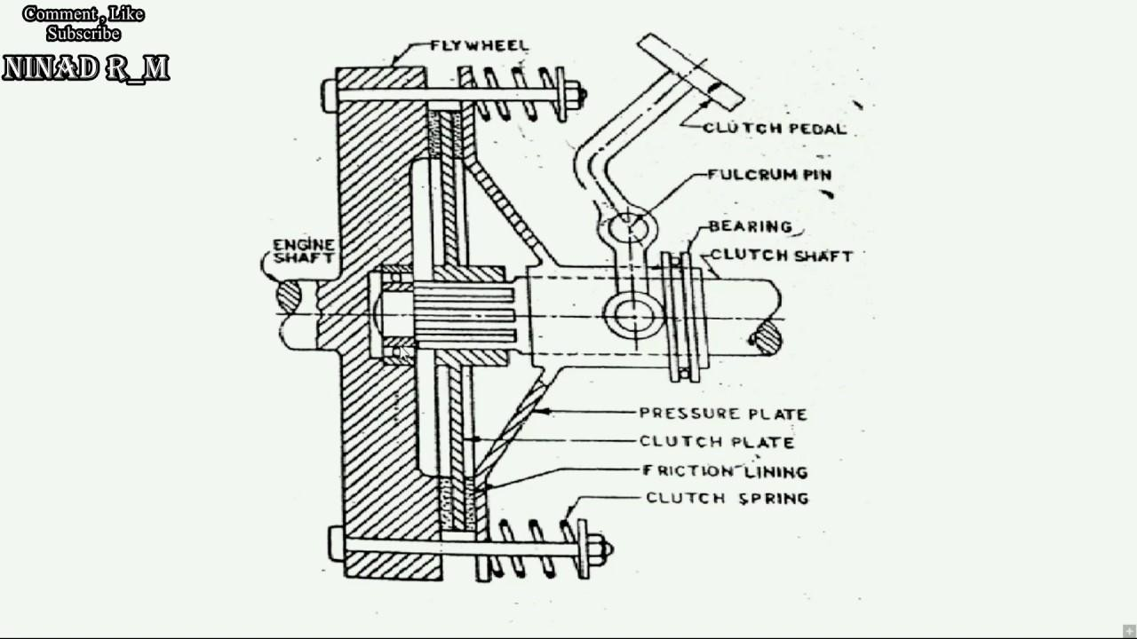
mounted on the splines of the clutch shaft. The fly wheel is mounted on the engine crankshaft and rotates with it. The pressure plate is bolted to the flywheel through clutch springs and is free to slide on the clutch shaft when the clutch pedal is operated. When the clutch is engaged the clutch plate is gripped between the flywheel and the pressure plate. The friction linings are on both the sides of the clutch plate. Due to the friction between the flywheel, clutch plate and pressure plate, the clutch plate revolves with the flywheel. As the clutch plate revolves, the clutch shaft also revolves.
Multiplate clutch:
Multiplate clutch consists of a number of clutch plates, instead of only one clutch plate as in the case of single plate clutch. As the number of clutch plates are increased, the friction surface also increase. The increased number of friction surfaces obviously increases the capacity of the clutch to

Slide 15
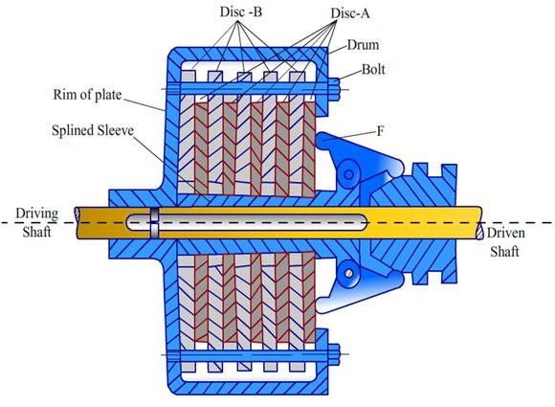
transmit torque. The plates are alternately fitted to the engine shaft and the gear box shaft. They are firmly pressed by strong coil spring and assembled in a drum. Each of the alternate plate slides in grooves on the flywheel and the other slides on splines on the pressure plate. Thus, each alternate plate has
inner and outer splines.
Working Of Multi Plate Clutch
The multiple clutch works in the same way as the single plate clutch, by operating the clutch pedal. The multiplate clutches are used in heavy commercial vehicles, racing cars and motor cycles for transmitting high torque.
The multiple clutches may be dry or wet. When the clutch is
operated in an oil bath, it is called a wet clutch. When the clutch is operated dry, it is called dry clutch. The wet clutch are generally used in conjunction with, or as a part of the automatic transmission.

Slide 16
Centrifugal Clutch is in which centrifugal force is used to connect engine drive shaft with the shaft of transmission. It is placed in between the engine flywheel and transmission system. Its main function is to connect the engine shaft with the transmission shaft. It works more efficiently at higher speed.
Main Parts-
Shoes: The shoes are of sliding types which slides in the guide ways. It consists of friction
lining at the end and this friction lining makes contact with the drum during engagement.
Spring: Spring is used to disengage the clutch when the engine rotates at lower speed.
Spider or guides: The spiders are mounted on the driver (engine) shaft or motor shaft. The spiders are equally spaced. Equally spaced means, if they are four guides than each guide is separated from each other by 90 degree. The sliding shoes are kept in between these guides and each guide is holding a spring.
Friction lining: The outer surface of sliding shoes has friction lining. It helps in making grip with the inner surface of the drum.
Drum: The drum of the clutch act as housing which encloses all the parts of the clutch that includes sliding shoes, guides, springs etc. It is connected to the driven shaft of the transmission system or chains or belt.

Slide 17
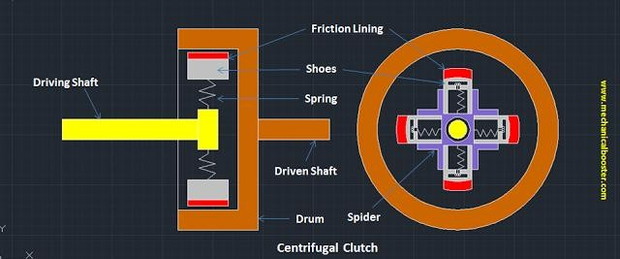
Working-Its working is totally depends upon the centrifugal force created by the driving member (engine or motor). The centrifugal force is used to engage the clutch with driven shaft. As the engine starts rotating, it produces a centrifugal force which makes the sliding shoes to move outward. The friction lining of the shoes gets connected to the inner surface of the drum and it starts moving. Since the drum is connected to the driven shaft, so the power is transmitted from the engine shaft to the transmission shaft and finally to the load.
GEARS:
Sliding Mesh Type of Gear Box
This is the simplest type of gear box. The figure gives a simplified view if the gear box. The power comes from the engine to the clutch shaft and hence to the clutch gear which is always in mesh with a gear on the lay shaft. All the gears on the lay shaft are fixed to it and as such they are all the time rotating when the engine is running and the clutch is engaged. Three direct and one reverse speeds are attained on suitably moving the gear on the main shaft by means of selector

Slide 18
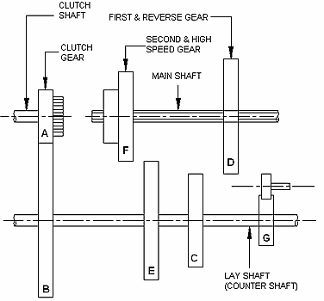
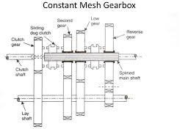
mechanism
Constant mesh gearbox-Constant mesh gearbox is a type of Transmission in which all or most of the gears are always in mesh with one another, as opposed to a sliding-gear transmission, in which engagement is obtained by sliding some of the gears along a shaft into mesh. In a constant-mesh manual gearbox, Gear ratios are selected by small Clutches that connect the various gear sets to their shafts so that power is transmitted through them. The following diagram shows the arrangement of a constant mesh gear box.

Slide 19
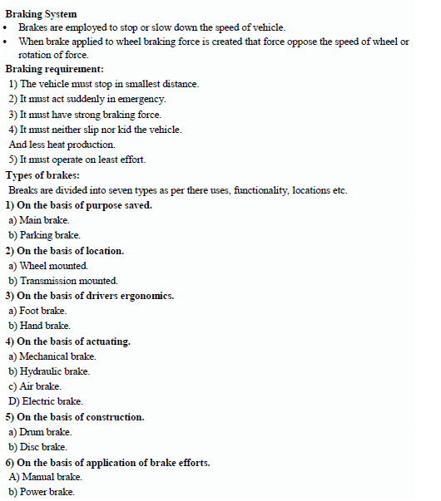

BRAKING SYSTEM

Slide 20
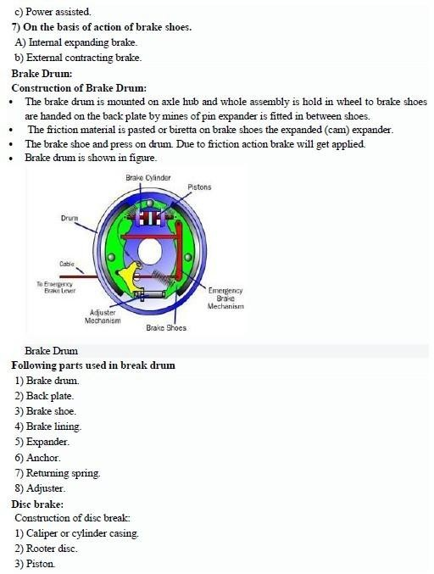

Slide 21
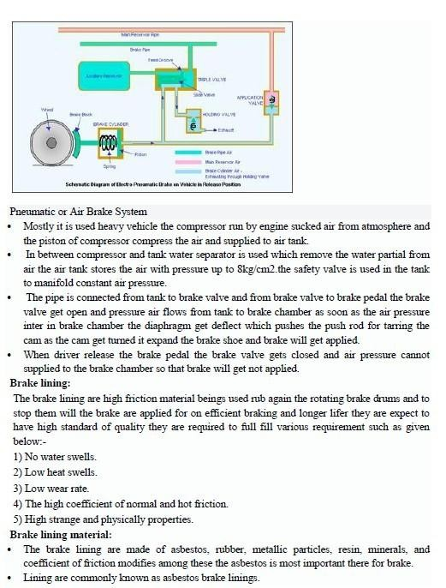
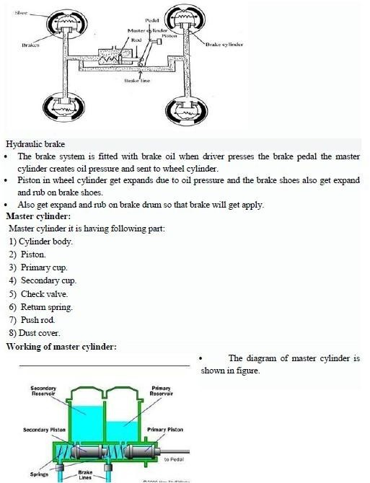

Slide 22
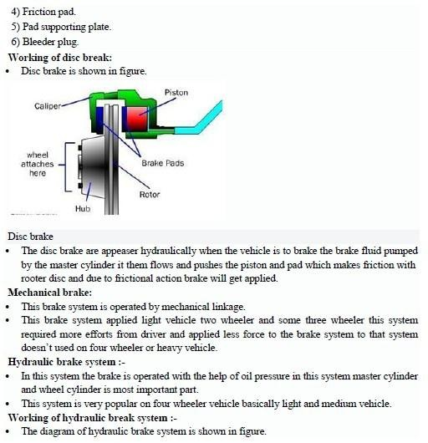

Slide 23
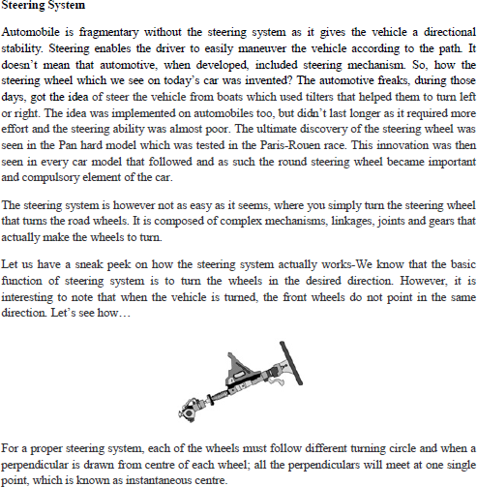
STEERINGGEOMETRYANDFRONT AXLE

