Slide 1
TURBINE AND PUMP
◆ A turbine is a rotary engine that extracts energy from a fluid flow and converts it into useful work
Eg: steam turbine, gas turbine, hydraulic turbine
◆ Hydraulic Turbines transfer the kinetic energy and potential energy of water into a rotation .
◆ We can generate electricity by coupling to electric generator
◆ Pump is work consuming device and it is just opposite to turbine.
Eg. Centrifugal pump

Slide 2
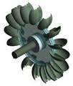
CLASSIFICATION OF HYDRAULIC TURBINES:
BASED ON FLOW PATH
Axial Flow
Radial Flow
Tangential Flow
Mixed Flow
Based on flow path
◆ Axial Flow Hydraulic Turbines: flow path of the liquid mainly parallel to the axis of rotation. Eg: Kaplan turbine
◆ Radial Flow Hydraulic Turbines: liquid flowing mainly in a plane perpendicular to the axis of rotation.
◆ Tangential Flow Hydraulic Turbines: liquid flowing mainly in a plane tangential to the turbine. Eg: Pelton turbine

Slide 3
Mixed Flow Hydraulic Turbines: For most of the Hydraulic Turbines used there is a significant component of both axial and radial flows. They are called as Mixed Flow Turbines.
eg.Francis Turbine is an example of mixed flow type, in Francis Turbine water enters in radial direction and exits in axial direction.
3. BASED ON WORKING PRINCIPLE
◆ Impulse turbine
◆ Reaction turbine
Kinetic energy changes and pressure energy
Kinetic energy changes but pressure energy remains constant
Stator
runner
Fig Impulse machine

Slide 4
Pressure change occur only in the nozzles of the machine. Eg : Pelton Turbine.
The change in fluid velocity and reduction in its pressure causes a reaction on the turbine
blades.
Eg: Francis and Kaplan Turbines
Kinetic energy changes and pressure energy
Kinetic energy changes as wellas pressure energy also changes
Stator
runner
Fig Reaction machine

Slide 5
SL NO | IMPULSE TURBINE | REACTION TURBINE
1 | Impulsive force is rotating the turbine | Reaction force is rotating turbine
2 | Pressure of liquid is decreasing in nozzle before entering to turbine | Pressure decreases as it flows over the blades
3 | Blades are of symmetrical profile | Blades having aerofoil profile
4 | The size of turbine is small for the same power output | Size of reaction turbine is large for the same power output
5 | Whole pressure energy of water is converted into kinetic energy before passed onto turbine wheel | Part of pressure energy only converted to kinetic energy
6 | Water discharges directly from turbine wheel to tail race | Water discharges into a draft tube then it is finally discharged to tail race
7 | Pressure of water will be atmospheric as it flows over moving blades | Pressure of water continuously decreases as it flows over the blades

Slide 6
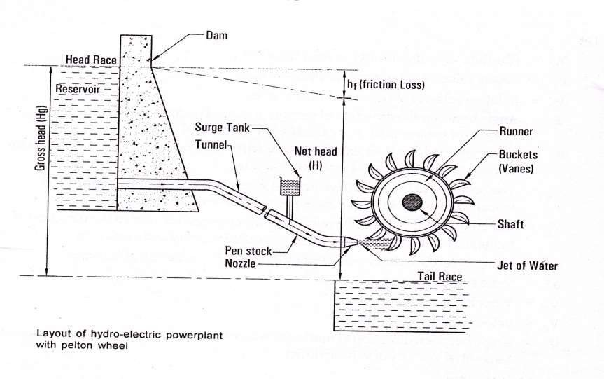
PELTON TURBINE POWER PLANT

Slide 7
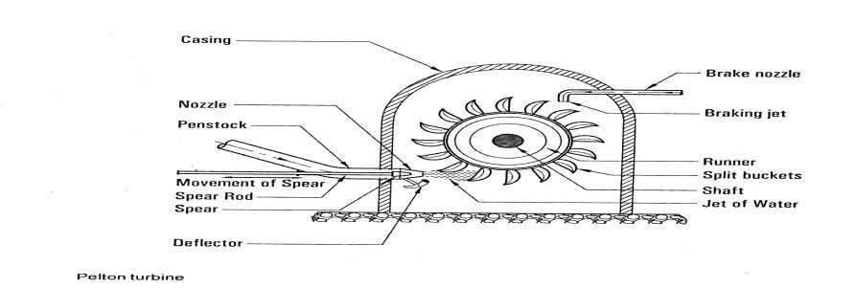
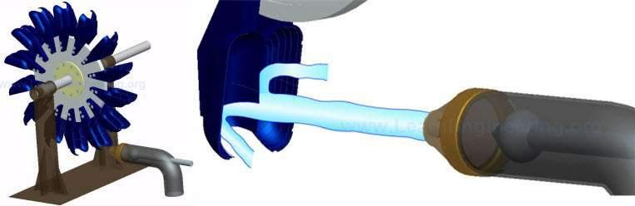
PELTON TURBINE

Slide 8
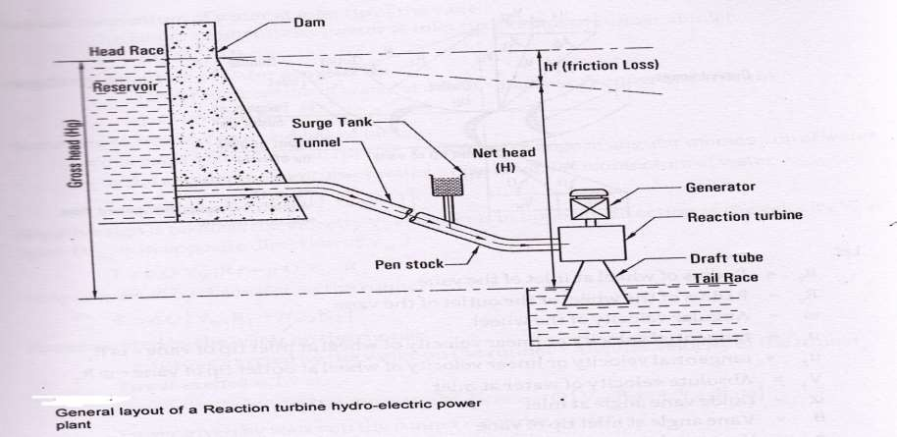
REACTION TURBINE

Slide 9
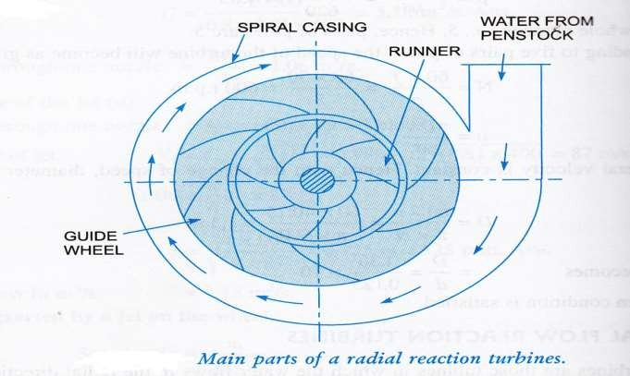
Francis Turbine

Slide 10
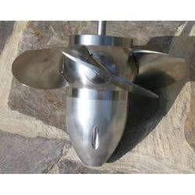
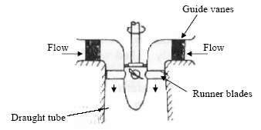
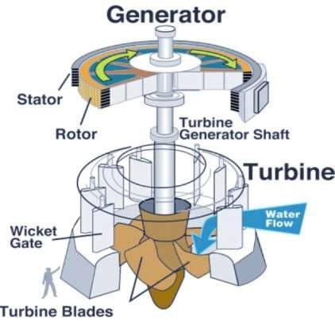
Kaplan Turbine:

Slide 11
CLASSIFICATION OF PUMPS
Pumps are broadly classified into
Positive- displacement pumps
Rotodynamic pumps
◆ Positive- displacement pumps: They make a fluid move by trapping a fixed amount and displacing the trapped volume into the discharge pipe. Discharge is directly proportional to speed.
Eg : Reciprocating pump, Vane pump, Gear pump
◆ Rotodynamic pumps: It is a machine in which energy is continuously imparted to the pumped fluid by means of a rotor and thus fluid is raised to higher elevation.
Eg: Centrifugal pump

Slide 12
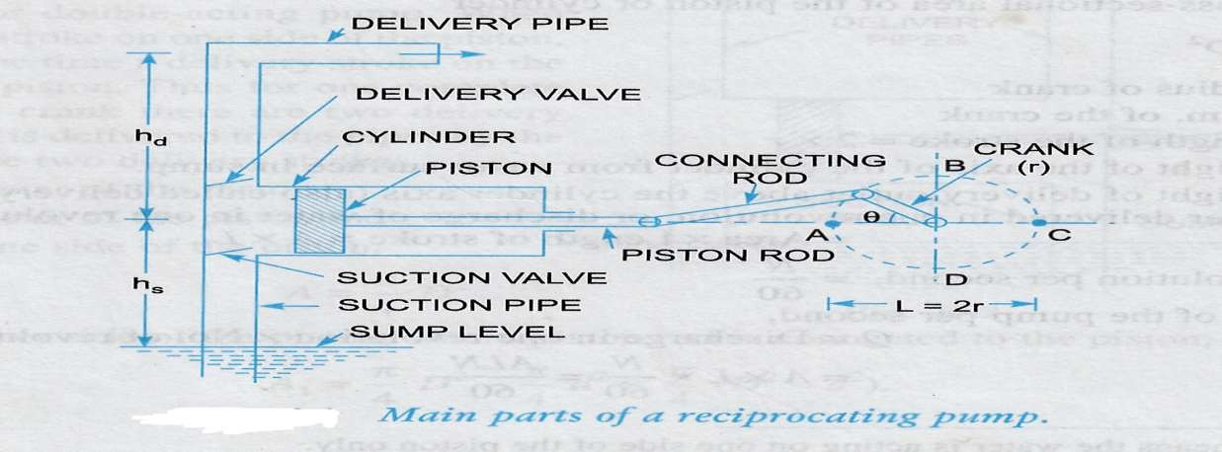
RECIPROCATING PUMP

Slide 13
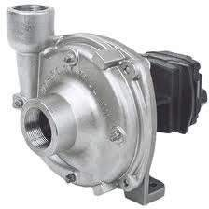
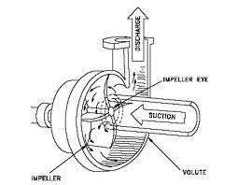
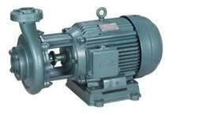
Centrifugal pumps

Slide 14
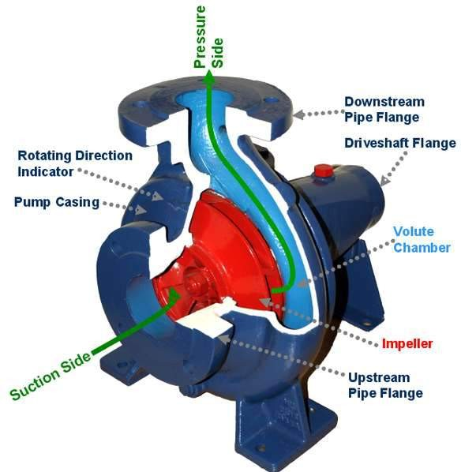
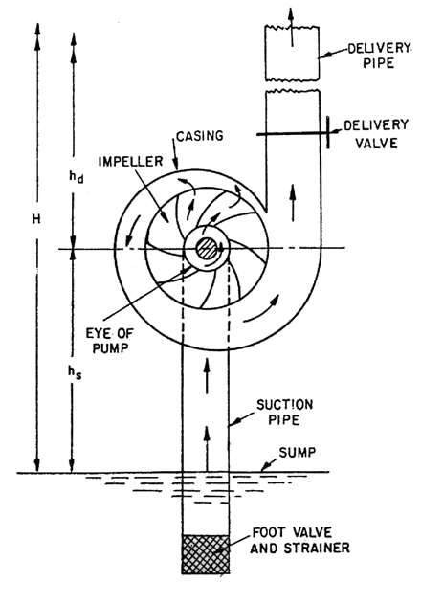

Slide 15
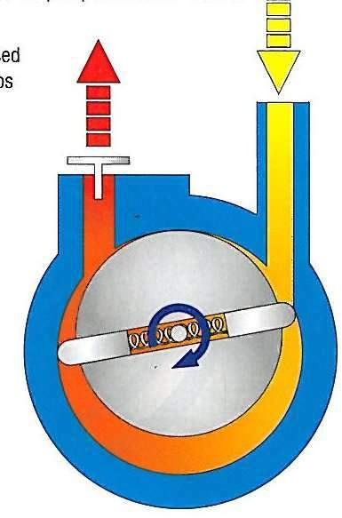
Rotary vane pump

Slide 16
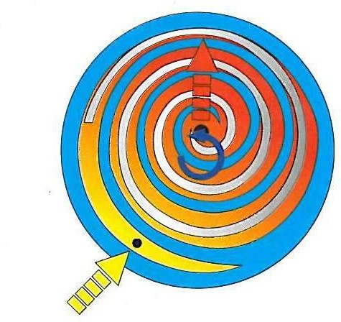
Scroll Pump
Exhaust port in center
Blue area rotates counterclockwise
with silver area sprung against it. Volume between parts decreases.
Intake

Slide 17
Pressure
◆ Fluid pressure = Normal compressive force
Area
◆ It is compressive in nature
◆ S.I unit is Pascal
◆ 1 atm pressure=101325 pa
◆ 1 atm pressure=1.o1325 bar
◆ 1 atm pressure=101.325 Kpa
◆ 1 atm pressure=10.3 mtr of water
◆ 1 atm pressure=76cm of Hg
◆ Atm pressure is measured by barometer
◆ It is scalor quantity Acq. To pascal law

Slide 18
Pressure of fluid expressed in 3 forms
◆ Absolute pressure
◆ Gauge pressure
◆ Negative gauge
P>Patm
Absalute pressure
Gauge pressure
Patm
Absalut e pressur e
Vacuum pressure
P<Patm
P=0

Slide 19
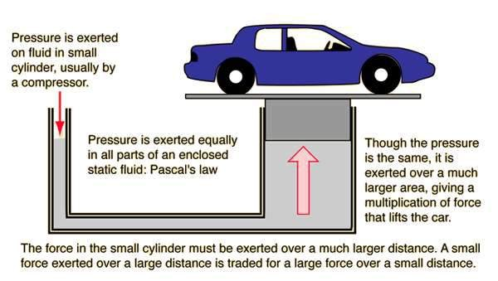
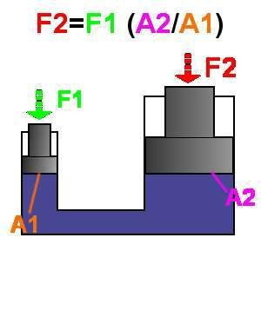
Pascal law:

Slide 20
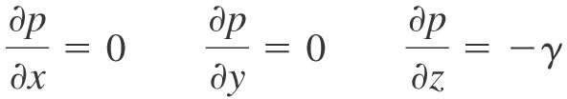
Pressure Variation in a Fluid at Rest- Hydrostatic law

Slide 21
Pressure measuring instruments:
Simple manometers
◆ Peizometer
◆ U-tube manometer
◆ Single column manometer
Differential manometer
◆ 2piezometer d.f
◆ Inverted u-tube manometer
◆ U-tube differential manometer
Pressure gauges
◆ Bourdon tube pressure gauges
◆ Diaphragam pressure gauges

Slide 22
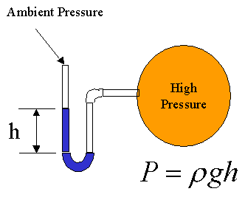
Manometers
Principle of operation: Manometers are devices in which columns of suitable liquid are used to measure the difference in pressure between two points, or between a certain point and the atmosphere (p_{atm}).
Applying fundamental equations of hydrostatics the pressure difference, P, between the two liquid columns can be calculated.

Slide 23
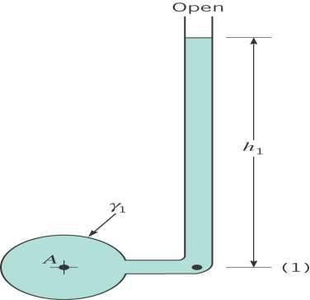
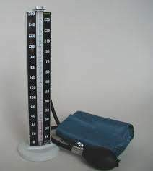
PEIZOMETER

Slide 24
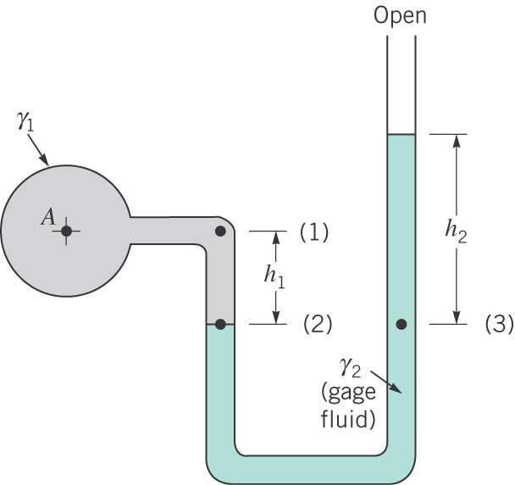
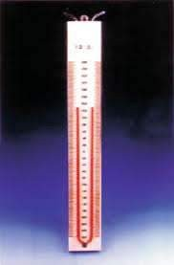
U-TUBE MANOMETER

Slide 25
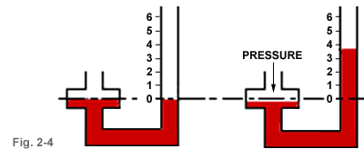
Single column manometer

Slide 26
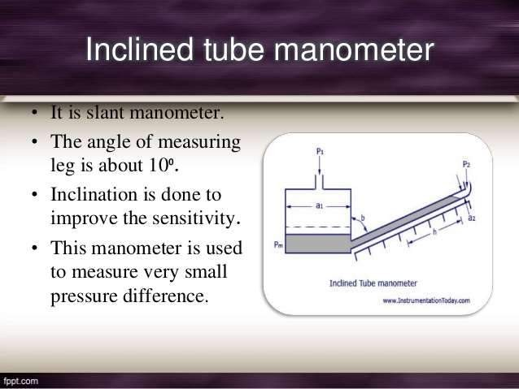

Slide 27
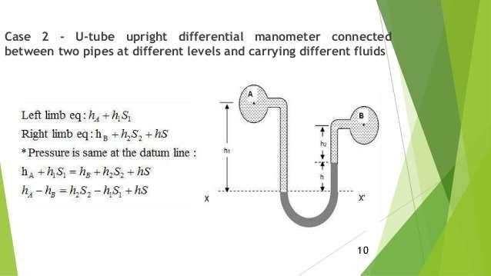
U-tube differential manometer

Slide 28
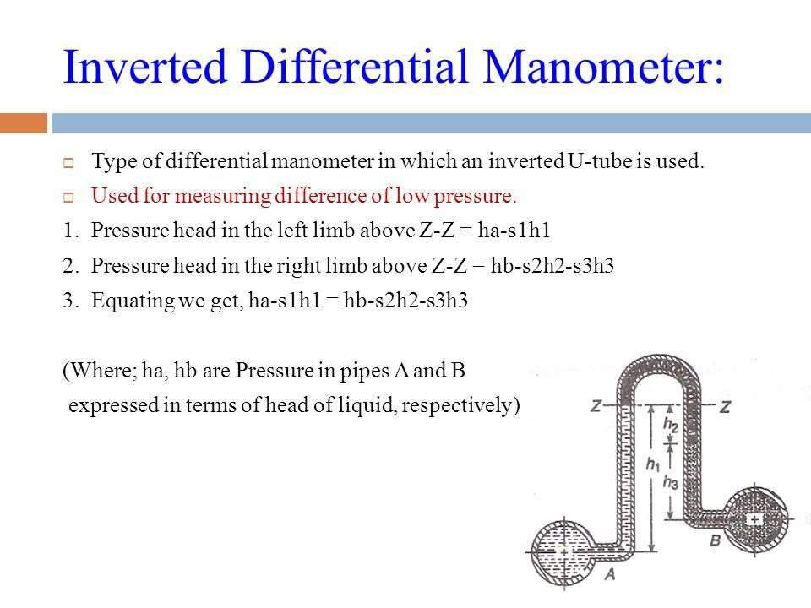

Slide 29
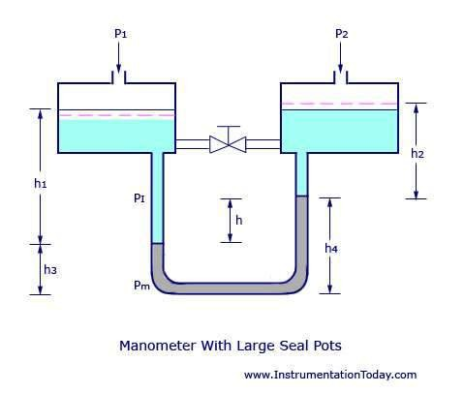
Micromanometer

Slide 30
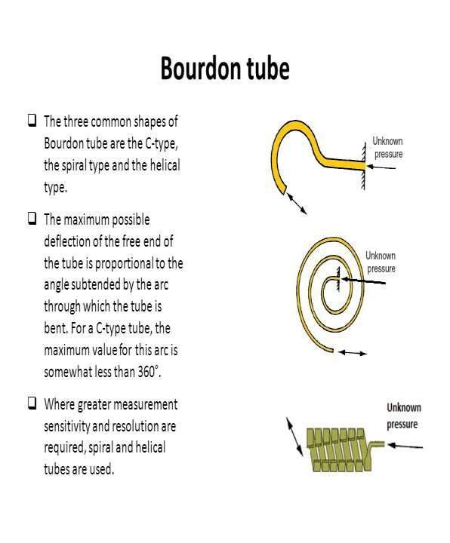
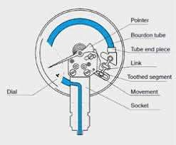
Bourdon Gauge (Mechanical)

Slide 31
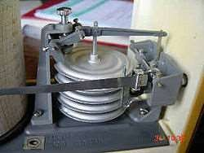
Diaphragm pressure gauge

Slide 32
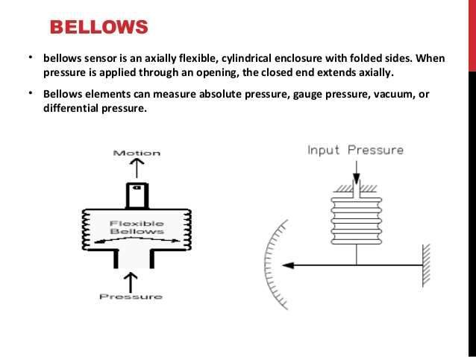

Slide 33

Thank You

