Slide 1
Sentiment Analysis of Tweets

Slide 2
Problem Statement: Given a set of Tweets, classify whether the tweet is of positive ,negative or neutral sentiment. For tweet conveying both a positive and negative sentiment, whichever is the stronger sentiment should be chosen.

Slide 3
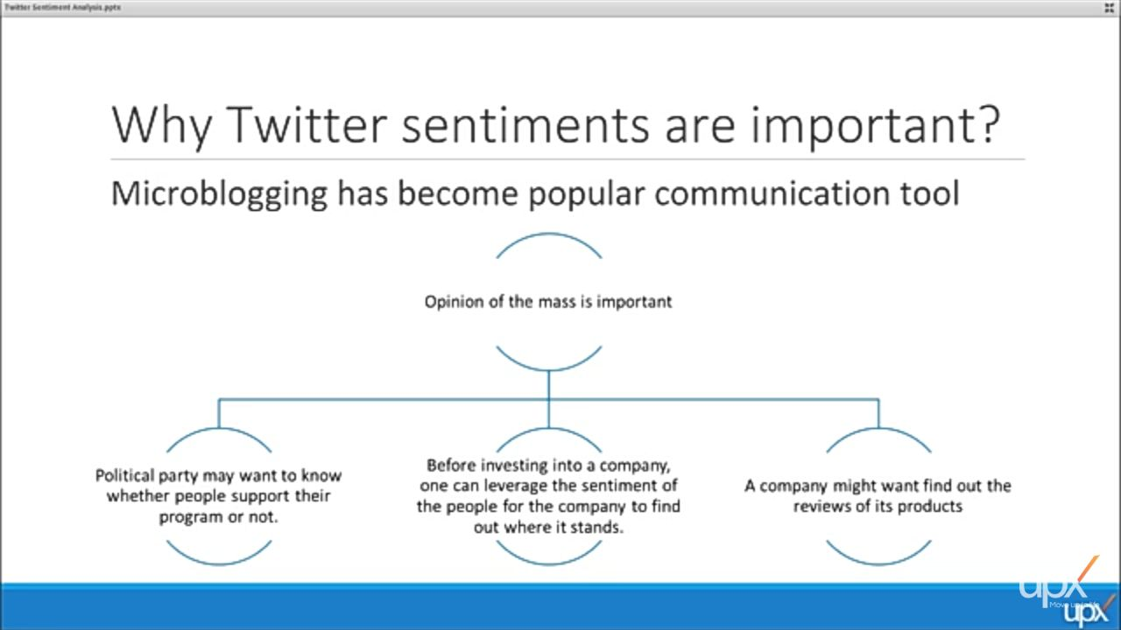

Slide 4
Categories
We took following Sentiment into consideration for classifying twitter data.
1)Positive
2)Negative
3)Neutral

Slide 5
Various approaches:
Naïve Bayes
Support Vector Machines
Maximum Entropy

Slide 6

Naïve Bayes’ algorithm
Conditional Probability:
The conditional probability of A given B is defined as the quotient of the probability of the joint of events A and B, and the probability of B:

Slide 7
Bayes' theorem is a formula that describes how to update the probabilities of hypothesis when given evidence. It follows simply from the axioms of conditional probability, but can be used to powerfully reason about a wide range of problems involving belief updates. Given a hypothesis H and evidence E, Bayes' theorem states that the relationship between the probability of the hypothesis P(H) before getting the evidence and the probability P(H | E) of the hypothesis after getting the evidence is

Slide 8
Pros: It is easy and faster to implement the naïve Bayes' algorithm. Categorical input variables are only use. Cons: If the categorical input variable was a categories which was not found in training dataset then model will assign a zero probability & will be unable to make a prediction. This is called “zero frequency”. Avoid the zero frequency use the “Smoothing technique”.it is also known as "Laplace Estimation “. Naive bayes is a bad estimator.

Slide 9
Applications of Naïve Bayes’:
Real time prediction
Multi class prediction
Text classification/spam filtering/sentiment analysis
Recommendation system

Slide 10
Reason For Low Accuracy For naïve Bayes
Over –Fitting of data-set.
Emoticons not taken into consideration for Analysis.
Future-Aspect :
(Training DataSet Can be increased )
(Emoticons should not be removed and thus taken into consideration)

Slide 11
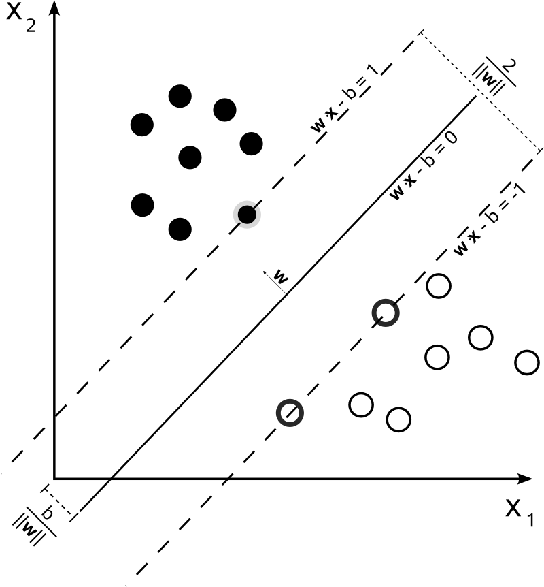
Support Vector machines - SVM

Slide 12
Support Vector Machines (SVMs) are another technique which can be used to classify the tweets. Support vector machines are supervised learning models with associated learning algorithms that analyse data used for classification and regression analysis. Given a set of training examples, each marked as belonging to one or the other of two categories, an SVM training algorithm builds a model that assigns new examples to one category or the other, making it a non-probabilistic binary linear classifier.

Slide 13
More formally, a support vector machine constructs a hyper plane or set of hyper planes in a high- or infinite-dimensional space, which can be used for classification, regression, or other tasks. Intuitively, a good separation is achieved by the hyperplane that has the largest distance to the nearest training-data point of any class (so-called functional margin), since in general the larger the margin the lower the generalization error of the classifier.

Slide 14
Advantages: Effective in high dimensional spaces. Effective in cases where number of dimensions is greater than the number of samples. Uses a subset of training points in the desision function (support vectors), therefore more memory efficient. They are versatile. SVMs can work effectively on smaller training datasets as they don't rely on the entire data.

Slide 15
Disadvantages: They are not suitable for larger datasets because the training time with SVMs can be high and much more computationally intensive. They are less effective on noisier datasets that have overlapping classes.

Slide 16
Reason For Low Accuracy in SVM
The matrix created was highly sparse.
This led to a low prediction result of 35-40%
Future aspect : (Use Dimension Reduction Technique like PCA for Increasing the accuracy.)

Slide 17
Maximum entropy
The principle of maximum entropy states that the probability distribution which best represents the current state of knowledge is the one with largest entropy, in the context of precisely stated prior data (such as a proposition that expresses testable information).

Slide 18
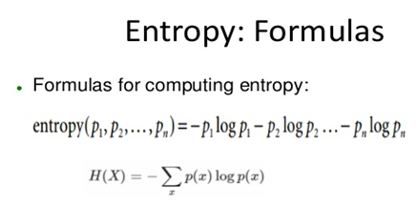

Slide 19
flowchart

Slide 20
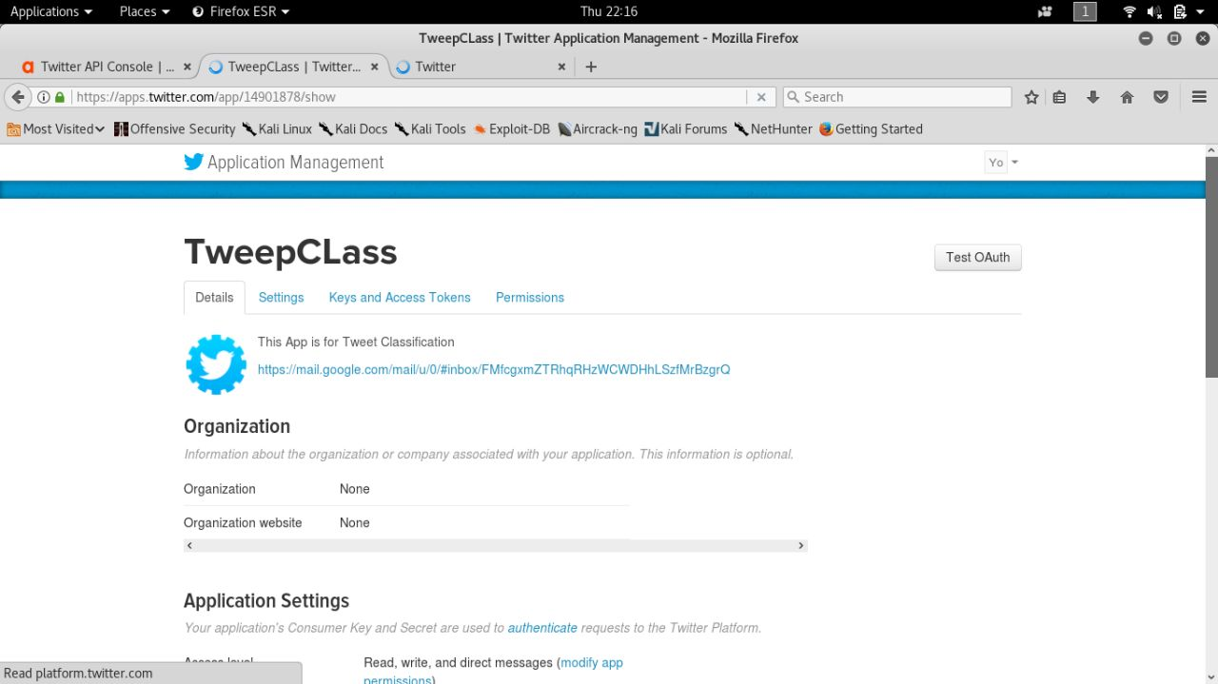
Crawling

Slide 21
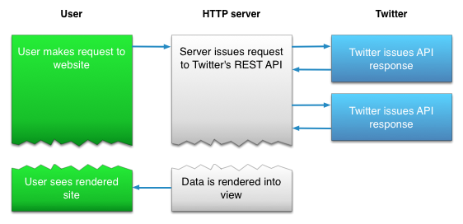
API Interaction

Slide 22
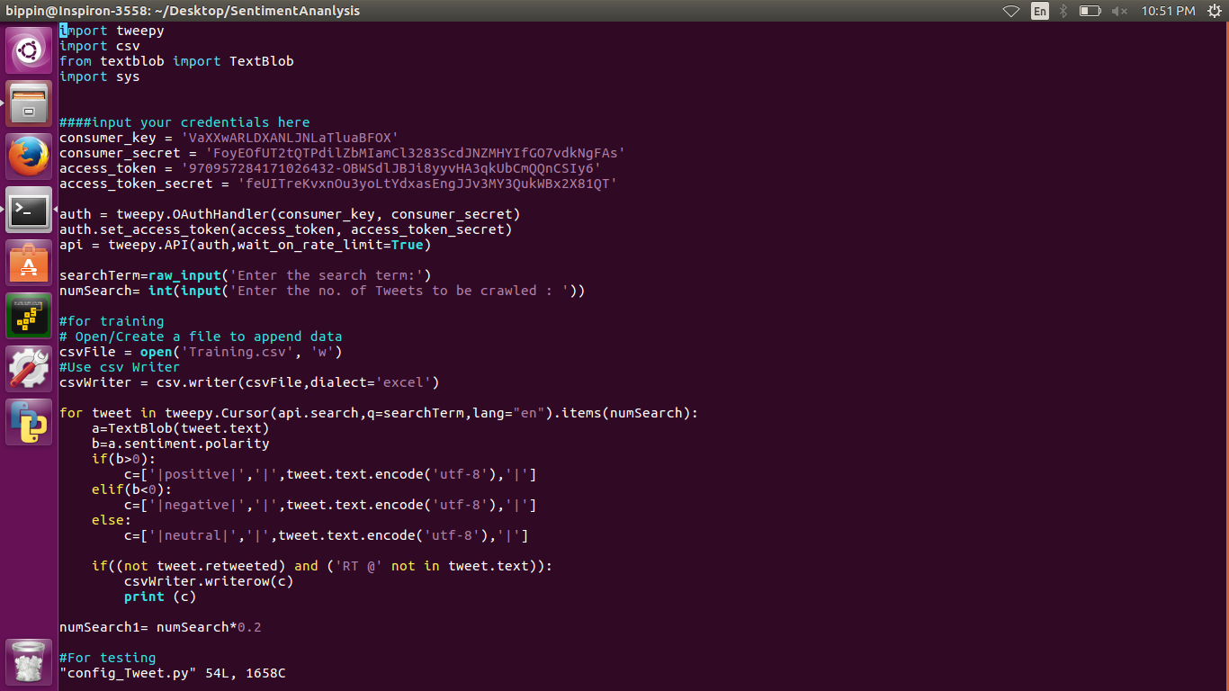
Tweepy

Slide 23
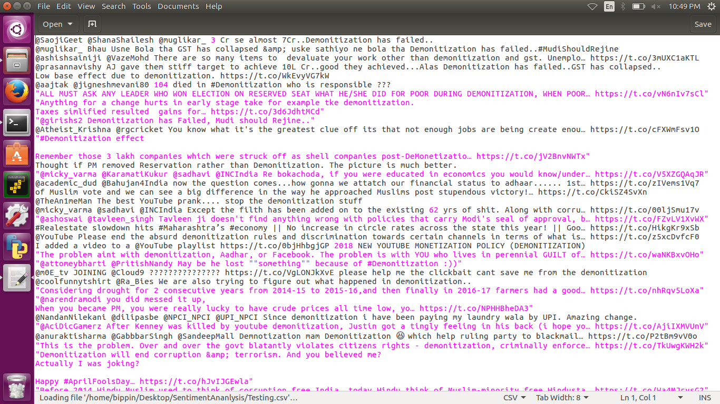
crawling

Slide 24
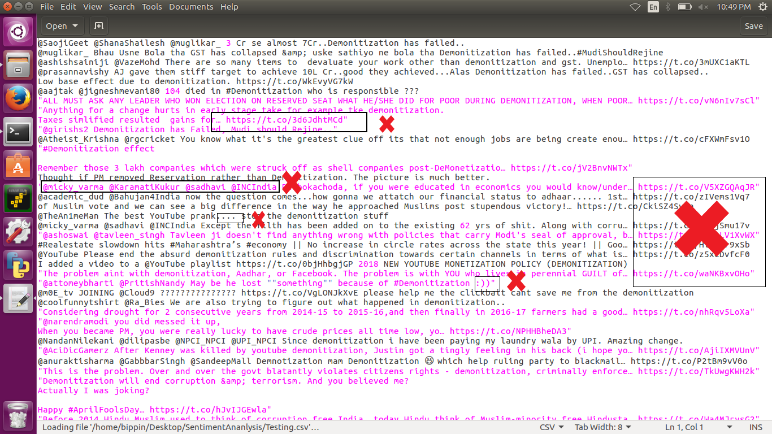
Filtering

Slide 25
Feature Extraction:
After the removal of the following –
HTML tags
URL links
Username
Stop words
Emoticons
We got the feature Vector—

Slide 26
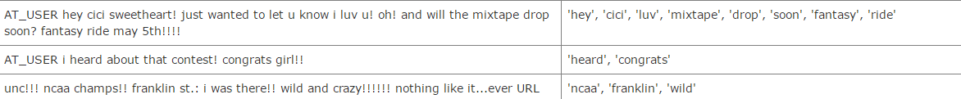
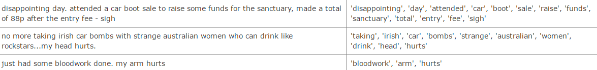
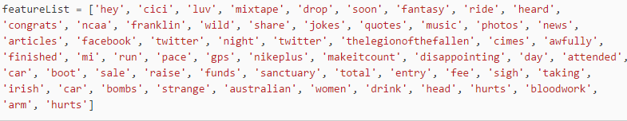

Slide 27
Genarating DataSets
We used TextBlob and manual verification for genarating real time dataset .
TextBlob is a Python (2 and 3) library for processing textual data. It provides a simple API for diving into common natural language processing (NLP) tasks such as part-of-speech tagging, noun phrase extraction, sentiment analysis, classification, translation, and more.
We have used TextBlob to classify the training dataset for Naive-Bayes Classification.

Slide 28
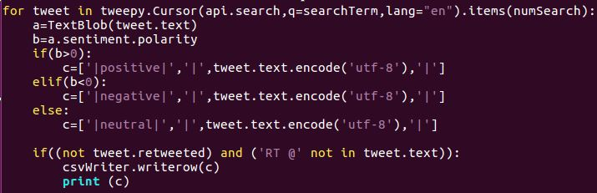
TextBlob

Slide 29
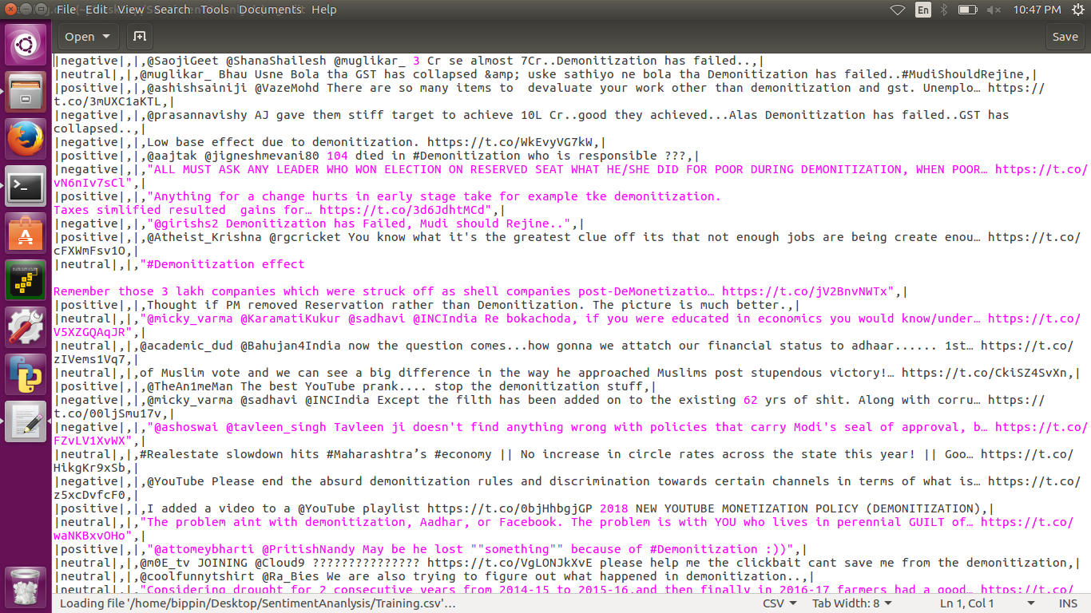
Training DataSet

Slide 30
Testing Datasets

Slide 31
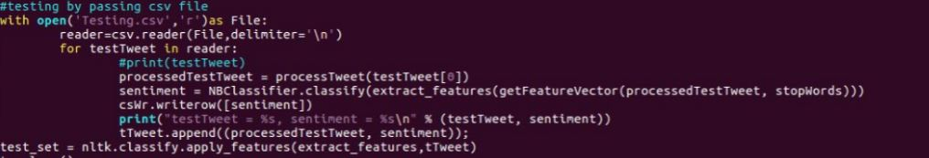
Training and Testing
Naïve -bayes

Slide 32
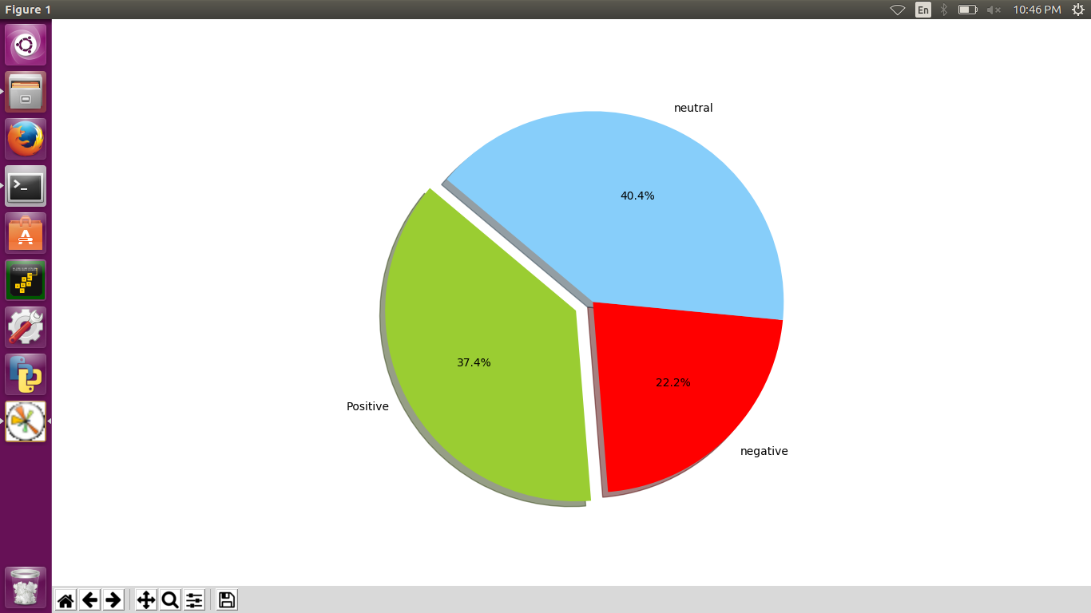
Sentiment pie-chart of naïve bayes.

Slide 33
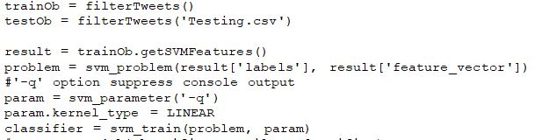
Svm

Slide 34
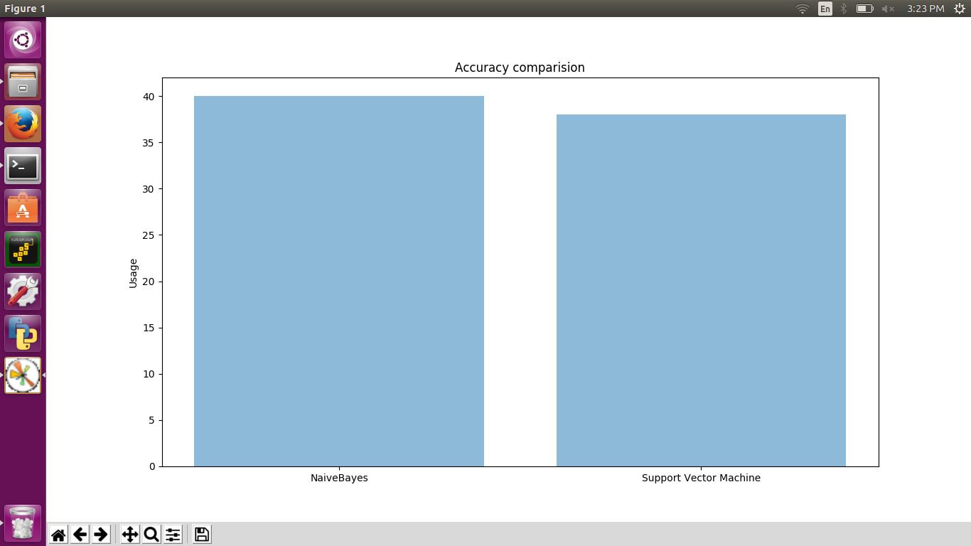
Accuracy Comparison

Slide 35
Future scope/work:
Improvements in SVM classifier:
Increasing the data set.
Improved feature extraction.
E.g. Clustering
Using multiple kernels.(E.g. RBG and polynomial instead of linear.)
Using Emoticons for more precise analysis.

Slide 36
References
Ravikiranj:
GitHub:
GeeksforGeeks:
Ipullrank:
Marcobonzani:

Slide 37
Thank you

