Slide 1
A Look into the
FUTURE 5G WIRELESS TECHNOLOGY
By:- Himanshu Lawaniya

Slide 2
Contents
Objective
Introduction
5G Hardware
5G Software
Architecture
Features
Advantages
Applications
Challenges
Future Scope
Conclusion
Reference

Slide 3
Objective
Big Data analysis has proven that it can add value to existing business and provide innovative solutions. This lead to revolutionize the business ideas over the globe
The required objectives for 5G wireless technologies as stated below: -
1.) 5G networks will able to serve 100 billion connections.
2.) 10 Gb/s will be the data rate per user.
3.) 5G networks will have new RAT+LTE+LTE-A+WiFi+GSM+HSPA.
4.) Several thousands of simultaneous connection.
5.) 5G network may serve 3 folds of world population in M2M connections
6.) Multi-hop communication, Massive MIMO.

Slide 4
INTRODUCTION
1.) Fifth generation networks (5G) is currently under development and hit the market at the horizon 2020.
2.) Compared with current 4G LTE technology, 5G is targeting to reach both high speed (1Gbps), low power and low latency (1ms or less), for massive IoT, tactile internet and robotics.
3.) Huawei and DOCOMO teamed up in December 2016 to conducted the world’s first 5G large scale field trail. Using 4.5 GHz frequency band, both companies recorded data transfer speeds of 11.29 Gbps, which is about 40 times faster than the current 4G standard.

Slide 5
5G HaRDWaRE
1.) 5G hardware uses UWB (Ultra Wideband Networks) with higher bandwidth at low energy levels.
2.) Bandwidth is of 400 times faster than today’s wireless network.
3.) It uses CDMA (Code Division Multiple Access) with smart antennas
4.) Smart antennas include Switched beam antennae, Adaptive array antennae.

Slide 6
5G SOFTWaRE
1.) 5G will be a single unified IP standard of different wireless networks and a seamless combination of broadband, including wireless technologies, such as IEEE802.11, Lan, Wan, Pan and WWWW.
2.) 5G will enable software-defined radio, packet layers, implementation of packets, encryption flexibility, etc.

Slide 7
ARCHITECTURE
1.) 5G wireless technology defines by OSI layer1 and layer2, for these two layers 5G network is likely to be based on Open Wireless Architecture(OWA).
2.) OWA is combination of Physical layer and Data Link layer.
3.) 5G network terminals have transport layer that is possible to be downloaded and installed is an OTP(Open Transport Protocol).
4.) The OTP is combination of Transport Layer and Session Layer.

Slide 8
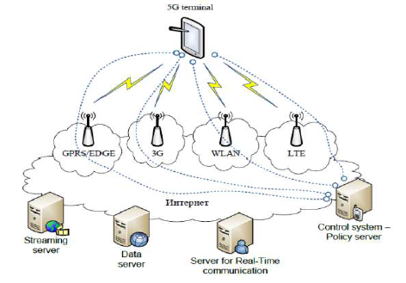

Slide 9
FeATURES
1.) Very high speed, high capacity, and low cost per bit.
2.) It offers high quality services due to high error tolerance.
3.) 5G technology offers Global access and service portability.
4.) The uploading and downloading speed of 5G technology is very high.
5.) Provides 100% coverage.
6.) 90% reduction in network energy usuage

Slide 10
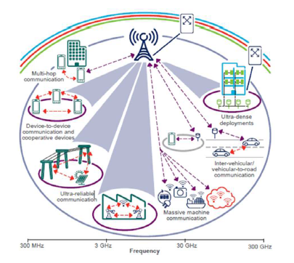
ADVANTAGES
1.) High resolution and bi-directional large bandwidth shaping.
2.) Technology to gather all networks on one platform.
3.) More effective and efficient.
4.) Easily manageable with the previous generation.
5.) Possible to provide uniform, uninterrupted, and consistent connectivity across the world.

Slide 11

ApplicAtion
1.) It will make unified global standard for all.
2.) Network availability will be everywhere and will facilitate people to use their computer and such kind of mobile devices anywhere anytime.
3.) Because of the IPv6 technology, visiting care of mobile IP address will be assigned as per the connected network and geographical position.
4.) Its application will make world real Wi Fi zone.
5.) It’s application will facilitate people to avail radio signal at higher altitude as well.

Slide 12

CHALLENGES
1.) Challenges are the inherent part of the new development; so, like all technologies, 5G has also big challenges to deal with. As we see past i.e. development of radio technology, we find very fast growth. Starting from 1G to 5G, the journey is merely of about 40 years old (Considering 1G in 1980s and 5G in 2020s). However, in this journey, the common challenges that we observed are lack of infrastructure, research methodology, and cost.
2.) To understand the challenges of 5G are categorized into the following two headings −
Technological Challenges
Common Challenges

Slide 13
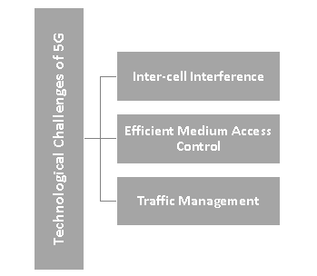
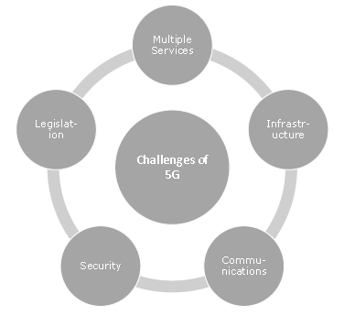
3.)
4.)
Technological challenges
Common challenges

Slide 14
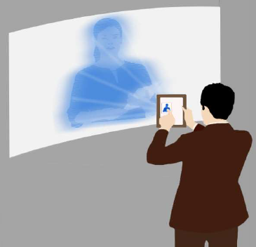
FUTURE SCOPE
1.) 5th generation technology is designed to provide incredible and remarkable data capabilities, unhindered call volumes, and immeasurable data broadcast within the latest mobile operating system.
2.) It is more intelligent technology, which will interconnect the entire world without limits. Likewise, our world would have universal and uninterrupted access to information, communication, and entertainment that will open a new dimension to our lives and will change our life style meaningfully.
3.) Governments and regulators can use this technology as an opportunity for the good governance and can create healthier environments, which will definitely encourage continuing investment in 5G, the next generation technology.

Slide 15
CONCLUSION
1.) The development of wireless network is going towards higher data rates and all IP principal.
2.) 5G include latest technologies such as cognitive radio, SDR, Nano-technology, Cloud computing.

Slide 16
REFERENCES
1.) https://www.tutorialspoint.com/5g/index.htm
2.) https://www.gemalto.com/mobile/inspired/5G
3.) http://bu.edu.eg/projects/Evolution/index.php
4.) https://5g-ppp.eu/wp-content/uploads/2018/01/5G-PPP-5G-Architecture-White-Paper-Jan-2018-v2.0.pdf
5.) https://www.huawei.com/minisite/hwmbbf16/insights/5G-Nework-Architecture-Whitepaper-en.pdf
6.) https://www.zdnet.com/article/what-is-5g-everything-you-need-to-know/

