Slide 1
Language Translator Project
Title: Scientific Calculator
SUBMITTED BY:
IT-124 VAGHELA HIMANSHU
IT-125 VERMA JIYA

Slide 2
Language Description/Features of the language
Supported operations:
Arithmetic operations.
Modulo operation
Squareroot & Power operation
Main Trigonometric functions.
Inverse Trigonometric function.
Hyperbolic Trigonometric function.
Logarithmic function with base 10 & e.
Factorial.
Note: All operations input is in radian.

Slide 3
Compilation & execution steps
Step 1: lex cal.l
Step 2: yacc cal.y
Step 3: cc y.tab.c -ly -ll -lm
Step 4: ./a.out

Slide 4
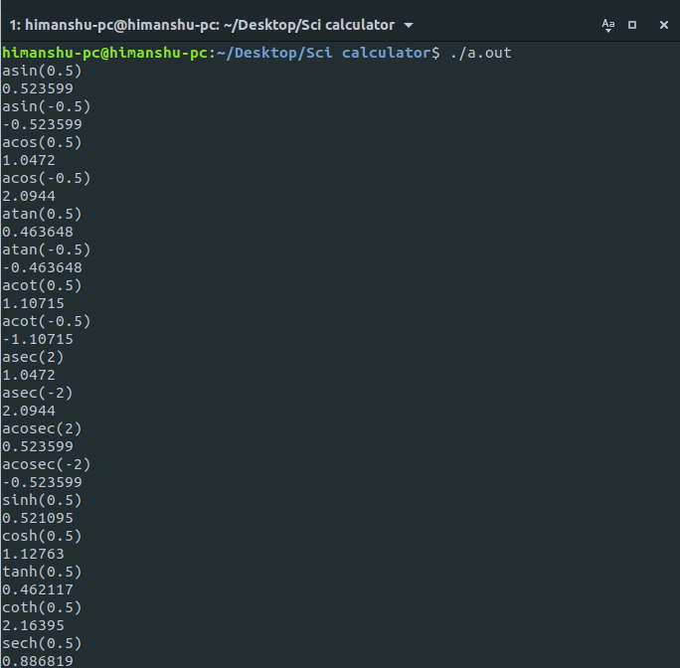
Inputs & Outputs

Slide 5
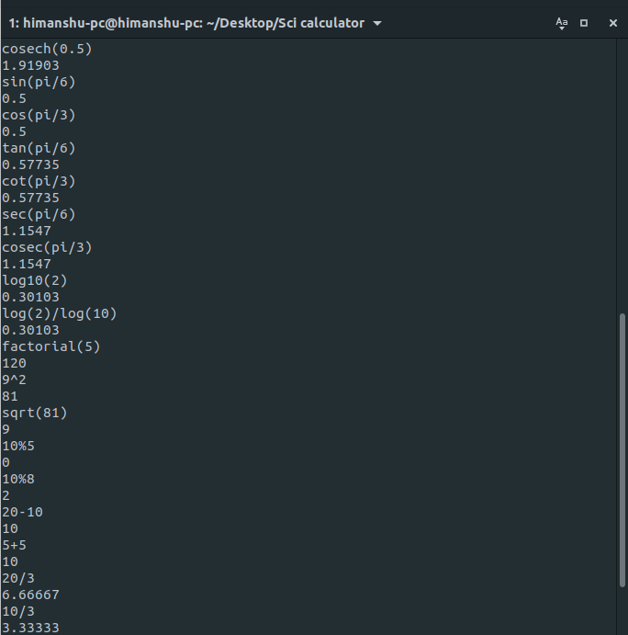
Inputs & Outputs

Slide 6
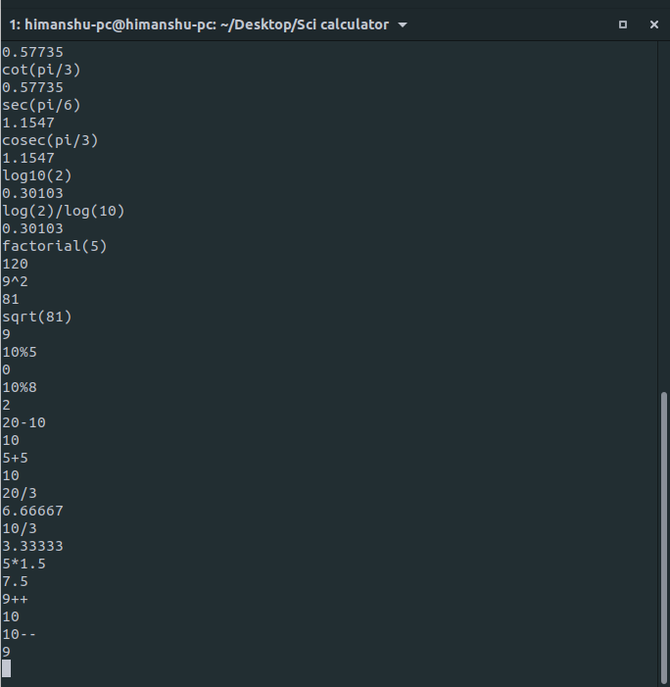
Inputs & Outputs

