Slide 1
ExitDrill
A fire drill for your DeFi exit
Rehearse a vault withdrawal. Keep the evidence.
Recheck through a local kit when the website is gone.
3rd-Web-Hack · Himanshu Kumar · September 2026

Slide 2
The withdrawal problem
A vault balance does not tell you whether
your exact withdrawal will execute.
Limits, contract changes, gas, and unavailable interfaces can interrupt an exit. A saved transaction alone can become stale.
ExitDrill targets direct ERC-4626 redemption by the owner.
It does not recover keys or bypass contract restrictions.

Slide 3
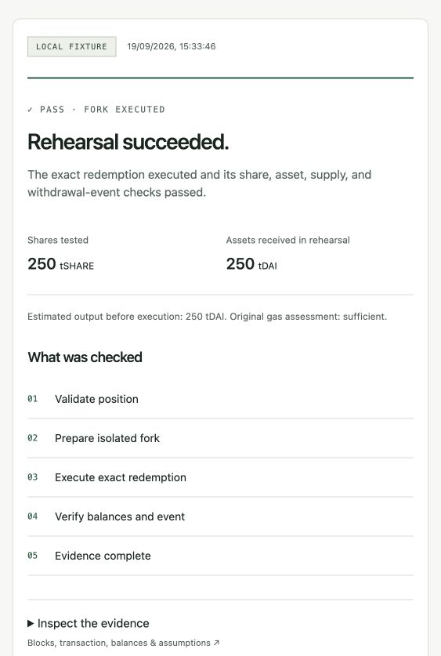
A rehearsal with a receipt
01 Inspect a pinned source block
02 Reconstruct the exact redeem call
03 Execute inside a private Anvil fork
04 Check event, balances, and supply
PASS, BLOCKED, or UNKNOWN stays attached to its evidence and limitations.

Slide 4
Ethereum evidence
1 sDAI → 1.180831208759861486 DAI
Executed inside a private fork at source block 26,031,607.
Receipt, Withdrawal event, share burn, asset increase, and total supply checks passed.
Compiled pinned SavingsDai source with solc 0.8.17 and compared deployed executable bytes and immutables.
Second-provider repeat passed on 22 September. Live sDAI rehearsal enabled. No mainnet transaction.
Notes:
Evidence: docs/evidence/sdai-fork-experiment.json and sdai-source-validation.json in the repository. Output is observed fork output, not a future promise.

Slide 5
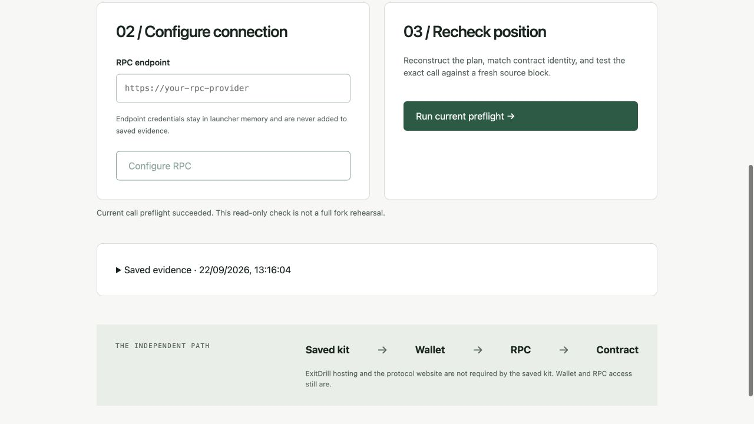
The kit survives a hosting outage
A ZIP contains the interface, exit plan,
evidence, launcher, and file checksums.
Saved evidence opens offline. Fresh checks use your own RPC connection. No npm install or hosted ExitDrill API is required.
Ethereum preflight passed with web and API stopped. Wallet-extension testing remains open.

Slide 6
Prototype and next steps
Working today
Next release gates
Live sDAI + four test vault cases
Exact bigint amounts and calldata
41 tests · 30/30 hosted runs passed
Standalone kit and public demo
Load and cold-start testing
Injected-wallet demonstration
Full accessibility audit
User comprehension testing
Next.js · TypeScript · Viem · Fastify · SQLite · Anvil · OpenZeppelin
Public demo: jhahimanshu653--exitdrill-web.modal.run
Notes:
Impact is a product hypothesis: help vault users prepare and independently recheck an exit. No measured adoption or guaranteed recovery claim. AI assistance: Cursor for the PRD/initial work, Codex for implementation, tests, and submission preparation.

