Slide 1

VEILPASS
Prove eligibility.
Keep the credential private.
A selective-disclosure age check built with Midnight Compact.
COMPACT CONTRACT COMPILED
MIDNIGHT BUILDATHON · AKINDO
01 / 08
Notes:
[Sources]
- contract/src/veilpass.compact
- generated/managed/veilpass/contract/index.js

Slide 2
THE PROBLEM
02
Most age checks collect a file to learn one bit.
A verifier needs YES or NO. Conventional flows expose a date of birth, an identity document and a retention burden.
WHAT GETS COLLECTED
WHAT THE POLICY NEEDS
Full birth date
Government ID
Document image
1
eligible / not eligible
The extra data creates breach risk, compliance work and user distrust without improving the decision.
Notes:
[Sources]
- Product problem statement, no external numerical claim

Slide 3
THE PRIVACY PROMISE
03
VeilPass discloses the decision, not the credential.
PRIVATE
PUBLIC
Birth year
Issuer trust
Random nonce
Eligible: true
Policy: age-18
Issuer verified
COMPACT
POLICY
Private witness → policy evaluation → minimal receipt
Notes:
[Sources]
- contract/src/veilpass.compact
- src/lib/compact.ts

Slide 4
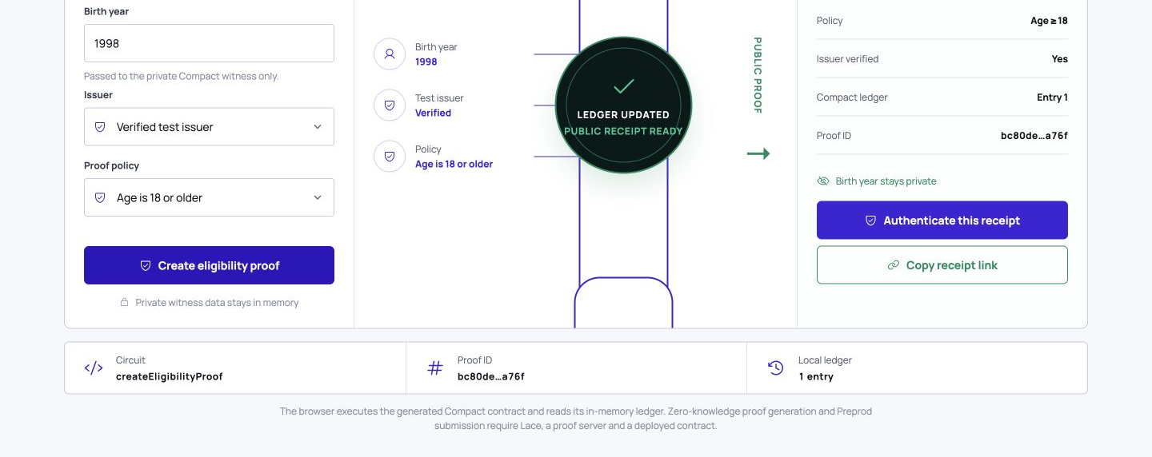
WORKING PRODUCT
The privacy boundary is visible in one flow.
Private input in. Public receipt out.
04 / 08
Notes:
[Sources]
- work/qa/veilpass-compact-desktop-viewport.png, captured from the tested local build

Slide 5
COMPACT IMPLEMENTATION
05
The circuit stores only the public receipt.
contract/src/veilpass.compact
witness getPrivateCredential():
PrivateCredential;
export ledger proofs:
Map<ProofId, ProofReceipt>;
const eligible = credential.issuerVerified
&& credential.birthYear <= cutoffYear;
proofs.insert(
disclose(proofId),
disclose(receipt)
);
STAYS PRIVATE
Birth year
Credential payload
Proof nonce
BECOMES PUBLIC
Eligibility result
Policy identifier
Issuer verification
Notes:
[Sources]
- contract/src/veilpass.compact
- generated/managed/veilpass/contract/index.js

Slide 6
ENGINEERING EVIDENCE
06
We tested the boundary, not just the happy path.
1
10
0
0
Compact circuit
compiled
contract + privacy
tests passing
high-severity dependency
vulnerabilities
private fields in
public receipt links
Build: production Vite bundle · Flow: create → authenticate → reject tamper · License: Apache 2.0
Notes:
[Sources]
- npm test
- npm run build
- npm audit --omit=dev --audit-level=high
- security_best_practices_report.md

Slide 7
PRODUCT POTENTIAL
07
One disclosure primitive supports many policies.
AGE
18+ access
PROVE A POLICY
WITHOUT SHARING
THE SOURCE FACTS
MEMBERSHIP
active member
LICENSING
credential valid
COMPLIANCE
rule satisfied
A production verifier SDK can fit existing checkout and access-control flows.
Notes:
[Sources]
- Product extension examples, no external numerical claim

Slide 8
NEXT: MIDNIGHT PREPROD
Take VeilPass from generated Compact runtime to live proofs.
01
02
03
04
Connect Lace
Deploy contract
Wire proof server
Integrate issuer
Funded Preprod wallet
Publish contract address
Generate live ZK proofs
Replace test issuer fixture
VEILPASS · APACHE 2.0 · MIDNIGHT BUILDATHON
08 / 08
Notes:
[Sources]
- outputs/veilpass-akindo-submission.md

