Slide 1
MagicBot
Property Chat Bot
By Ateam
Himanshu Gautam
Mohit Kumar

Slide 2

Problem Statement
Shifting of market over the internet.
Rising popularity of e-Commerce websites.
Requirement of a dependable and more interactive application on social media.

Slide 3
Solution Overview
Almost 125 million Facebook users in India.
Facebook Messenger provides a frequently visited platform.
Best platform for public interaction and information gathering over the internet.
Chat Bot provides close to reality assistive way to do so.

Slide 4
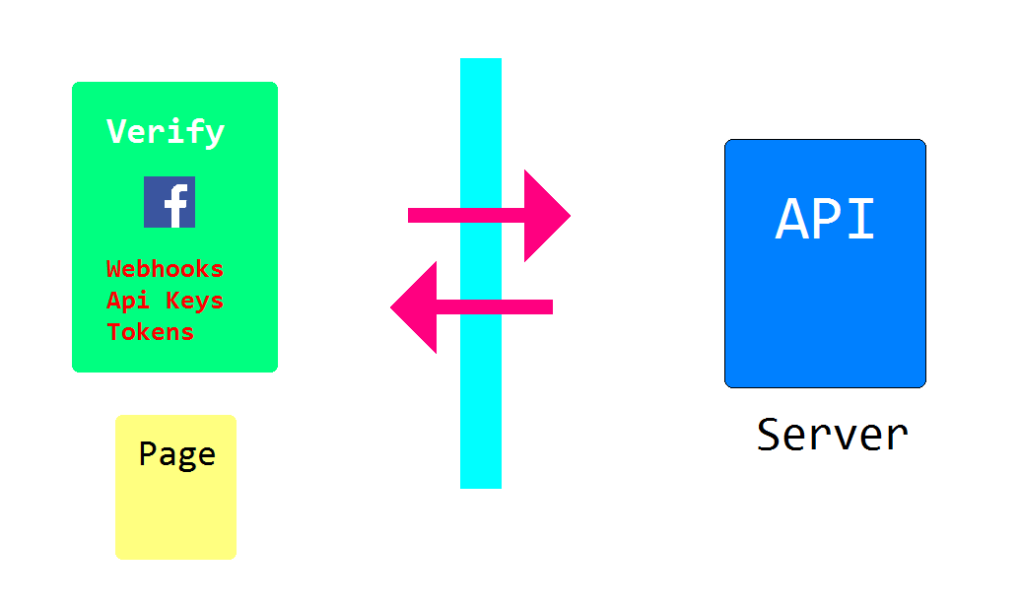
Architecture Diagram

Slide 5
Technology Stack List
Python 2.7 – Used as the programming language to build the chat bot
Flask API – Used to host heroku server
Facebook Messenger App – as a platform
Python Modules used –
re – Regex expression module to enhance pattern matching
requests , httplib2, urllib, SQLAlchemy etc.

Slide 6
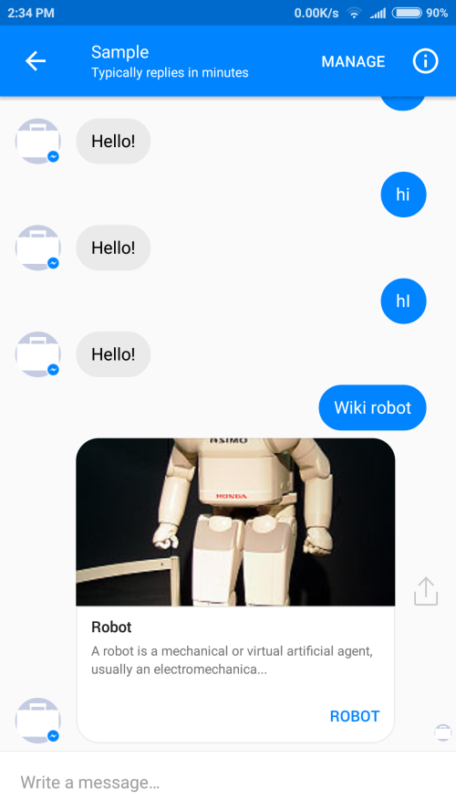
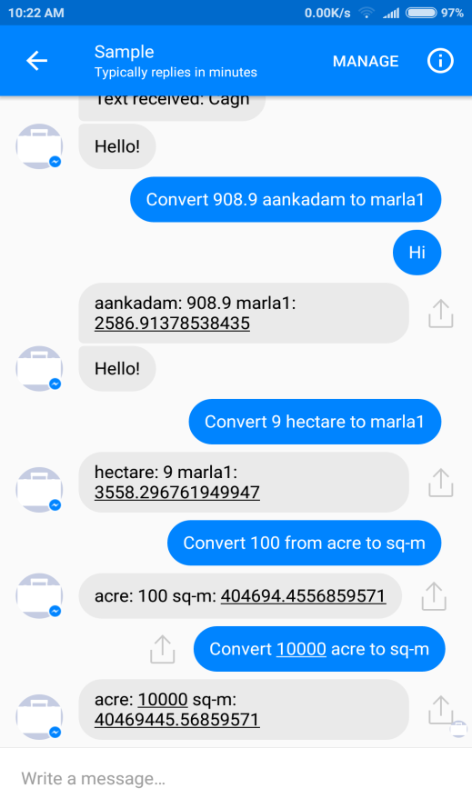
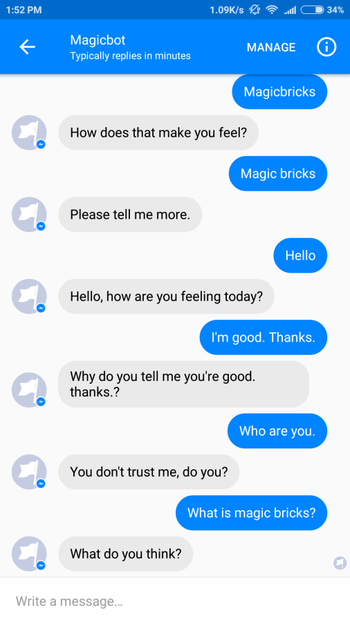
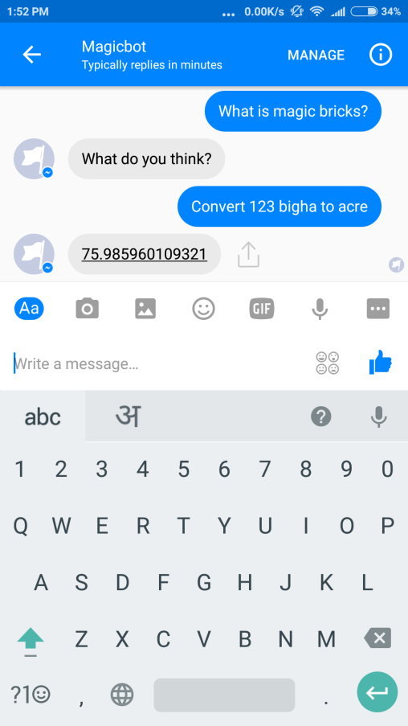
Demonstration Status
ChatBot can reply to user queries.
Users can search property using ChatBot.
ChatBot also provides area converter.
Users can also search topics on wikipedia using commands.

