Slide 1
Simulation of VoLTE using NS-3
Project website: http://hgarg.com/ensc427/
ENSC 427: COMMUNICATION NETWORKS SPRING 2017
TEAM # 9, Continues Bitstream 0xFF
Kuznetsov Evgeny – 301215280 – ekuznets@sfu.ca
Himanshu Garg – 301215259 – hgarg@sfu.ca
Bob Jiu – 301215502 – cjiu@sfu.ca

Slide 2
Outline
Introduction
Overview of LTE network
About NS-3
Simulation scenarios
Results
Conclusion
Challenges and future work

Slide 3
Introduction
In the past, native voice call service
by wired network through only Circuit Switched (CS) domain
good network in terms of Quality of Service (QoS) but it wastes lots of resources for the during of a call
The second (2G) and third (3G) generation mobile networks
voice communication service through Circuit Switched (CS) domain and data service through Packet Switched (PS) domain
Long Term Evolution (LTE) technology
evolution of fourth generation network through PS domain
powerful capabilities to deal with growing data services over mobile application
peak data rate up to 100 Mbps (downlink) and 50 Mbps (uplink)

Slide 4
Introduction
Issue:
nature of LTE, or the lack of CS domain
how to provide quality voice call and promise its continuity with 2G/3G legacy networks
Possible Solution:
Voice over LTE (VoLTE)

Slide 5
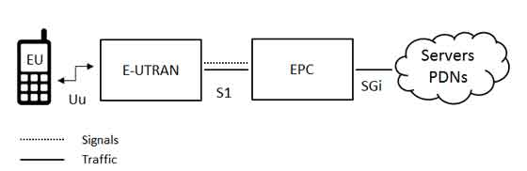
Architecture of the Network
Three main components:
User Equipment (UE)
Evolved UMTS Terrestrial Radio Access Network (E-UTRAN)
Evolved Packet Core (EPC)
The endpoint can be connected to any IP based network in the diagram below represented as cloud
Packet Data Network (PDN) acts as gateway connector, makes it possible for two EU to communicate with each other
Figure 1. Architecture of the Network

Slide 6
Architecture of the Network
User Equipment (UE)
mobile terminal such as smartphone, tablet, a laptop equipped with a mobile broadband adaptor, or other devices
UICC, known as SIM card, stores user-specific information
Evolved UMTS Terrestrial Radio Access Network (E-UTRAN)
consists of multiple of ENodeB or eNB stations
covers particular area on which LTE signaling and communication
Evolved Packet Core (EPC)
responsible for communication and management of user traffic with external world networks

Slide 7
Quality of Service (QoS)
Two standardized LTE characteristics as defined in the 3GPP TS 23.203 standard "Policy and Charging Control Architecture"
IMS signaling is responsible for providing an interface connection for the UE by controlling LTE radio access medium of the signal
Conversational Voice is an actual application that is running on user phone and provide service of Voice over IP (VoIP) communication
Name of service | QCI | Resource Type | Priority | Packet Delay Budget | Packet Error Loss Rate
IMS Signalling | 5 | non-GBR | 1 | 100ms | 10⁻⁶
Conversational Voice | 1 | GBR | 2 | 100ms | 10⁻²

Slide 8
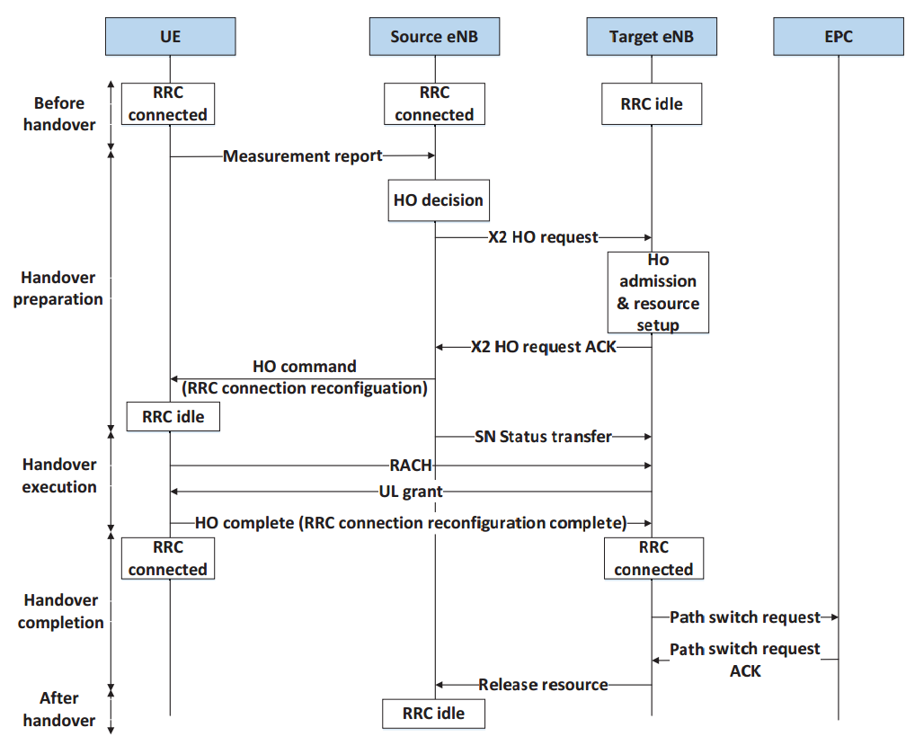
X2 Handover Strategy
X2 interface is a point-to-point interface between the two eNBs.
Figure 2. X2 based Handover

Slide 9
Simulation using NS-3
NS-3 is a discrete-event network simulator for Internet systems
LENA project is NS-3 module that provides tools to simulate LTE networks
Flowmon and RLC traces libraries used to collect simulation data
Nam - tool for scenario visualisation

Slide 10
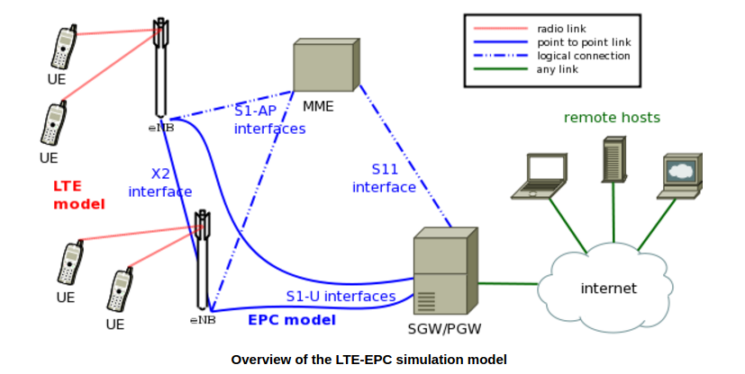
High Level overview
Figure 3. overview of the LTE-EPC simulation model

Slide 11
Simulations
1) 1 eNodeB and various stationary users
Description and Nam
Throughput graph vs number of users
2) 2 eNodeB - Handover vs No Handover
Description and Nam
Handover graphical example
Delay comparison

Slide 12
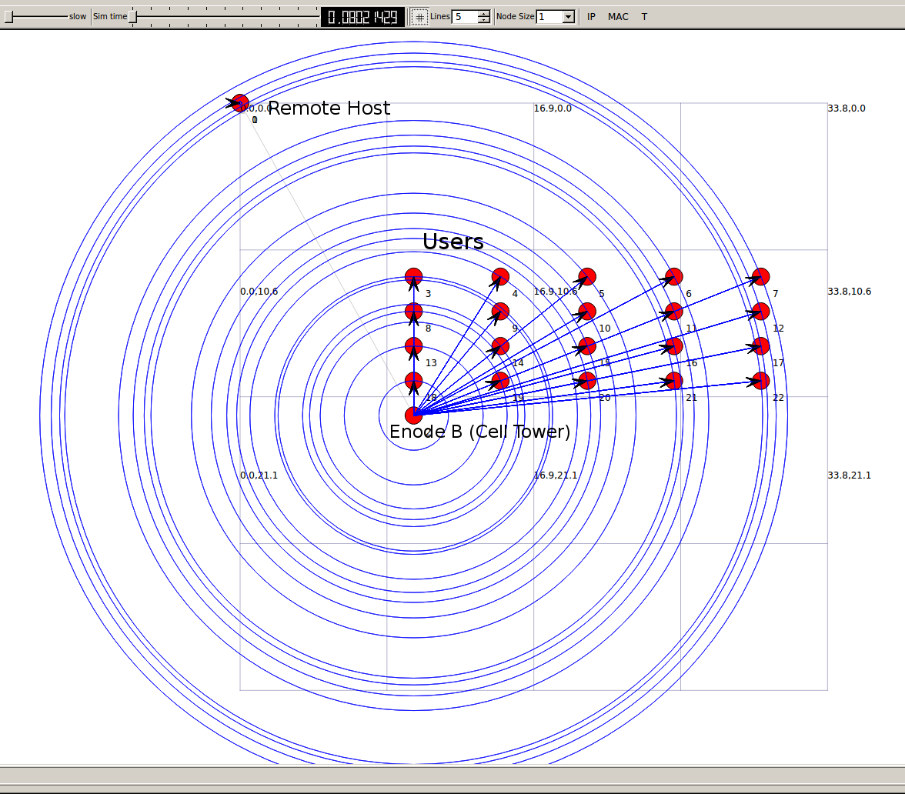
Scenario 1: one eNB with varying Number of Users
This scenario analyze the effect of No. of UE’s on throughput.
The simulation connects 2,6,10,20,40,80,160 users to a single eNodeB and studies the effect on throughput
Figure 4. one eNB Scenario

Slide 13
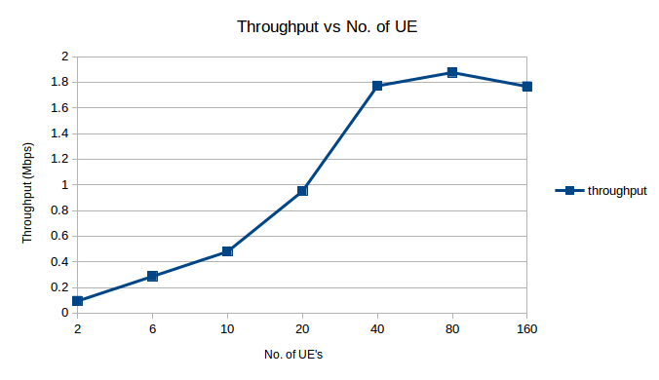
Throughput vs. No of UE’s
Figure 5. Result of Scenario 1
As seen from the graph above, the throughput increases first with 80 UE’s and then starts to decrease as more UE’s are added

Slide 14
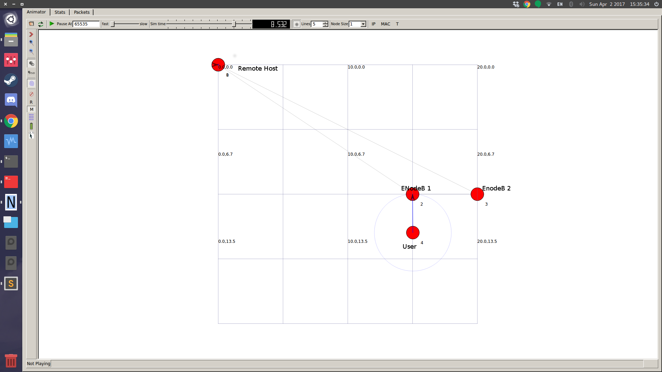
Scenario 2: Two eNBs and 1 User
In this scenario, we simulate a scenario where we have 2 EnodeB’s and 1 user
We look at 2 cases
No Handover
Handover
Figure 6. Two eNBs Scenario

Slide 15
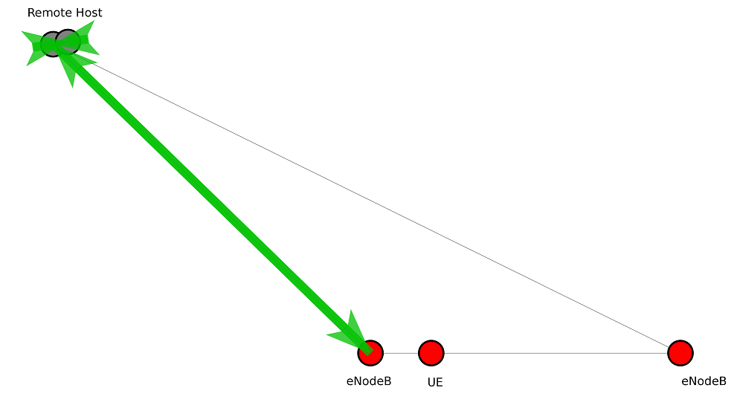
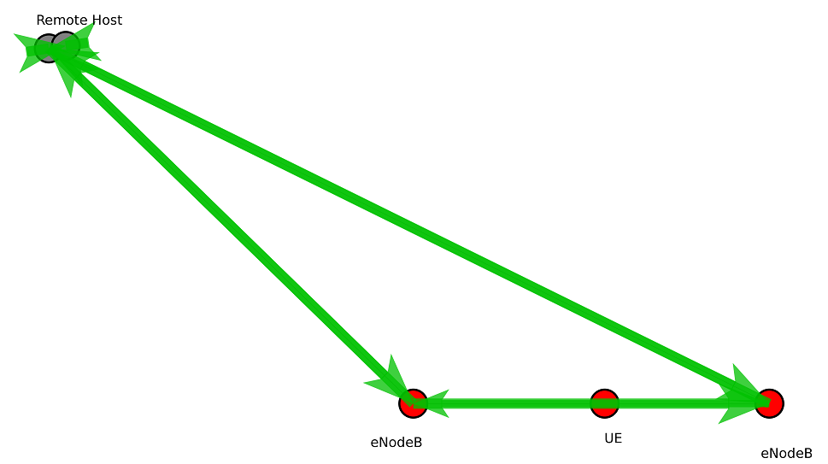
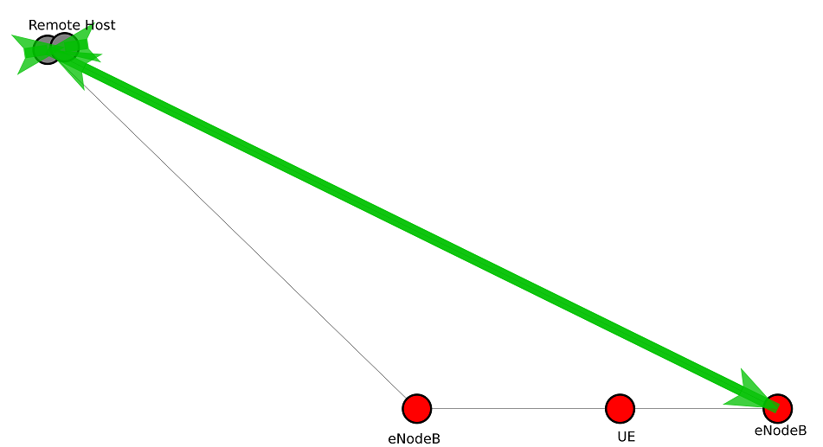
X2 Handover procedure
#1
#2
#3
Figure 7. X2 Handover Step by Step

Slide 16
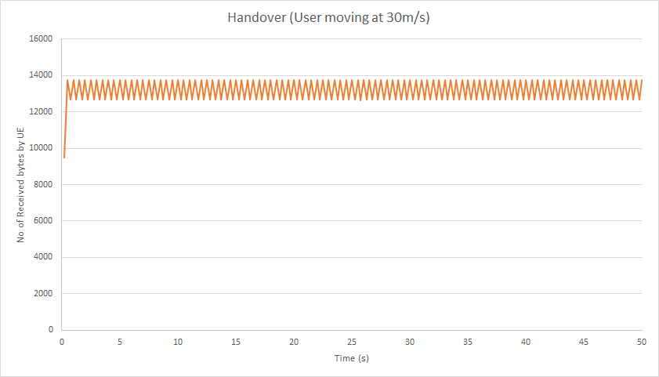
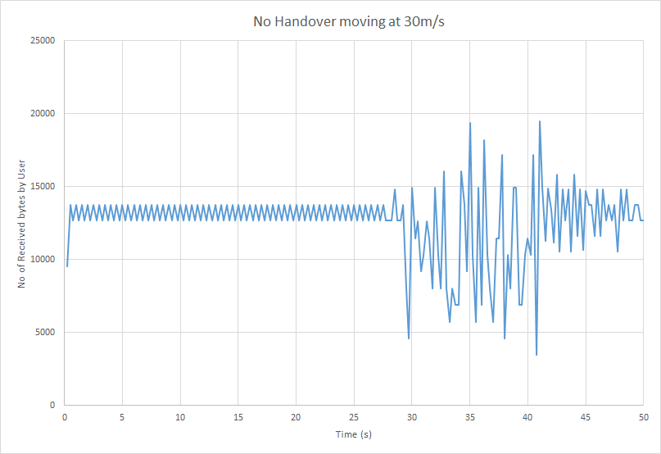
Delay Handover vs No Handover
In case of handover connection is stable.
In case with no handover connection worsens due to UE moving away from EnodeB.

Slide 17
Conclusion
Throughput increases with proportionally to number of users to a certain limit after which there is a negative impact on throughput due to link is being conjectured with a lot of data
Handover is necessary to maintain stable connection when object is moving
VoLTE can meet the high level of QoS standards that traditional methods cannot reach

Slide 18
Challenges
The biggest challenge we faced was understanding NS-3 as a tool for simulation
Loads of unanswered discussions on Google groups regarding NS-3 LTE simulation
Data Analysis from the different output files that NS-3 generates

Slide 19
Future Work
Study the effect of different scheduling algorithms on throughput, delay and jitter
Develop realistic simulation that is including obstacles that prevent signal to pass trough (ex. Walls of a house)
Compare VoLTE with traditional GSM circuit switch technology and run simulations

Slide 20


Question?

Slide 21
References
[1] V. Paisal, "Seamless voice over LTE", 2010 IEEE 4th International Conference on Internet Multimedia Services Architecture and Application, 2010.
[2] A. El Arby and O. Thiare, "Handling voice in LTE", 2015 International Conference on Computer, Communications, and Control Technology (I4CT), 2015.
[3] M. R. Tabany, "An End-to-End QoS Performance Evaluation of VoLTE in 4G E-UTRAN-based Wireless Networks", Wireless Communications Research Lab School of Systems Engineering, pp. 92-94, 2014
[4] "LTE Network Architecture", www.tutorialspoint.com, 2017.
[Online]. Available: https://www.tutorialspoint.com/lte/lte_network_architecture.htm.
[5] "LTE Network Architecture", www.tutorialspoint.com, 2017.
[Online]. Available: https://www.tutorialspoint.com/lte/lte_network_architecture.htm.
[6] "NS3: A discrete-event Simulator," [Online]. Available: https://www.nsnam.org/docs/models/html/lte.html
[7] Alexandris, Konstantinos et al. "Analyzing X2 Handover In LTE/LTE-A". 2016 14th International Symposium on Modeling and Optimization in Mobile, Ad Hoc, and Wireless Networks (WiOpt) (2016): n. pag.
.

Slide 22
Thank you for listening!
If you are interested in the research of our topic, you can visit http://www2.ensc.sfu.ca/http://www2.ensc.sfu.ca/~ljilja/ENSC427/Projects/ENSC427_Spring2017_projects.html~ljilja/ENSC427/Projects/ENSC427_Spring2017_projects.html for more details.

