Slide 1
Convolutional Neural Network With Transfer Learning
Data Mining : CSEN 5303
Presented by
Himanshu Anil Joshi (K00431136).

Slide 2
Objectives
Introduction
Datasets
Data Mining Tool
Data Mining Task
Results

Slide 3
Introduction
1) CNN- A convolutional neural network (CNN) is a type of artificial neural network used in image recognition and processing that is specifically designed to process pixel data. 2) TensorFlow – TensorFlow is the open source library for a number of various tasks in machine learning and it was introduced and researched by google. 3) Keras - Keras is a neural network library used in TensorFlow. 4) Google Collab - It is a free cloud service integrated with GPU can be used as IDE.

Slide 4
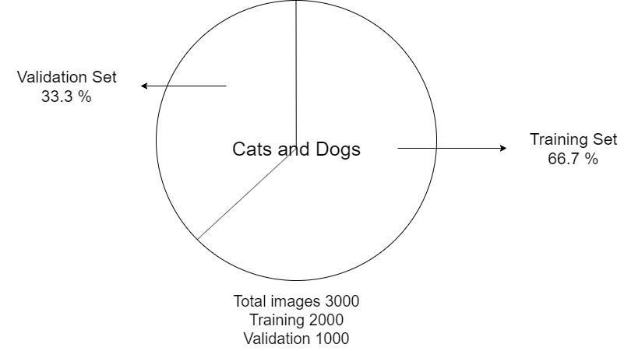
Dataset
Name- Cats and dog dataset
Source – Microsoft Azure
Each image labeled with 1 or 0 Where, 1 = Dog; 0 = Cat;
More than 3 million images in dataset but only 25000 are publicly available.
Only used 3000 images due to resources

Slide 5
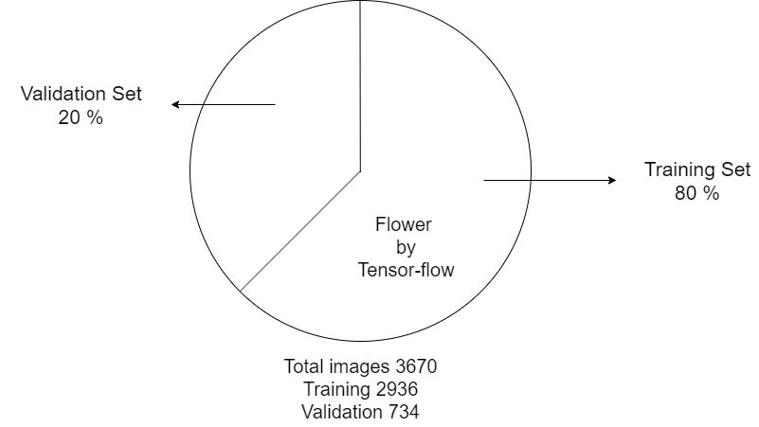
Dataset
Name- Flower dataset
Source – TensorFlow datasets
Five different classes indicates 5 different types of flowers;
Size: 3670 images.

Slide 6
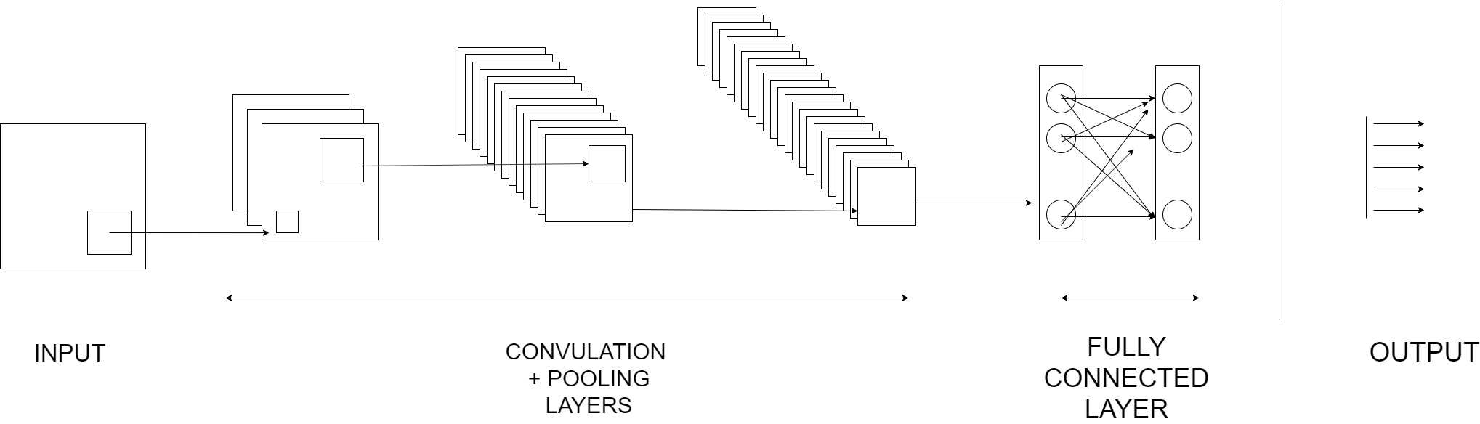
Data Mining Tools and Techniques
Convolutional neural network using TensorFlow and Keras
The images from the training dataset will be provided to the input layer.
All layers in the neural network are fully connected.
Convolution and pooling techniques will be applied in the hidden layer.
The final output will be based on the different output classes

Slide 7
Data Mining Tool and Techniques
CNN with Transfer learning Using TensorFlow and Keras
It is technique that reuses the model that was created by machine learning expert and that has already been trained on large dataset.
A neural network that has been trained on large dataset can applied its knowledge to a dataset it has never seen before.

Slide 8
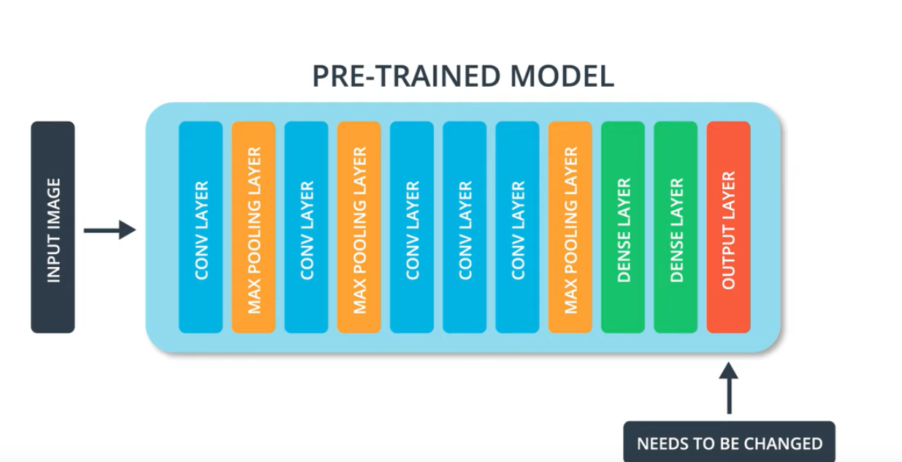
Dataset | Output Classes
ImageNet | 1000
Fashion MNIST | 10
Cats and Dogs | 2
Flower | 5
Source: https://classroom.udacity.com/courses/ud187/lessons/

Slide 9
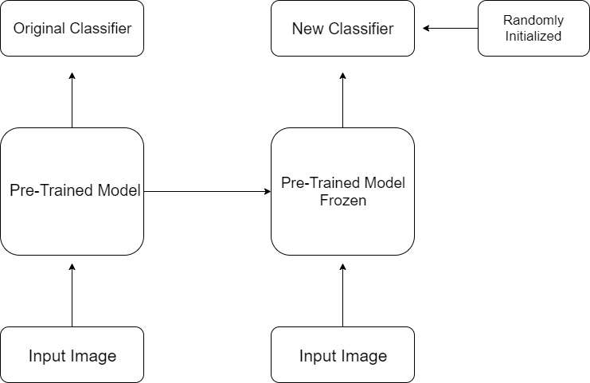
Transfer Learning

Slide 10
Transfer Learning Using MobileNet
URL = "https://tfhub.dev/google/tf2-preview/mobilenet_v2/feature_vector/2"
feature_extractor = hub.KerasLayer(URL, input_shape=(IMAGE_RES, IMAGE_RES,3))
model = tf.keras.Sequential([ feature_extractor,
layers.Dense(2, activation='softmax’) ])
model.compile( optimizer='adam’,
loss='sparse_categorical_crossentropy’, metrics=['accuracy'])
EPOCHS = 40
history = model.fit(train_batches,
epochs=EPOCHS,
validation_data=validation_batches)

Slide 11
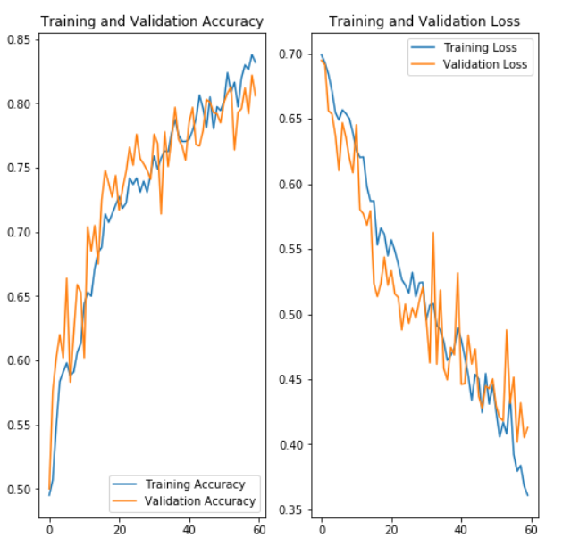
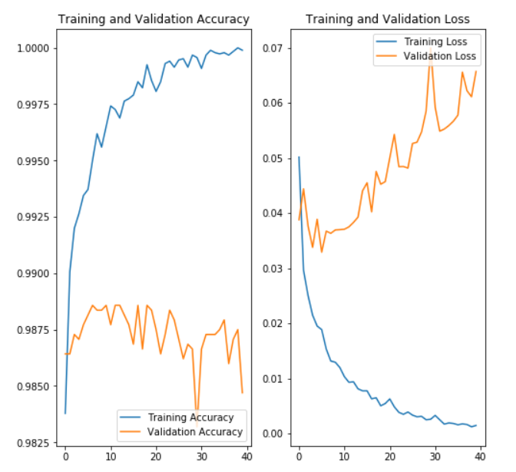
Cats VS Dogs Dataset
CNN
CNN Using Transfer Learning

Slide 12
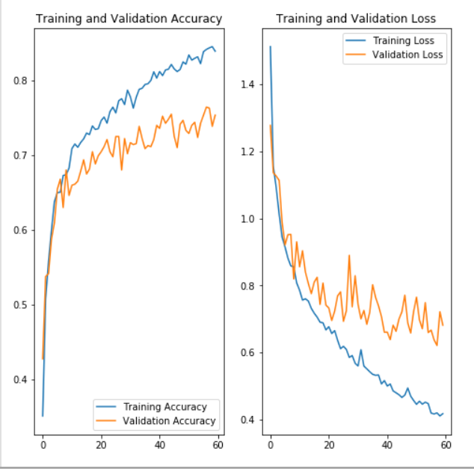
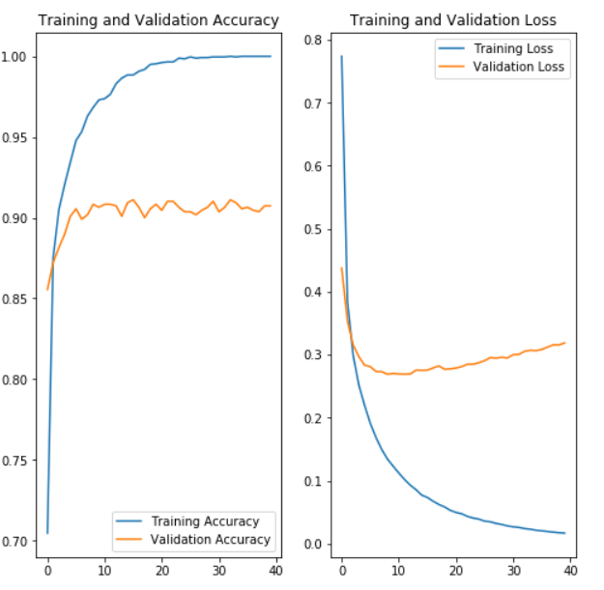
Flowers Dataset
CNN
CNN Using Transfer Learning

Slide 13
Results
Learned and implemented application of transfer learning using MobileNet
Achieved more than 90 % accuracy in just 6-8 epochs
Significant reduce in computational time
~97% validation accuracy, which is absolutely awesome

Slide 14
Thank You
Any Questions..?

Slide 15
References
https://classroom.udacity.com/courses/ud187
https://colab.research.google.com/github/tensorflow/examples/blob/master/courses/udacity_intro_to_tensorflow_for_deep_learning/l06c01_tensorflow_hub_and_transfer_learning.ipynb#scrollTo=76as-K8-vFQJ
https://colab.research.google.com/github/tensorflow/examples/blob/master/courses/udacity_intro_to_tensorflow_for_deep_learning/l06c03_exercise_flowers_with_transfer_learning_solution.ipynb#scrollTo=d28dhbFpr98b
https://colab.research.google.com/github/tensorflow/examples/blob/master/courses/udacity_intro_to_tensorflow_for_deep_learning/l05c02_dogs_vs_cats_with_augmentation.ipynb#scrollTo=8CfngybnFHQR
https://colab.research.google.com/github/tensorflow/examples/blob/master/courses/udacity_intro_to_tensorflow_for_deep_learning/l05c04_exercise_flowers_with_data_augmentation_solution.ipynb#scrollTo=8CfngybnFHQR

