Slide 1

Amazon Sales Data Analysis
Architecture Design
WRITTEN BY - Himanshu Pewal
Document Version - 1

Slide 2
DOCUMENT CONTROL
CHANGE RECORD :
DATE | VERSION | AUTHOR | COMMENTS
10/01/23 | 1 | Himanshu Pewal | Introduction and architecture defined.
20/01/23 | 1 | Himanshu Pewal | Architecture & Architecture description appended and updated.
DATE | VERSION | REVIEWER | COMMENTS

Slide 3
CONTENTS:
Introduction....................................................................................................04
1.1 What is Architecture Design Document?..........................................04
1.2 Scope...................................................................................04
Architecture ...................................................................................................05
2.1 Power BI Architecture..........................................................................05
2.2 Power BI Architecture Design................................................................. 06
2.3 Power BI Service ................................................................................06
2.4 Power Bi Dashboard ............................................................................06
Deployment.......................................................................................................07

Slide 4
Introduction:
1.1What is Architecture design document?
Any software needs the architectural design to represents the design of software. IEEE defines architectural design as “the process of defining a collection of hardware and software components and their interfaces to establish the framework for the development of a computer system.” The software that is built for computer-based systems can exhibit one of these many architectures.
Each style will describe a system category that consists of:
A set of components (e.g.: a database, computational modules) that will perform a function required by the system.
The set of connectors will help in coordination, communication, and cooperation between the components.
Conditions that how components can be integrated to form the system.
Semantic models that help the designer to understand the overall properties of the system.

Slide 5
1.2 Scope : Architecture Design Document (ADD) is an architecture design process that follows a step-by-step refinement process. The process can be used for designing data structures, required software architecture, source code and ultimately, performance algorithms. Overall, the design principles may be defined during requirement analysis and then refined during architectural design work.

Slide 6
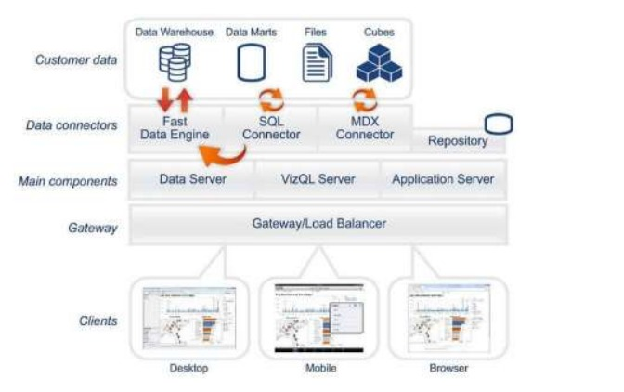
Architecture:

Slide 7
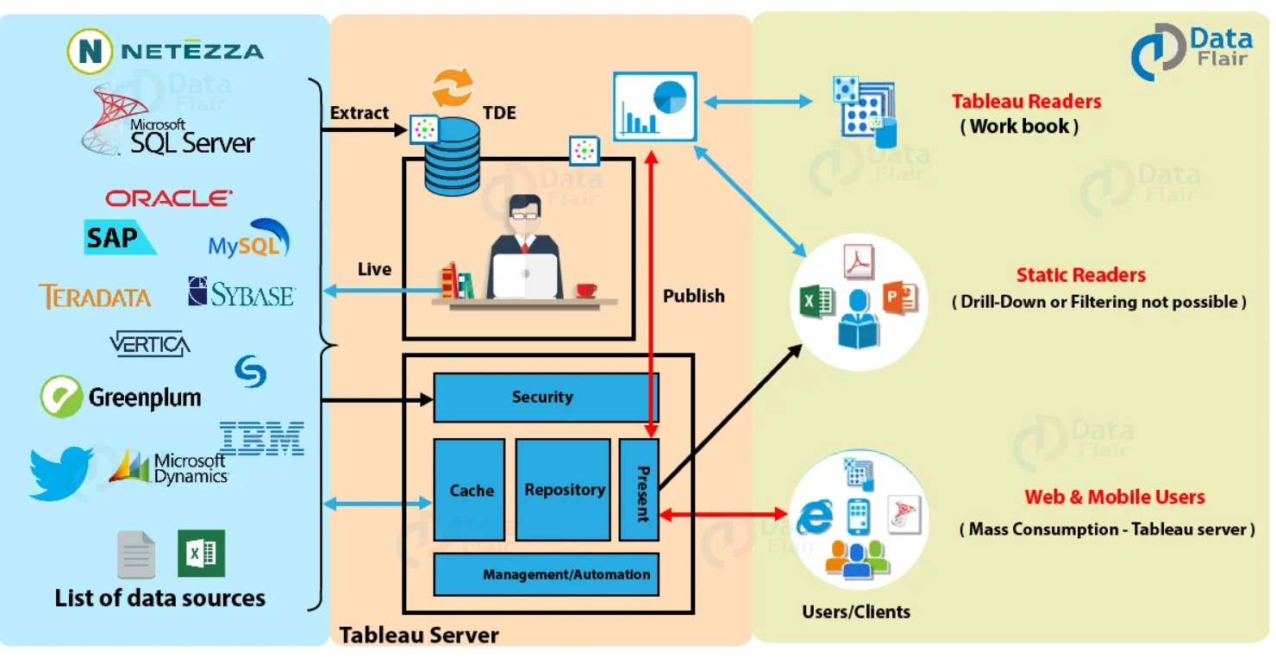
Tableau Architecture:
Tableau has a highly scalable architecture that serves mobile clients, web clients and desktop installed software. Tableau architecture supports fast and flexible report and dashboard creation to drive business insights.

Slide 8
Tableau Architecture Design:
It can be categorized into three main segments. The segments are –
Data Sources
Tableau Server
Tableau Desktop and the clients.
Data Source
The first section of Tableau architecture is where a user can extract data from a gamut of data source options available like SAP, Salesforce, Excel file, MySQL, Teradata etc. A user can establish data connection in two ways; a live data connection which sends instant queries to the data source and gets results instantly. Another way is to extract data from the data source and have a local copy of it as a temporary database. Data can be fetched through a live connection or extraction into both Tableau Desktop and Tableau Server.
Tableau Server and Desktop
Tableau Desktop as it is the platform through which a user gets the ball rolling for further actions to take place. Because depending on the user’s request the actions for all the other architectural components are assigned.
The Tableau Server has many components working together as it manages a bunch of important processes. It has components taking care of the user and data security, a repository which stores all the visualizations published to the Server, a cache for performance improvement, a manager/automation to manage data loads and schedule updates, a presentation layer which is responsible for all the visualization/presentation related activities. The Tableau Server primarily serves the dynamic user base of the web and mobile customers interacting with the data on Tableau platforms.

Slide 9
3. Clients The clients are the end users using Tableau through a web, mobile devices, on-cloud, on-premise, or on a command-line interface for development. These end-users interact mainly with Tableau Server for accessing workbooks or visualizations. The server components then work as per the client’s request and return the outcome.

Slide 10
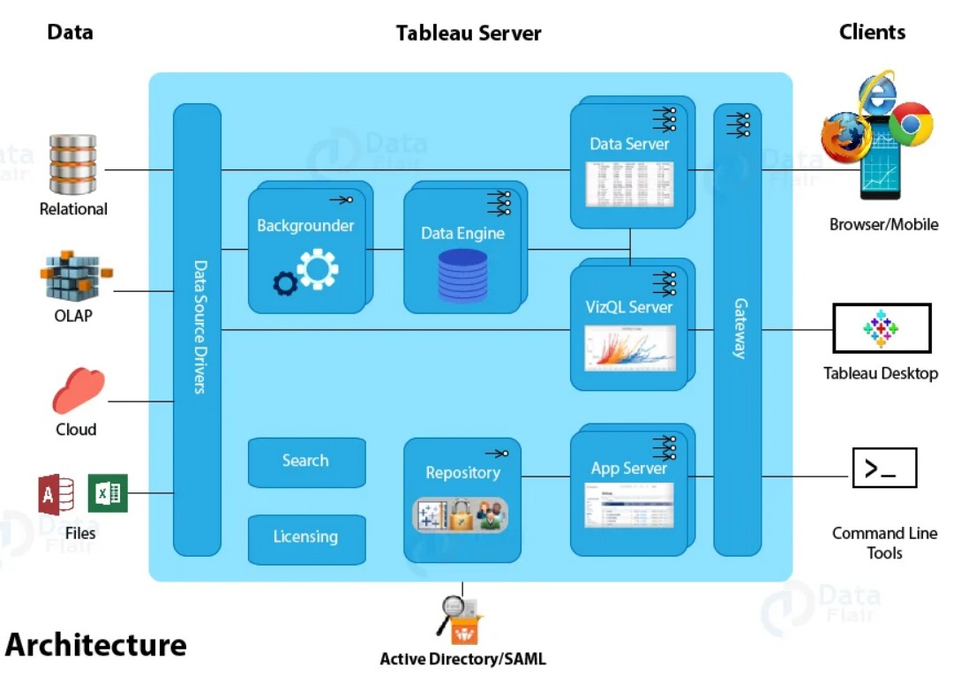
Tableau Server Components: Tableau Server is an important component in the Tableau architecture as it is thoughtfully designed to manage and execute crucial processes. Tableau Server as it is a core component and helps to understand Tableau better.

Slide 11
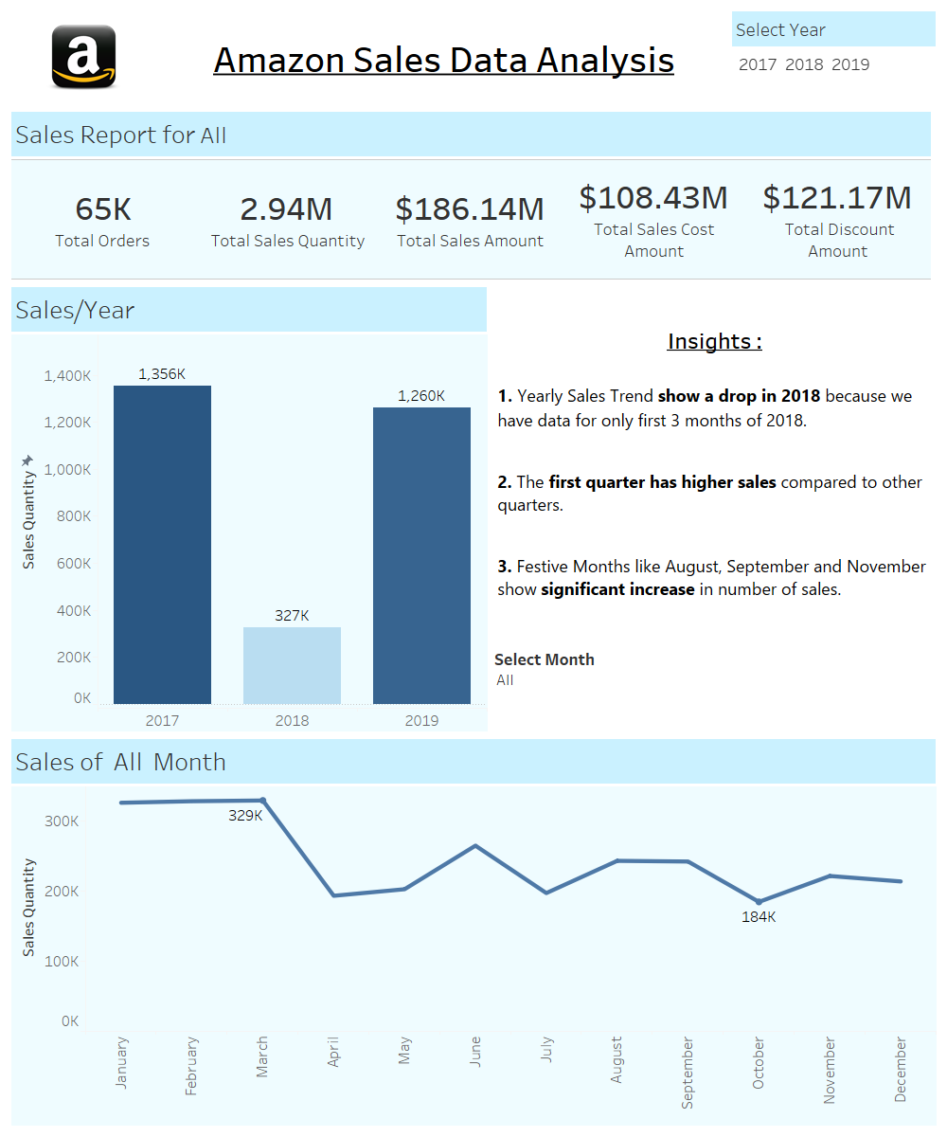
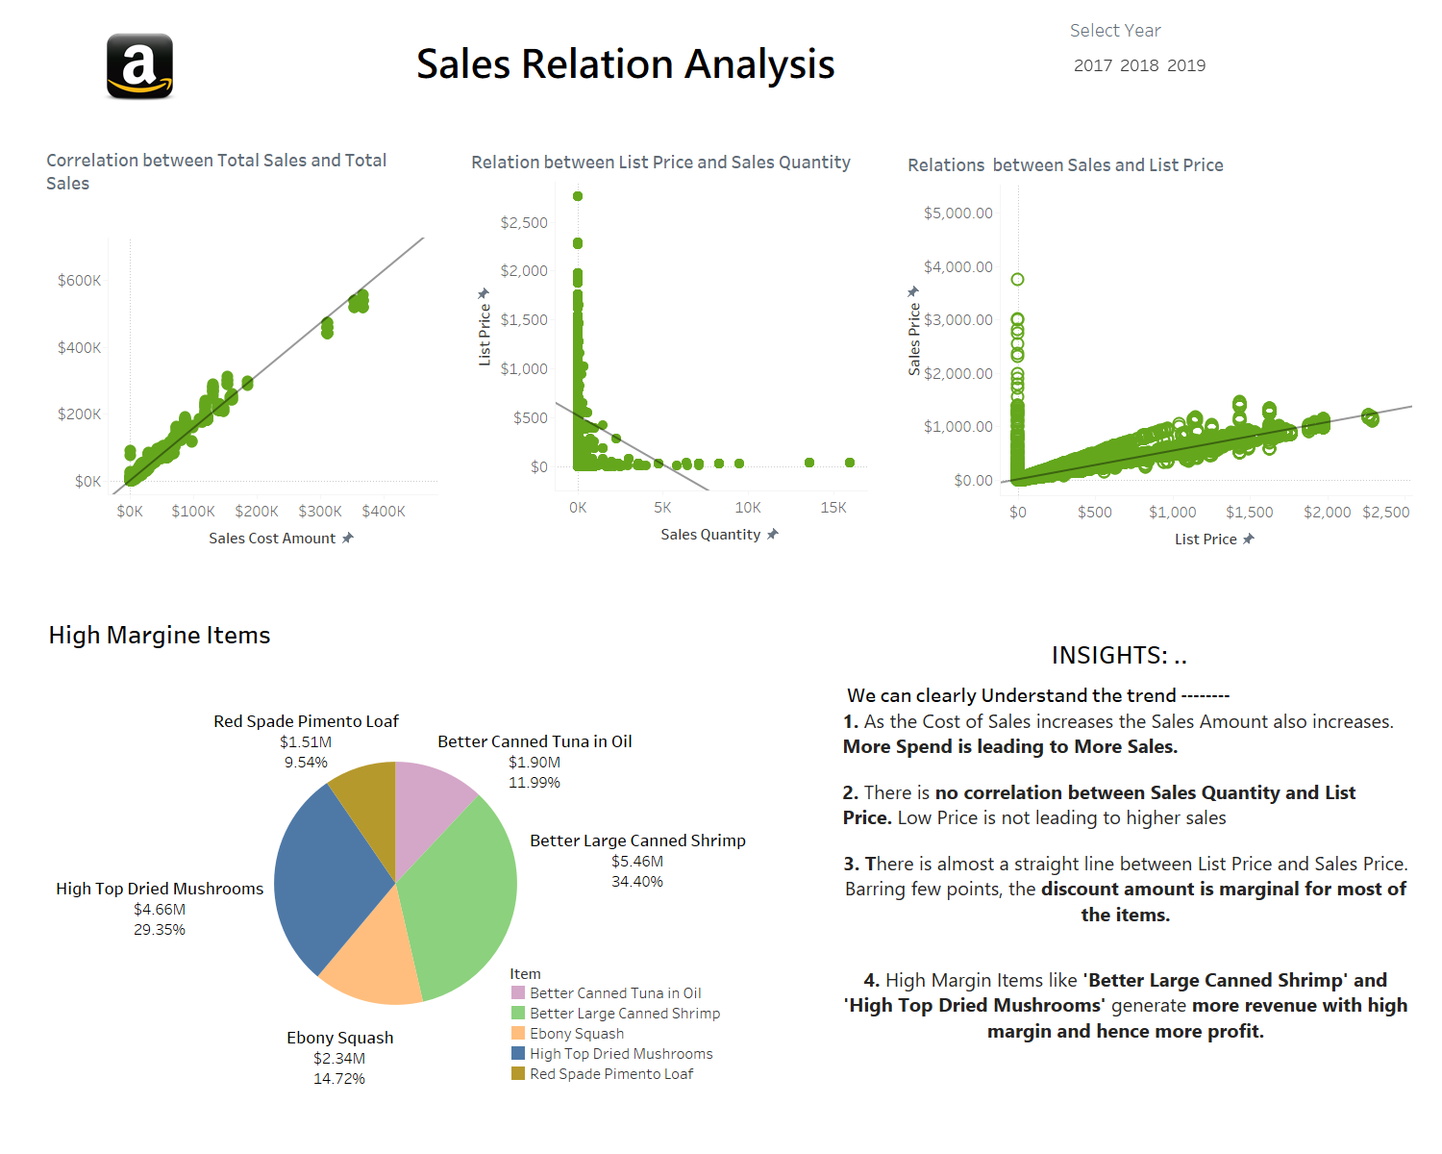
TABLEAU DASHBOARD:

Slide 12
Tableau Deployment: Prioritizing data and analytics couldn’t come at a better time. Your company, no matter what size, is already collecting data and most likely analyzing just a portion of it to solve business problems, gain competitive advantages, and drive enterprise transformation. With the explosive growth of enterprise data, database technologies, and the high demand for analytical skills, today’s most effective IT organizations have shifted their focus to enabling self-service by deploying and operating Tableau at scale, as well as organizing, orchestrating, and unifying disparate sources of data for business users and experts alike to author and consume content.

