Slide 1
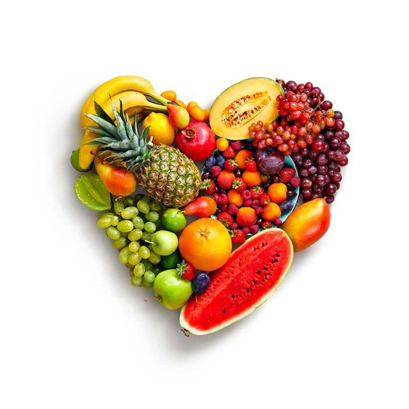
Nutri+
NUTRITION
ANALYSIS SYSTEM

Slide 2

TEAM
BASHI
HIMANSHU
ISHAN
2110993771
2110993792
2110993798
Nutri+

Slide 3

PROBLEM STATEMENT
DESIGN AND DEVELOP A COMPUTER VISION-BASED DEEP LEARNING SYSTEM FOR REAL-TIME CALORIE DETECTION IN VARIOUS FOODS, ENABLING USERS TO EASILY ASSESS THE NUTRITIONAL CONTENT OF THEIR MEALS. THE SYSTEM SHOULD UTILIZE A CAMERA-EQUIPPED DEVICE TO CAPTURE IMAGES OF FOOD ITEMS AND EMPLOY ADVANCED IMAGE ANALYSIS TECHNIQUES TO ACCURATELY IDENTIFY AND QUANTIFY THE CALORIE CONTENT. THE GOAL IS TO PROVIDE USERS WITH AN INTUITIVE AND USER-FRIENDLY TOOL THAT PROMOTES HEALTHIER EATING HABITS BY EMPOWERING THEM TO MAKE INFORMED DECISIONS ABOUT THEIR FOOD CHOICES.
Nutri+

Slide 4
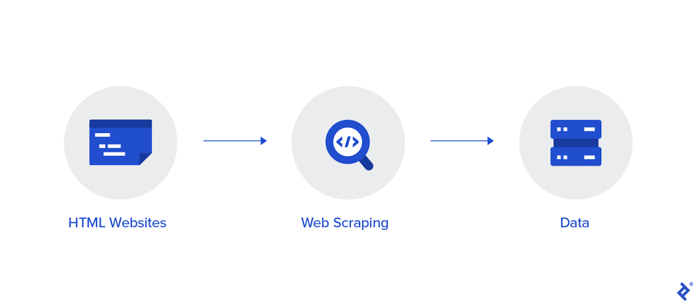
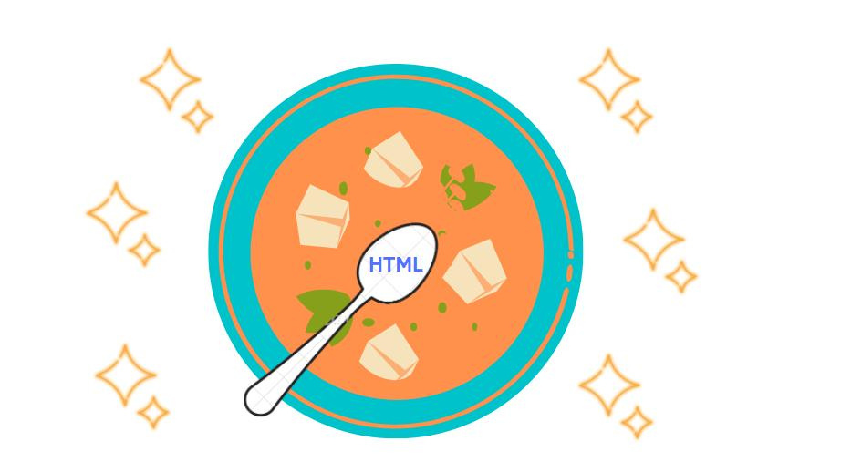
WEB SCRAPING
BEAUTIFUL SOUP IS A PYTHON PACKAGE FOR PARSING HTML AND XML DOCUMENTS. IT CREATES A PARSE TREE FOR PARSED PAGES THAT CAN BE USED TO EXTRACT DATA FROM HTML, WHICH IS USEFUL FOR WEB SCRAPING.
Nutri+

Slide 5
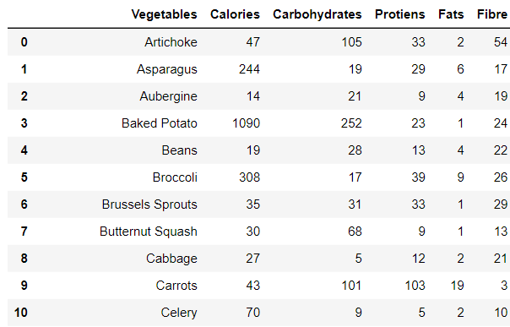
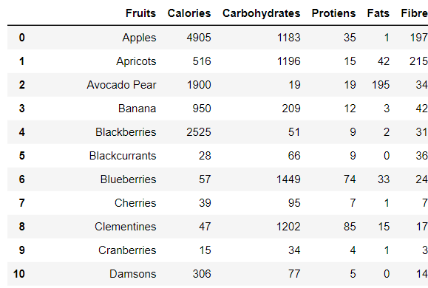
DATASET
VEGETABLE
FRUITS
These datasets encompass six attributes: Vegetables/Fruits, Calories, Carbohydrates, Proteins, Fats, and Fiber.
Nutri+

Slide 6
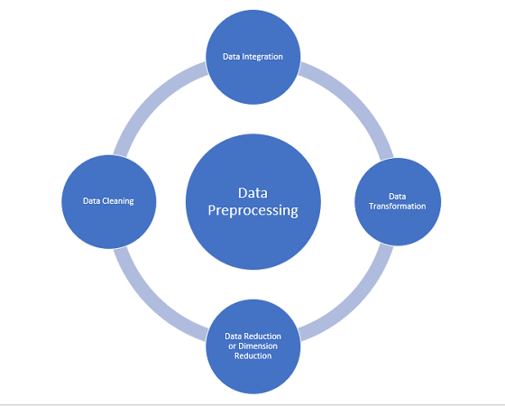
DATA PREPROCESSING
REMOVE NULL VALUES
CONVERT FIELDS TO TEXT
REMOVING-FRESH/RAW FROM COLUMNS
REMOVE DUPLICATES
REINDEXING

Slide 7
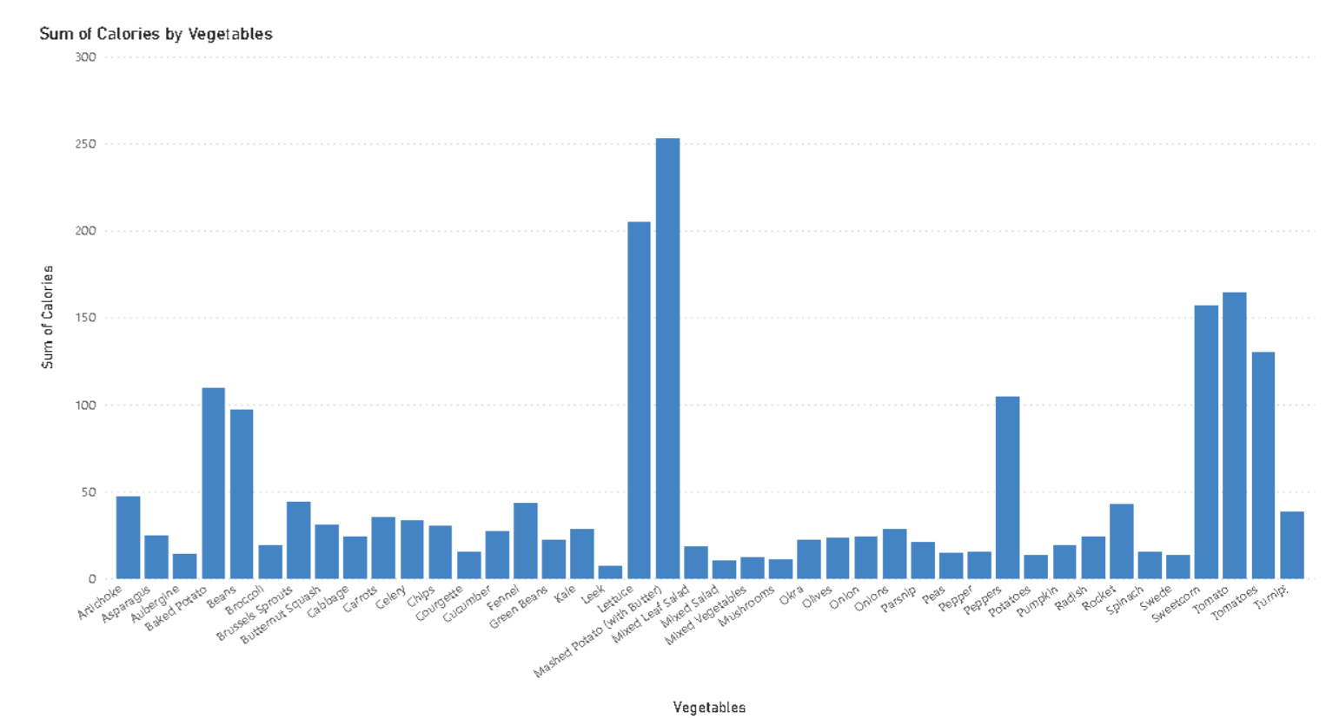
DATA VISUALIZATION
Nutri+

Slide 8
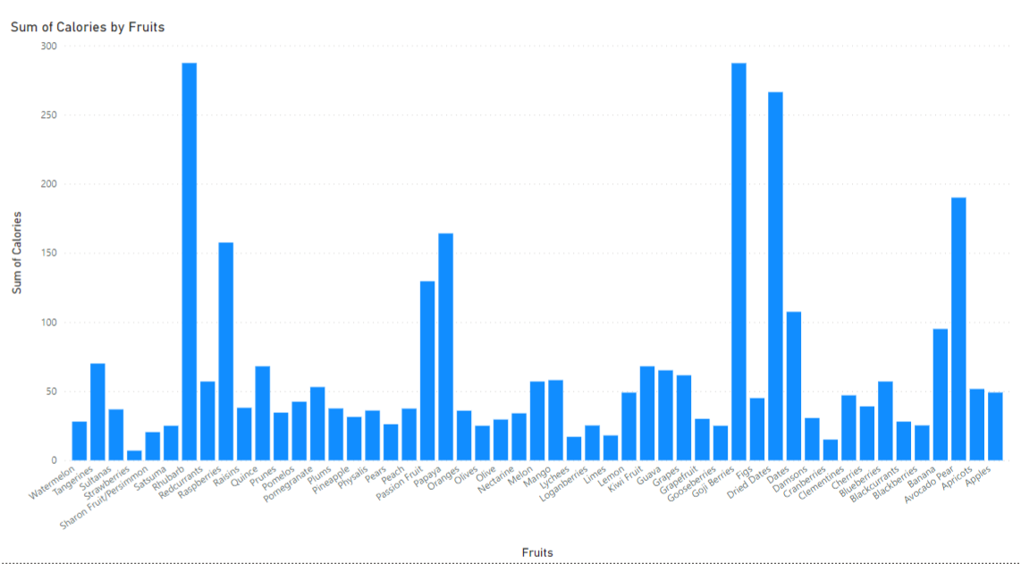
Nutri+

Slide 9
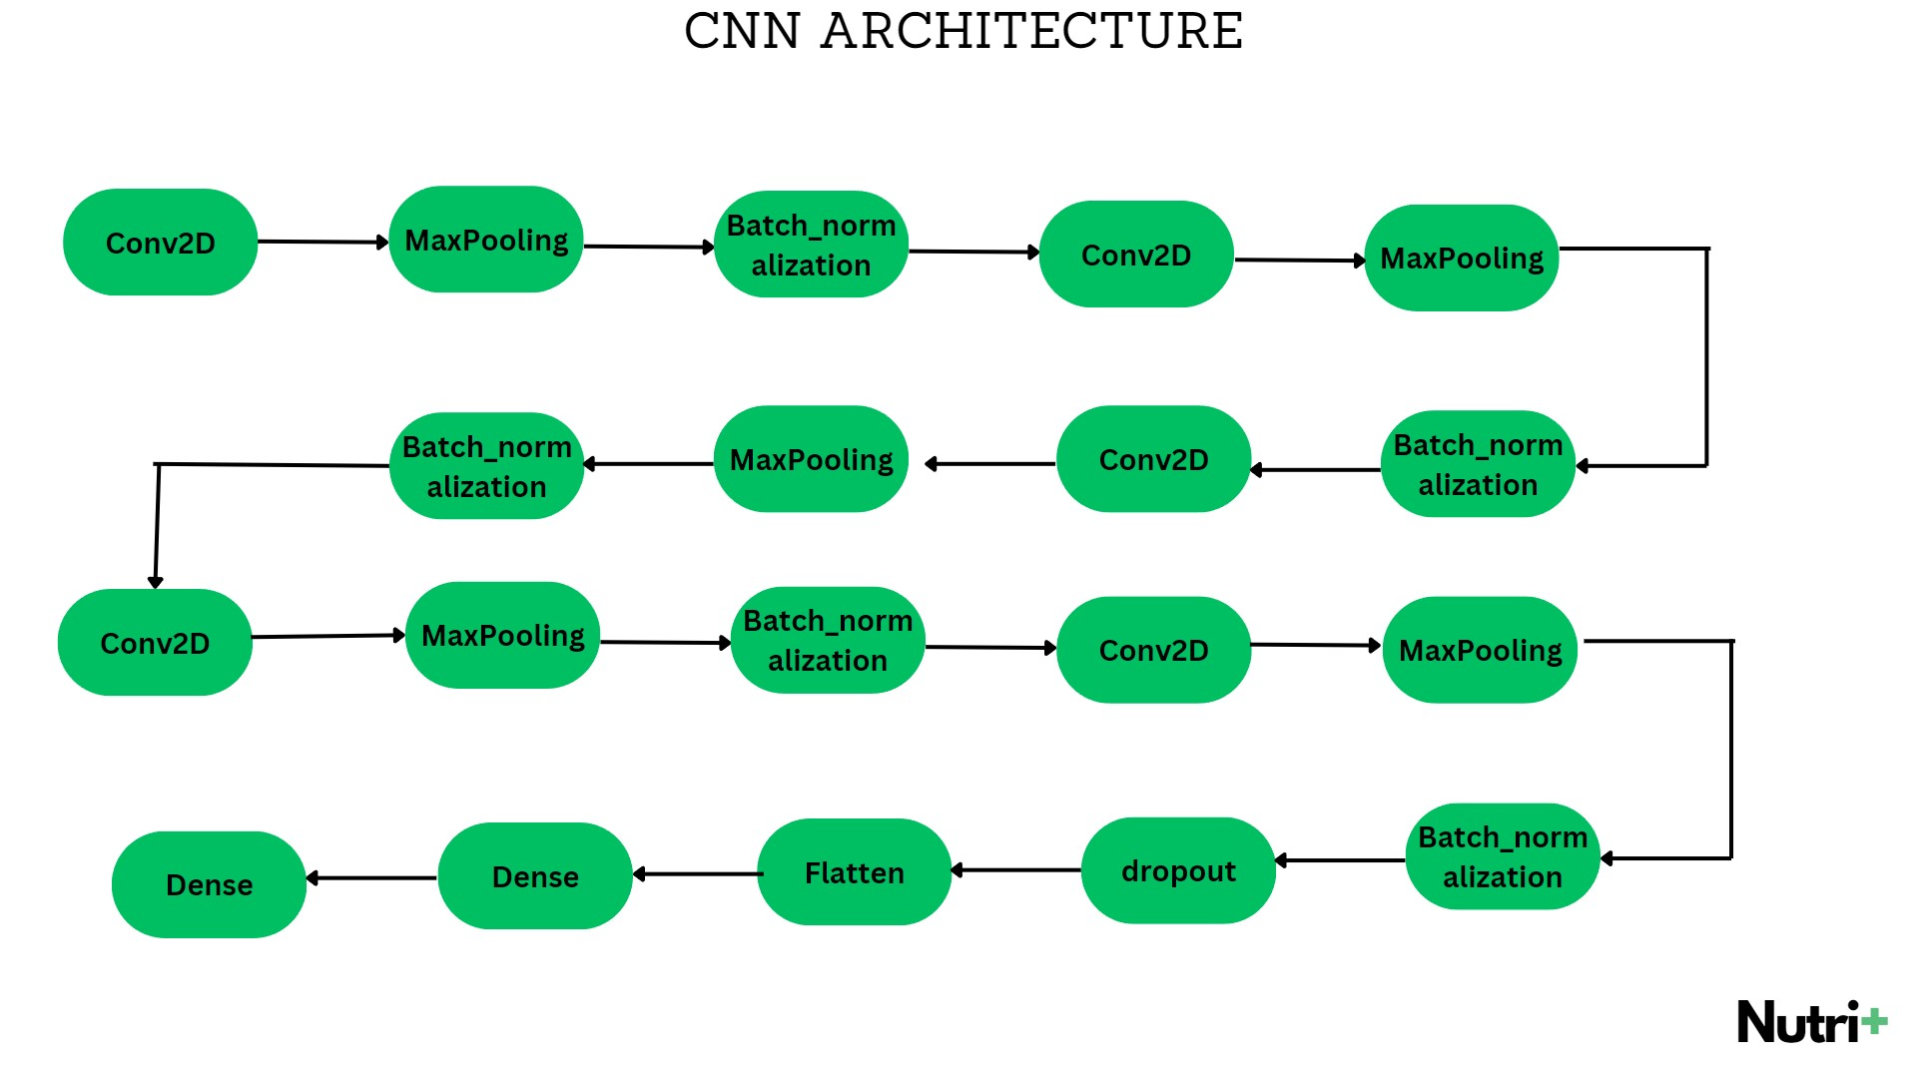

Slide 10



DEPLOYEMENT
REACT
NATIVE
FLASK
FIREBASE
React is a popular JavaScript library for building user interfaces, particularly single-page applications.
React uses a component-based architecture, enabling developers to create reusable UI components that manage their own state and efficiently update the DOM.
Firebase is a comprehensive mobile and web application development platform provided by Google.
It offers various services, including authentication, real-time database, hosting, storage, and more.
Flask is a lightweight and flexible web application framework in Python.
It's used for developing server-side applications, including web APIs and web applications.
Nutri+

Slide 11

FLOWCHART
TEXT BOX
LOGIN
IMAGE/TEXT
IF
DETECT CALORIES
IMAGE
TEXT
SCANNER
Nutri+

Slide 12
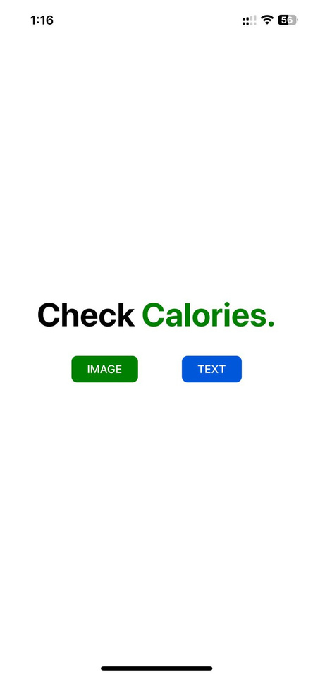
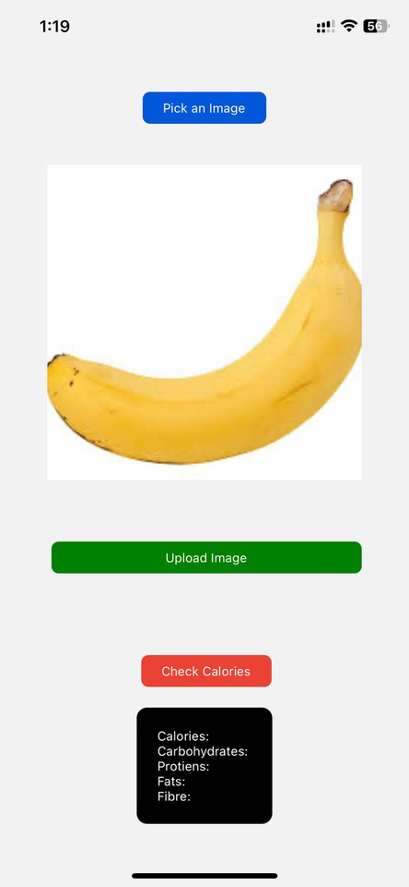
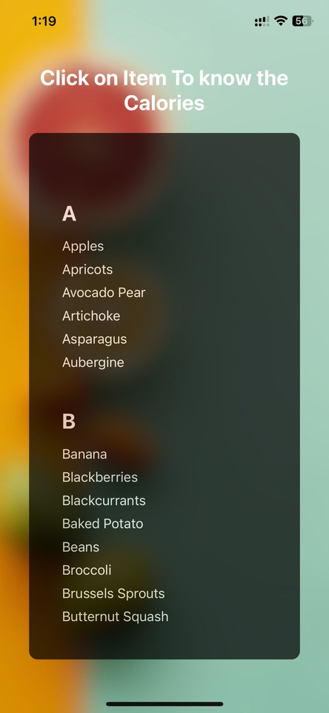




RESULT
Nutri+
Select
Banana
2. Apple
3. Mango
Username
Password
New User?
Sign up.
Nutri+

Slide 13
CONCLUSION
IN THIS PROJECT, WE SUCCESSFULLY DEVELOPED A SYSTEM UTILIZING OPENCV AND DEEP LEARNING TECHNIQUES TO SCAN AND DETECT FRUITS, VEGETABLES, AND DRY FRUITS FROM INPUT IMAGES. OUR OBJECTIVE WAS TO PROVIDE A TOOL THAT AIDS IN ASSESSING NUTRITIONAL CONTENT FOR HEALTHY DIETARY CHOICES.
THE PROJECT'S SUCCESS IS A SIGNIFICANT STEP TOWARDS AUTOMATING NUTRITIONAL ASSESSMENT AND AIDING INDIVIDUALS IN MAKING INFORMED DECISIONS ABOUT THEIR DIETARY HABITS. FUTURE WORK COULD INVOLVE EXPANDING THE DATASET FOR IMPROVED ACCURACY AND INCORPORATING ADDITIONAL FEATURES, SUCH AS SUGGESTING SUITABLE PORTION SIZES BASED ON DIETARY REQUIREMENTS.
Nutri+

