Slide 1
Targeted Location Analysis for Family Dining Expansion Client: Owner of a suburban family dining restaurant in Brookfield, Waukesha County, WI Objective: Identify potential locations in Wisconsin for expanding a family dining restaurant
MGMT-58200 - Group 17

Slide 2




We used a 4-step approach to identify suburban CBGs in the state of Wisconsin that were underserved for Family-Dining
CBG Classification
Define Rural, Suburban and Urban CBGs based on population and housing
Demographic Benchmarking
Define demographics (education, income, population) for base location – Brookfield, WI
7 suburban CBGs where 30%-40% people hold a Bachelor's Degree and 10% people earn more than $100,000
Addressable Market
Find all CBGs in the Wisconsin that are similar to Brookfield
Total CBGs: 70+, Underserved CBGs: 24 & Suburban underserved CBGs: 23
Opportunity Identification
Identify Underserved Counties (based on population per restaurant)
Total of 16 suburban underserved counties with 5 having the highest population per restaurant

Slide 3
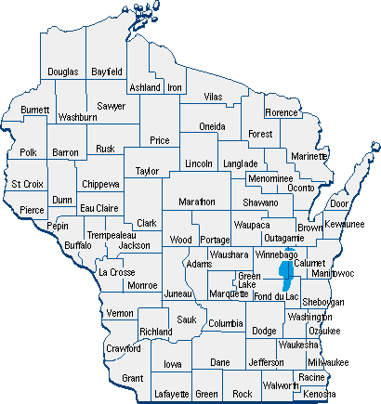
16 Counties Have Similar Characteristics to Home Location and are Underserved with Family Dining Restaurants.
We identified the Top 5 counties, containing 11 Suburban CBGs that had the highest population per restaurant in Wisconsin
St. Croix County
Waukesha County – also the home location
Kenosha County
Brown County
Dane County
Additionally, 11 counties, containing 13 CBGs had an above average population per restaurant parameter
Outagamie County
Rock County
Sauk County
Sheboygan County
Washington County
Calumet County
Chippewa County
Door County
Eau Claire County
Green County
Jefferson County

Slide 4
THANK YOU

