Slide 1

Team :Creative Minds

Slide 2

Theme
Problem Statement:
Develop a platform connecting aircraft manufacturers, airlines, and recycling facilities for the repurposing and recycling of end-of-life aircraft components. The goal is to reduce the aviation industry's environmental impact by promoting sustainability and the circular economy. The platform should include a comprehensive database of aircraft parts, enable manufacturers and airlines to identify and arrange for repurposing or recycling, and allow recycling facilities to source recycled materials. A dashboard should provide key metrics on recycling and repurposing, evaluating efficiency, environmental impact, and performance. The solution should be fully functional, efficient, innovative, and meet the evaluation criteria.

Slide 3

Developed application:
The developed application is a web platform that connects aircraft manufacturers, airlines, and recycling facilities for the repurposing and recycling of end-of-life aircraft components. It includes a comprehensive database of parts, allows manufacturers and airlines to identify and arrange for repurposing or recycling, and enables recycling facilities to source recycled materials. The platform features a dashboard displaying key metrics on recycling and repurposing, promoting sustainability and the circular economy in the aviation industry

Slide 4
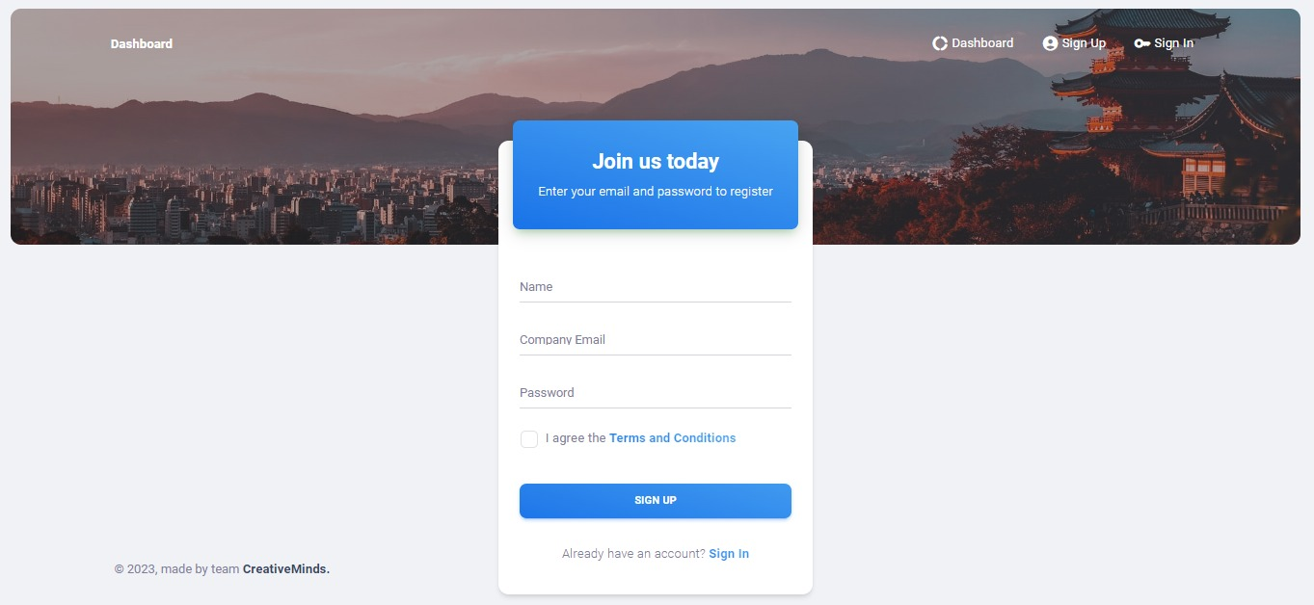
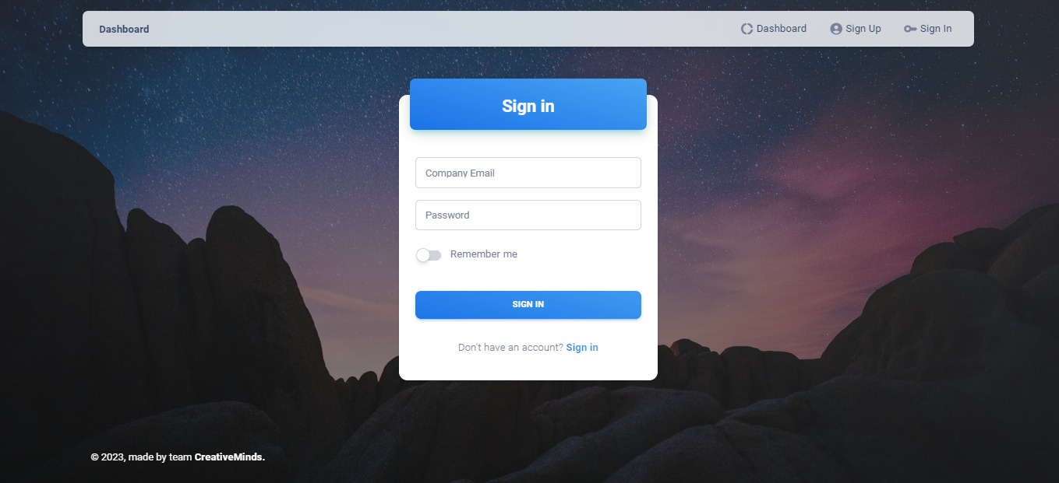
Preview of the developed application
Img 1-Sign Up Page
Img 2-Sign In Page

Slide 5

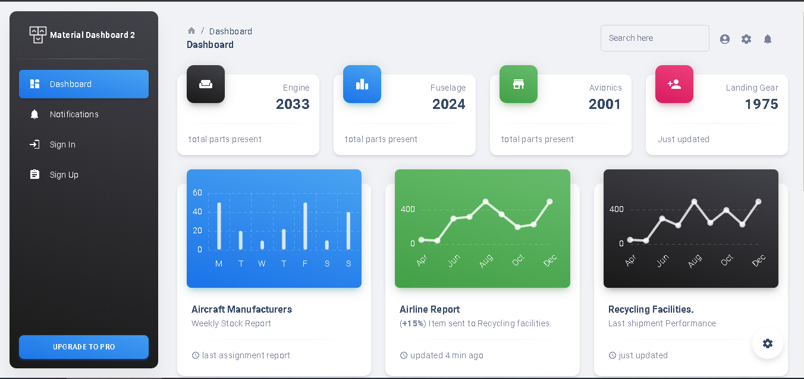


Slide 6




Data Flow
Aircraft Manufacturers
Aircraft Manufacturer employee
Call Out
Call in
Sign in/Sign Up
Airline Employee
Airline
Login
Stakeholder
Call Out
Call In
Recycling employee
Recycling facilities.

Slide 7

Benefits of the Platform
Environmental Sustainability: The platform promotes sustainable practices by facilitating the repurposing and recycling of end-of-life aircraft components, reducing waste and minimizing environmental impact.
Resource Optimization: The platform enables efficient management and utilization of aircraft parts, extending their lifespan and reducing the need for new production.
Streamlined Collaboration: Stakeholders in the industry, including manufacturers, airlines, and recycling facilities, can easily connect and collaborate, improving overall efficiency in the repurposing and recycling process.
Regulatory Compliance: The platform ensures adherence to regulations and industry standards by tracking and documenting the entire lifecycle of aircraft components.
Data-Driven Insights: Real-time metrics and dashboard analytics show data in chart form for informed decision-making, allowing stakeholders to monitor performance and implement sustainable strategies.
Cost Efficiency: Manufacturers and airlines can purchase components nearing the end of their useful life at lower costs, reducing expenses without compromising quality.

Slide 8


About Deployment Service Provider
Front End was created using react.js and is hosted on Amazon Web Services (AWS).
Backend was created using springbot which is java framework. The web application and postgres database was hosted on an AWS EC2 instance.
AWS offers limited free of cost perks as well as low, pay-as-you-go pricing with no up-front expenses or long-term commitments.
Source code can be found on our GitHub repository: link.

Slide 9


