Slide 1
UPHI - Unified Patient Health Insights
Main Project M.Sc CS
Fergusson College
Himanshu Tokekar (256230)
Mayuresh Thorat (256215)
Irfan Shaikh (256212)

Slide 2
Problem Statement & Motivation
» Healthcare data is heavily fragmented.
» Lack of unified patient history during emergencies.
» Inefficient manual onboarding & identity verification.

Slide 3
The UPHI Solution
» Centralized health registry connecting entities.
» Universal Health ID (Verifiable PDF & QR).
» Real-time longitudinal data merging.
» End-to-end Consent Management System.

Slide 4
Tech Stack & Architecture
» Frontend: Vite + React JS + Tailwind CSS
» Backend: Spring Boot (Java)
» Database: MongoDB
» AI/LLM: Google Gemini (Predictive Risk & Snapshots)
» Security: Stateless JWT

Slide 5
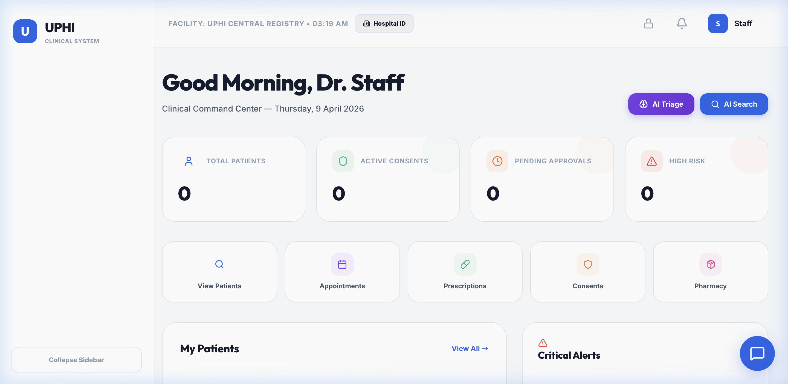
Live: Hospital Dashboard

Slide 6
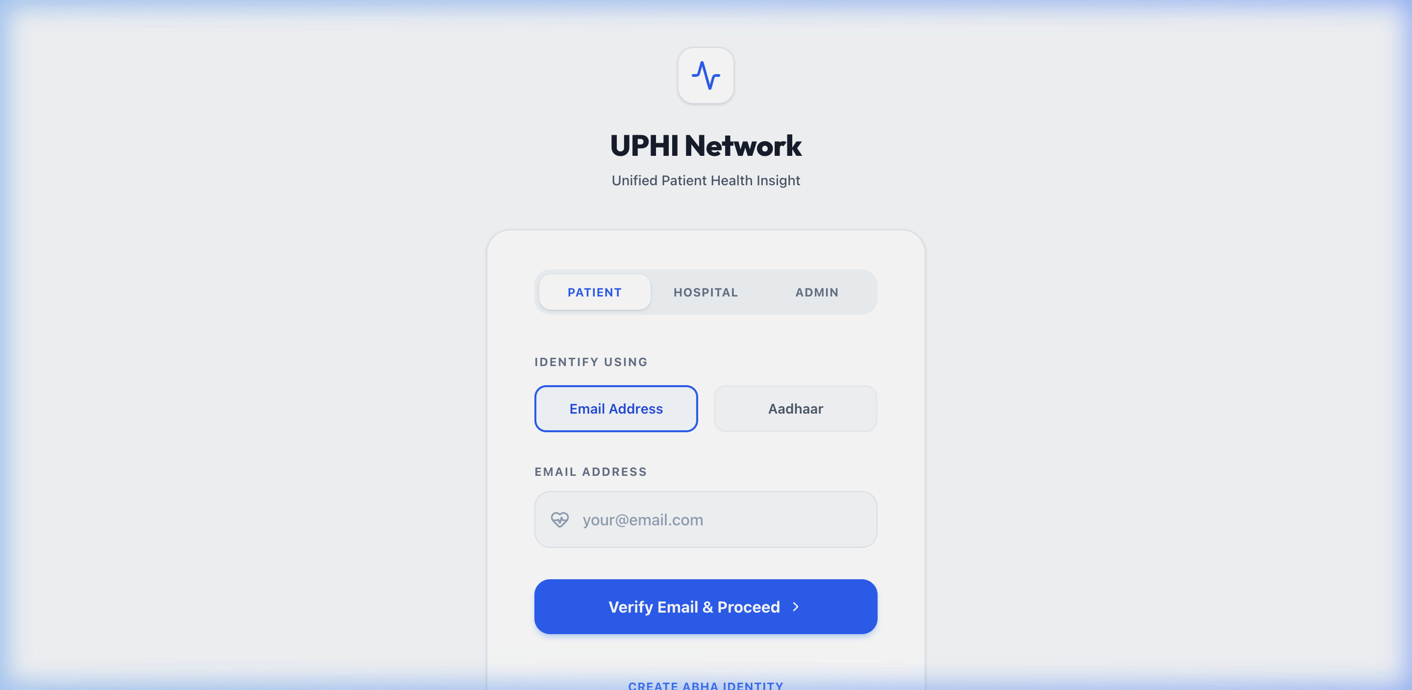
Live: Patients List

Slide 7
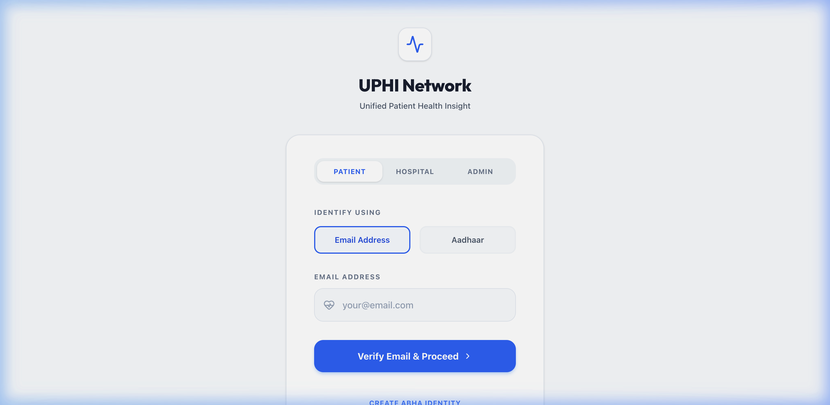
Live: Patient Profile View

Slide 8
Under the Hood: Security Configuration
@Bean public SecurityFilterChain securityFilterChain(HttpSecurity http) throws Exception { http.cors(cors -> cors.configurationSource(corsConfigurationSource())) .csrf(AbstractHttpConfigurer::disable) .authorizeHttpRequests(auth -> auth .requestMatchers("/api/auth/**").permitAll() .requestMatchers("/api/hospitals/*/id-card").permitAll() .anyRequest().authenticated()) .sessionManagement(s -> s.sessionCreationPolicy(SessionCreationPolicy.STATELESS)) .addFilterBefore(jwtAuthFilter, UsernamePasswordAuthenticationFilter.class); return http.build(); }

Slide 9
Future Scopes
» Integration with the real-world ABDM/ABHA networks.
» Expanding AI capabilities for radiology diagnostics natively.
» Dedicated mobile application (React Native) for bedside tracking.
» Integration of wearable device data (Apple Health).

