Slide 1

BACHELOR OF BUSINESS ADMINISTRATION BBA - 3rd Semester COMPUTER APPLICATION – I : BBA306
Manish
Assistant Professor
Faculty of CS & IT
Kalinga University
Naya Raipur (C.G.), India

Slide 2

COURSE OBJECTIVES
To familiarize with Front-end concept for developing various IT Applications Project.

Slide 3
COURSE OUTCOMES
The successful completion of this course shall enable the student:
CO1: To understand the GUI and Windows Programming.
CO2: To understand about the Concepts in Visual Basic.
CO3: To understand about the programming in visual basic.
CO4: To understand creating and application of problems.

Slide 4
CONTENTS
BACHELOR OF BUSINESS ADMINISTRATION
Semester- 3rd
Paper Code – BBA306
Subject Name-COMPUTER APPLICATION – I
S.No. | Unit Name /Topic
1 | Unit 1
2 | Unit 2
3 | Unit 3
4 | Unit 4
5 | Unit 5

Slide 5
Content (Unit – II)
Concepts in Visual Basic: Events, Modules, Methods, Procedure, Function Procedures, SUB Procedures, Event Procedure, Creating and Event Procedure, Parts of an Event Procedure, General Procedures, Creating a General Procedure Working with Forms : Forms, Controls, Custom Controls, Properties, MDI Forms, Create and MDI Application, MDI Child Property, Menus, The Menu Editor, Creating a Menu, Creating Popup Menus, Growing Menus, Sub Menus.
BBA306 computer Application

Slide 6
Text & Reference Books :
Text Book:
Foxall James, 2008, Visual Basic in 24 hrs/ SAMS Teach Yourself in 24 hrs, 1st Edition, Pearson Education.
Teach yourself Visual Basic, 2004, Tech media Publication.
Reference Books:
Black Book of Visual Basic, 2008, Dream Tech Press.
Beginning in Visual Basic 6.0, 2008, Wrox Publication.

Slide 7
LECTURE PLAN
Lecture No. | Topics to be covered | Slide No.
L-1 | Concepts in Visual Basic: Events, Modules, | 9-10
L-2 | Methods, Procedure, Function Procedures, SUB Procedures, Event Procedure | 11-13
L-3 | Creating and Event Procedure, Parts of an Event Procedure | 14
L-4 | General Procedures, Creating a General Procedure Working with Forms | 15-16
L-5 | Forms, Controls, Custom Controls, Properties, MDI Forms | 17-18
L-6 | Create and MDI Application, MDI Child Property, Menus, The Menu Editor, | 19-20
L-7 -8 | Creating a Menu, Creating Popup Menus, Growing Menus, Sub Menus. | 21-27
Quiz |  | 29-35

Slide 8
Unit – II

Slide 9
Concepts in Visual Basic Events
While you might visualize a Visual Studio project as a series of procedures that execute in a sequence, in reality, most programs are event driven—meaning the flow of execution is determined by external occurrences called events.
An event is a signal that informs an application that something important has occurred. For example, when a user clicks a control on a form, the form can raise a Click event and call a procedure that handles the event. Events also allow separate tasks to communicate.
Say, for example, that your application performs a sort task separately from the main application. If a user cancels the sort, your application can send a cancel event instructing the sort process to stop. Event Terms and Concepts This section describes the terms and concepts used with events in Visual Basic. Declaring Events You declare events within classes, structures, modules, and interfaces using the Event keyword, as in the following example

Slide 10
Concepts in Visual Basic Events
Declaring Events
You declare events within classes, structures, modules, and interfaces using the Event keyword
Raising Events
An event is like a message announcing that something important has occurred. The act of broadcasting the message is called raising the event. In VB, you raise events with the Raise Event statement Events must be raised within the scope of the class, module, or structure where they are declared.
Event Senders
Any object capable of raising an event is an event sender, also known as an event source. Forms, controls, and user-defined objects are examples of event senders.
Event Handlers
Event handlers are procedures that are called when a corresponding event occurs. You can use any valid subroutine with a matching signature as an event handler.

Slide 11
Methods, Procedure
In visual basic, Method is a separate code block that will contain a series of statements to perform particular operations.
Generally, visual basic Methods are useful to improve the code reusability by reducing code duplication. Suppose, if we have the same functionality to perform in multiple places, we can create one method with the required functionality and use it wherever required in the application.
Synatx:
<Access_Specifier> Sub Method_Name(<Parameters>) // Statements to Execute End Sub

Slide 12
Sub Procedure , Event Procedure
We use procedures and functions to create modular programs. Visual Basic statements are grouped in a block enclosed by Sub, Function and matching End statements. The difference between the two is that functions return values, procedures do not.
A procedure and function is a piece of code in a larger program. They perform a specific task. The advantages of using procedures and functions are:
Reducing duplication of code
Decomposing complex problems into simpler pieces
Improving clarity of the code
Reuse of code
Information hiding

Slide 13
Sub Procedure , Event Procedure
A procedure is a block of Visual Basic statements inside Sub, End Sub statements. Procedures do not return values.
Program.vb
Option Strict On
Module Example
Sub Main()
SimpleProcedure()
End Sub Sub
SimpleProcedure()
Console.WriteLine("Simple procedure")
End Sub End Module
This example shows basic usage of procedures. In our program, we have two procedures. The Main procedure and the user defined SimpleProcedure. As we already know, the Main procedure is the entry point of a Visual Basic program.

Slide 14
Event Procedure with Parts
Event Procedures
An Event Procedure is a block of code that executes in response to an event, such as a user action like clicking a button or typing text into a textbox.
Parts of an Event Procedure
Declaration Section:
This part defines the procedure and the event it handles. It typically includes the event keyword and the name of the control, followed by the event type.
Statements:
This part contains the actual code that runs when the event occurs. It can
include method calls, property assignments, and other executable code.
End Sub Statement:
This part marks the end of the Event Procedure.
Example
Private Sub Button1_Click(sender As Object, e As EventArgs) Handles Button1.Click
MessageBox.Show("Button Clicked") ‘
End Sub

Slide 15
General Procedures
General Procedures
General procedures in Visual Basic are blocks of code that can be called from multiple places within an application. They are used to perform common tasks and can be divided into two types: Function Procedures and Sub Procedures.
Function Procedures
A Function Procedure returns a value after performing a task. It can be called from anywhere in the application to perform its defined task and return a result.
Sub Procedures
A Sub Procedure performs a task but does not return a value. It is used when the task does not need to return any result.

Slide 16
Working with Forms
Forms are the fundamental building blocks of a Visual Basic application’s user interface. They act as containers for controls, such as buttons, textboxes, labels, and other UI elements.
Creating a New Form:
In Visual Studio, you can create a new form by adding a new Windows Form to your project. Right-click on your project in the Solution Explorer, select "Add," and then "Windows Form."
Designing the Form:
Use the Visual Studio Designer to add controls (such as buttons, textboxes, labels, etc.) to your form. You can drag and drop controls from the Toolbox onto the form.
Arrange and resize controls as needed.
Common Controls and Their Properties
Button: Used to initiate actions. Properties: Text, Enabled, Visible.
TextBox: Used to accept user input. Properties: Text, MaxLength, ReadOnly.
Label: Used to display text. Properties: Text, Font, ForeColor.
ComboBox: Used to display a drop-down list of items. Properties: Items, SelectedIndex, DropDownStyle.
ListBox: Used to display a list of items. Properties: Items, SelectedIndex, SelectionMode.

Slide 17
MDI Forms
MDI (Multiple Document Interface) forms in Visual Basic (VB) allow an application to manage multiple child forms within a single parent form. This interface is useful for applications that need to handle multiple documents or windows simultaneously, such as text editors or spreadsheet programs.
Key Concepts of MDI Forms
MDI Parent Form: The main form that acts as a container for child forms. It holds the menu bar, toolbars, and other UI elements that are shared among all child forms.
MDI Child Form: Forms that reside within the MDI parent form. These child forms can be minimized, maximized, or restored within the parent form.

Slide 18
Creating MDI Forms
1. Start a new project by selecting file->new project. Select standard EXE as the project type if you have the project wizard enabled.
2. You will already a have a form in the project. Set its name property to formchild and its caption property to MDI child.
3. To create the MDI parent form, right click the forms folder in the project Explore and select add ->MDI form. If the form wizard appears, select MDI form.
4. Set the name property to formMDI and the caption property to MDI parent to MDI parent.
5. Right click project1 in the project Explorer and select project1 properties from the top-up menu. Set the startup object list to form MDI. If you omit this, the application will start with the child form showing.
6. Select form child from the project Explorer. Set the form’s MDI child property to true. This will case this form, which is the child, to rest inside of the MDI parent container.

Slide 19
Creating MDI Forms
7. Select form MDI the project Explorer.
8. Start the menu designer by selecting tools->Menu Editor. You will see a window like the one in
9. Type & file in the caption field.
10. in the name field, type menufile.
11. Click the next button.
12. Click the arrow right button.
13. Enter & new in the caption field.
14. in the name field, type menunew.
15. Click the ok button to close the Menu Editor.

Slide 20
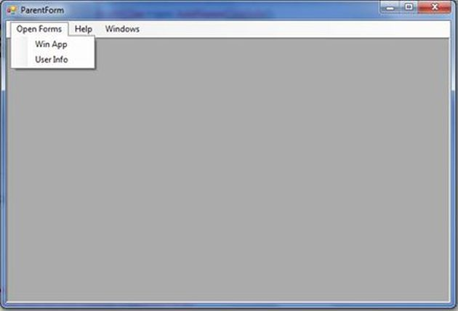
Creating MDI Forms
16. The form MDI from should now have a file menu on it. Select file ->New from the MDI menu. this will open up the window.
17. In the private sub menu file New-click () event, type the lines of code:
18. Save and Run the project.
CODING:
Private Sub menunew_Click (Index As Integer)
Dim Form As New formchild
Form.Show
End Sub

Slide 21
Working With Menus In VB 6
Windows applications provide groups of related commands in Menus. These commands depends on the application, but some-such as Open and Save are frequently found in applications. Menus are intrinsic controls, and as such they deserve a place in this chapter. On the other hand, menus behave differently from other controls. For example, you don't drop menu items on a form from the Toolbox; rather, you design them in the Menu Editor window, as you can see in the figure below. You invoke this tool from the Menu Editor button on the standard toolbar or by pressing the Ctrl+E shortcut key. There's also a Menu Editor command in the Tools menu, but you probably won't use it often.
Visual Basic provides an easy way to create menus with the modal Menu Editor dialog. The below dialog is displayed when the Menu Editor is selected in the Tool Menu. The Menu Editor command is grayed unless the form is visible. And also you can display the Menu Editor window by right clicking on the Form and selecting Menu Editor.

Slide 22
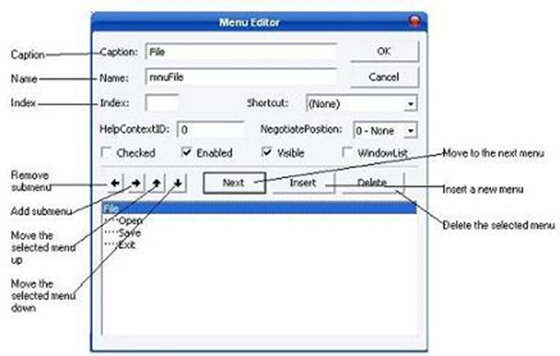
An expanded Menu Editor window

Slide 23
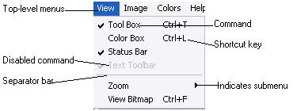
An expanded Menu Editor window

Slide 24
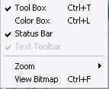
An expanded Menu Editor window
The Menu Editor dialog also provides several Check Boxes to control the appearance of the Menu.
Checked : This is unchecked by default and allows the programmer the option of creating a checked menu item( a menu item that act as a toggle and displays a check mark when selected. The following is a Check Menu items.
Enabled : specifies whether a menu is disabled or not. If you see a disabled command in a menu that means that feature is not available. The Visible checkbox specifies whether the menu is visible or not.
To add commands to the Form's menu bar, enter a caption and a name for each command. As soon as you start typing the command's caption, it also appears in a new line in the list at the bottom of the Menu Editor window. To add more commands click Enter and type the Caption and the Name.

Slide 25
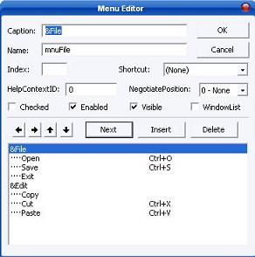
Creating Menus:
Open a new Project and save the form as menu.frm and save the project as menu.vbp.
Choose Tools ››› Menu Editor and type the menu items as shown below.
Run the application by pressing F5. You can see that you can select a menu.

Slide 26
Creating Pop-Up Menus In VB:
Visual Basic also supports pop-up menus, those context-sensitive menus that most commercial applications show when you right-click on an user interface object. In Visual Basic, you can display a pop-up menu by calling the form's PopupMenu method, typically from within the MouseDown event procedure of the object:
Private Sub List1_MouseDown(Button As Integer, Shift As Integer, _ X As Single, Y As Single) If Button And vbRightButton Then ' User right-clicked the list box. PopupMenu mnuListPopup End If End Sub

Slide 27
The Common Dialog Control
The Common Dialog control provides a standard set of dialog boxes for operations such as opening, saving, and printing files, as well as selecting colors and fonts and displaying help. Any six of the different dialog boxes can be displayed with just one Common Dialog control. A particular dialog box is displayed by using one of the six "Show..." methods of the Common Dialocontrol: ShowOpen, ShowSave, ShowPrinter, ShowColor, ShowFont, or ShowHelp.
The Common Dialog control not an intrinsic control; rather, it is an "Active X" control that must be added to the toolbox via the Components dialog box, as shown below. This dialog box is accessed via the Project menu, Components item. Once you check "Microsoft Common Dialog Control 6.0" and click OK, the control is added to your toolbox (also shown below, circled). Then you can double-click it to make it appear on your form, as you would with any other control. The Common Dialog control is not visible at run-time.

Slide 28
MCQ

Slide 29
1. Date and Time are internally stores as _______ in Visual Basic.
A. strings
B. numbers
C. characters
D. symbols
ANSWER: B
2. The ____________ function in VB retrieves the date and time.
A. date
B. now
C. datediff
D. datenow
ANSWER: B
3. The individual elements of an array are identified using an _______.
A. number
B. character
C. index
D. value
ANSWER: C

Slide 30
4. ______is a data type that can be used to declare a text of maximum 10 million characters.
A. String.
B. Numeric.
C. Single precision.
D. Date.
ANSWER: A
5. A module-level is available to all the _______ in the module.
A. data.
B. procedures.
C. event.
D. task.
ANSWER: B
6. ____variables are not reinitialized each time Visual basic invokes a procedure and thus retains or preserves value even when a procedure end.
A. Static.
B. Dynamic.
C. Virtual.
D. Currency.
ANSWER: A

Slide 31
7. Code window consists of a ______ box and procedure list box.
A. object.
B. event.
C. tool.
D. message.
ANSWER: A
8. The ____ statement checks in the module for usage of any undeclared variables and reports an error to the user.
A. looping.
B. iteration.
C. dim.
D. external.
ANSWER: C
9. Dynamic arrays can be declared when the user may not know the _____of the array at design time.
A. exact column.
B. exact variable.
C. exact value.
D. exact size.
ANSWER: D

Slide 32
10. Variables are named storage locations in memory, the value of which does not change during program ______.
A. design.
B. execution.
C. debug.
D. modification.
ANSWER: B
11. Variables of different data types when combined as a single variable to hold several related information is called as ______ data types.
A. numeric.
B. user defined.
C. string.
D. byte.
ANSWER: B
12. ____ function translates a numeric value to a variable.
A. Message.
B. Build In.
C. Val.
D. Mod.
ANSWER: C

Slide 33
13. ____box provides a set of choices to the user.
A. List.
B. Command.
C. Combo.
D. Text.
ANSWER: A
14. All the controls in an array will have the same _____.
A. Value.
B. properties.
C. address.
D. location
ANSWER: B
15. The _____property in Visual basic is common for many a tools.
A. location.
B. place.
C. window status.
D. name.
ANSWER: D

Slide 34
16. Option button can be grouped in a ______control.
A. label.
B. text box.
C. frame.
D. check box.
ANSWER: C
17. A _____ bar appears in the top of the screen.
A. title.
B. menu.
C. tool.
D. debug.
ANSWER: A
18. A disabled menu item does not appear in the ____ bar.
A. menu.
B. standard.
C. status.
D. title.
ANSWER: A

Slide 35
19. A __________ array is a group of controls that share the same name and type.
A. control
B. fixed
C. static
D. local
ANSWER: A
20. The ____________ is a commonly used control, which enables the user to select a value by
positioning it at the desired location.
A. verticalbar
B. horizonalbar
C. scrollbar
D. menubar
ANSWER: C

Slide 36
Thank You

