Slide 1
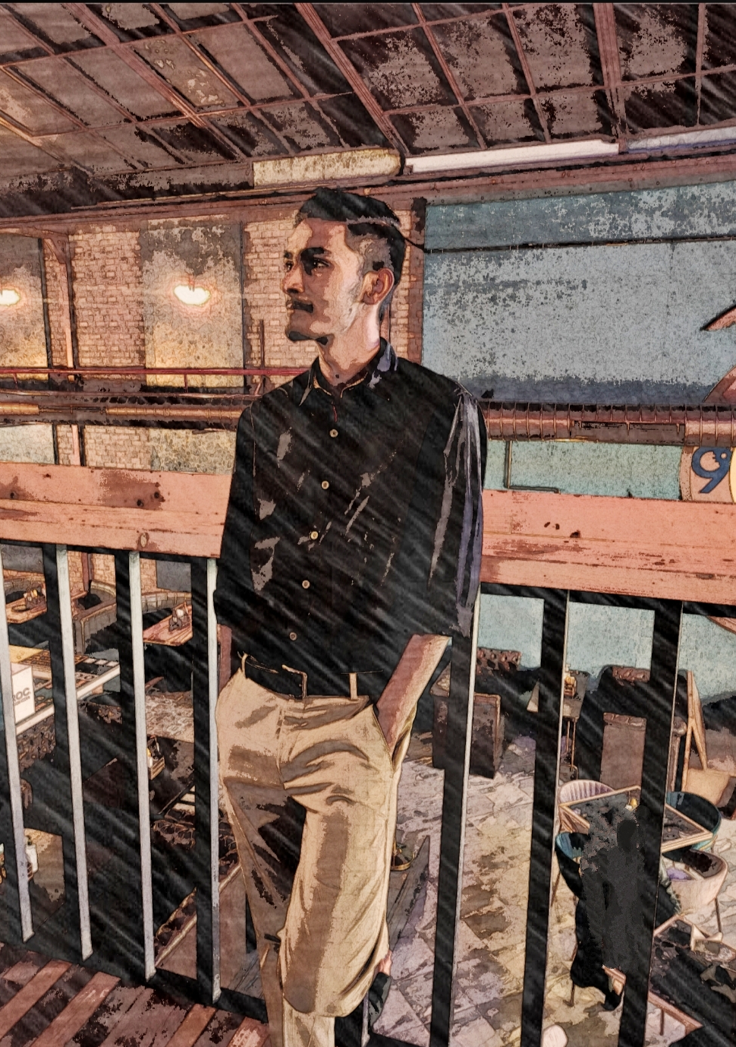
DIGITAL
DIGITAL
PORTFOLIO
-Himanshu Vaishnav
2111981268

Slide 2
IDEA :
A platform that can showcase my Skills and Expertise.
A professional online presence that reflects my personal brand.
A portfolio website can attract networking opportunities, collaborations, freelance work, or potential job offers by being easily accessible and shareable.
Career advancement by providing a comprehensive view of my qualifications and accomplishments.
Personal development my accessing strengths, areas of improvement, and career goals.

Slide 3
CONCEPT:
Technologies used: HTML, CSS, BOOTSTRAP 5.0.
Bootstrap Components are used for achieving responsiveness and increasing code reusability.
The application emphasizes on friendly user interface.
Currently the application has a navbar, home section, about section, blog’s section, and footer section.

Slide 4
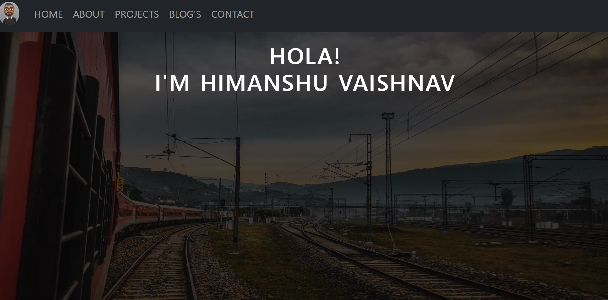
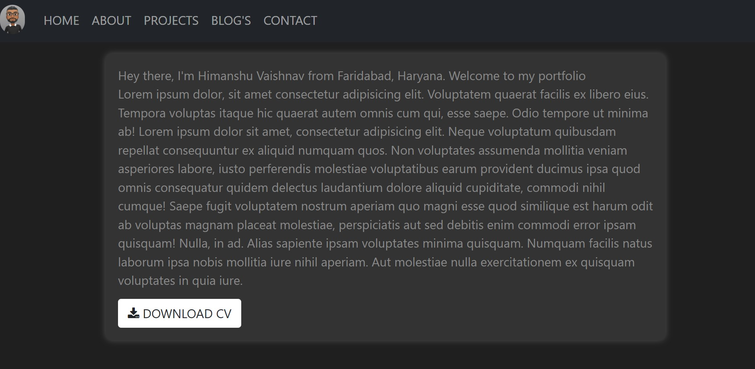
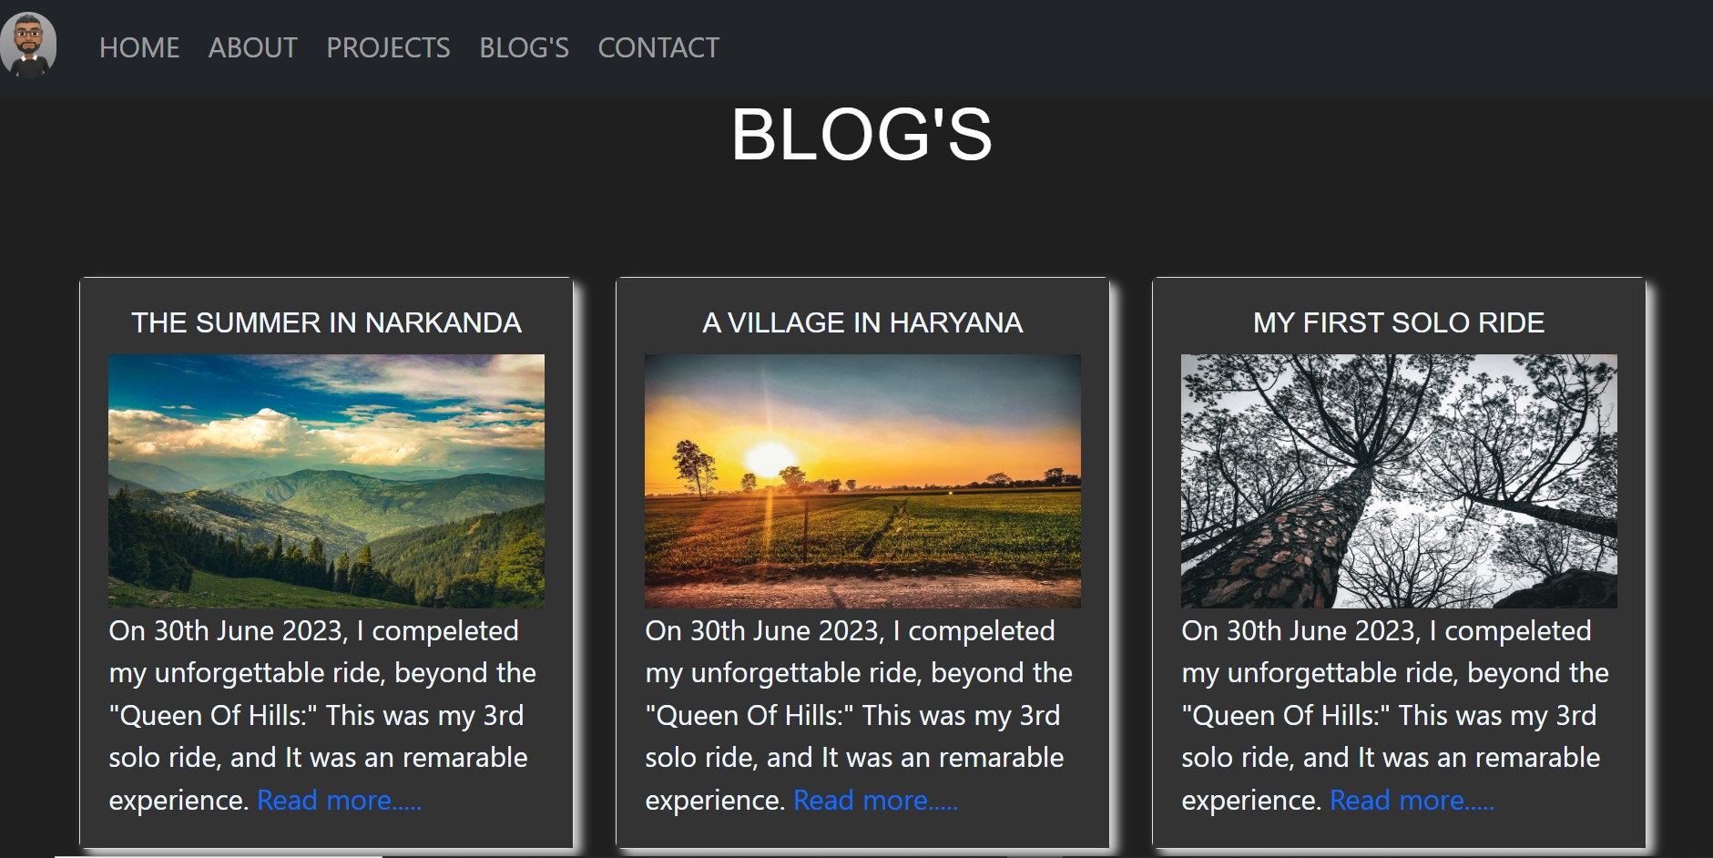
HOME PAGE:
OTHER PAGES:

Slide 5
DRAWBACKS:
Lack of interaction: JS is to be added.
Performance can be increased by moving more towards single page application.
Data Base, Backend logic implementation.
Content for the blog’s is missing.
More sections are to be added for providing more detailed information.

Slide 6
THANK YOU
FOR YOUR TIME!

