Slide 1


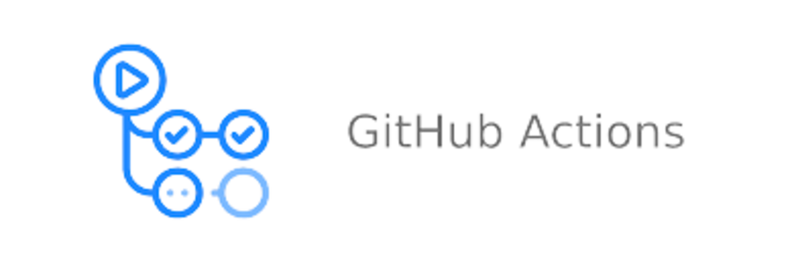
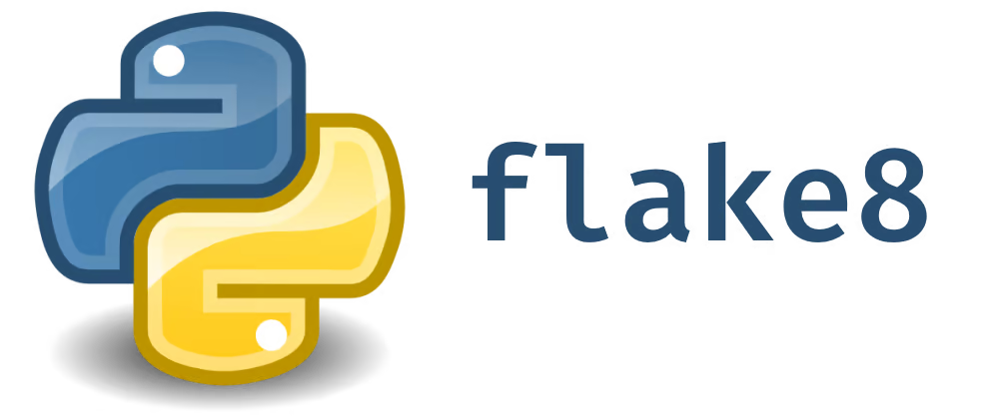
MLOps Assignment 1: Task M1 HLD
Creates pull request to merge feature branch changes with master branch
Pull Request
GitHub
Feature Branch
GitHub
Main Branch
Automatically triggers GitHub action for CI pipeline.
Reference issue in PR comments
GitHub Issue
Validate code linting using flake8
Has
linting error ?
Raise GitHub issue with linting error details
YES
NO
Notify of success in PR comments
Build Model
Raise GitHub issue with unit testing error details
Validate unit test cases (like Hyperparameters in acceptable range)
(etc.)
UT Errors?
YES
Notify of success in PR comments
CI Pipeline
NO
Exit

Slide 2

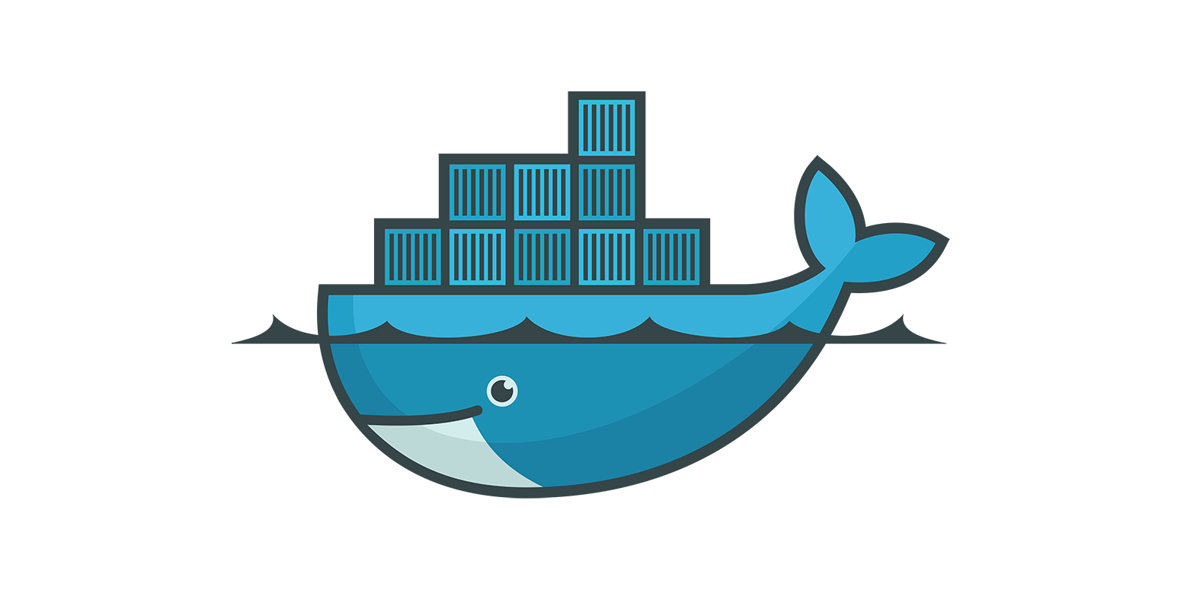
MLOps Assignment 1: Task M1 HLD (cont.)
GitHub
Main Branch
Start
Is running from main
branch
?
NO
Manually triggers GitHub action for CD pipeline
YES
Build Model
Build Docker Image
Deploy / Push local image to Docker Hub
Exit
CD Pipeline

