Slide 1
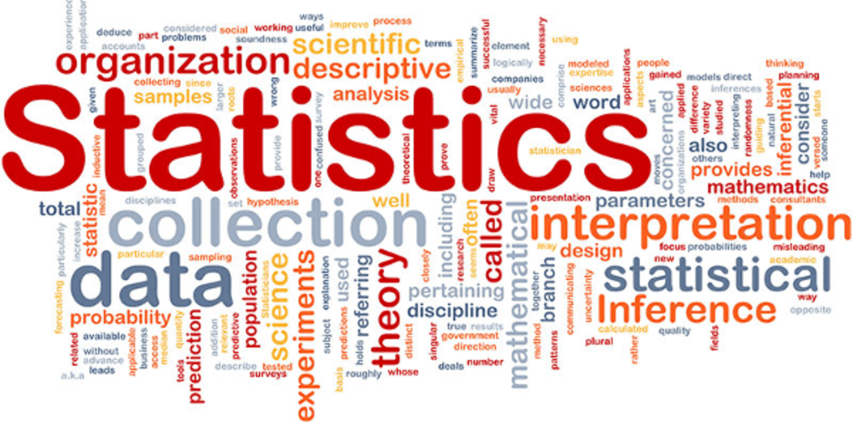
STATISTICS
Himanshu Shukla
Data Scientist
BY Himanshu Shukla (Statistical Expert & Data Scientist)

Slide 2
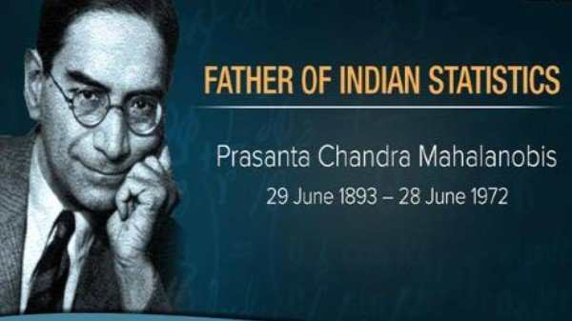
Fathers of Statistics
National Statistics Day is celebrated every year on June 29 to mark the birth anniversary of Indian scientist and statistician Prasanta Chandra Mahalanobis.
In 1950, he formed the Indian Statistical Institute (ISI) with a Statistical Laboratory set up

Slide 3
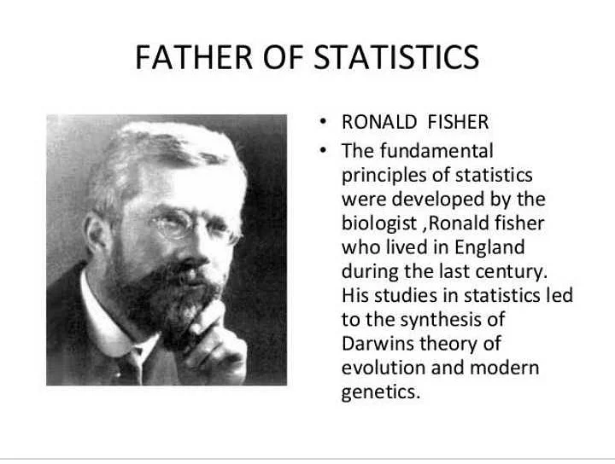

Slide 4
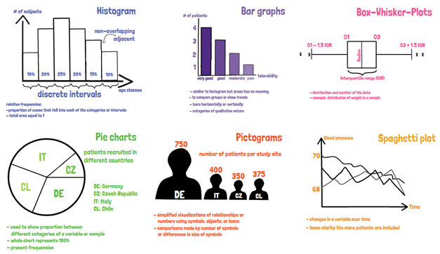
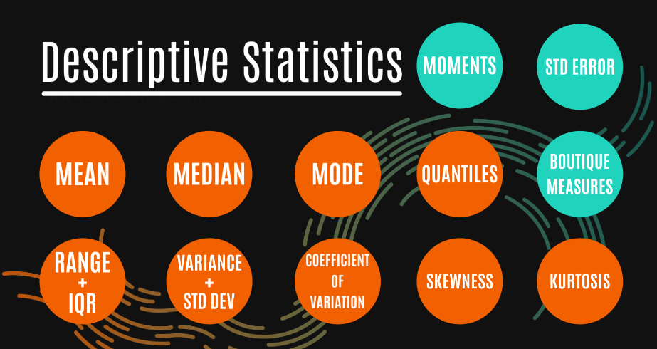
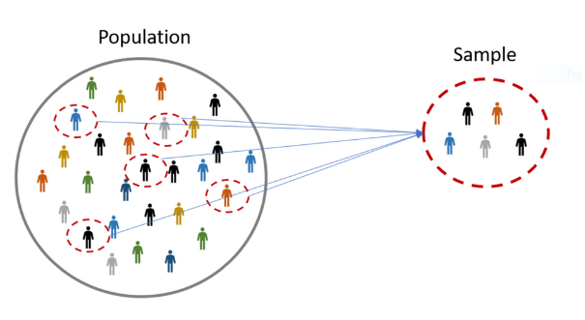
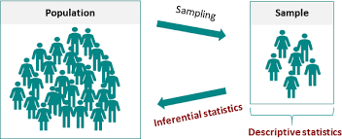
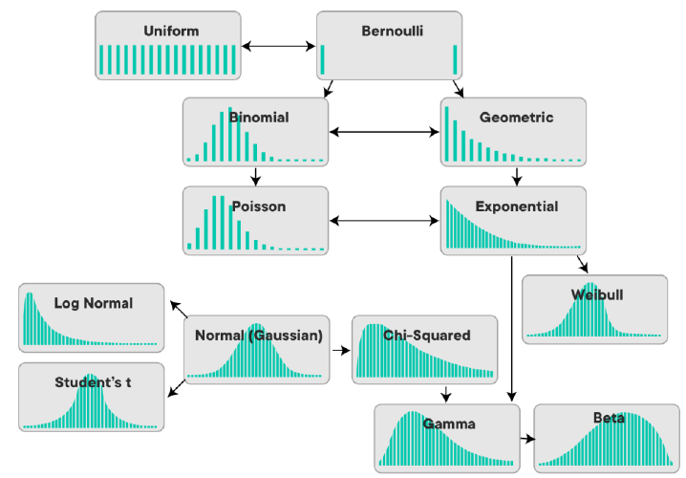
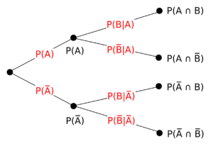
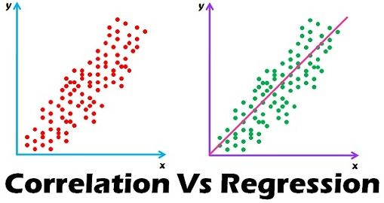
What we will learn:
1. Graphical Representation of data
2. Descriptive Statistics
3. Sampling
4. Inferential Statistics
5. Probability
6. Probability Distribution
7. Correlation & Regression

Slide 5
Main Division of Statistics->
Mathematical or Theoretical statistics
Applied Statistics
Statistical methods or functions
Descriptive statistics
Inferential Statistics
Statistical Distributions, experimental designs, sampling designs, etc.
Collection, tabulation, analysis and interpretation of data, etc.
Classification and diagrammatic representation of data.
To draw conclusion about population on the basis of sample drawn from it.
It mainly covers population, census, national income, production, business statistics, industrial statistics, quality control, biostatistics, etc.
In this we check hypothesis.
Sir R. A. Fisher
Himanshu Shukla
Data Scientist
“The science of statistics is essentially a branch of applied mathematics and may be regarded as mathematics applied to observational data.”
Nonsense Statistics

Slide 6
Some times We say statistics “Bekar hai”
Himanshu Shukla
Data Scientist
Statistics is true on an average only.
Statistics deals with the masses, not an individual. No statistics is applicable for a single observation.
Statistical results are correct in a general sense. They are always subject to certain amount of error.
Statistics is only a means to draw conclusions about masses or population but nota panacea to all sort of problems.
Statistics deals with quantitative data only. Even qualitative information is converted into numerical data by the method of ranking, scoring or scaling.

Slide 7
DATA : Primary and Secondary
Himanshu Shukla
Data Scientist
Data
Quantitative (Numerical) (Continuous)
Interval
(Grouping)
Ratio (comparison)
Qualitative (Categorical) (Discrete)
Nominal
Ordinal
Is ranked
Same info is collected
We can’t ordering, can’t find mean ex. Area code
Can order or ranked, either numeric or nonnumeric

Slide 8
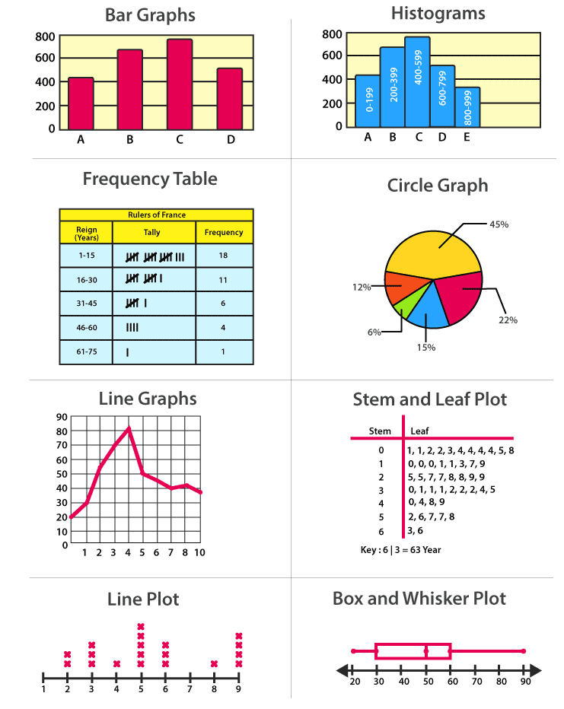
Diagrammatic and Graphical Representation
Himanshu Shukla
Data Scientist
Used to describe the basic feature of the data in a study.
Provide simple summaries about the sample and the measures.
What the data shows .
Central tendency
Variance
Skewness
kurtosis.

Slide 9
Descriptive Statistics
Himanshu Shukla
Data Scientist
Used to describe the basic feature of the data in a study.
Provide simple summaries about the sample and the measures.
What the data shows .
Central tendency
Variance
Skewness
kurtosis.

Slide 10
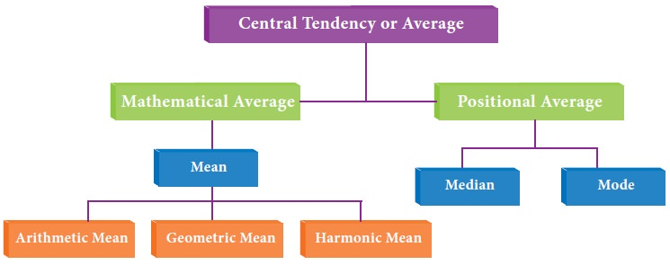
Measure of Central Tendency
Himanshu Shukla
Data Scientist
It is a single value with the range of data which represents a group of individual value in a simple and concise manner. So that the mind can get quick understand. Since the value lies within the range of data, it is known as a measure of central tendency.
Good one
Based on all observation
Easily computable
Least affected by extreme values
Fluctuate least from sample to sample drawn from the same population

Slide 11
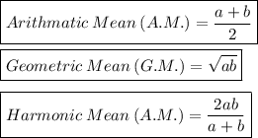
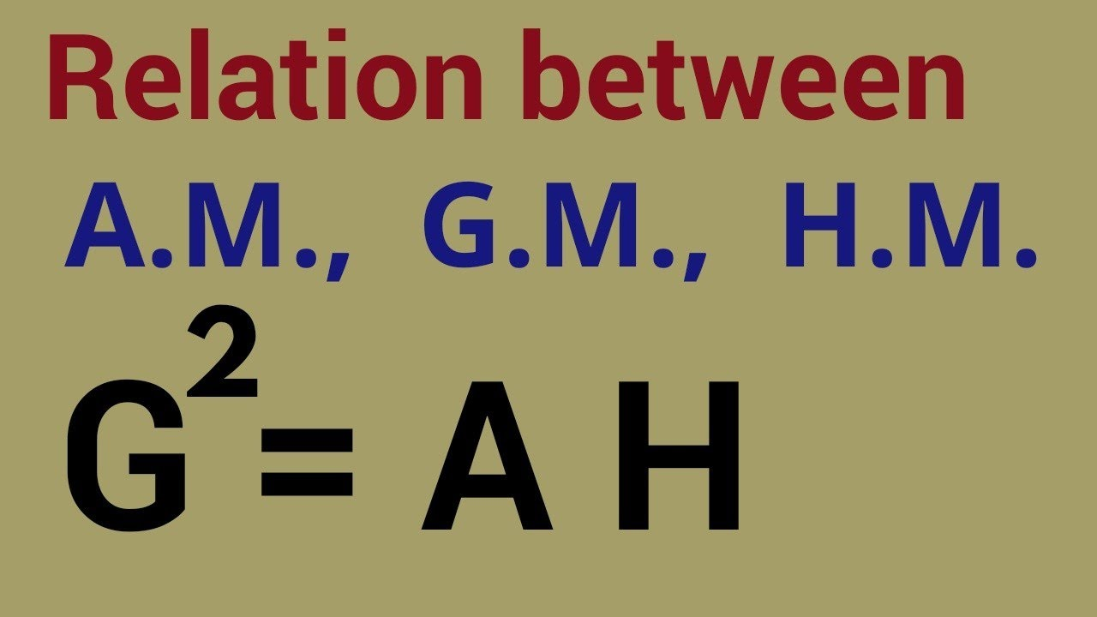
Problem in Average
Himanshu Shukla
Data Scientist
It represent a group of whole not an individual.
Often an average is a value which does not exist in the set of data.
Sometimes an average gives a value which is not feasible eg. Average size of a family is 3.62.
Note: we generally refer A.M. for average. Because G.M. have boundation of data in data zero and –ve values should not be percent otherwise we can not calculate G.M. while G.M. is least effected by extreme values. It is basically used in case of Index numbers problems. If 0 is present in data we cant calculate H.M. also H.M. is used when the values are pertaining to the rate of change per unit time such as speed, number of items produced per day etc.

Slide 12

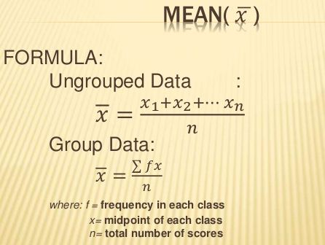
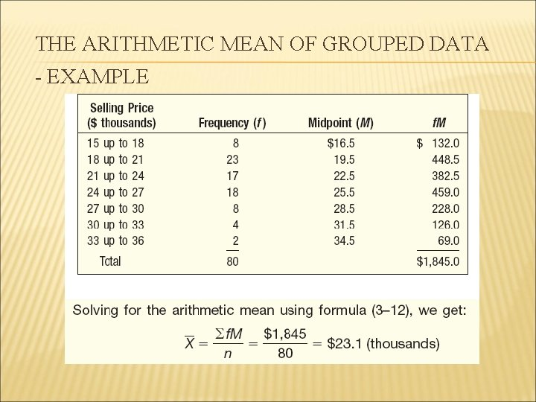
Mean
Himanshu Shukla
Data Scientist

Slide 13
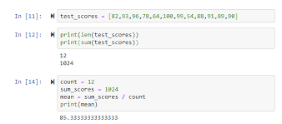
Mean in python
Himanshu Shukla
Data Scientist
Use the NumPy mean() method to find the average speed:
import numpy speed = [99,86,87,88,111,86,103,87,94,78,77,85,86] x = numpy.mean(speed) print(x)
Too much affected by extreme values.
mostly it does not correspond to any value of the set of observations.
It does not convey any info. About the spread or trend of data.
It is not suitable measure of central values in case of highly skewed distribution.
Demerits of Mean:

Slide 14
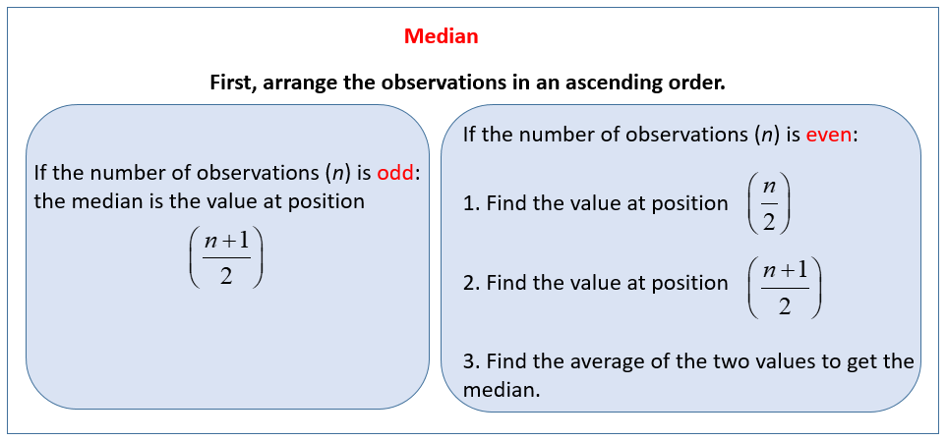
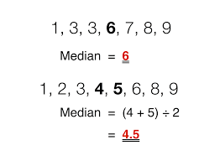
Median
Himanshu Shukla
Data Scientist
Median is the value of the variable that divides the ordered set of values into two equal halves.

Slide 15
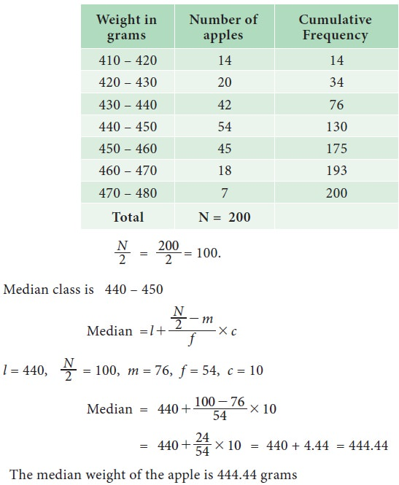
Median in Python
Himanshu Shukla
Data Scientist
import numpy
x = [99,86,87,88,111,86,103,87,94,78,77,85,86]
sorted_x=sorted(x)
sorted_x
[77, 78, 85, 86, 86, 86, 87, 87, 88, 94, 99, 103, 111]
m=(len(sorted_x)+1)/2
median= sorted_x[int(m)]
median
87
import numpy speed = [99,86,87,88,111,86,103,87,94,78,77,85,86] x = numpy.median(speed) print(x)

Slide 16
Advantage:
It is not influenced by extreme values. But it is position average.
For data from skewed distributions, the median is better than the mean because it isn't influenced by extremely large values.
Disadvantage:
Data should be arranged.
A slight change in the series may bring drastic change in median value.
It is not suitable for further mathematical treatment except its use in mean deviation.
Himanshu Shukla
Data Scientist

Slide 17
Mode
Himanshu Shukla
Data Scientist
Drawback: It cant use mathematically in Quantitative data
Maximum frequency in a distribution.
Some distributions have equal peaks and hence ode is not necessarily unique. There will be as many modes of distribution as the number of peaks in it.
The mode is the least used of the measures of central tendency
The mode will be the best measure of central tendency (as it is the only one appropriate to use) when dealing with nominal data.
The Mode value is the value that appears the most number of times:
99, 86, 87, 88, 111, 86, 103, 87, 94, 78, 77, 85, 86 = 86
The SciPy module has a method for this.
Example
Use the SciPy mode() method to find the number that appears the most:
from scipy import stats speed = [99,86,87,88,111,86,103,87,94,78,77,85,86] x = stats.mode(speed) print(x)
# The mode() method returns a Mode Result object that contains the mode number (86), and count (how many times the mode number appeared (3)).
With a single-mode sample. In python 3.8 multimode() function is present in Statistics

Slide 18
Himanshu Shukla
Data Scientist
Advantages of the mode
mode is easy to determine
It is easy to understand
mode is not affected by extremes of values
When data are not complete, mode cannot be difficult to estimate
mode is very easy to compute
Disadvantages of mode accuracy
It is not a very good measure of accuracy
It is relevant in further statistical calculation
It represents a very poor average
It is difficult to calculate, especially when more than one mode or large numbers are involved.
There may be uncertainty in the exact location
Arrangement of data is always tedious

Slide 19
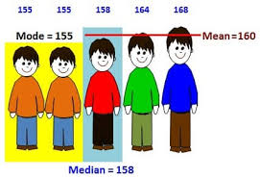
In Machine Learning (and in mathematics) there are often three values that interests us:
Himanshu Shukla
Data Scientist
Mean - The average value
Median - The mid point value
Mode - The most common value

Slide 20
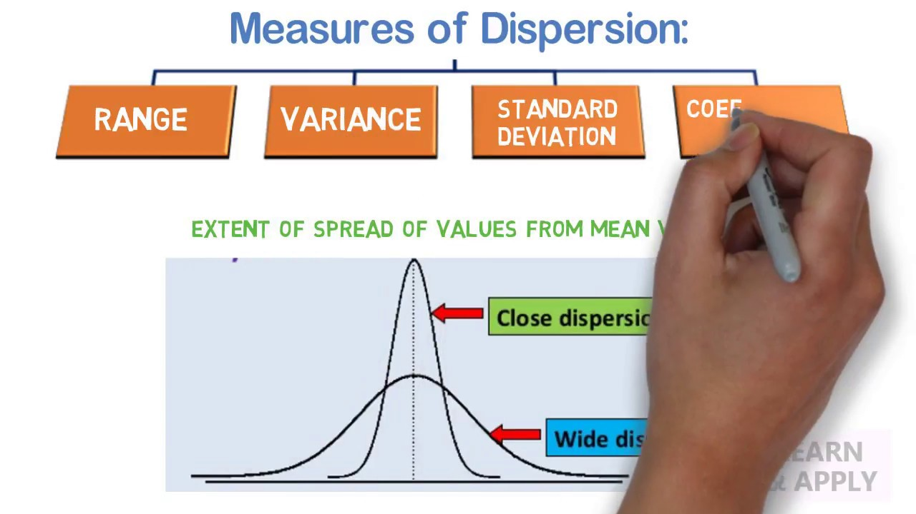
Himanshu Shukla
Data Scientist
Measures of Dispersion
Measure of dispersion help to gauge the spread of data about a central value. These measures help to determine how stretched or squeezed the given data is.
There are many Measures of Dispersion found that help us to get more insights into the data:
Range
IQR and Quartile Deviation
Variance
Standard Deviation
Mean deviation
Skewness
Kurtosis
IQR

Slide 21
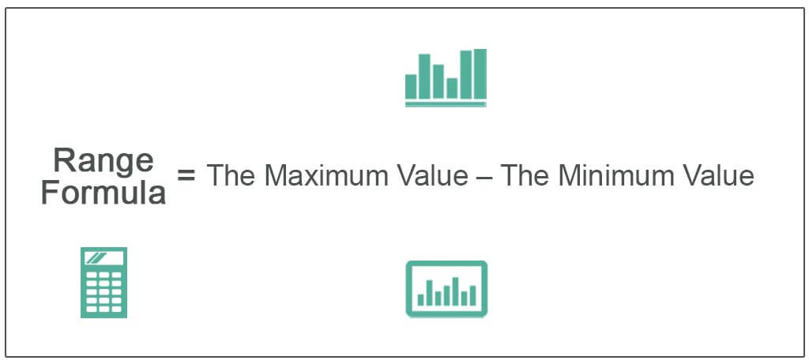
Himanshu Shukla
Data Scientist
1. Range:
Range is the measure of the difference between the largest and smallest value of the data variability. The range is the simplest form of Measures of Dispersion. Example: 1,2,3,4,5,6,7
Range = Highest value – Lowest value = ( 7 – 1 ) = 6
import numpy
speed = [2.74, 1.23, 2.63, 2.22, 3, 1.98]
Range= max(speed)- min(speed)

Slide 22
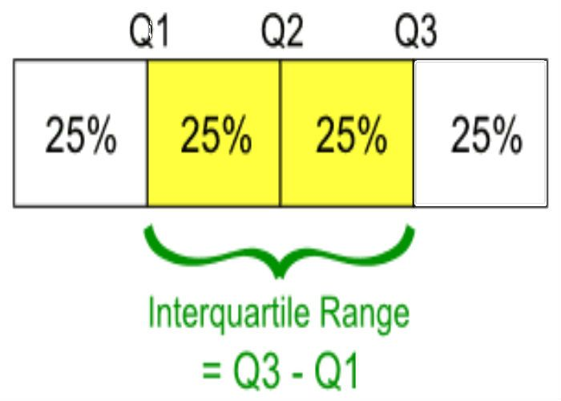
2. Quartile Deviation and IQR: Quartile deviation is the half of the difference of third quartile (Q3) and first quartile (Q1) i.e. half of the interquartile range (IQR). (Q3 – Q1) / 2 = IQR / 2
Decision making The data set having higher value of quartile deviation has higher variability.
Himanshu Shukla
Data Scientist
# Import numpy library
import numpy as np
data = [32, 36, 46, 47, 56, 69, 75, 79, 79, 88, 89, 91, 92, 93, 96, 97, 101, 105, 112, 116]
# First quartile (Q1)
Q1 = np.percentile(data, 25, interpolation = 'midpoint')
# Third quartile (Q3)
Q3 = np.percentile(data, 75, interpolation = 'midpoint')
# Interquaritle range (IQR)
IQR = Q3 - Q1
# Quartile Deviation
qd = IQR / 2
print(qd)
from scipy import stats
data = [32, 36, 46, 47, 56, 69, 75, 79, 79, 88, 89, 91, 92, 93, 96, 97,101, 105, 112, 116]
# Interquartile range (IQR)
IQR = stats.iqr(data, interpolation = 'midpoint')
print(IQR)

Slide 23
3. Variance (σ2): The average squared deviation from the mean of the given data set is known as the variance.
It can be calculated by obtaining the sum of the squared distance of each term in the distribution from the Mean, and then dividing this by the total number of the terms in the distribution.
This measure of dispersion checks the spread of the data about the mean.
It basically shows how far a number, for example, a student’s mark in an exam, is from the Mean of the entire class.
Formula: (σ2) = ∑ ( X − μ)2 / N
A low value for variance indicates that the data are clustered together and are not spread apart widely, whereas a high value would indicate that the data in the given set are much more spread apart from the average value.
Variance will be always positive value.
Variance is sensitive to extreme values.
Himanshu Shukla
Data Scientist

Slide 24
Variance in Python
Himanshu Shukla
Data Scientist
# variance() function of Statistics Module
# Importing Statistics module
import statistics
# Creating a sample of data
sample = [2.74, 1.23, 2.63, 2.22, 3, 1.98]
# Prints variance of the sample set
# Function will automatically calculate
# it's mean and set it as xbar
print("Variance of sample set is % s"%(statistics.variance(sample)))
Note: What is %s and %D Python?
%s is used as a placeholder for string values you want to inject into a formatted string. %d is used as a placeholder for numeric or decimal values. For example (for python 3) print ('%s is %d years old' % ('Joe', 42))

Slide 25

4. Standard Deviation: Standard Deviation can be represented as the square root of Variance. To find the standard deviation of any data, you need to find the variance first. Standard Deviation is considered the best measure of dispersion. Formula: Standard Deviation = √σ
Himanshu Shukla
Data Scientist
# Python code to demonstrate stdev() function
# importing Statistics module
import statistics
# creating a simple data - set
sample = [1, 2, 3, 4, 5]
# Prints standard deviation
# xbar is set to default value of 1
print("Standard Deviation of sample is % s "
% (statistics.stdev(sample)))
5. Mean Deviation
It is defined as the average of absolute deviations taken from an average, usually the median.

Slide 26
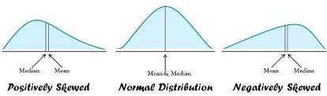
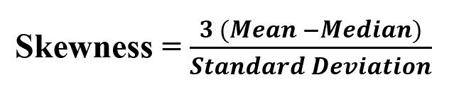
6. Skewness
Himanshu Shukla
Data Scientist
Skewness is the measure of how much the probability distribution of a random variable deviates from the normal distribution.

Slide 27
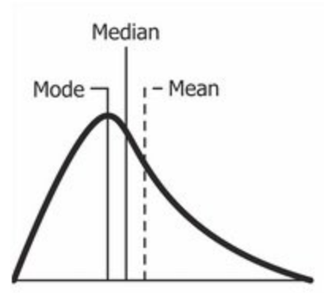
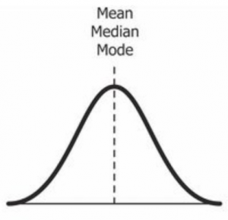
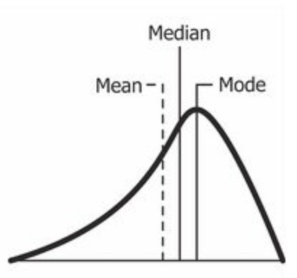
Skewness in python
Himanshu Shukla
Data Scientist
function calculates the skewness of the data set.
scipy.stats.skew(array, axis=0)
# skewness along the index axis
df.skew(axis = 0, skipna = True)
skewness < 0 : more weight in the right tail of the distribution i.e positively skewed
skewness = 0 :
normally distributed.
skewness > 0 : more weight in the left tail of the distribution i.e negatively skewed
mode<median<mean.
mode=median=mean
mode>median>mean

Slide 28
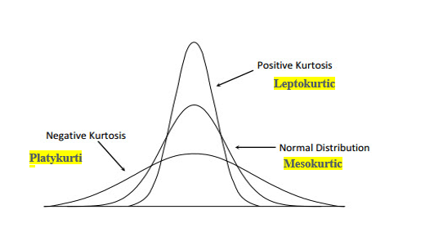
Kurtosis
Himanshu Shukla
Data Scientist
Kurtosis refers to the degree of presence of outliers in the distribution.
Kurtosis is a statistical measure, whether the data is heavy-tailed or light-tailed in a normal distribution.
In finance, kurtosis is used as a measure of financial risk. A large kurtosis is associated with a high level of risk for an investment because it indicates that there are high probabilities of extremely large and extremely small returns. On the other hand, a small kurtosis signals a moderate level of risk because the probabilities of extreme returns are relatively low.

Slide 29
from scipy.stats import kurtosis
sample = [1,2,3,4,5]
kurtosis(sample)
Himanshu Shukla
Data Scientist
Leptokurtic (kurtosis > 3)
means there are more chances of outliers. Positive values of kurtosis indicate that distribution is peaked and possesses thick tails.
Mesokurtic (kurtosis = 3)
Distribution is normal distribution.
platykurtic (kurtosis < 3)
A platykurtic distribution is flatter (less peaked) when compared with the normal distribution.

Slide 30
The end
Himanshu Shukla
Data Scientist

