Slide 1
Applied Machine Learning using MS Azure
Himanshu Beniwal

Slide 2
Basics & Applying ML to real-world using MS Azure
Himanshu Beniwal

Slide 3
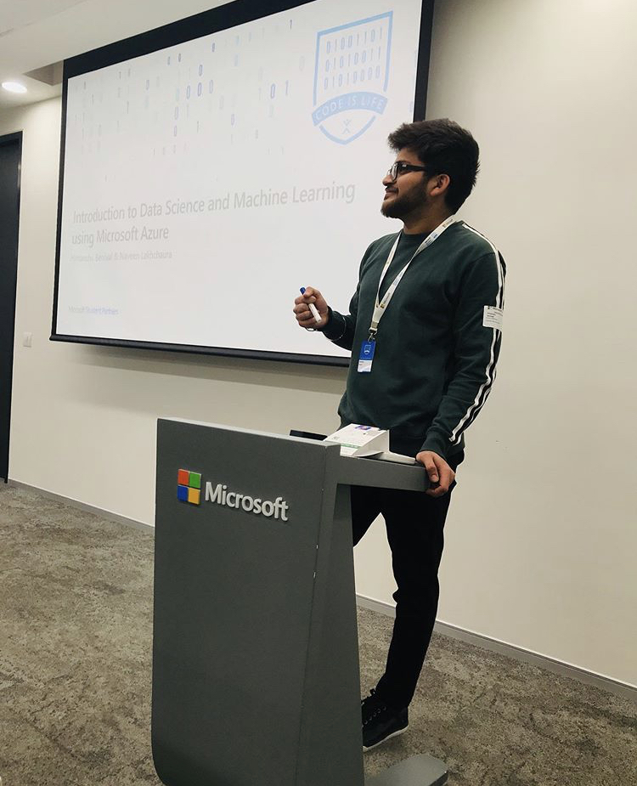


Hello! I’m Himanshu Beniwal! 😀
Microsoft Student Partner since 2018.
M. Tech. in Computer Science, Central University of Punjab.
Self-driving cars, ML, Computer Vision, and much more.
🖤 to explore Azure ML!
himanshubeniwal.codes
@himanshu_beniwa

Slide 4

Have you ever wanted to predict the future?

Slide 5
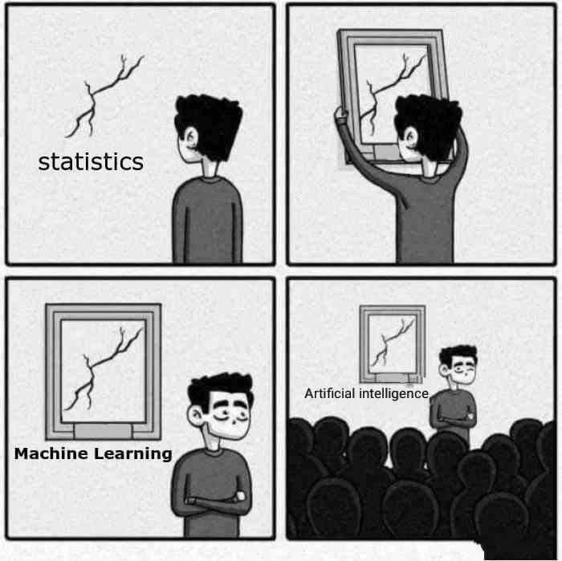
So, What is really Machine Learning?
Branch of computer science in which a computer “Learns” from data in order to perform predictive analytics.
Credit-card fraud detection
Online shopping recommendations
Self-driving cars and more
Supervised learning
Regression and Classification
Unsupervised learning
Clustering

Slide 6
Machine Learning is mostly about!
ML uses the historical data to make predictions.

Slide 7
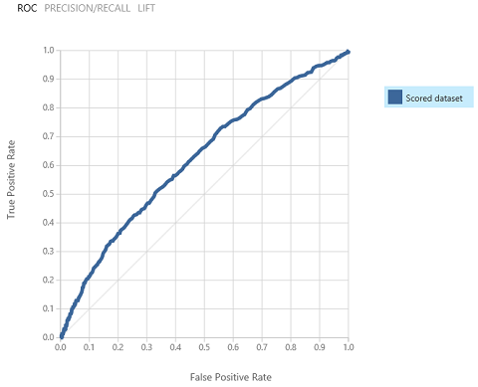
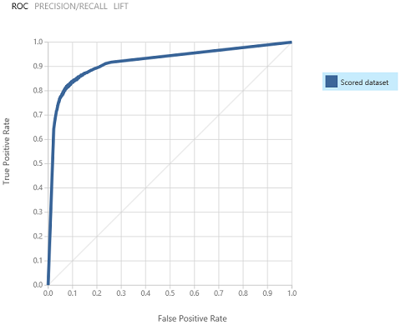
Data Science = Data -> Insight -> Experience -> Action

Slide 8
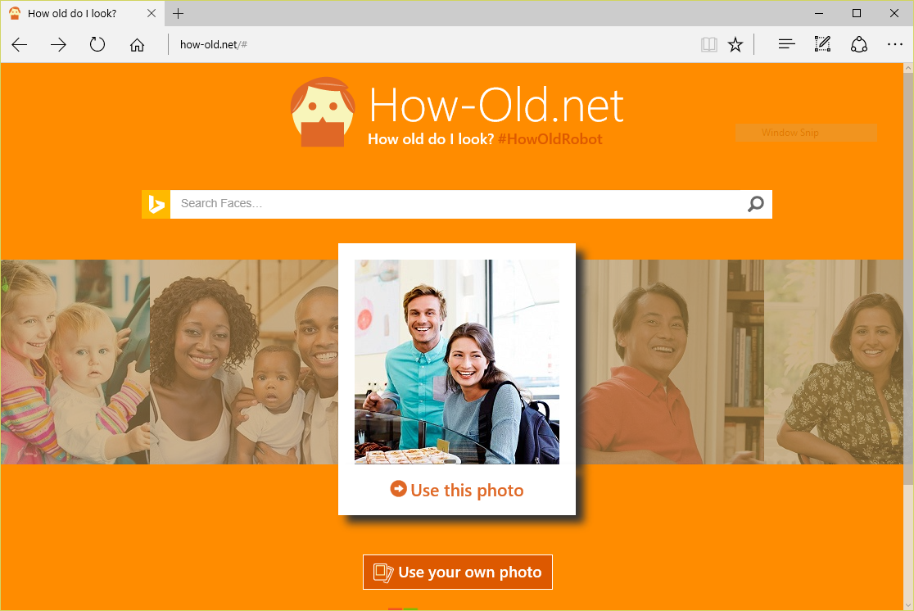
Machine Learning in Action

Slide 9

Machine Learning in Action

Slide 10
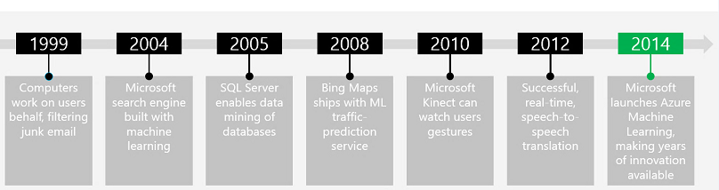


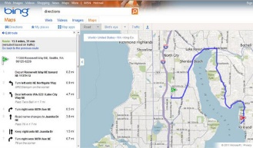
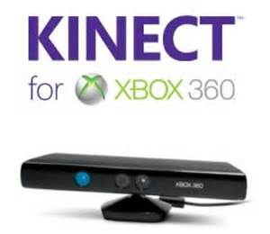
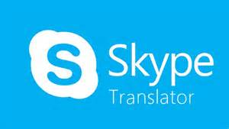
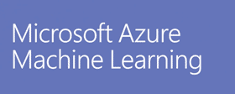

Microsoft and Machine Learning
Modified from http://pulsweb.fr/predict-wine-quality-azureml

Slide 11
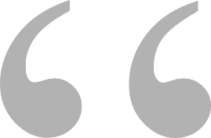

I spent a full semester writing code for Neural Network Model in Python, and I just did the same thing in 10 minutes with Azure Machine Learning Studio.

Slide 12
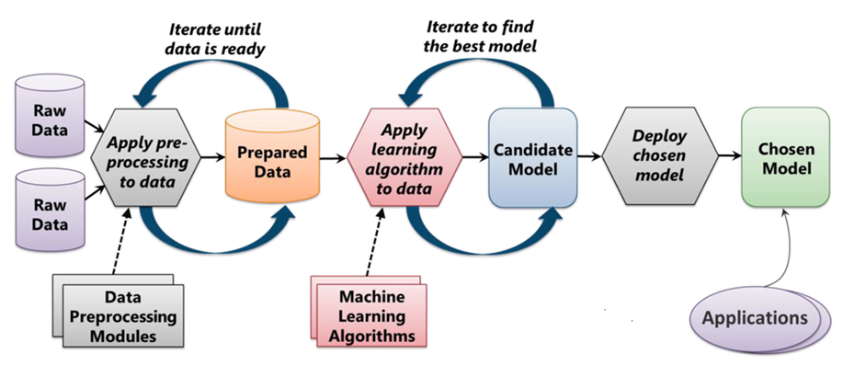
How does Machine do the learning process?
From "Introduction to Microsoft Azure" by David Chappell

Slide 13
Applying ML to real-world!
Applying our ML model to the real-world in a more abstract way.
Understand the data concisely.
Gain expertise over more problem solving, like Kaggle or other competitive challenges.
Let’s just see further…

Slide 14

Challenges?

Slide 15
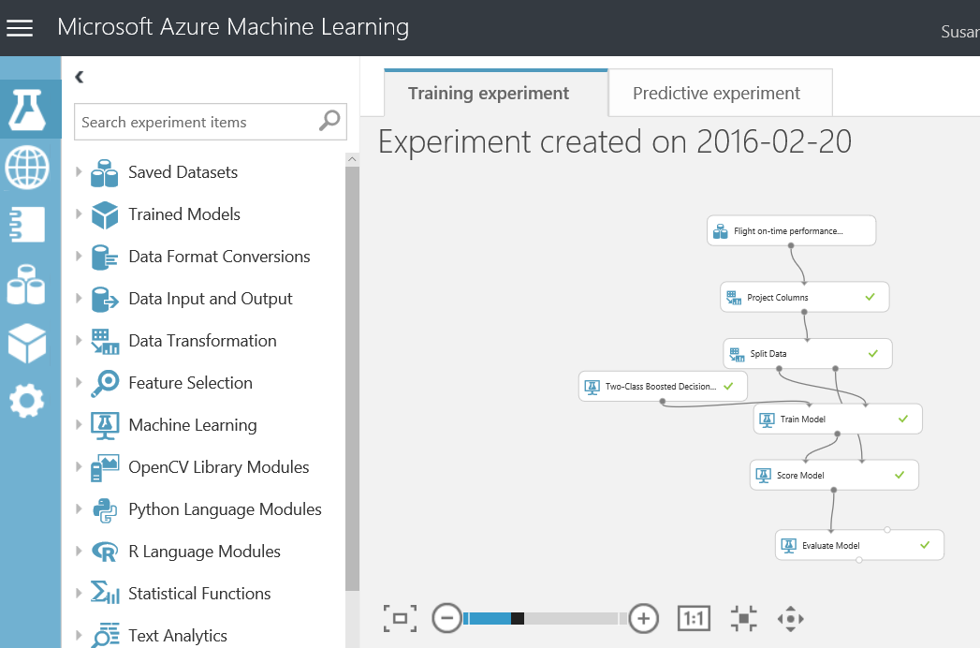
Using Azure Machine Learning Studio, you can explore the depth of Machine Learning without a degree in statistical analysis.

Slide 16
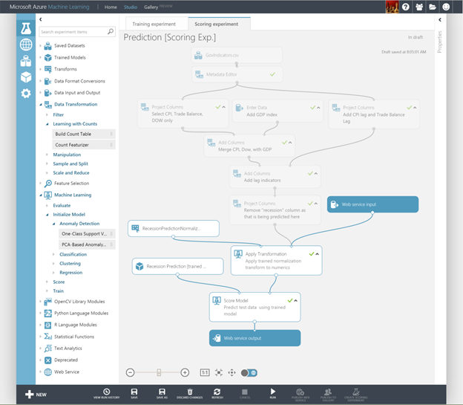
What is Azure ML Studio?
Visual editor for composing, testing, refining, and deploying machine learning models.
Includes hundreds of modules
Includes common algorithms for classification, regression, and more.
Supports numerous input formats
Supports Python and R
Machine Learning for the masses.

Slide 17
What are we going to do?
Start with the data
"Clean" the data and train the model
Create the web service

Slide 18
Where to look for data?
Use any of sample datasets built into Azure ML Studio.
Create new data sets by uploading CSV or TSV files.
Use the Import Data module to import data from Web URLs, SQL Databases, Hive Queries, Blob storage, and other sources.
We here use the data: http://bit.ly/ML_Datasets

Slide 19
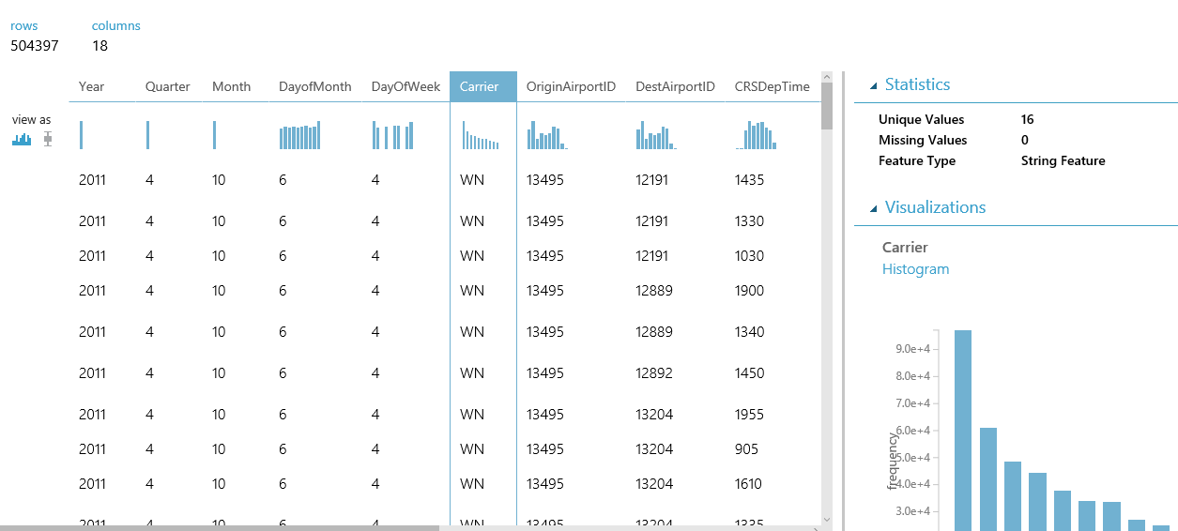
The better insights, the better results!

Slide 20
Demo to ML Studio, loading dataset and visualizing the data
Himanshu Beniwal

Slide 21
Now what?
Start with the data
“Clean” the data and train the model
Create the web service

Slide 22
What’s inside Azure ML Studio for data?
Data almost always requires preparation or “cleaning”.
Azure ML Studio provides several modules to help with this task, including Select columns from dataset, Clean missing data, and remove duplicate rows.

Slide 23
What’s inside Azure ML Studio for learning?
Training the model involves using a learning algorithm to analyze the data and find patterns.
ML Studio includes 25 modules implementing common ML algorithms: Linear Regression, Multiclass Neural Network, One-Class SVM, and many more.

Slide 24
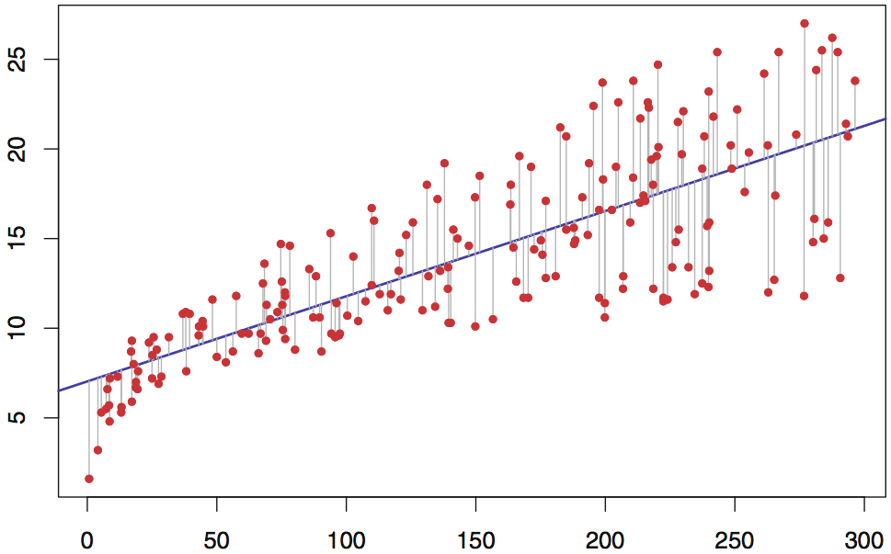
Looking at simple math's?
Regression Line
Error

Slide 25
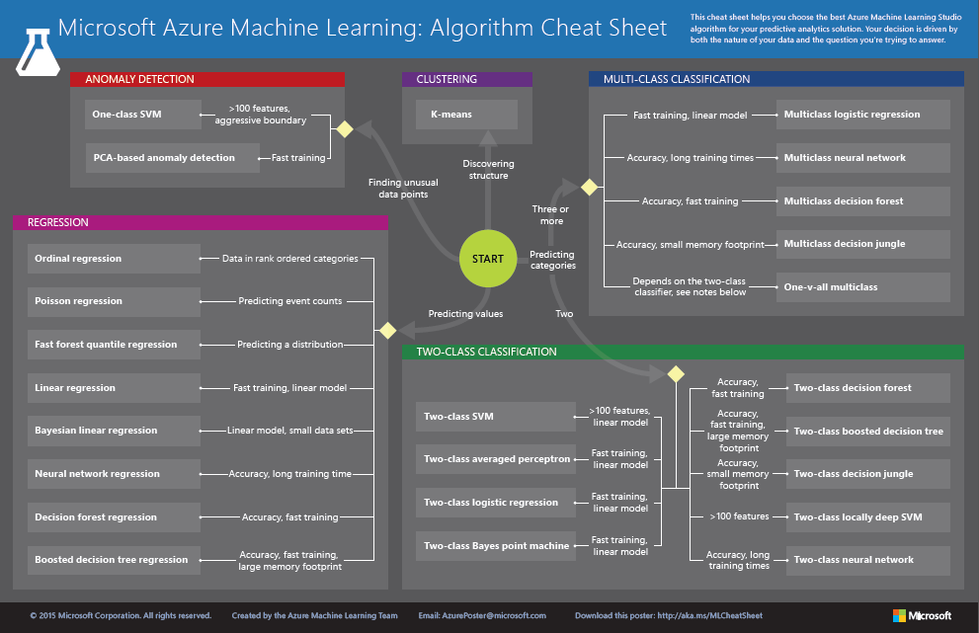
http://aka.ms/MLCheatSheet

Slide 26
Which algo to choose, depends on type of prediction!
Algorithm type | Type of prediction
Classification | Predict a category, e.g. what income range you fall into, which hockey team you cheer, or which political party you prefer
Regression | Predict a value, e.g. someone’s income or the price of gas
Anomaly detection | Find anomalies in the data, e.g. credit-card fraud detection

Slide 27
What after the training?
After you train the model, check the accuracy.
Use Score Model to “score” the model and Evaluate Model to visualize the results.
You may need to make changes to improve the results.

Slide 28
Demo to prepare the data, training, and checking the accuracy
Himanshu Beniwal

Slide 29
Improving the accuracy!
More rows of data.
Selecting the columns from data (Choose which are statistically significant and eliminate the ones that aren’t.
Clean data (handle missing/incorrect values, minimize imbalance, normalize non-normalized values, remove outliers, etc.)
Different algorithms, tuning of hyper-parameters.

Slide 30
Finally!
Start with the data
“Clean” the data and train the model
Create the web service

Slide 31
What after machine completed learning?
Create a predictive model.
Deploy it as a web service.
Call it from your code to ask for prediction.

Slide 32
Demo to create a predictive model, deploying, and testing the web service using Azure ML Studio.
Himanshu Beniwal

Slide 33
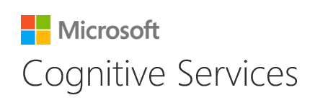
You can also use someone else’s trained models to do cool stuff!

Slide 34
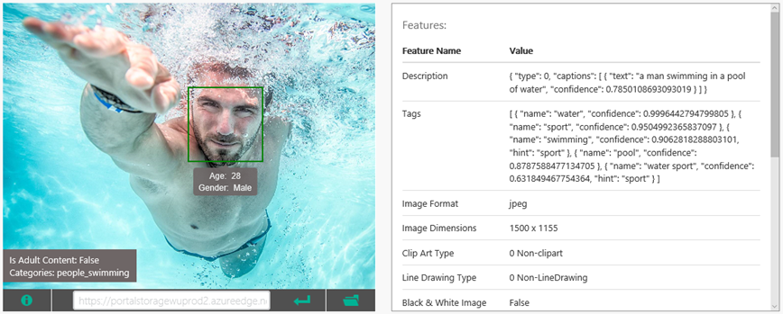
Use the Computer Vision API to analyze images for content, generate captions, and more

Slide 35
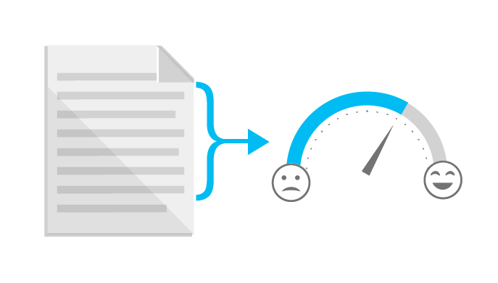
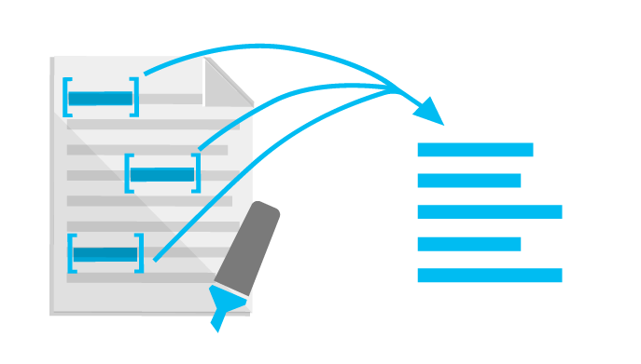
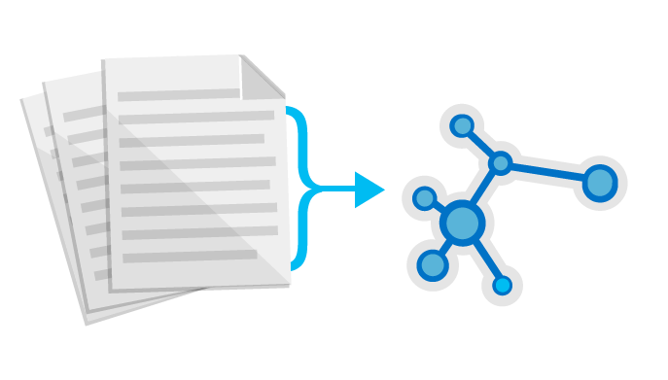
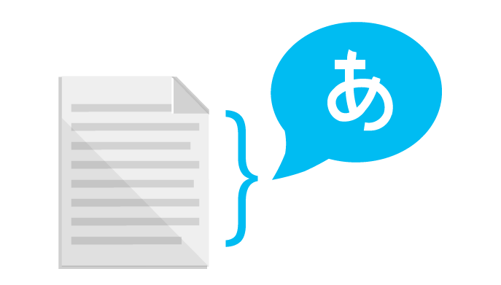
Use the Text Analytics API to identify sentiment expressed in text (e.g., Twitter feeds)
Sentiment Analysis
Key Phrase Extraction
Topic Detection
Language Detection

Slide 36
Time to clean now!
Delete the resources which might hurt in background.
Save us from unexpected billing.
Keep an eye on the computing resources.

Slide 37
Wait! There’s some home-work for you!
Visit Microsoft Learn [https://docs.microsoft.com/en-us/learn/]
Basics of Data Science. [https://docs.microsoft.com/en-us/learn/modules/intro-to-data-science-in-azure/]
Learn about ML with Python and Azure Notebooks. [https://docs.microsoft.com/en-us/learn/paths/intro-to-ml-with-python/]
Publishing ML Experiment with Azure ML Studio. [https://docs.microsoft.com/en-us/learn/paths/publish-experiment-with-ml-studio/]
Sneak from coding for Machine Learning using Azure [https://medium.com/@himanshubeniwal/sneak-from-coding-for-machinelearning-using-ms-azure-95e45c26ee3f]

Slide 38
And now finally!..

Slide 39
Thank you! ☺ Connect with me on: Twitter: @himanshu_beniwa LinkedIn: @himanshubeniwal Insta: @himanshubeniwal_

