Slide 1
Azure Days by Microsoft Student Partners | MSPImpact
Himanshu Beniwal & Ambika

Slide 2
Introduction to Data Science and Machine Learning using Microsoft Azure
Himanshu Beniwal & Ambika

Slide 3

Have you ever wanted to predict the future?

Slide 4
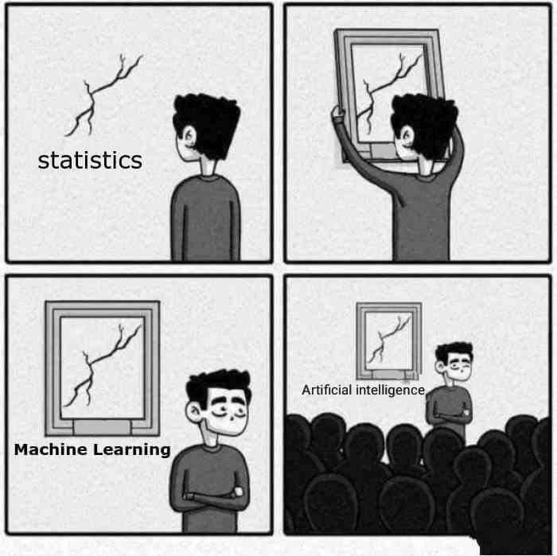
So, What is really Machine Learning?
Branch of computer science in which a computer “Learns” from data in order to perform predictive analytics.
Credit-card fraud detection
Online shopping recommendations
Self-driving cars and more
Supervised learning
Regression and Classification
Unsupervised learning
Clustering

Slide 5
Machine Learning is mostly about!
ML uses the historical data to make predictions.

Slide 6
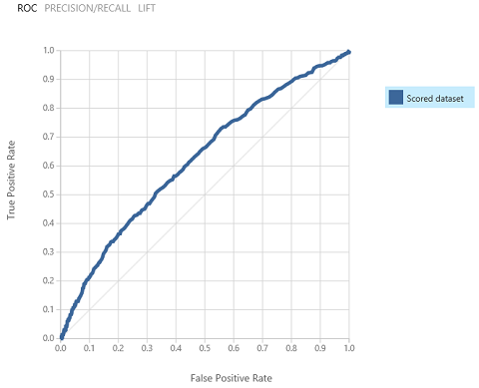
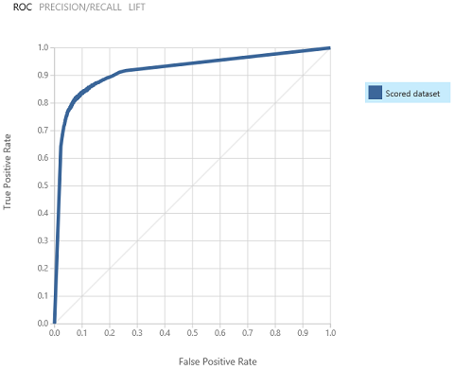
Data Science = Data -> Insight -> Experience -> Action

Slide 7
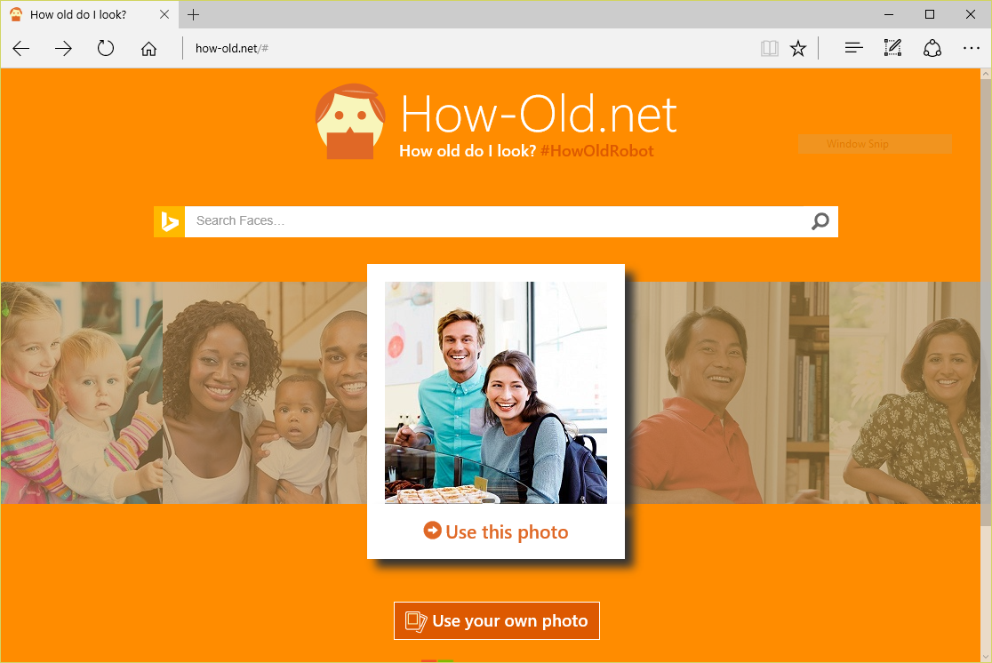
Machine Learning in Action

Slide 8

Machine Learning in Action

Slide 9
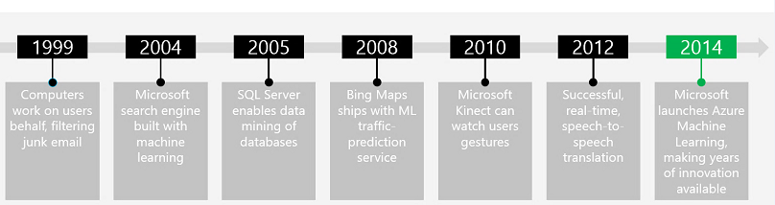


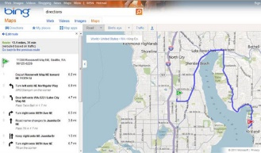
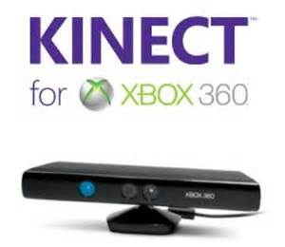
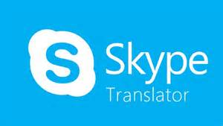
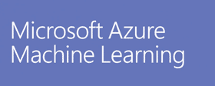

Microsoft and Machine Learning
Modified from http://pulsweb.fr/predict-wine-quality-azureml

Slide 10


I spent a full semester writing code for Neural Network Model in Python, and I just did the same thing in 10 minutes with Azure Machine Learning Studio.

Slide 11
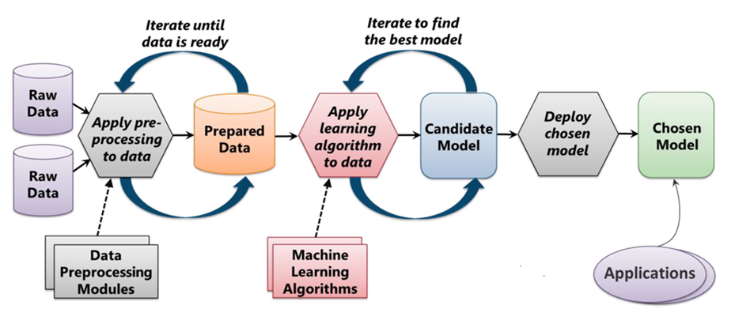
How does Machine do the learning process?
From "Introduction to Microsoft Azure" by David Chappell

Slide 12
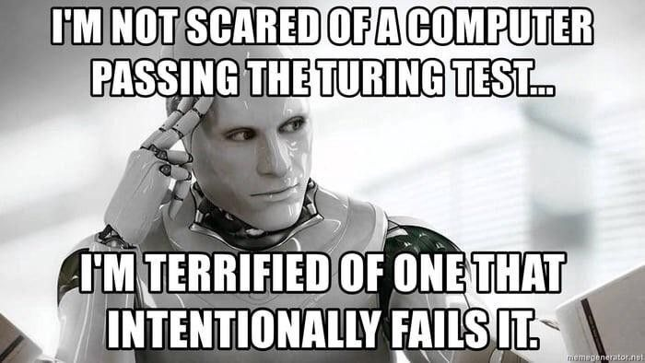
Challenges?

Slide 13
Demo to Azure Notebooks, loading dataset and visualizing the data
Ambika

Slide 14
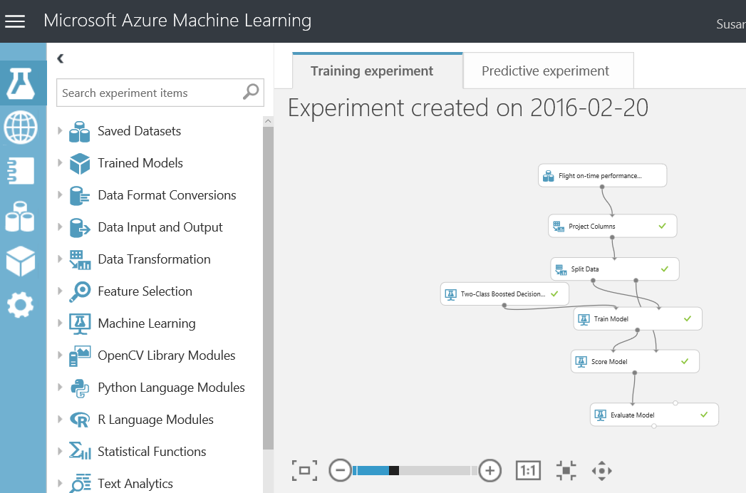
Using Azure Machine Learning Studio, you can explore the depth of Machine Learning without a degree in statistical analysis.

Slide 15
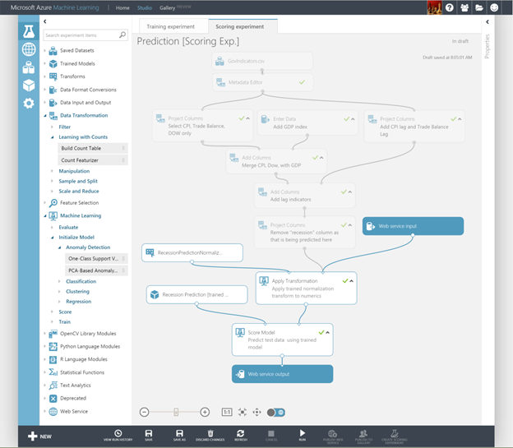
What is Azure ML Studio?
Visual editor for composing, testing, refining, and deploying machine learning models.
Includes hundreds of modules
Includes common algorithms for classification, regression, and more.
Supports numerous input formats
Supports Python and R
Machine Learning for the masses.

Slide 16
What are we going to do?
Start with the data
"Clean" the data and train the model
Create the web service

Slide 17
Where to look for data?
Use any of sample datasets built into Azure ML Studio.
Create new data sets by uploading CSV or TSV files.
Use the Import Data module to import data from Web URLs, SQL Databases, Hive Queries, Blob storage, and other sources.
We here use the data: https://bit.ly/AzureDays_MLData

Slide 18
Demo to ML Studio, loading dataset and visualizing the data
Himanshu Beniwal

Slide 19
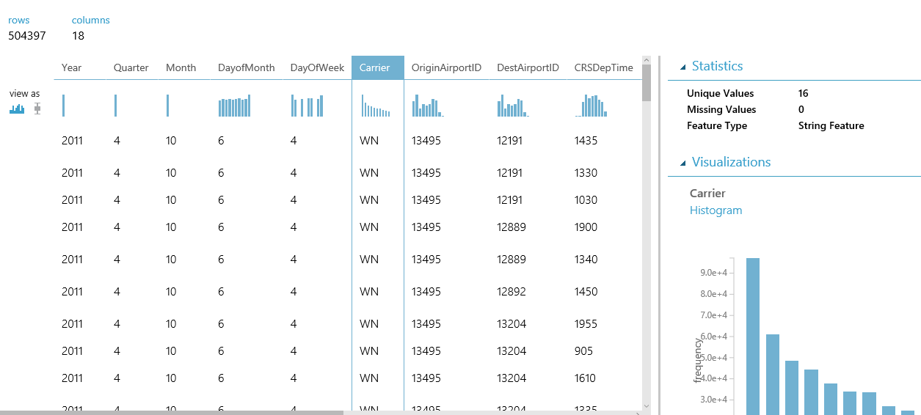
The better insights, the better results!

Slide 20
Now what?
Start with the data
“Clean” the data and train the model
Create the web service

Slide 21
What’s inside Azure ML Studio for data?
Data almost always requires preparation or “cleaning”.
Azure ML Studio provides several modules to help with this task, including Select columns from dataset, Clean missing data, and remove duplicate rows.

Slide 22
What’s inside Azure ML Studio for learning?
Training the model involves using a learning algorithm to analyze the data and find patterns.
ML Studio includes 25 modules implementing common ML algorithms: Linear Regression, Multiclass Neural Network, One-Class SVM, and many more.

Slide 23
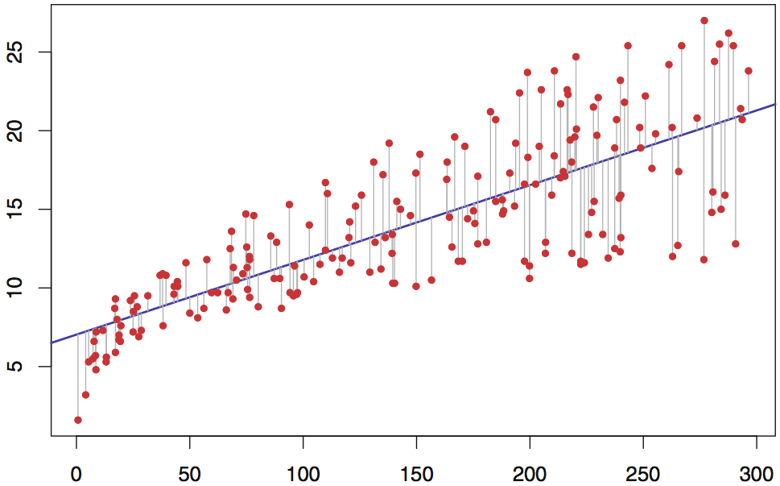
Looking at simple math's?
Regression Line
Error

Slide 24
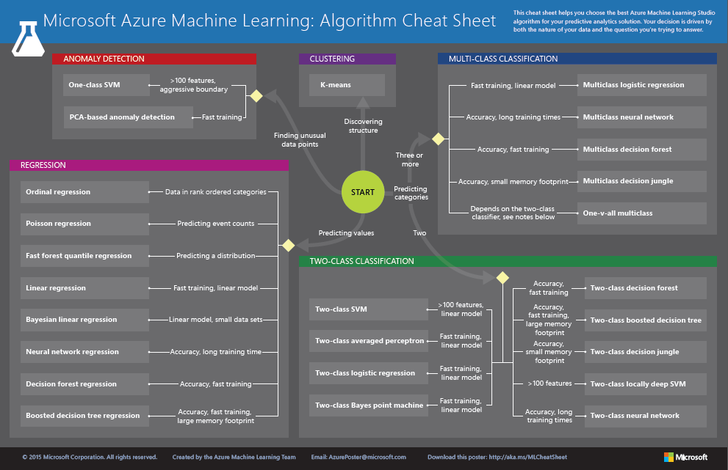
http://aka.ms/MLCheatSheet

Slide 25
Which algo to choose, depends on type of prediction!
Algorithm type | Type of prediction
Classification | Predict a category, e.g. what income range you fall into, which hockey team you cheer, or which political party you prefer
Regression | Predict a value, e.g. someone’s income or the price of gas
Anomaly detection | Find anomalies in the data, e.g. credit-card fraud detection

Slide 26
What after the training?
After you train the model, check the accuracy.
Use Score Model to “score” the model and Evaluate Model to visualize the results.
You may need to make changes to improve the results.

Slide 27
Demo to prepare the data, training, and checking the accuracy
Himanshu Beniwal

Slide 28
Improving the accuracy!
More rows of data.
Selecting the columns from data (Choose which are statistically significant and eliminate the ones that aren’t.
Clean data (handle missing/incorrect values, minimize imbalance, normalize non-normalized values, remove outliers, etc.)
Different algorithms, tuning of hyper-parameters.

Slide 29
Take the challenge!
Building a model using instructions provided, and then tune it to improve its accuracy!
http://bit.ly/AD_MLTask

Slide 30
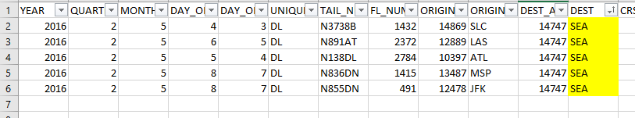
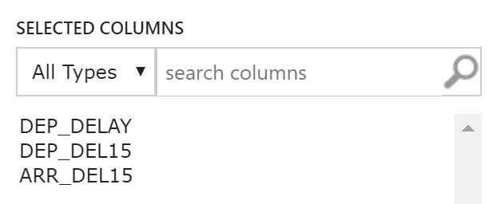
ML Challenge restrictions
#1
No deleting rows of data (or fixed values).
#2
No using data that can’t be inputted by a user.
Why?
You’re changing reality. ☺
Why?
Users book a flight
(data + destination)

Slide 31
Finally!
Start with the data
“Clean” the data and train the model
Create the web service

Slide 32
What after machine completed learning?
Create a predictive model.
Deploy it as a web service.
Call it from your code to ask for prediction.

Slide 33
Demo to create a predictive model, deploying, and testing the web service using Azure ML Studio.
Himanshu Beniwal

Slide 34
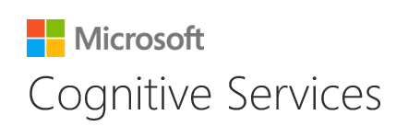
You can also use someone else’s trained models to do cool stuff!

Slide 35
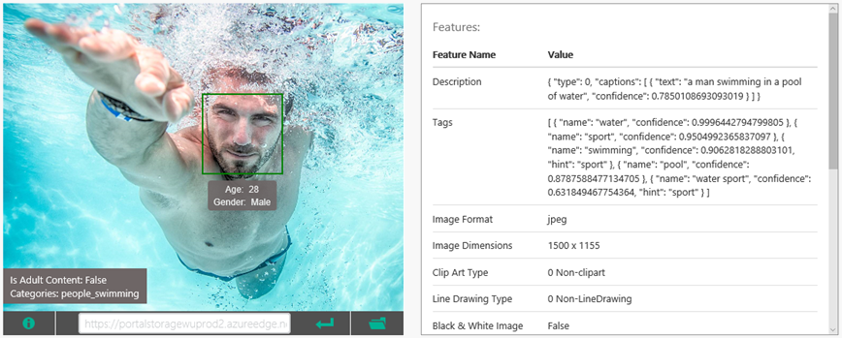
Use the Computer Vision API to analyze images for content, generate captions, and more

Slide 36
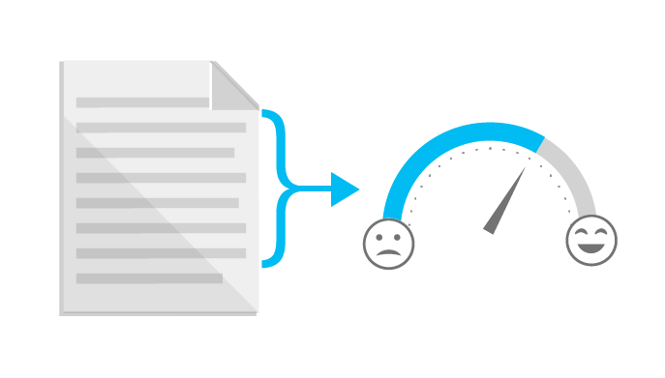
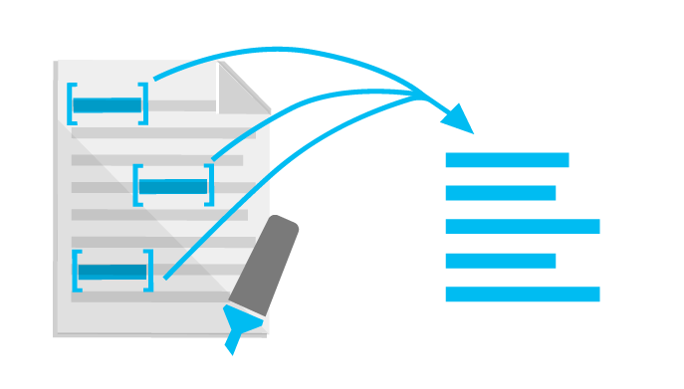
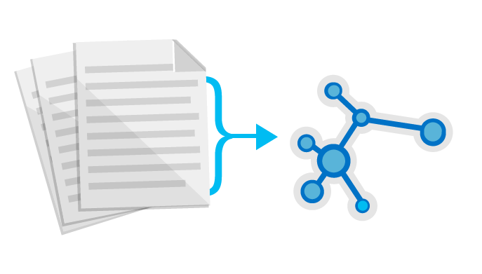
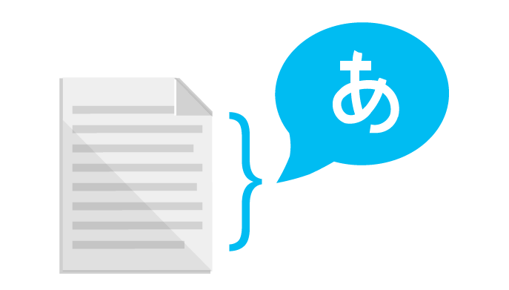
Use the Text Analytics API to identify sentiment expressed in text (e.g., Twitter feeds)
Sentiment Analysis
Key Phrase Extraction
Topic Detection
Language Detection

Slide 37
Time to clean now!
Delete the resources which might hurt in background.
Save us from unexpected billing.
Keep an eye on the computing resources.

Slide 38
Wait! We got some home-work for you!
Visit Microsoft Learn [https://docs.microsoft.com/en-us/learn/]
Basics of Data Science. [https://docs.microsoft.com/en-us/learn/modules/intro-to-data-science-in-azure/]
Learn about ML with Python and Azure Notebooks. [https://docs.microsoft.com/en-us/learn/paths/intro-to-ml-with-python/]
Publishing ML Experiment with Azure ML Studio. [https://docs.microsoft.com/en-us/learn/paths/publish-experiment-with-ml-studio/]

Slide 39
And now finally!..

Slide 40
Thank you! ☺ Connect with Himanshu on: Twitter: @himanshu_beniwa LinkedIn: @himanshubeniwal
Connect with Ambika on: Twitter: @AmbikaA55 LinkedIn: @ambika55

