Slide 1


Slide 2
Brief Synopsis
This document describes the solutions to a product recommendation problem. It can be interpreted as a rating prediction problem, as once we are able to predict rating, we can set a prediction threshold above which an item qualifies to be recommended.
First we look at introduction to method adopted and the technology stack. Then we look at architecture design of solutions. Finally we see the graphical results obtained by the implementation of solutions. We conclude with the challenges faced and possible improvements for the future.

Slide 3
Problem Being Solved
Problem : To build a system that can predict rating given user ID, product ID and other features like model attribute etc. Then we can use that rating to recommend item based on a threshold value e.g., if rating > 3, recommend otherwise do not recommend.
Solutions : I have created a formula to express dependency of rating on user vector, item vector, user bias, item bias and other features. This formula has been implemented using below three versions.
SVD (to learn user vector and item vector) + SGD (to learn user bias and item bias)
NN v1 (using only user vector, item vector, user bias and item bias
NN v2 (using all four above as well as other features

Slide 4
Technology/Tool/Stack
Language: Python
Platform: Jupyter notebook, Google Colaboratory
Frameworks: Scikit Learn, Matplotlib, Numpy, Tensorflow
Notebooks:
Data Exploration.ipynb – Perform EDA on data
Null Values Imputation.ipynb – Remove Null values from data
Train and Test preparation.ipynb – One hot encode the categorical data, and standardize numerical data
SVD.ipynb – Model trained using SVD and SGD
Neural Network.ipynb – First NN, designed to learn only using user_id, item_id and rating
Neural Network v2.ipynb – Second NN, designed to learn from user_id, item_id, other features and ranking

Slide 5
Solution Architecture
To solve the problem of rating prediction using the given data, I took inspiration from famous solution of Netflix Recommendation proposed by Simon Funk. I broke down the dependency of rating as below formula
For a given user i and product j, the rating will be calculated as
R = Bi + Cj + U.V^{T} + X.W^{T}
where
Bi = User Bias for user i (scalar)
Cj = Product Bias for product j (scalar)
U = User Vector for user I (vector of size (1 X k))
V = Product Vector for user j (vector of size (1 X k))
X = vector with features other than user id, product id and rating (vector of size (1 X f))
W = weight matrix (vector of size (f X 1))
Other than Mu and X, all the parameters are to be learned using SVD + SGD and/or Machine Learning. I implemented solution in 3 ways
1. SVD + SGD => I used SVD to learn the value of U and V, and then used SGD to learn value of B and C. I did not use X.W^{T} in this version.
2. NN v1 => I used NN to learn the values of U, V, B, and C. In this version I did not use SVD and X.W^{T}.
3. NN v2 => I used NN to learn the values of U, V, B, C and X. This model learned most accurately amongst all three models.

Slide 6
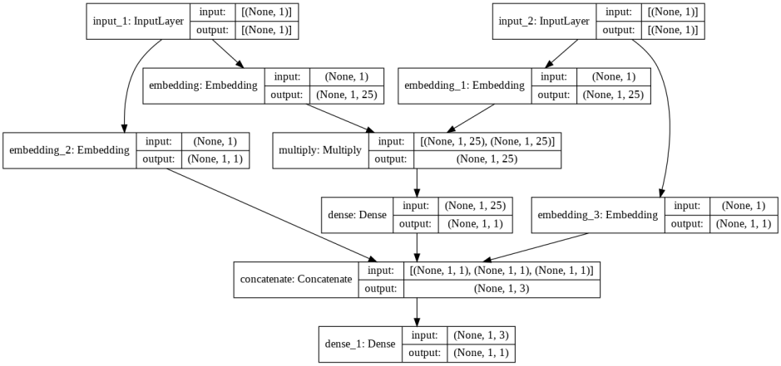
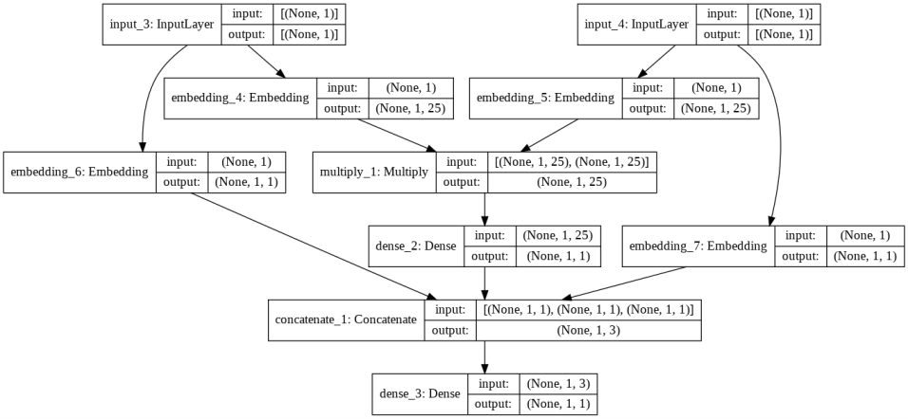
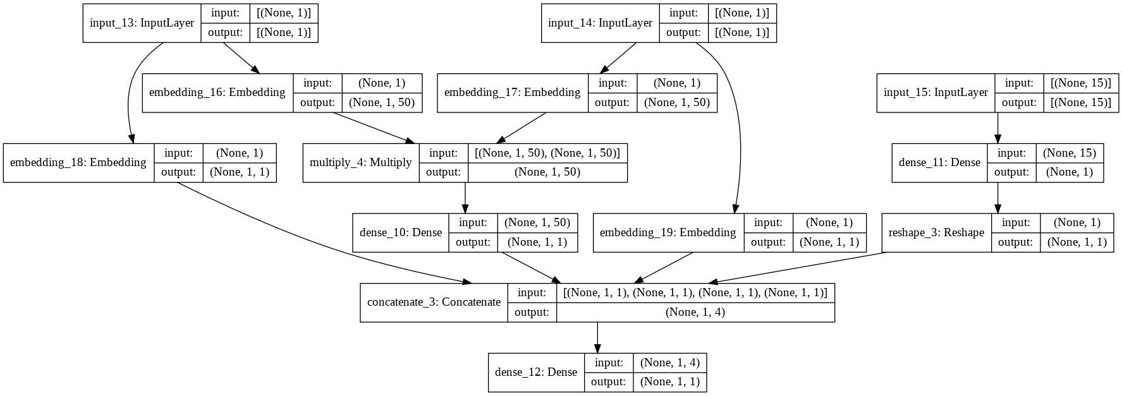
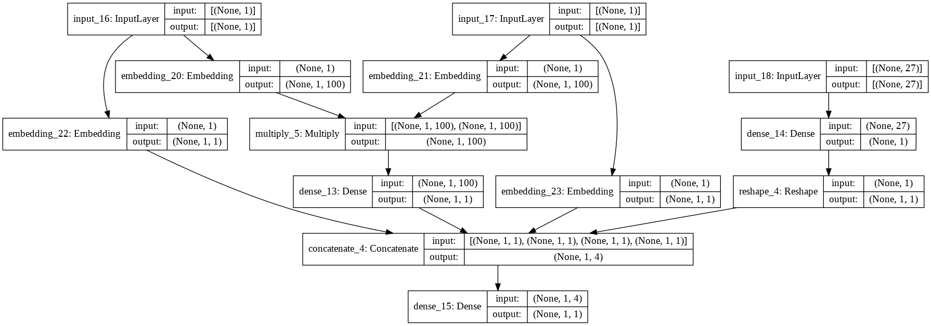
Solution Architecture (Contd.)
Architecture of NN v1 (for electronics and modcloth datasets respectively)
Architecture of NN v2 (for electronics and modcloth datasets respectively)

Slide 7
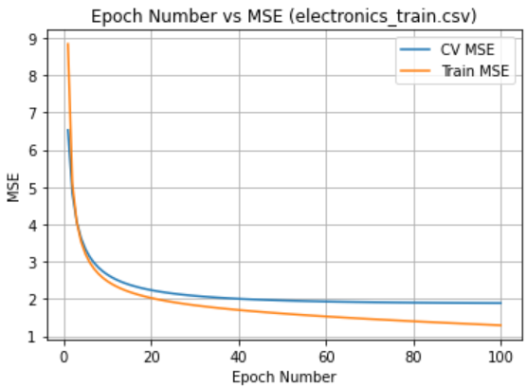
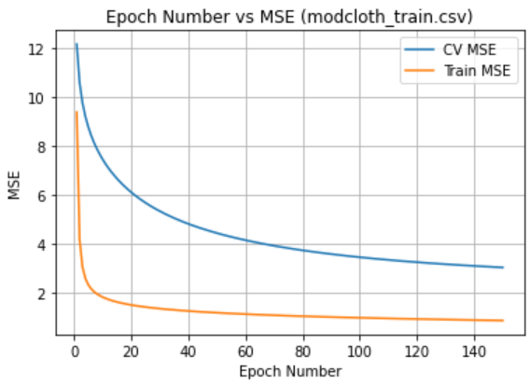
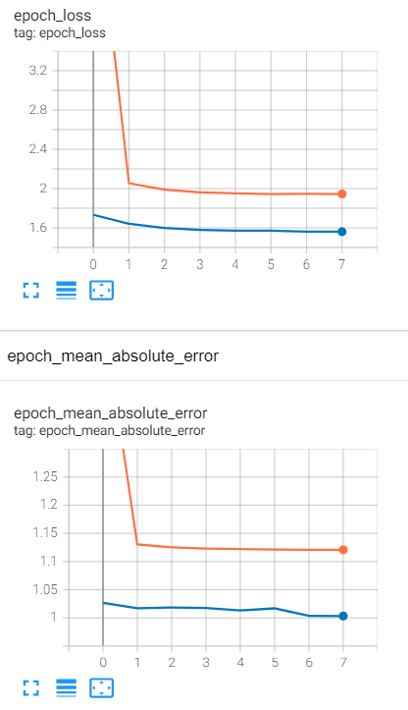
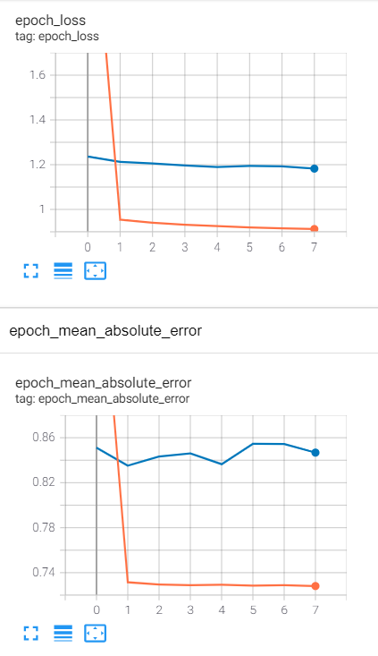
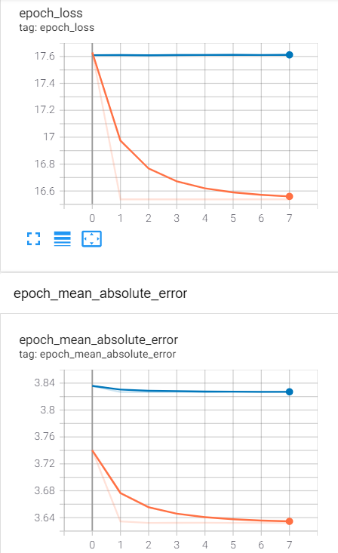
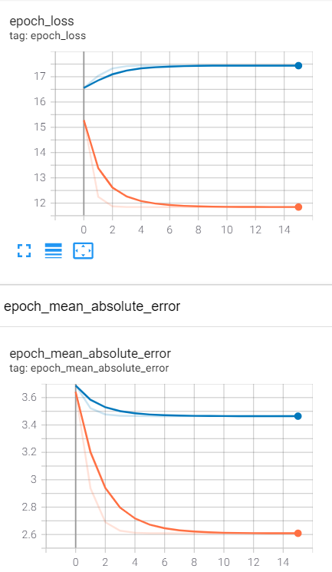
Prototype/ MVP Demo Video/Screenshots
MSE over epochs for model using SVD + SGD
MSE and MAE over epochs for model using NN v2
Electronics (CV MSE ~ 1.9)
Modcloth (CV MSE ~ 3)
MSE and MAE over epochs for model using NN v1
Electronics (CV MSE ~ 1.15)
Modcloth (CV MSE ~ 1.18)
Electronics (CV MSE ~ 17.6)
Modcloth (CV MSE ~ 17.4)

Slide 8
Challenges Faced
Splitting of data : The data in this problem was unlike most of the datasets. The user_id and item_id are actually unique values, and if data was not split properly, there could be a case where a user_id and/or item_id would be missing from training set. It could lead to the problem of “Cold Start”, where the model has never seen a user or item before, and is not able to predict well for it during test. Furthermore, it can lead to incorrect size of User Vector and Item Vector
Solution : I employed two types of solutions. To split into training and test, I first split the data using 50:50 split, then the rows in test data which had unique item_id or user_id that was not present in the training data were transferred to training dataset. This ensured that there were no “unseen” users or items.
To split between training and CV, I used a field to store count of user_id and item_id in the original dataset. Then I used this field to split, keeping user_id and item_id that had count of 1 in the training set (this set is called “compulsory set”). Then I splitted the user_id and item_id that have count greater than 1, into training and CV.

Slide 9
Future enhancements
1
Neural Network with SVD
In the current solution, I have used NN without learning user vectors and item vectors using SVD. If this technique is employed to initialize user vectors and item vectors before training, significant gains could be observed
Null value Imputation using prediction
2
I have replaced null values with a new value to handle it during training. More sophisticated method may be to employ a model to predict missing values. One may even employ SVD or NN to predict this value, same way as I did for rating.
Smaller batch size for NN v2 for electronics dataset
3
The convergence of NN for electronics dataset was extremely slow and time taking. Therefore I had to use bigger batch size, but in return the model did not converge to as low an error as it could have. With more resources, one can use batch size < 64 and achieve lower error

Slide 10
Thank You

