Slide 1

Note: The data and information in this document is reflective of a hypothetical situation and client. This document is to be used for KPMG Virtual Internship purposes only.
Sprocket Central Pty Ltd
Data analytics approach
[Division Name] - [Engagement Manager], [Senior Consultant], [Junior Consultant]

Slide 2
Note: The data and information in this document is reflective of a hypothetical situation and client. This document is to be used for KPMG Virtual Internship purposes only.
Agenda
Introduction
Data Exploration
Model Development
Interpretation

Slide 3
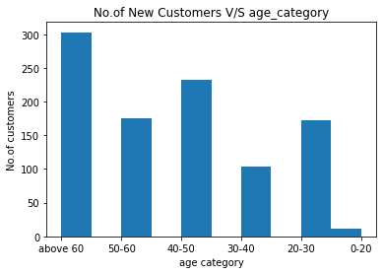
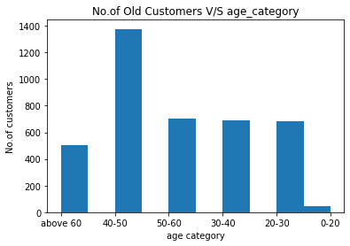
Note: The data and information in this document is reflective of a hypothetical situation and client. This document is to be used for KPMG Virtual Internship purposes only.
Data Exploration
No of customers V/S Age category
As we can see most of our new customers are above age range of 60.
Also no of customers in age range of 40-50 has increased.
No. of customers in age range of 40-50 have been reduced.

Slide 4
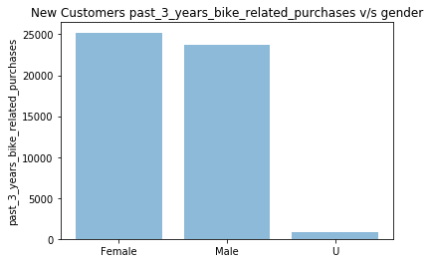
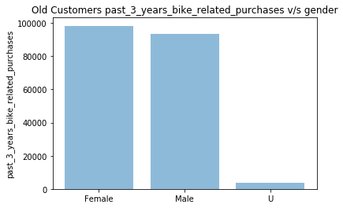
Note: The data and information in this document is reflective of a hypothetical situation and client. This document is to be used for KPMG Virtual Internship purposes only.
Data Exploration
No of past 3 years related purchases
V/S gender
Females seems to be more potential customers than males.

Slide 5
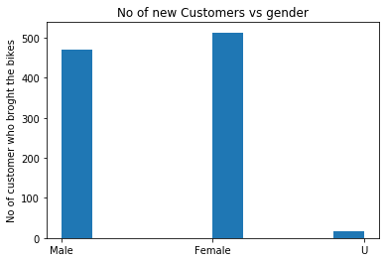
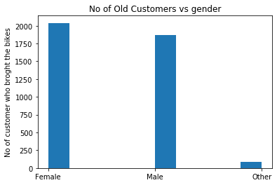
Note: The data and information in this document is reflective of a hypothetical situation and client. This document is to be used for KPMG Virtual Internship purposes only.
Data Exploration
No of customers V/S Gender
Females seems to be more potential customers than males.

Slide 6
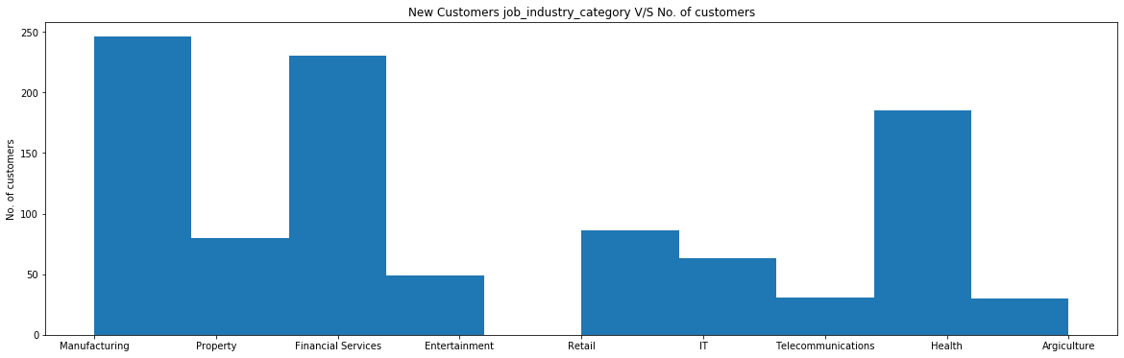
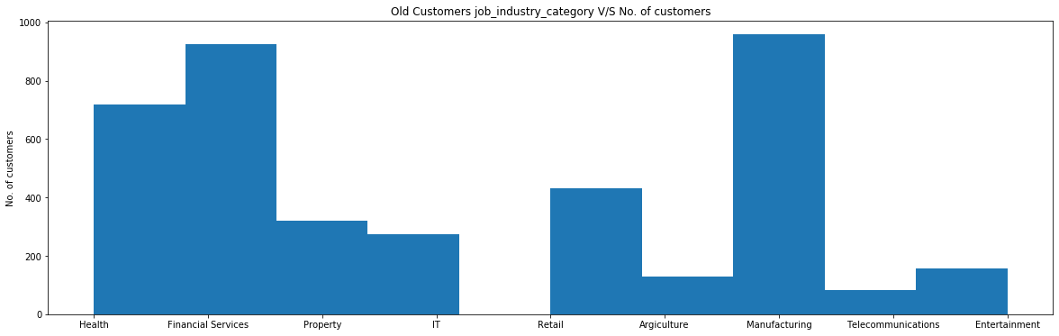
Note: The data and information in this document is reflective of a hypothetical situation and client. This document is to be used for KPMG Virtual Internship purposes only.
Data Exploration
No of customers V/S job industry category
There’s an increase in customers from retail and health sectors.

Slide 7
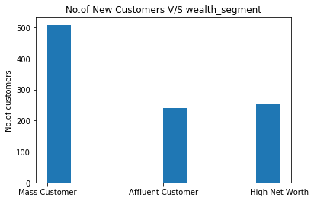
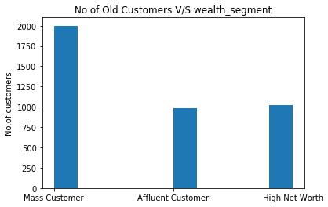
Note: The data and information in this document is reflective of a hypothetical situation and client. This document is to be used for KPMG Virtual Internship purposes only.
Model Development
No of customers V/S wealth segment
There seems to be no particular change in no of customers from particular wealth segment.

Slide 8
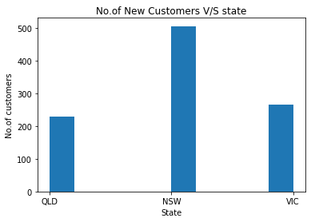
Note: The data and information in this document is reflective of a hypothetical situation and client. This document is to be used for KPMG Virtual Internship purposes only.
Interpretation
No. of New Customers V/S State

Slide 9
Note: The data and information in this document is reflective of a hypothetical situation and client. This document is to be used for KPMG Virtual Internship purposes only.
Appendix

Slide 10
Note: The data and information in this document is reflective of a hypothetical situation and client. This document is to be used for KPMG Virtual Internship purposes only.
Appendix
Files and images can be found at - https://github.com/vedesh95/Projects_ML

