Slide 1
Project Name: My Parking Space
Project Member:
Himanshu Deshpande Amit Khendake
(210543181029) (210543181042)
Akshay Ringe Sahil Kshirsagar
(210543181006) (210543181046)

Slide 2
Content
Abstract
Introduction
Objectives
Problem Statement
Advantages Of Systems
Applications
Technologies Used
Entity Relationship Diagram
Future Scope
Conclusion

Slide 3
Abstract
In metropolitan areas, most vehicle drivers have the daily concern of finding a vacant parking space especially during the rush hours.
So, many parking management systems have been deployed in order to reduce such traffic congestion and improve the convenience for vehicle drivers.
Current systems cannot guide the drivers to their desired parking destinations.

Slide 4
Introduction
Currently most of the existing car parking system are manually managed and a little inefficient.
In urban areas, where number of vehicles is higher as compared to the availability of parking spaces, a lot of time being wasted in searching for parking locations.
Hence online booking parking system is a proposed method that users can reserve their parking places using web.

Slide 5
Objectives
Providing a simple web application for parking vehicles.
Booking for parking slot at home.
Can search near by places using Google map.
Easy payment system.
Parking owners can add their own parking places.
Make easy to automate parking owners

Slide 6
Problem Statement
With the growing ownership of private cars/bikes, it is increasingly difficult for the driver to quickly find a parking space upon arriving at the destination.
Empirical evidences indicate that drivers on average spend 3-15min looking for parking spaces.
it is necessary to develop a parking guidance model that assists the driver in finding the right parking lot with minimum time requirement.

Slide 7
Advantages Of Systems
Users can get learn about parking areas for particular locations.
It saves user time in search of parking space available in such a long parking area.
The system provides a graphical view of the parking spaces, User can pay online on the spot and confirm their space. It excludes the need of human efforts for managing parking spaces

Slide 8
Applications
The project can be implemented in commercial areas for employee parking.
The system can also be used in public places for public parking like in shopping malls, station, and restaurant.

Slide 9
Technologies Used:-
Spring Framework
MySQL
Hibernate
ReactJs

Slide 10

Spring Framework
Spring Framework is a Java platform that provides comprehensive infrastructure support for developing Java applications. Spring handles the infrastructure so you can focus on your application.
Features of Spring Framework:
Lightweight
Aspect Oriented Programming (AOP)
Transaction Management
Container

Slide 11

MySQL
MySQL, the most popular Open Source SQL database management system, is developed, distributed, and supported by Oracle Corporation.
Features of MySQL:
Software is Open Source.
Server works in client/server or embedded systems.
Database Server is very fast, reliable, scalable, and easy to use.

Slide 12

Hibernate
Hibernate is an object–relational mapping tool for the Java programming language.
It provides a framework for mapping an object-oriented domain model to a relational database.
Hibernate handles object–relational impedance mismatch problems by replacing direct, persistent database accesses with high-level object handling functions.

Slide 13
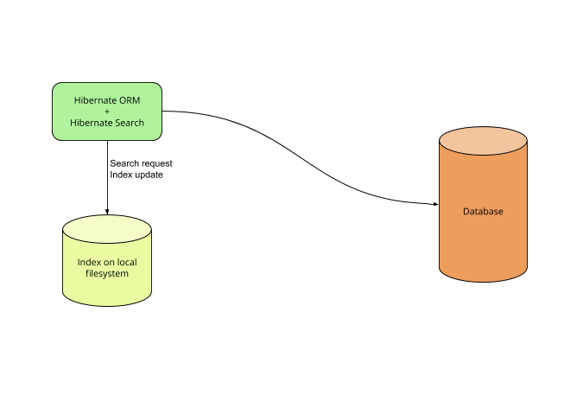
Features of MySQL:
Open Source and Lightweight
Fast Performance
Database Independent Query
Automatic Table Creation
Simplifies Complex Join

Slide 14
ReactJs
React (also known as React.js or ReactJS) is a free and open-source front-end JavaScript library for building user interfaces or UI components. It is maintained by Facebook and a community of individual developers and companies.
React can be used as a base in the development of single-page or mobile applications.

Slide 15
Entity Relationship Diagram
User Registration:
First Name
Last Name
Name
userID
Phone
User Registration
Email
Vehicle
Reg. Number
Type
2 Wheeler
4 Wheeler
3 Wheeler

Slide 16
Types
Vendor Details:
vendorID
No of Spots
Spot Types
ID
Vendor
ID
Name
Categories
Vendor
Name
Address
Pincode
City
State
Country

Slide 17
Home
Login
User
Register
Fig. 1User Diagram

Slide 18
Locations
Spot Types/ Vendors
Vehicle Type
Fig.2 Flow Diagram

Slide 19
User
Login
Locations
Current Bookings
History

Slide 20
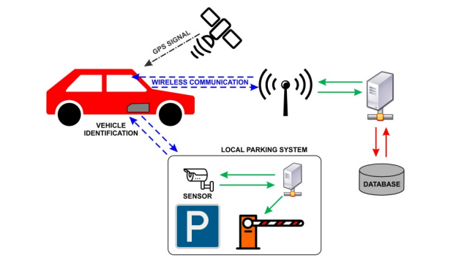
Future Scope
It should allow reservation and intelligent guidance to the parking lot.
the possible implementation with existing systems for the navigation of
vehicles. It can reduce investments and increases the probability of real
operation.

Slide 21
Conclusion
As conclusion, the objective of online booking parking system have been achieved.
The difficulty of searching available parking lots has been completely eliminated by reserving lots via the proposed system.
Users can get learn about parking areas for particular locations.
It saves user time in search of parking space available in such a long parking area.

Slide 22
Thank You!

