Slide 1



AINESP
AINESP
AINESP
HIMANSHU GOYAL
PRIYANSHU YADEV
RIDAM MITTAL
ABHISHEK

Slide 2
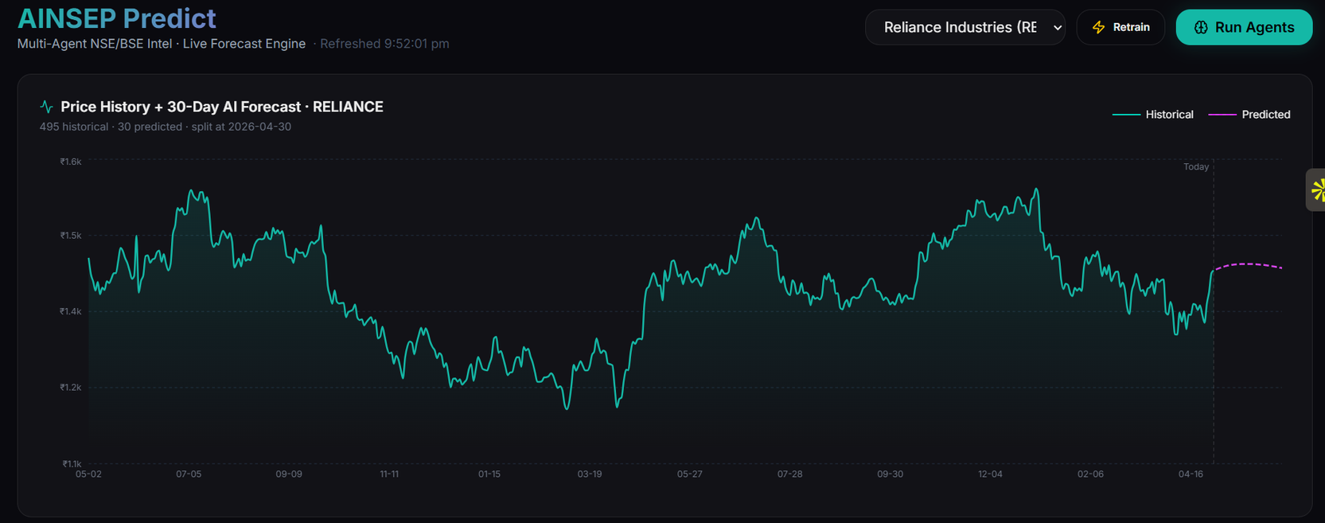

Introduction
AINSEP
AI-based systems analyze large amounts of financial and market data to identify patterns and trends.
01
Data Analysis
02
Intelligent Prediction
03
Multi-Factor Analysis
The system analyzes historical stock prices and market trends using machine learning techniques to understand price movements.
It combines LSTM and XGBoost models with sentiment analysis to generate accurate forecasts and actionable recommendations.
It combines historical trends, technical indicators, and news sentiment to generate smarter stock predictions.

Slide 3
Why This System?
Reduces black-box behavior by explaining model decision-making clearly
Makes predictions interpretable by showing feature contribution values
Builds user trust through transparent and understandable prediction insights
Useful in real-world finance for reliable and explainable decision support

Slide 4
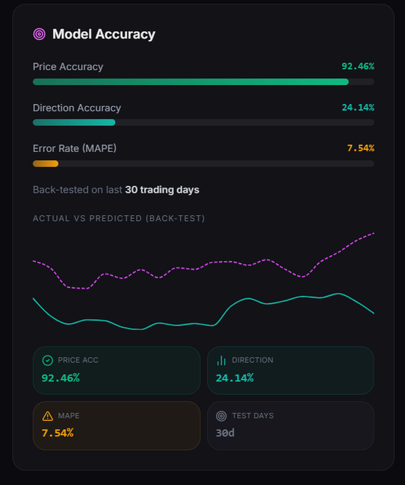
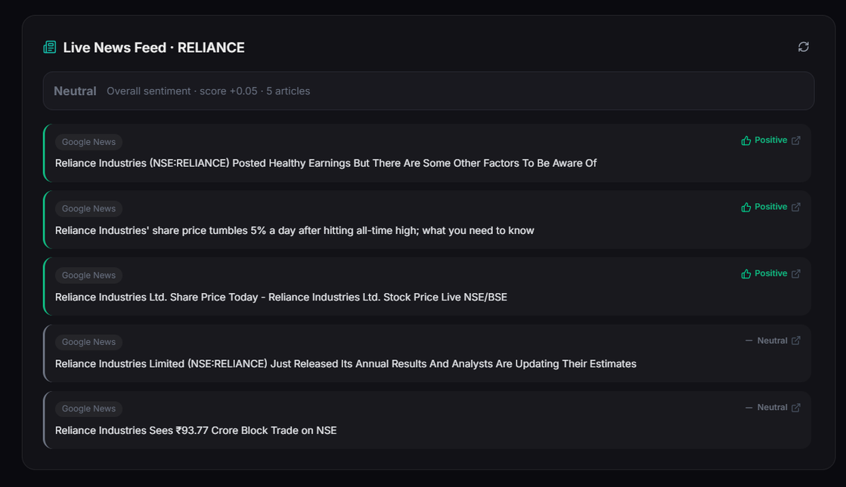
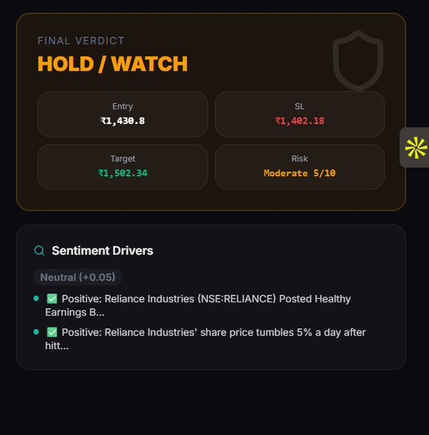
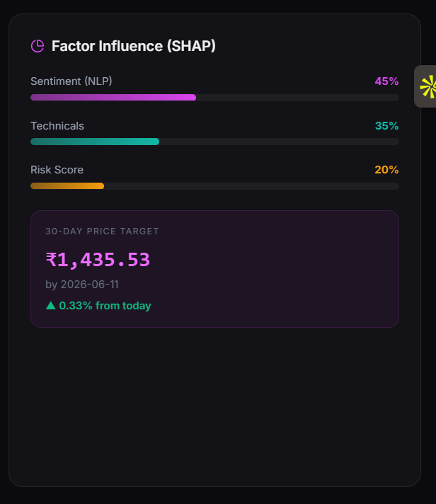

Slide 5
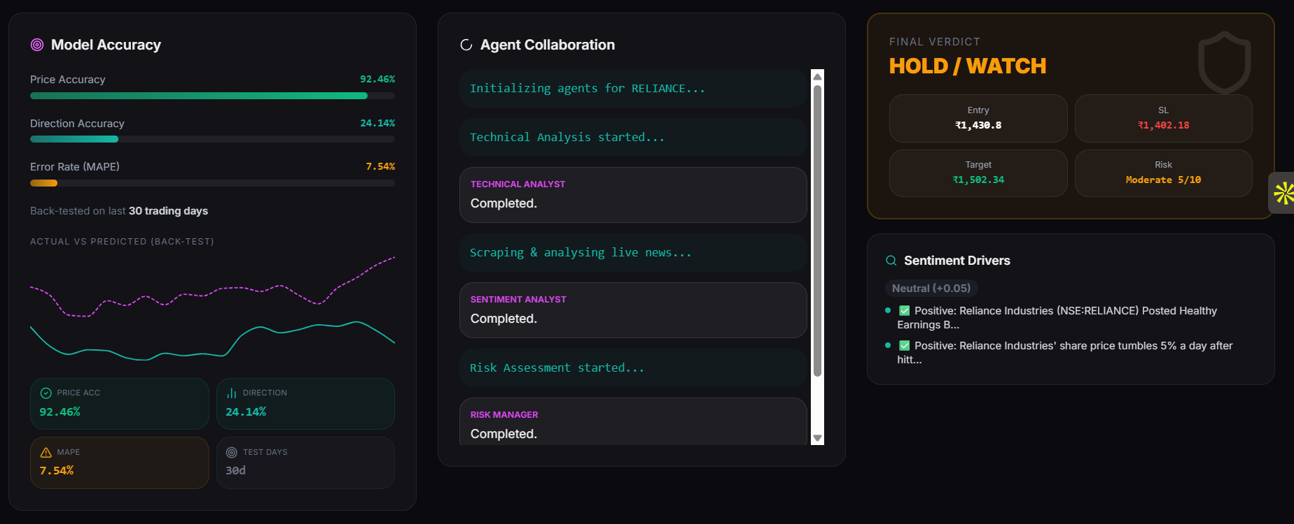
AINESP
Key Features of AINSEP
AINSEP provides an intelligent stock prediction system that combines machine learning, technical analysis, and real-time news sentiment to generate accurate forecasts and actionable insights.
Accurate Price Prediction
Multi-Factor Analysis
Real-Time Insights
Uses hybrid machine learning models like LSTM and XGBoost to analyze historical trends and generate reliable future stock price predictions.
Combines technical indicators, news sentiment, and market trends to provide deeper insights beyond traditional price-based prediction methods.
Fetches live data and news to provide up-to-date analysis, helping users make informed and timely investment decisions.

Slide 6
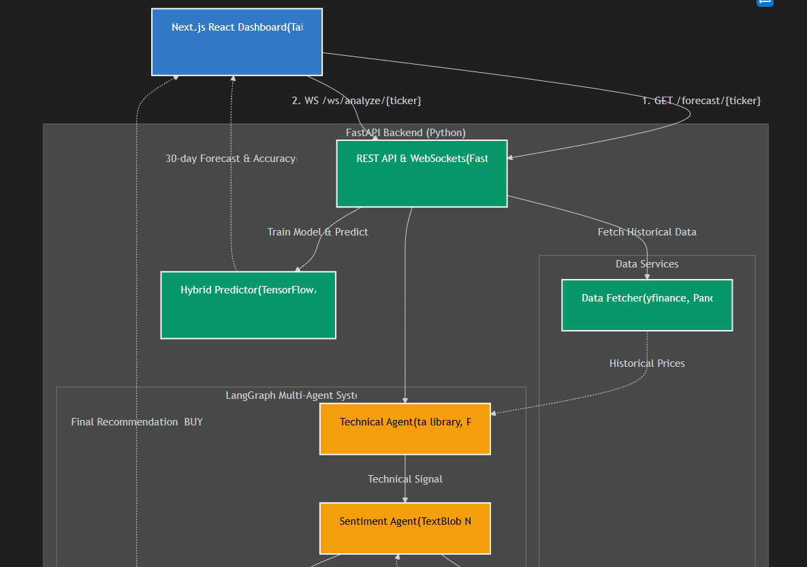
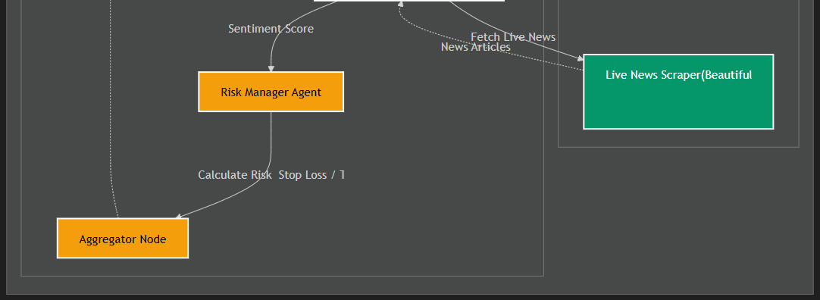
System Workflow
User enters stock ticker from dashboard
Frontend sends request to FastAPI backend
System fetches historical stock data using yfinance
Data is processed and prepared for model input
Hybrid model (LSTM + XGBoost) predicts future prices
Technical agent analyzes indicators like RSI and MACD
Sentiment agent analyzes news and calculates sentiment score
Aggregator combines all outputs to generate final decision
System returns forecast and BUY/SELL/HOLD recommendation

Slide 7
Tech Stack
AINESP
The frontend is built using Next.js, while the backend uses FastAPI for handling APIs. For prediction, I used a hybrid model combining LSTM and XGBoost, and integrated sentiment analysis using TextBlob.
FRONTEND
Next.js, React, Tailwind CSS
BACKEND
FastAPI, Uvicorn , GCP
ML MODELS
LSTM (TensorFlow), XGBoost
DATA & NLP
finance, pandas, TextBlob

Slide 8

AINESP
AINESP
AINESP
THANK YOU

